Slide 1



Validating Model Accuracy With Cross Validation
Joseph L. Hellerstein^{1,2}
¹eScience Institute
²Department of Computer Science & Engineering
July, 2022

Slide 2

Modeling Workflow
Data A
Data B
Construct Model
Estimate Parameters
Validate Accuracy
A modeling dilemma
Data A $≠$Data B are collected separately.
But this doubles the data requirements.
Save on data collection by making Data A = Data B.
But this biases the last step.

Slide 3






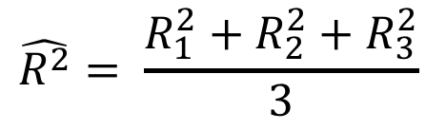
Cross Validation Summary
S1
S2
S3
S4
Divide full data set into N Folds
time
Data
Train 1
Test 1
{
Construct N training data sets and N test data sets
Train 2
Test 2
{
Obtain N parameter fits and model evaluations
Train 3
Test 3
{
Report statistics of the evaluations

Slide 4
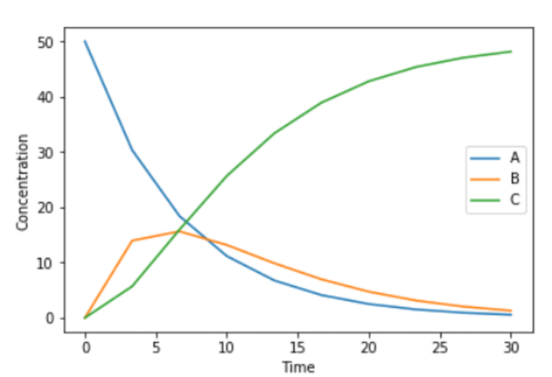
Choosing Folds Choose Wisely
X
Folds have very different dynamics
Folds have similar dynamics

