Slide 1
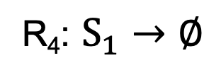



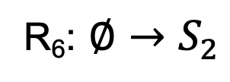
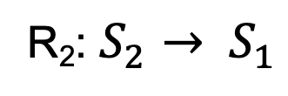
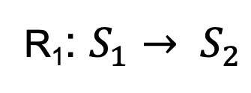



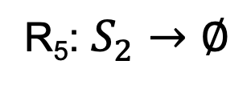

$$k6$$
$$k4$$
$$k_{1}S_{1}$$
R₆: $∅→S_{2}$
R₄: $S_{1}→∅$
R₁: $S_{1}→ S_{2}$
S1
S2
$$k_{5}S_{1}$$
R₅: $S_{2}→∅$
$$k_{3}S_{1}$$
$$\text{R}\text{3} \text{:}S_{1}→ {2 S}_{1}$$
$$k_{2}S_{2}$$
R₂: $S_{2}→ S_{1}$

