Slide 1
BIOE 437 / BIOE 537 Computational Systems Biology Lecture 19: Model Fitting With Uncertainty
Joseph L. Hellerstein*
Herbert Sauro**
*eScience Institute, Computer Science & Engineering
**BioEngineering
Notes:
Diverse students. Some with bio-backgrounds; some without. Some with CS background; some with very limited. Two separate courses combined because of a substantial shared curriculum.

Slide 2

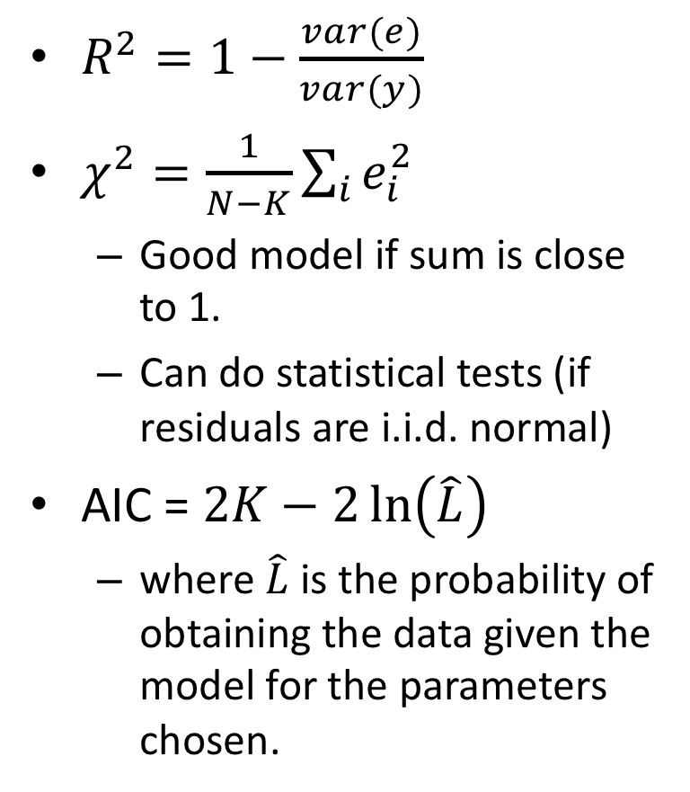
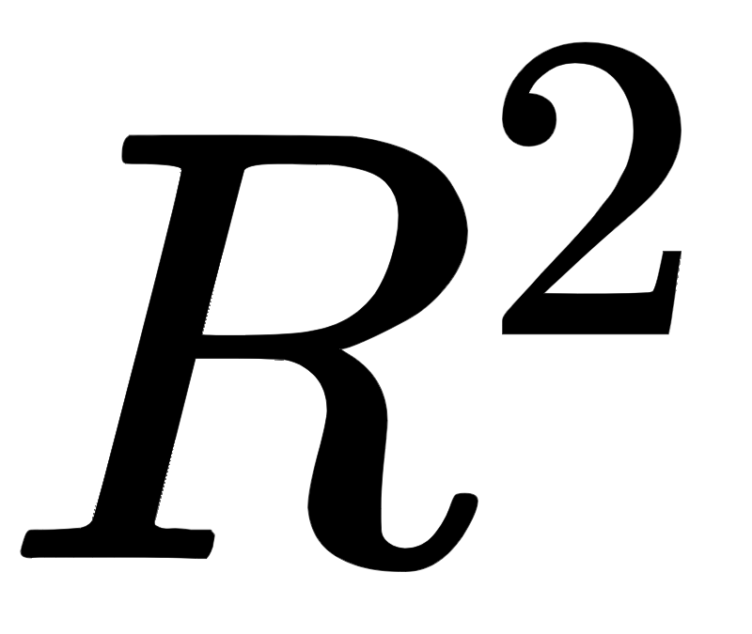



AIC
Considerations |  |  | AIC
Residuals
Parameters
Statistical test
Compare models

Slide 3






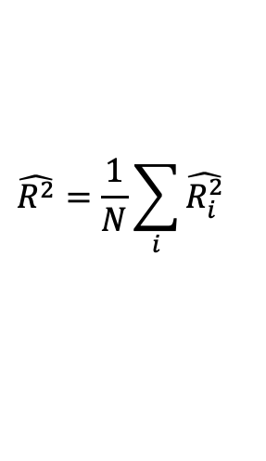
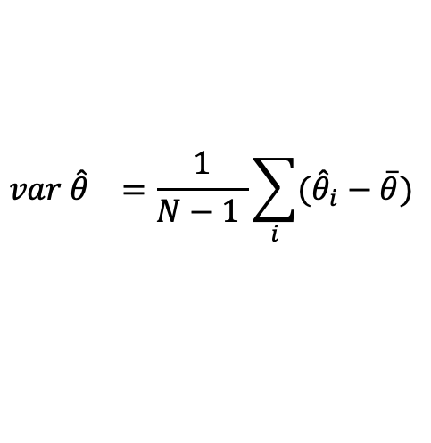
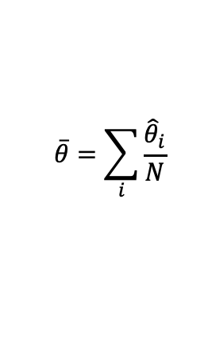
Cross Validation Summary
Data
Divide full data set into N Folds
Train 1
Test 1
{
Construct N training data sets and N test data sets
Train 2
Test 2
{
Obtain N parameter fits and model evaluations
Train 3
Test 3
{
$$\hat{R^{2}}=\frac{1}{N}\sum_{i}{{\hat{R_{i}^{2}}}_{}}$$
$$\overline{θ}=\sum_{i}{\frac{{\hat{θ}}_{i}}{N}}$$
Report statistics of the evaluations
2
$$var {\hat{θ}}_{}=\frac{1}{N−1 }\sum_{i}{({\hat{θ}}_{i}}−\overline{θ})$$

Slide 4
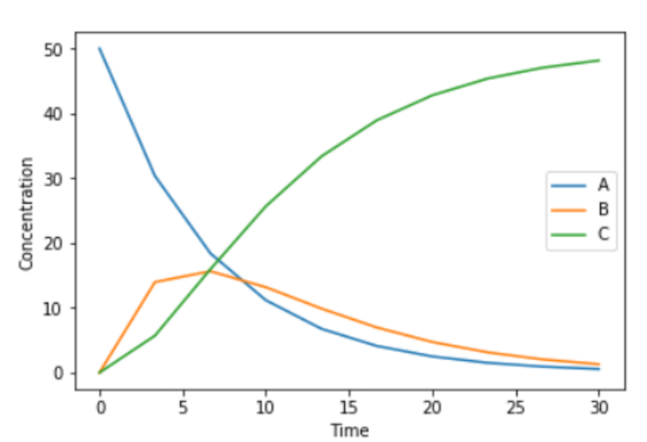
Choosing Folds Choose Wisely
X
Folds have very different dynamics
Folds have similar dynamics

