Slide 1
BIOE 498 / BIOE 599: Computational Systems Biology for Medical Applications Lecture 5: Design of Experiments
Joseph L. Hellerstein*
Herbert Sauro**
*eScience Institute, Computer Science & Engineering
**BioEngineering

Slide 2
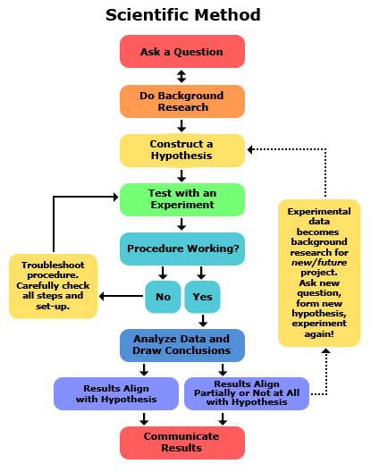
Design of experiments (DOE)
An experimental design is developed to address a research question.

Slide 3
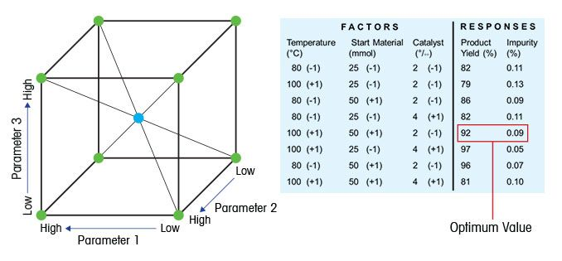
Key Concepts in DOE
Factor: Something changed in the experiment (e.g., parameter)
Level of factor: Value/setting of a factor
Response: Measured result of an experiment
An experimental design consists of:
experimental environment
factors and their levels
responses

Slide 4
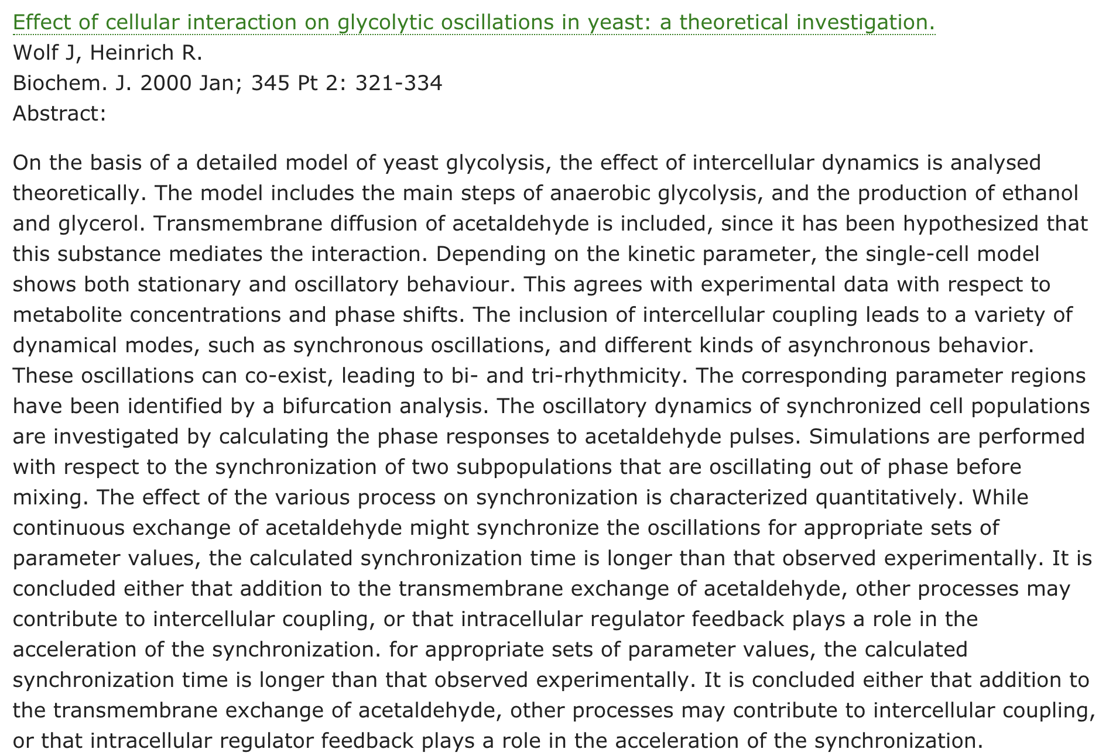
Research
Question
Experimental
Environment
Factors
Responses

Slide 5
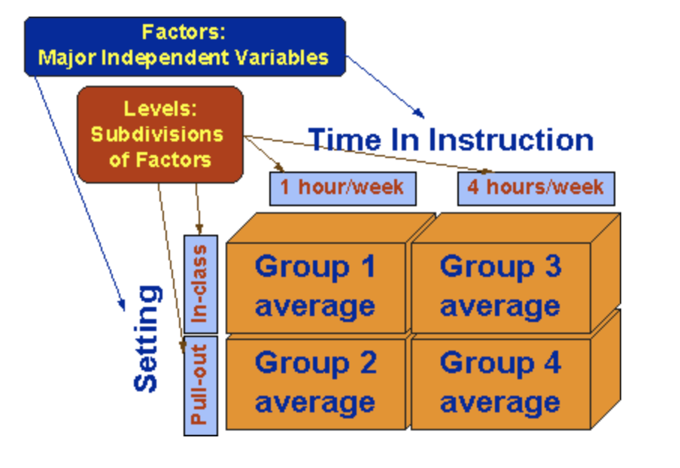
Factorial Design: All Combinations of Factor Levels
Wolf Model: Factors = 16 parameters
#levels | #experiments | Time (1 sec/sim)
2 | ~10⁵ | ~day
4 | ~10⁹ | ~month
8 | ~10¹⁴ | ~1M year
Scaling dimensions
Compute time
Visualization complexity

Slide 6

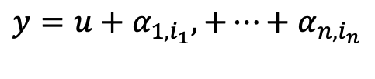


One Factor at a Time (OFT): Design
Wolf model: 16 parameters
#levels | #experiments
2 | 32
4 | 64
8 | 128
Implied model
$$y=u+α_{1,i_{1}},+⋯+α_{n,i_{n}}$$
$y$ = response
$u$ = baseline response (no change in factors)
$α_{k,i_{k}}$ = effect of factor k at level i_{k}
But what about interactions between factors?

Slide 7

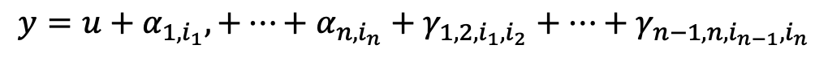



Two Factors in Combination (TFC) Design
#experiments (16 Factors)
# levels | OFT | TFC | Factorial
2 | 32 | ~10³ | ~10⁵
4 | 64 | ~10⁴ | ~10⁹
8 | 128 | ~10⁵ | ~10¹⁴
$$y=u+α_{1,i_{1}},+⋯+α_{n,i_{n}}+γ_{1,2,i_{1},i_{2}}+⋯+γ_{n−1,n,i_{n−1},i_{n}}$$
{
{
$n$ terms
$\left(\begin{matrix}n \\ 2\end{matrix}\right)$ terms
$y$ = response
$u$ = baseline response (no change in factors)
$α_{k,i_{k}}$ = effect of factor k at level i_{k}
$γ_{k_{1},k_{2},i_{k_{1}},i_{k_{2}}}$ = effect of interaction of factors $k_{1},{ k}_{2}$ at levels${ i}_{k_{1}},i_{k_{2}}$

Slide 8
Reducing the Complexity of TFC Designs
Focus on interaction between high impact factors
Strategic selection of the number of levels
Only explore more levels for those factors that have large impact
Notes:
More common to have 50 or so parameters.

Slide 9
Notes
Give more examples to clarify what is a factor, a level, a response.
Include cases where there are multiple responses.
Better illustrate and motivate the decomposition of response into different parts, including interactions.

