Slide 1



Modeling With Uncertainty:
Overview
Joseph L. Hellerstein^{1,2}
¹eScience Institute
²Department of Computer Science & Engineering
July, 2021

Slide 2
Notes
Give example in slide 4 of doing the steps

Slide 3

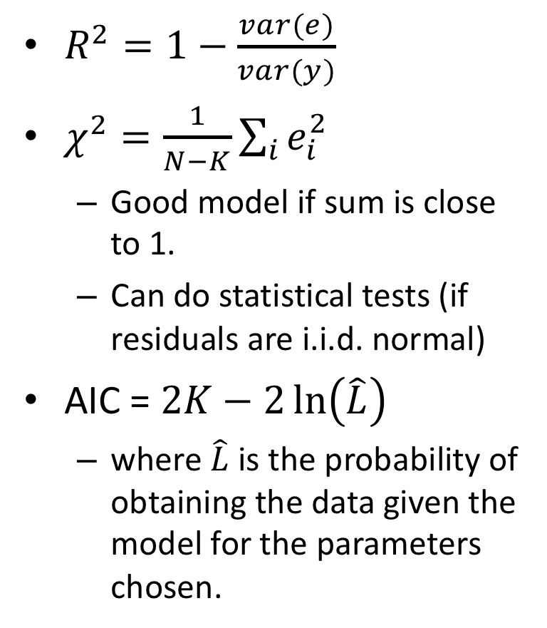
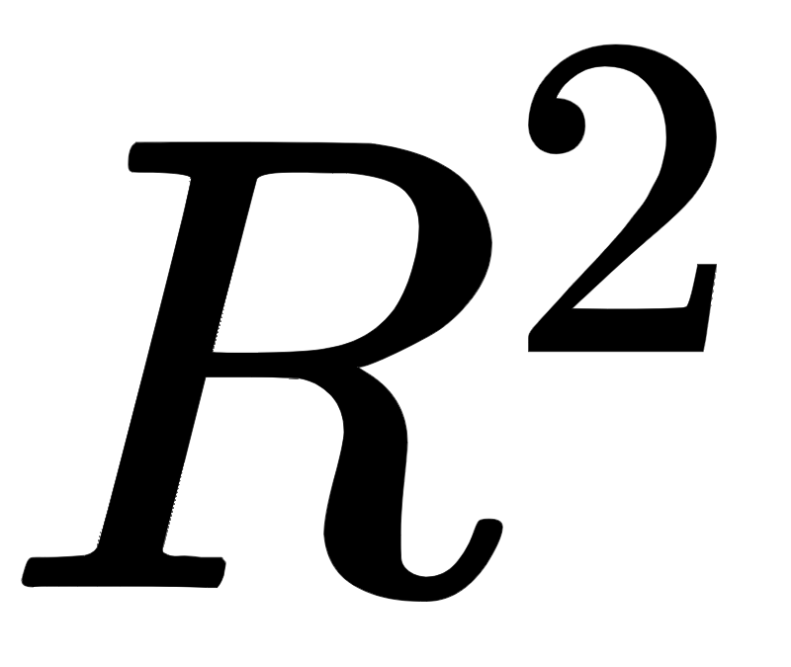
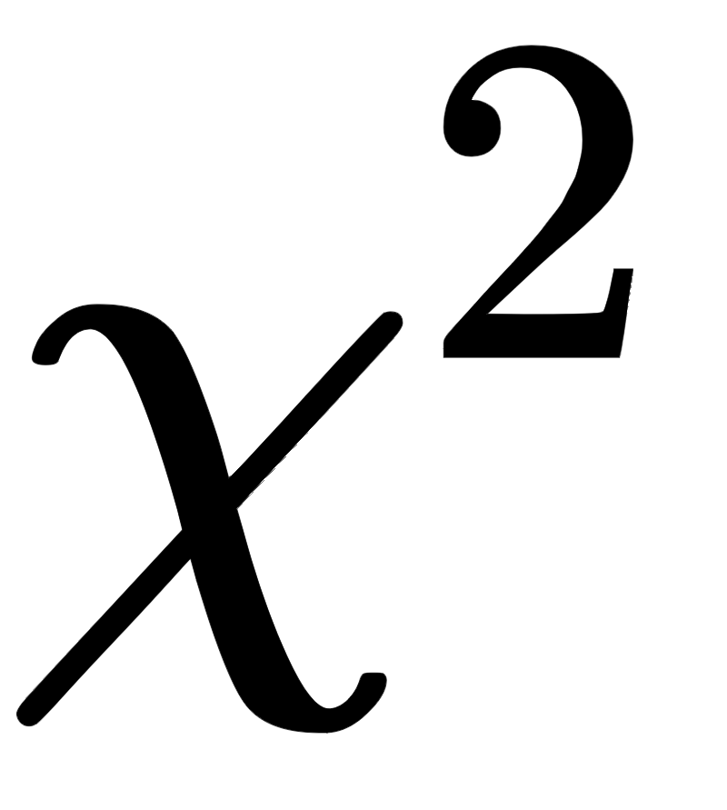


Considerations |  |  | AIC
Residuals
Parameters
Statistical test
Compare models
AIC

Slide 4






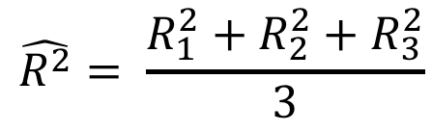
Cross Validation Summary
Divide full data set into N Folds
Data
Train 1
Test 1
{
Construct N training data sets and N test data sets
Train 2
Test 2
{
Obtain N parameter fits and model evaluations
Train 3
Test 3
{
Report statistics of the evaluations

Slide 5
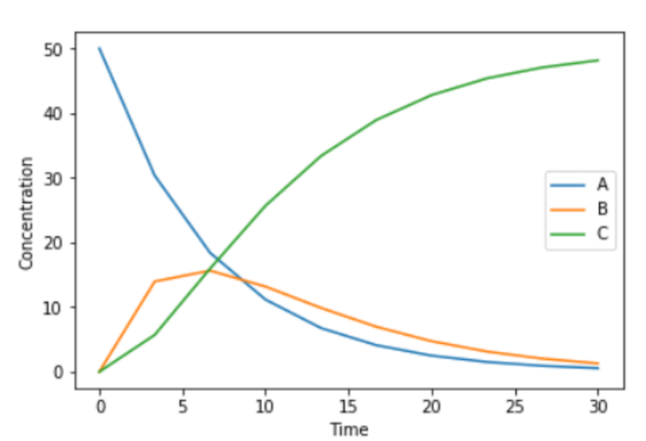
Choosing Folds Choose Wisely
X
Folds have very different dynamics
Folds have similar dynamics

