Slide 1



Design of Experiments:
Overview
Joseph L. Hellerstein^{1,2}
¹eScience Institute
²Department of Computer Science & Engineering
July, 2021

Slide 2
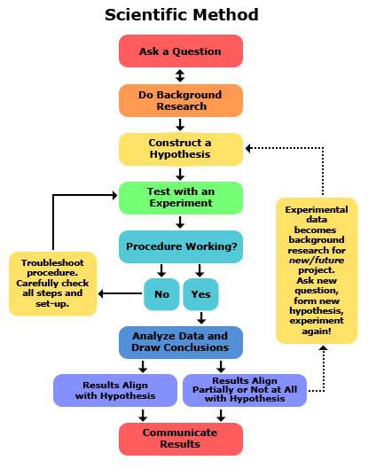
Design of experiments (DOE)
An experimental design is developed to address a research question.

Slide 3
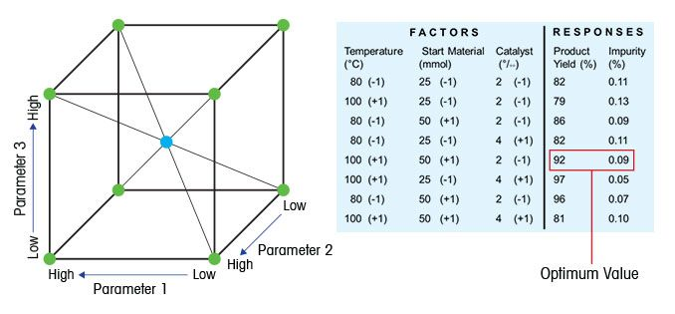
Key Concepts in Design of Experiments (DOE)
Factor: Something changed in the experiment (e.g., parameter)
Level of factor: Value/setting of a factor (something that is controlled)
Response: Measured result of an experiment
An experiment specifies the levels for each factor.
An experimental design specifies the:
experiments to conduct
response values to measure

Slide 4
Our Perspective
Baseline: Level “0” for all factors
Factor: Something changed in the experiment (e.g., parameter)
Level of factor: Value/setting of a factor.
Response: Measured result of an experiment
Since there are often a large number of factors, an experiment is specified by the levels of factors that are not at their baseline values.

Slide 5
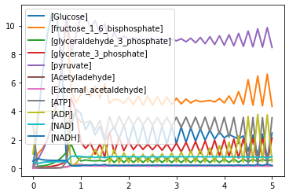
Wolf Model
Reaction Rates and kinetic constants
J0: $J0_inputFlux;
J1: J1_k1*Glucose*ATP*(1/(1 + (ATP/J1_Ki)^J1_n))
J2: J2_k*fructose_1_6_bisphosphate;
J3: J3_k*glyceraldehyde_3_phosphate*NADH
J4: (J4_kg*J4_kp*glyceraldehyde_3_phosphate*NAD*ADP
- J4_ka*J4_kk*glycerate_3_phosphate*ATP*NADH)
/(J4_ka*NADH + J4_kp*ADP)
J5: J5_k*glycerate_3_phosphate*ADP;
J6: J6_k*pyruvate
J7: J7_k*Acetyladehyde*NADH
J8: J8_k1*Acetyladehyde - J8_k2*External_acetaldehyde
J9: J9_k*ATP;
J10: J10_k*External_acetaldehyde;
Notes:
Why isn’t there a 0% change in 1WD?

Slide 6
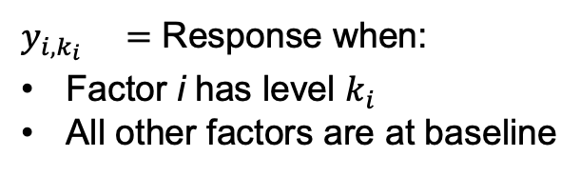
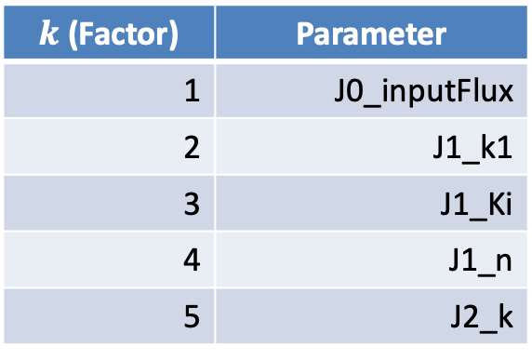



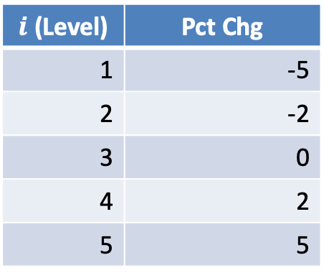
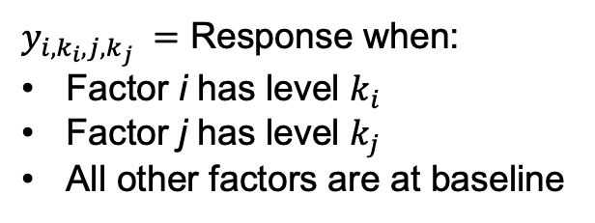
Specifying Experiments
${y_{i,k_{i}}}_{} =$ Response when:
Factor i has level $k_{i}$
All other factors are at baseline
$y_{i,k_{i},j,k_{j}} =$ Response when:
Factor i has level $k_{i}$
Factor j has level $k_{j}$
All other factors are at baseline
In the Wolf model, the factors are 16 parameters. Consider 5 levels.
$k$ (Factor) | Parameter
1 | J0_inputFlux
2 | J1_k1
3 | J1_Ki
4 | J1_n
5 | J2_k
$i$ (Level) | Pct Chg
1 | -5
2 | -2
3 | 0
4 | 2
5 | 5
Parameter 1 | Pct Chg 1 | Parameter 2 | Pct Chg 2
J1_k1 | -2 | J1_n | 5
J1_Ki | -5 | J2_k | 2
J1_k1 | -2
Experiment conducted for $y_{2,2,4,5 }?$
Experiment conducted for $y_{3,1,5,4 }?$
Experiment conducted for $y_{2,2 }?$
Notes:
This is a lot of notation. Needed to scale to a large number of factors and levels.
The number of subscripts is two times the number of factors not at their baseline value.

Slide 7
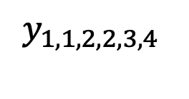
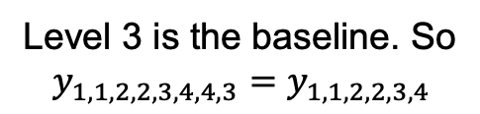
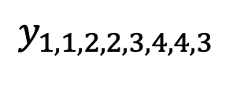
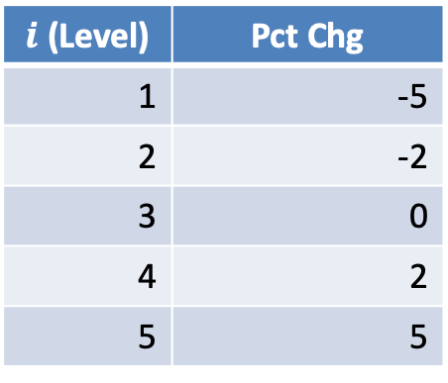
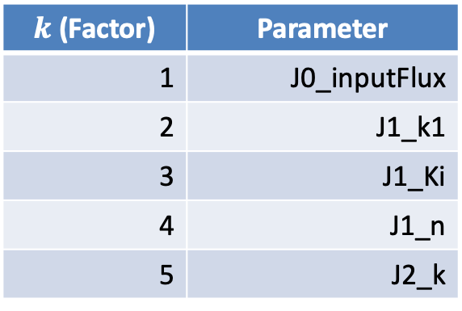
More Complicated Experiments
$k$ (Factor) | Parameter
1 | J0_inputFlux
2 | J1_k1
3 | J1_Ki
4 | J1_n
5 | J2_k
$i$ (Level) | Pct Chg
1 | -5
2 | -2
3 | 0
4 | 2
5 | 5
$$y_{1,1,2,2,3,4}$$
$$y_{1,1,2,2,3,4,4,3}$$
Parameter | Pct Chg
J0_inputFlux | -5
J1_k1 | -2
J1_Ki | 2
Level 3 is the baseline. So
$$y_{1,1,2,2,3,4,4,3}=y_{1,1,2,2,3,4}$$
Notes:
This is a lot of notation. Needed to scale to a large number of factors and levels.
The number of subscripts is two times the number of factors not at their baseline value.

Slide 8
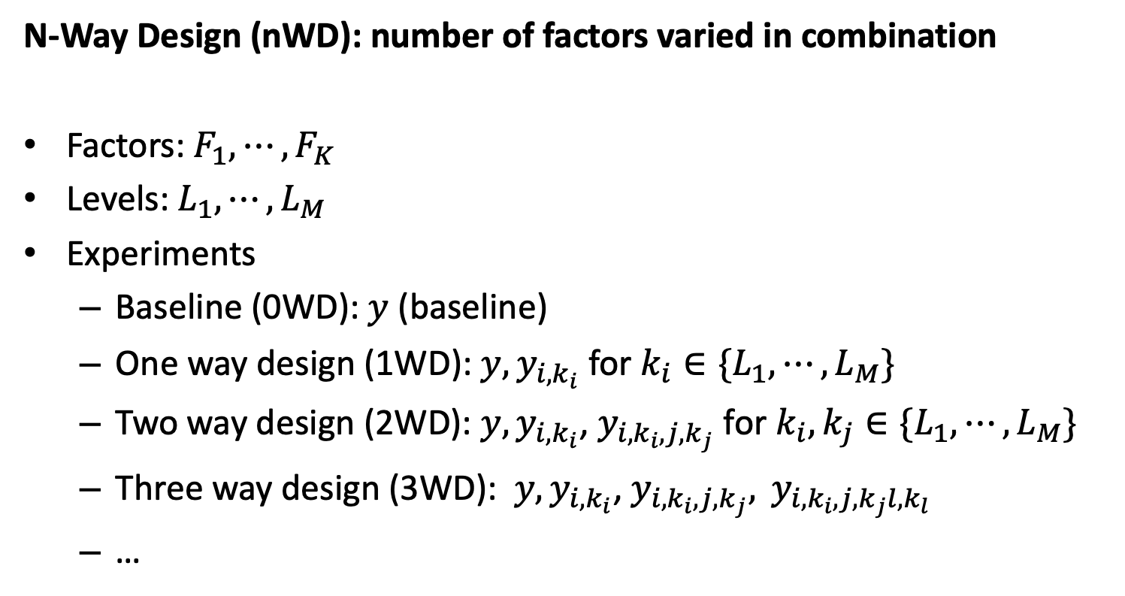
Specifying a Set of Experiments
N-Way Design (nWD): number of factors varied in combination
Factors: $F_{1},⋯,F_{K}$
Levels: $L_{1},⋯,L_{M}$
Experiments
Baseline (0WD): $y$ (baseline)
One way design (1WD): ${y, y}_{i,k_{i}}$ for $k_{i}∈\{L_{1},⋯,L_{M}\}$
Two way design (2WD): ${y, y}_{i,k_{i}}$, $y_{i,k_{i},j, k_{j}}$ for $k_{i},k_{j}∈\{L_{1},⋯,L_{M}\}$
Three way design (3WD): ${y, y}_{i,k_{i}}$, $y_{i,k_{i},j, k_{j}}, y_{i,k_{i},j, k_{j}l,k_{l}}$
…

Slide 9
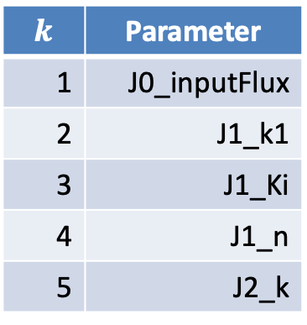
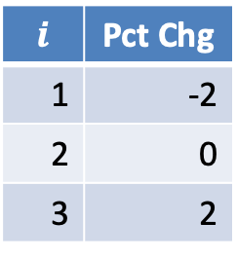
Experiments for nWD (Wolf): Part 1
$k$ | Parameter
1 | J0_inputFlux
2 | J1_k1
3 | J1_Ki
4 | J1_n
5 | J2_k
1WD:
0WD
0WD +
All parameters at
0 Pct Chg
Parameter | Pct Chg
J0_inputFlux | -2
J0_inputFlux | 2
J1_k1 | -2
J1_k1 | 2
J1_Ki | -2
J1_Ki | 2
J1_n | -2
J1_n | 2
J2_k | -2
J2_k | 2
$i$ | Pct Chg
1 | -2
2 | 0
3 | 2
Notes:
Why isn’t there a 0% change in 1WD?

Slide 10
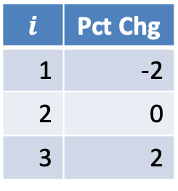
Set of Experiments (Wolf): Part 2
$k$ | Parameter
1 | J0_inputFlux
2 | J1_k1
3 | J1_Ki
4 | J1_n
5 | J2_k
P1 | %1 | P2 | %2
J0_inputFlux | -2 | J1_k1 | -2
J0_inputFlux | -2 | J1_k1 | 2
J0_inputFlux | -2 | J1_Ki | -2
J0_inputFlux | -2 | J1_Ki | 2
J0_inputFlux | -2 | J1_n | -2
J0_inputFlux | -2 | J1_n | 2
J0_inputFlux | -2 | J2_k | -2
J0_inputFlux | -2 | J2_k | 2
J0_inputFlux | 2 | J1_k1 | -2
J0_inputFlux | 2 | J1_k1 | 2
J0_inputFlux | 2 | J1_Ki | -2
J0_inputFlux | 2 | J1_Ki | 2
J0_inputFlux | 2 | J1_n | -2
J0_inputFlux | 2 | J1_n | 2
J0_inputFlux | 2 | J2_k | -2
J0_inputFlux | 2 | J2_k | 2
J1_k1 | -2 | J1_Ki | -2
J1_k1 | -2 | J1_Ki | 2
J1_k1 | -2 | J1_n | -2
J1_k1 | -2 | J1_n | 2
$i$ | Pct Chg
1 | -2
2 | 0
3 | 2
2WD: 0WD + 1WD +
Notes:
Why isn’t there a 0% change in 2WD?

Slide 11
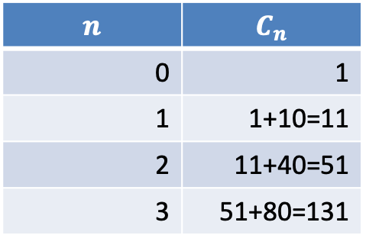
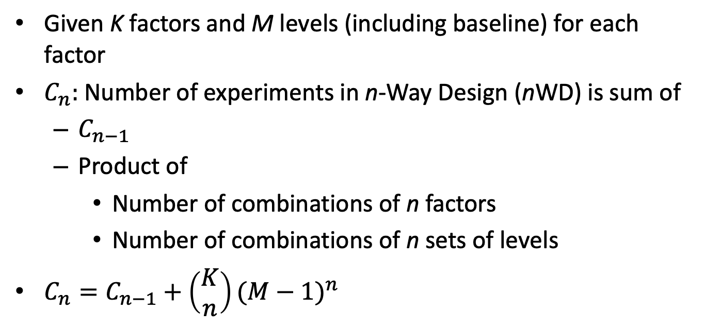

Counting the Number of Experiments in nWD
Given K factors and M levels (including baseline) for each factor
$C_{n}:$Number of experiments in n-Way Design (nWD) is sum of
$C_{n−1}$
Product of
Number of combinations of n factors
Number of combinations of n sets of levels
$C_{n}=C_{n−1}+\left(\begin{matrix}K \\ n\end{matrix}\right){(M−1)}^{n}$
$$K=5, M=3$$
$$n$$ | $$C_{n}$$
0 | 1
1 | 1+10=11
2 | 11+40=51
3 | 51+80=131

Slide 12



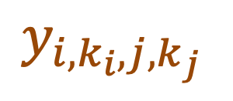

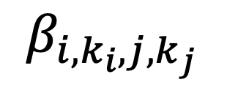



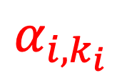
Decomposing the Responses
$$y_{i, k_{i},j,k_{j} }=μ+α_{i,k_{i} }+α_{j,k_{j} }+β_{i,k_{i},j,k_{j}}$$
Why decompose responses?
Provides a way to understand the effect of factors and levels.
Explicit understanding of assumptions of experiment.
$μ$ is the baseline ($k_{i}=0=k_{j}$)
$α_{i,k_{i}}=$ Effect of factor i level k_{i} in a 1WD
$α_{j,k_{j}}=$ Effect of factor j level k_{j} in a 1WD
$β_{i,k_{i},j,k_{j}}=$ Effect of interactions
$$y_{i,k_{i},j,k_{j} }$$
$$α_{j,k_{j} }$$
$$α_{i,k_{i}}$$
$$β_{i,k_{i},j,k_{j} }$$
$$μ$$
Notes:
In practice,there are replications at the same level.

Slide 13

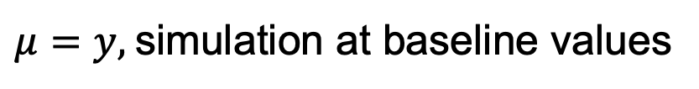







Calculating nWD Parameters
$$y_{i,k_{i},j,k_{j} }$$
$$β_{i,k_{i},j,k_{j} }$$
$$α_{j,k_{j} }$$
$$α_{i,k_{i}}$$
$$μ$$
$$y_{i, k_{i},j,k_{j} }=μ+α_{i,k_{i} }+α_{j,k_{j} }+β_{i,k_{i},j,k_{j}}$$
$μ=y,$simulation at baseline values
$$α_{i,k_{i}}=y_{i,k_{i}}−μ$$
$$β_{i,k_{i},j,k_{j}}=y_{i,k_{i},j,k_{j}}−μ−α_{i,k_{i}}−α_{j,k_{j}}$$
Notes:
In practice,there are replications at the same level.

Slide 14
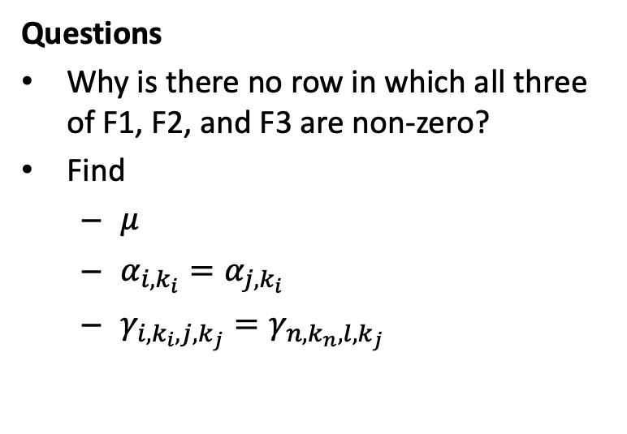
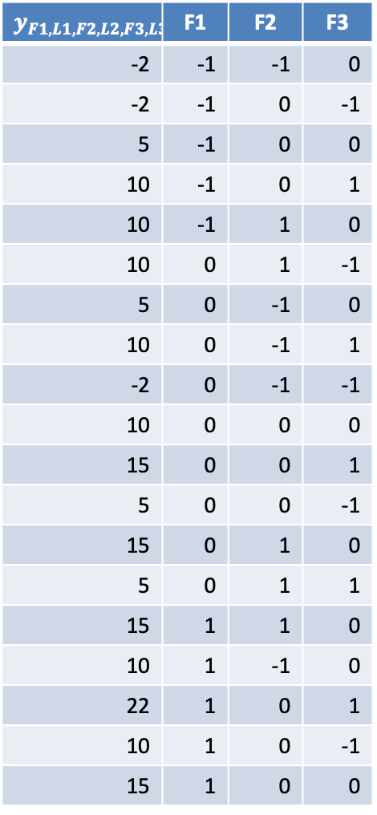
Exercise: 2WD
$$y_{F1,L1,F2,L2,F3,L3}$$ | F1 | F2 | F3
-2 | -1 | -1 | 0
-2 | -1 | 0 | -1
5 | -1 | 0 | 0
10 | -1 | 0 | 1
10 | -1 | 1 | 0
10 | 0 | 1 | -1
5 | 0 | -1 | 0
10 | 0 | -1 | 1
-2 | 0 | -1 | -1
10 | 0 | 0 | 0
15 | 0 | 0 | 1
5 | 0 | 0 | -1
15 | 0 | 1 | 0
5 | 0 | 1 | 1
15 | 1 | 1 | 0
10 | 1 | -1 | 0
22 | 1 | 0 | 1
10 | 1 | 0 | -1
15 | 1 | 0 | 0
Factors: F1, F2, F3
Level values: -1, 0, 1 (0 is baseline)
Questions
Why is there no row in which all three of F1, F2, and F3 are non-zero?
Find
$μ$
$α_{i,k_{i}}=α_{j,k_{i}}$
$γ_{i,k_{i},j,k_{j}}=γ_{n,k_{n},l,k_{j}}$
Notes:
Mu = 10
-1: -5
1: 5
-1,-1: -2
-1,1 & 1, -1: 0
1,1: 2

Slide 15
Other Considerations
Replicas?
Can be used in constructing folds
Can quantify effect of stochastics (Analysis of Variance)
Reducing the complexity of nWD
Focus on interaction between high impact factors
Strategic selection of the number of levels
Only explore more levels for those factors that have large impact
Notes:
More common to have 50 or so parameters.

Slide 16
BACKUP

Slide 17
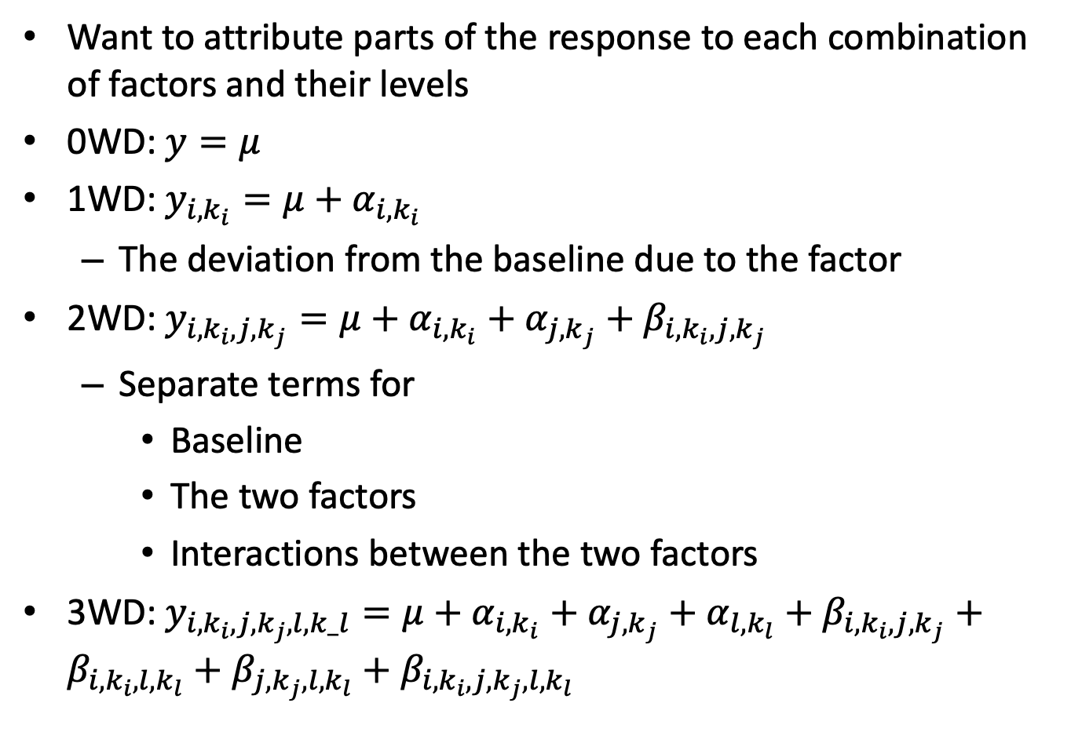
Analyzing Experimental Results
Want to attribute parts of the response to each combination of factors and their levels
0WD: $y=μ$
1WD: $y_{i,k_{i}}=μ+α_{i,k_{i}}$
The deviation from the baseline due to the factor
2WD: $y_{i,k_{i},j,k_{j}}=μ+α_{i,k_{i}}+α_{j,k_{j}}+β_{i,k_{i},j,k_{j}}$
Separate terms for
Baseline
The two factors
Interactions between the two factors
3WD: $y_{i,k_{i},j,k_{j},l,k_l}=μ+α_{i,k_{i}}+α_{j,k_{j}}+α_{l,k_{l}}+β_{i,k_{i},j,k_{j}}+β_{i,k_{i},l,k_{l}}+β_{j,k_{j},l,k_{l}}+β_{i,k_{i},j,k_{j},l,k_{l}}$

Slide 18

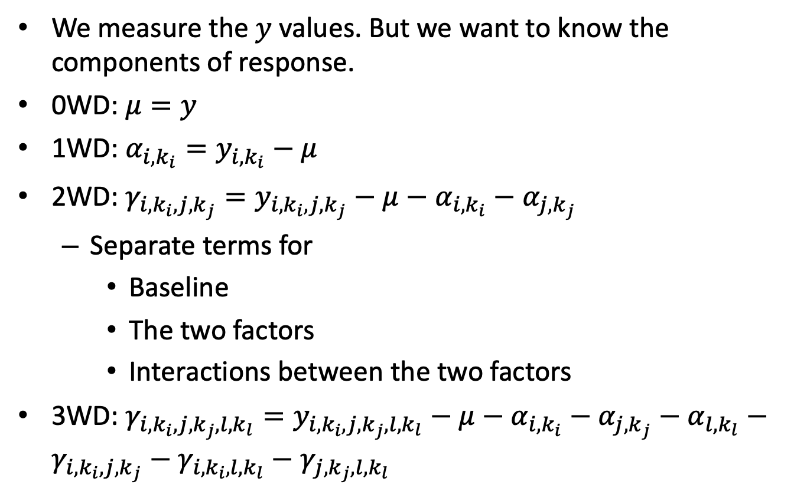
Calculating $μ, α, γ$
We measure the $y$ values. But we want to know the components of response.
0WD: $μ=y$
1WD: $α_{i,k_{i}}=y_{i,k_{i}}−μ$
2WD: $γ_{i,k_{i},j,k_{j}}=y_{i,k_{i},j,k_{j}}−μ−α_{i,k_{i}}−α_{j,k_{j}}$
Separate terms for
Baseline
The two factors
Interactions between the two factors
3WD: $γ_{i,k_{i},j,k_{j},l,k_{l}}=y_{i,k_{i},j,k_{j},l,k_{l}}−μ−α_{i,k_{i}}−α_{j,k_{j}}−α_{l,k_{l}}−γ_{i,k_{i},j,k_{j}}−γ_{i,k_{i},l,k_{l}}−γ_{j,k_{j},l,k_{l}}$

Slide 19
Notes
The table used as an example on page 9 may be in error for calculating interactions with 1,1. I expect that: mu = 10, alpha 1 = 5, alpha -1 = -5, gamma 1,1 =2 gamma -1,-1 = -2. other gammas are 0.
Show how the numbers from the table are plugged into the formula to calculate alpha, gamma
Organize the table so that it corresponds to the structure of C_n, where I do all combinations of levels for 1 combination of factors before proceeding to the next combination of factors.

Slide 20



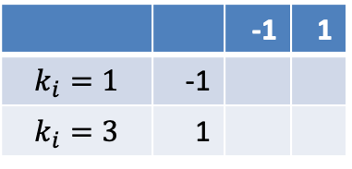

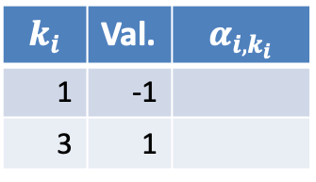

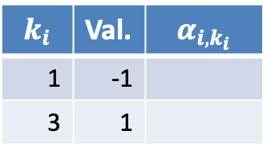

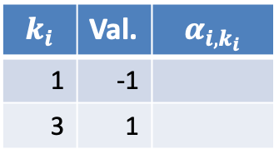


Components of Response in Example
$$γ_{i,k_{i},j,k_{j}}$$
$$μ$$
F2 (j$=2)$
$$k_{j}=1$$ | $$k_{j}=3$$
 |  | -1 | 1
$$k_{i}=1$$ | -1
$$k_{i}=3$$ | 1
F1
$$k_{i}$$ | Val. | $$α_{i,k_{i}}$$
1 | -1
3 | 1
F1$(i=1)$
F3 (j$=3)$
F2
$$k_{i}$$ | Val. | $$α_{i,k_{i}}$$
1 | -1
3 | 1
 | -1 | 1
-1
1
F1$(i=1)$
F3
$$k_{i}$$ | Val. | $$α_{i,k_{i}}$$
1 | -1
3 | 1
F3 (j$=3)$
 | -1 | 1
-1
1
F1$(i=2)$

