Slide 1



Pathway Modeling Course and Workshop July 19-23, 2021 (Monday-Thursday)
Instructors:
Teaching Assistants:
Herbert Sauro (UW)
Veronica Porubsky (UW) Joe Hellerstein (UW) Lucian Smith (UW) Michael Kochen
Lillian Tatka (UW) Jin Xu (UW) Janis Shin (UW)
Support: NIH U24 EB028887, R01GM123032, P41EB023912 and NSF 1933453

Slide 2


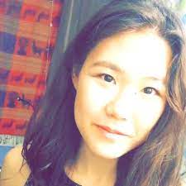


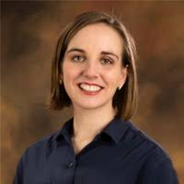
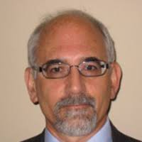

Meet the Instructors
Janis Shin
Michael Kochen
Herbert Sauro
Veronica Porubsky
Jin Xu
Lillian Tatka
Lucian Smith
Joe Hellerstein

Slide 3
Where things are kept?
The primary location for all material is at:
https://drive.google.com/drive/folders/16FIghBlRVFdI2wyH6CvhOCeleuJoijfH?usp=sharing
This should be posted to the slack channel.

Slide 4
What things are there in the Google Drive?
Daily Topics Schedule
Cheat sheets on modeling and Tellurium
Tellurium in a Nutshell
A folder for each day
Separate morning and afternoon folder
Scripts, ppts and exercises
Video recordings of lectures

Slide 5
Sources of Information
tellurium.analogmachine.org
https://tellurium.readthedocs.io/
Cheat sheets and other documents on the google drive

Slide 6
Topics for the Week
Time | Topic
Monday | Intro to Python.Intro to Differential Equations-based Biochemical Modeling
 | Intro to Tellurium, libRoadRunner, Antimony and Collecting Data
Tuesday | Model Construction/Simulation
 | Introduction to Model Fitting (Parameter Estimation)
Wednesday | Additional Simulation Topics: Analysis and Reproducibility
 | Verification and Validation of Models
Thursday | Model Repositories and Distribution

Slide 7
Software for Computational Science
Two broad approaches to doing computational science:
Using graphical user interfaces
Should be easy to get started (not always the case)
Limited functionality
Scripting languages
Harder to get started (not always the case)
Unlimited possibilities

Slide 8
Scripting Languages for Science
MATLAB | Proprietary
MATHEMATICA | Proprietary
R | Open Source
Python | Open Source
Julia | Open Source
Both MATLAB and MATHEMATICA are extremely good platforms to use.
The downside is that the algorithms they use are largely closed (especially in the case of MATHEMATICA). The other issue is that they can be expensive to purchase limiting their broad adoption.

Slide 9
Why Python?
Advantages:
Easy to learn and use
Widely employed from High School to Industry
There is a huge amount of online support
It gets used a lot of computational science
Disadvantages:
It can be slow but it’s getting faster and most computational work is done using external high performance libraries that are called from Python.
Python therefore acts as a glue.

Slide 10
Python
Where to get Python
The primary site from where to get Python is python.org
But this only gives you a very primitive interface to python. For real work you would not use this primitive interface

Slide 11
Fancy Interfaces to Python
Fancy Interfaces
People soon realized that the raw Python you download for python.org is a bit too primitive for daily use. As a result people created use more fancy interface that people could be used from.
Examples of fancy interfaces:
Spyder https://www.spyder-ide.org/
PyCharm https://www.jetbrains.com/pycharm/
Visual Studio Code https://code.visualstudio.com/

Slide 12
Python Notebooks
Notebooks
The Jupyter Notebook is an open source web application that you can use to create and share documents that contain live code, equations, visualizations, and text.
Note that a Jupyter Notebook can be run from the web or the desktop (as it does with Visual Studio Code).
We will be using a Google hosted Jupyter notebook system call CoLaboratory (CoLab).
The advantage of using CoLab this week is that there is nothing for you to install and you can get working right away.

Slide 13
Python Notebooks: Exercise
Notebooks
https://colab.research.google.com/notebooks/intro.ipynb
Or search for Colab on google

Slide 14
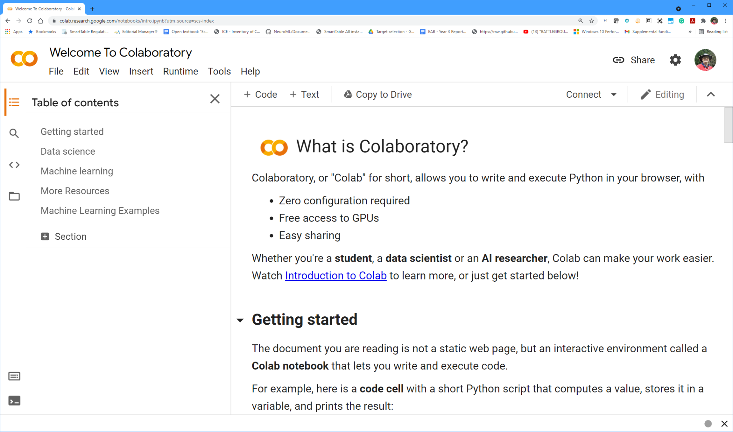
CoLab: Exercise
To get to CoLab just type CoLab in the google search bar.
The first search entry should be the link you want.

Slide 15
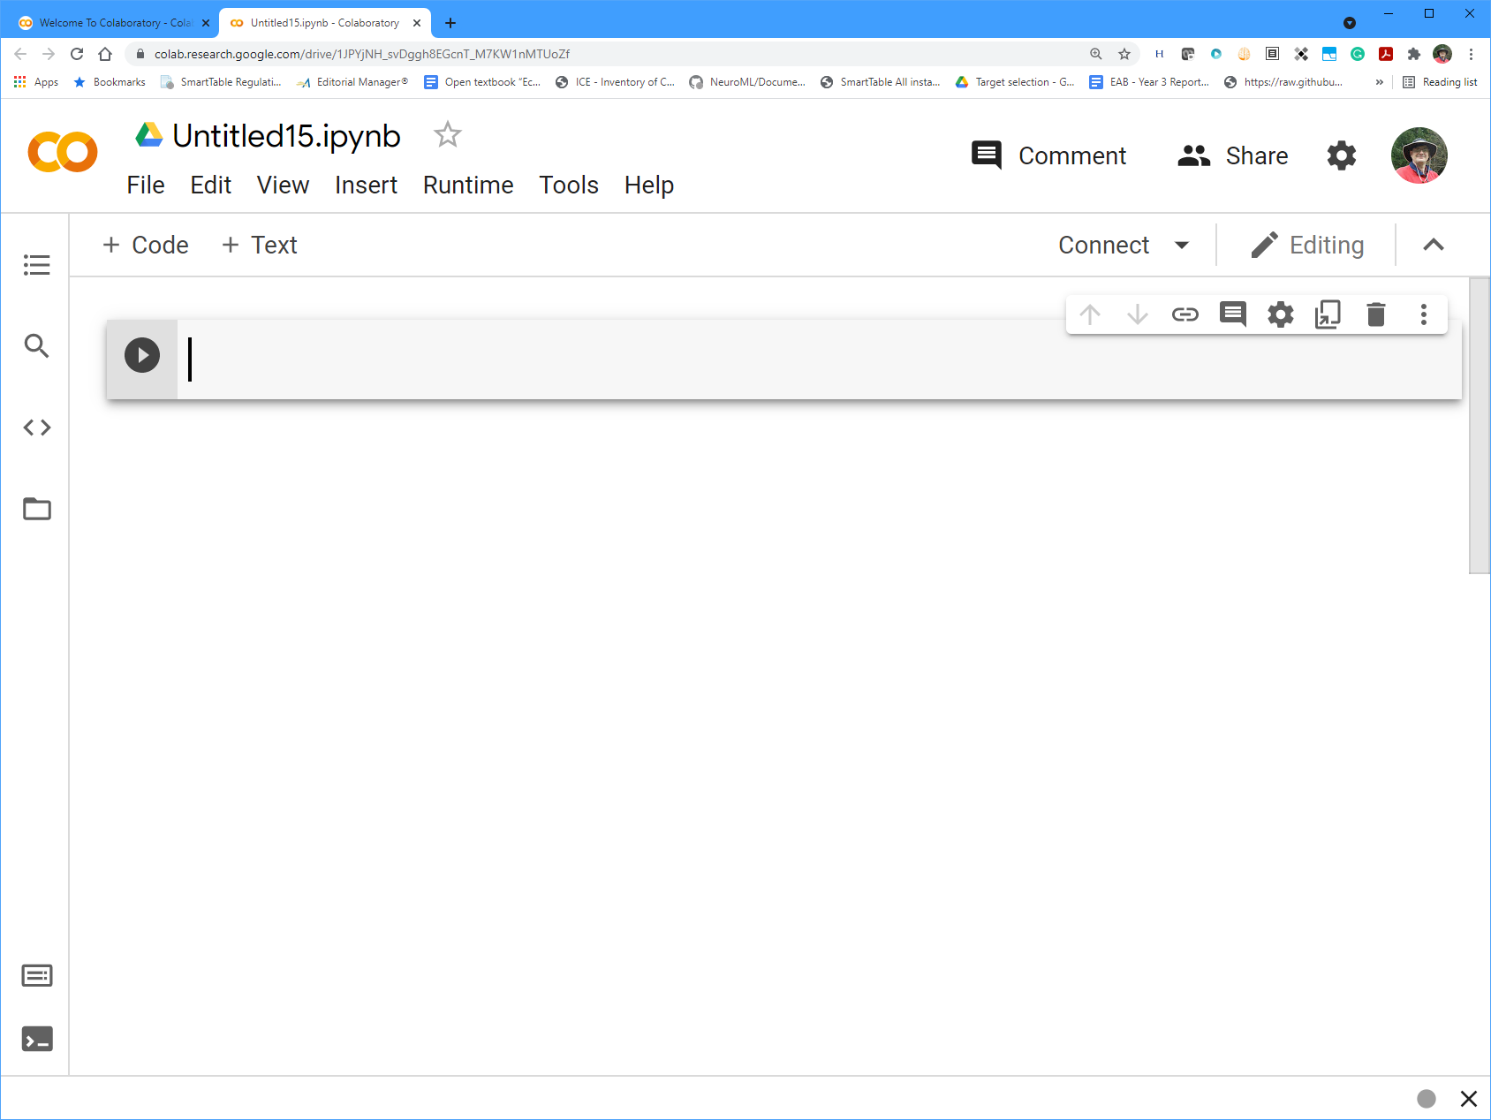
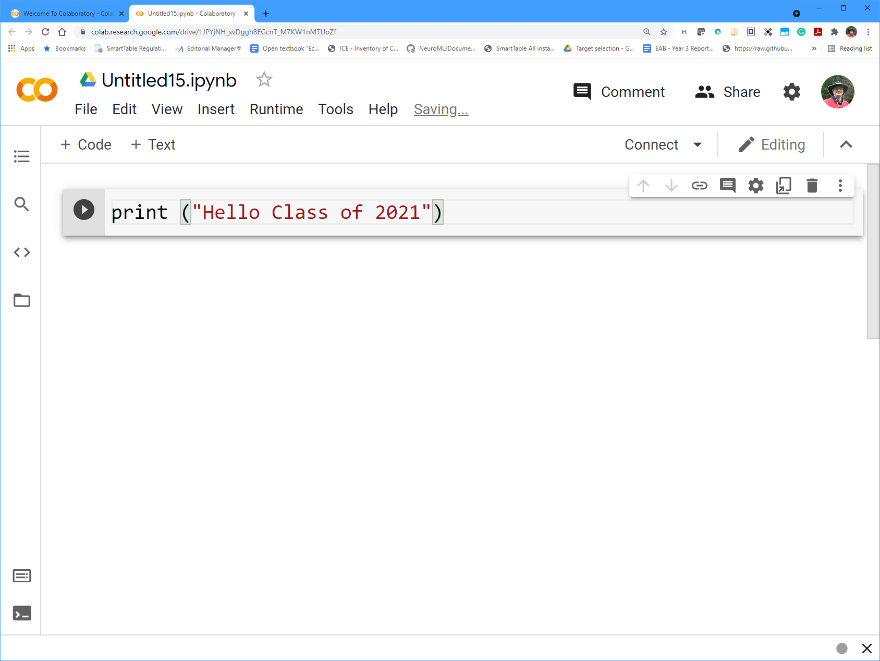
CoLab: Exercise
Select the File menu and pick “New Notebook”, left hand image.
Type the command print (“Hello etc…”)you see on the right image, then click the white arrow in the black button on the left.

Slide 16
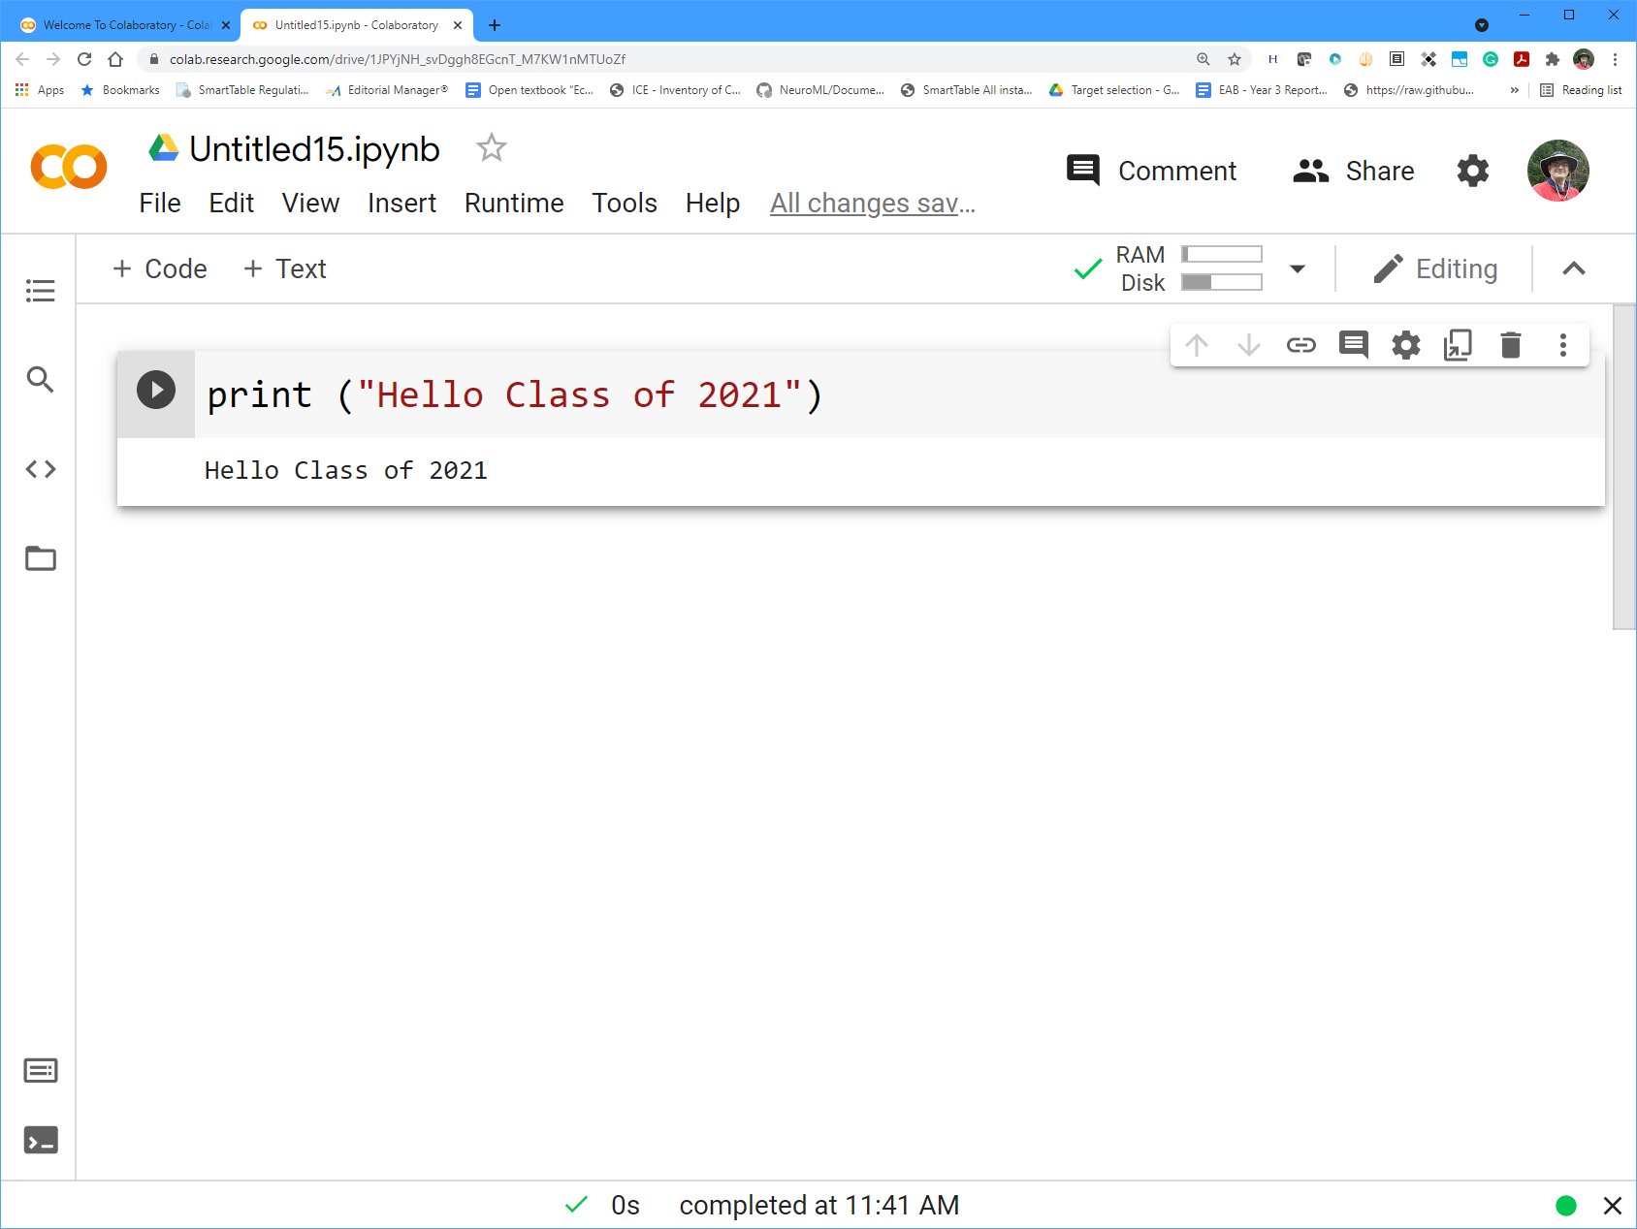
CoLab: Exercise
If you did that correctly you should see:

Slide 17
One Last thing Before we get Started
Python Versions
Python has been developed over many years with new releases announced every so often. These releases are called versions and the current version has the number:
3.9
CoLab uses Python 3.7
In our work we use Python 3.8
It doesn’t matter which version we use for this course.

Slide 18
Let’s get Started
First we need to learn some basic Python.
Structure of the google drive:
Lecture Materials
|
| - Day 1---|
| | - Session 1
| - Day 2 |
| | - Session 2
| etc

Slide 19
Let’s get Started
First we need to learn some basic Python.
Get hold of the Introductory Python notebook in the folder:
Day 1 -> Session 1: Introduction to Biochemical Modeling
You should find a file called: IntroPython.ipynb
There are two ways you can try to get this file into CoLab:
Right click over the file and you might see an option to load into CoLab

Slide 20
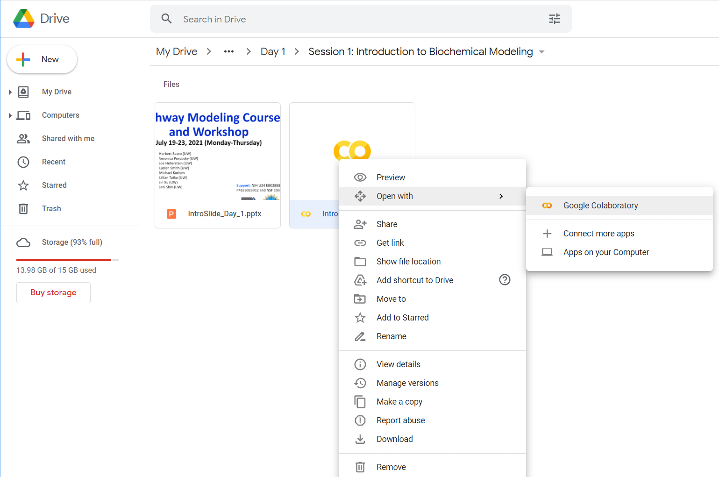
Let’s get Started
If you don’t see the CoLab option you can select
+ Connect more Apps
and install the CoLab option
If you can’t do that move to the next slide…..

Slide 21
Let’s get Started
A second approach is to download the file to your local hard-drive:

Slide 22
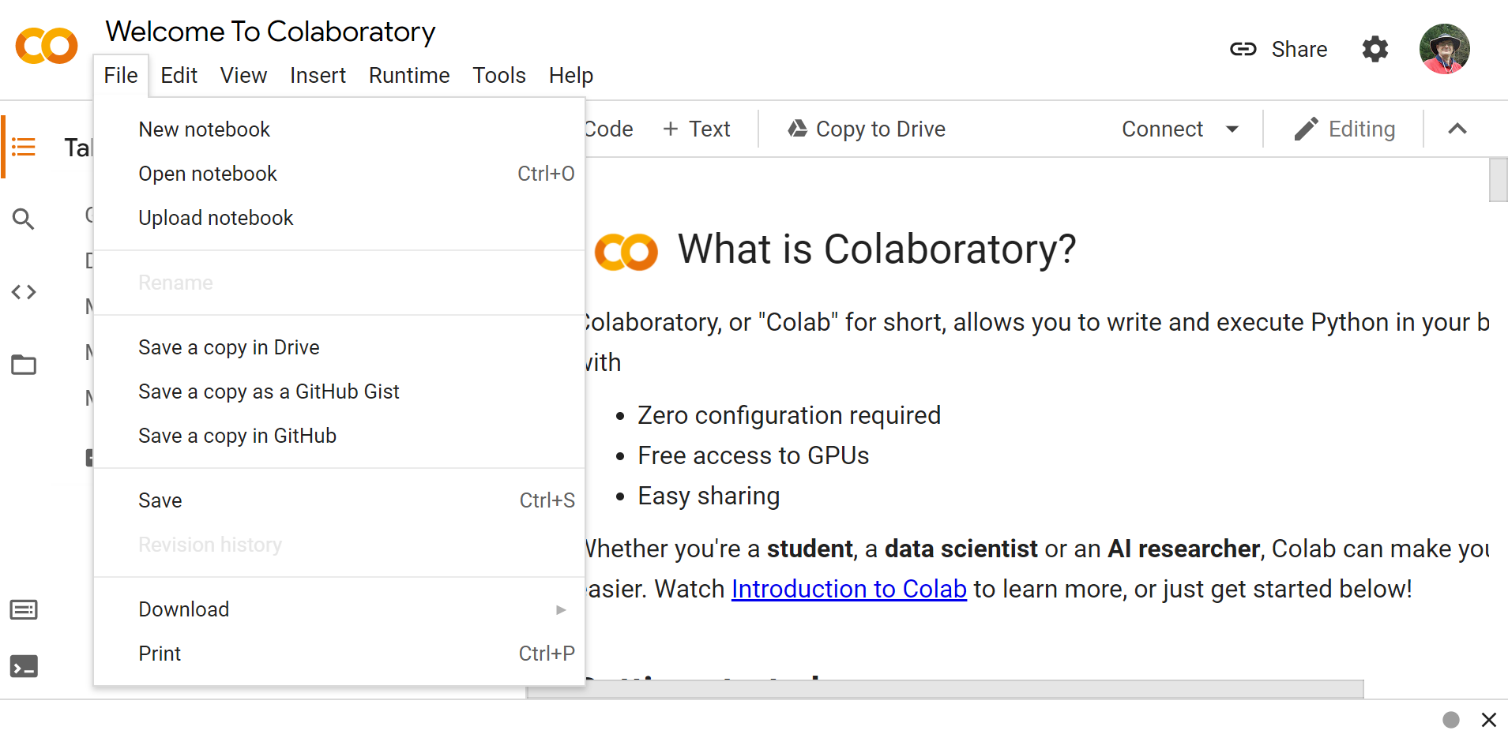
Let’s get Started
A second approach is to download the file to your local hard-drive via the File menu:

Slide 23
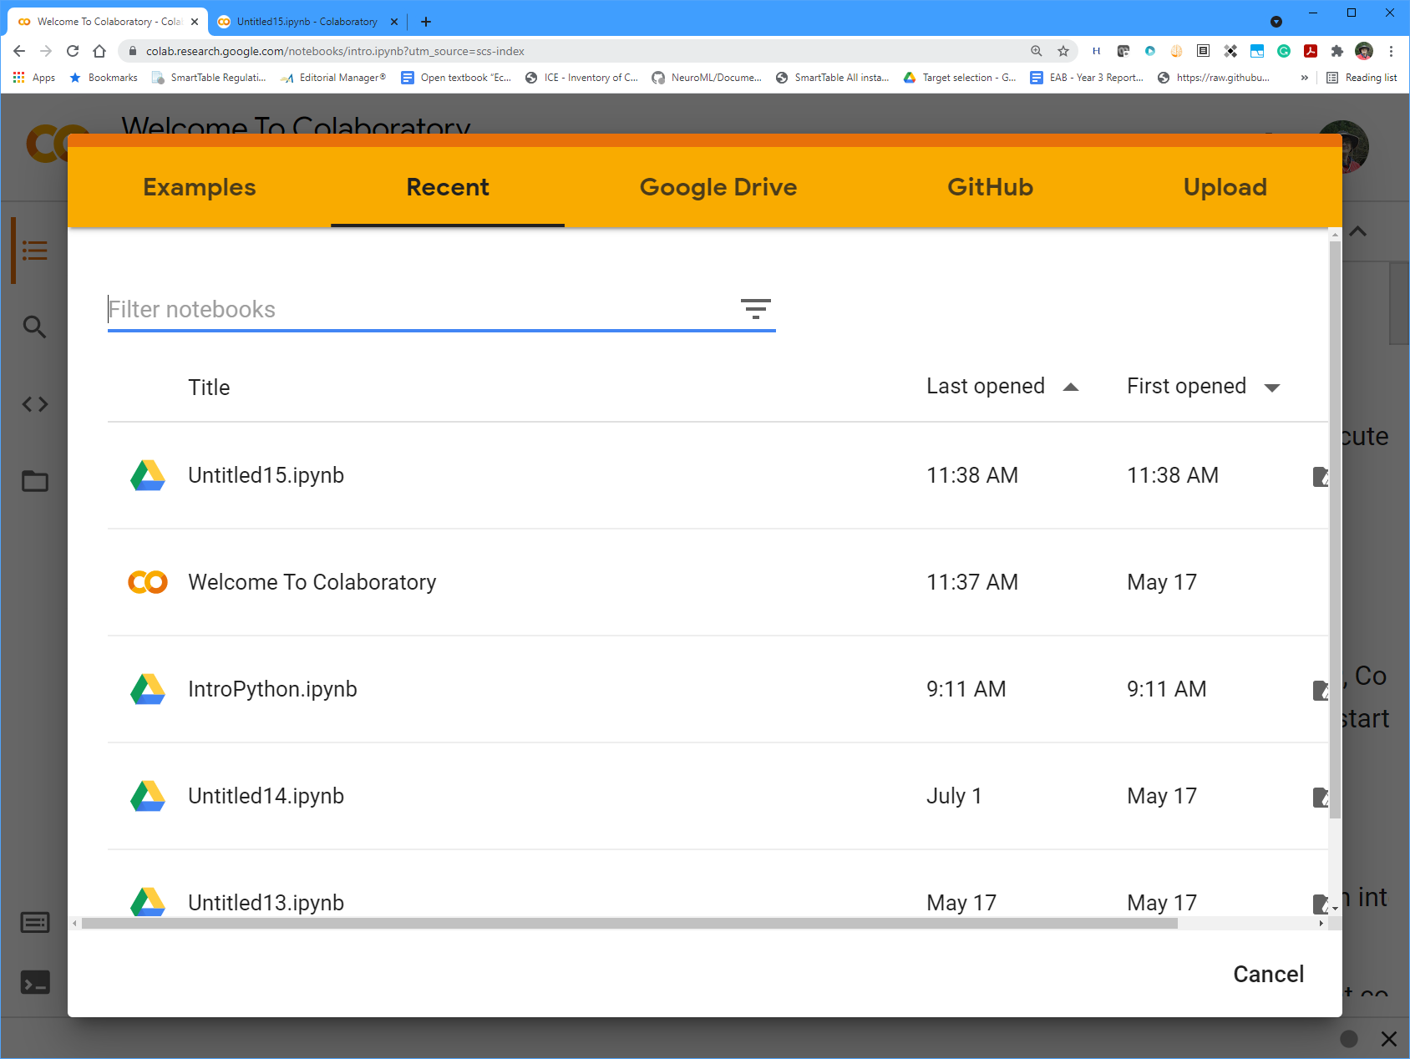
Let’s get Started
Once downloaded you can load it into CoLab from the File menu
Make sure you pick the upload button

Slide 24
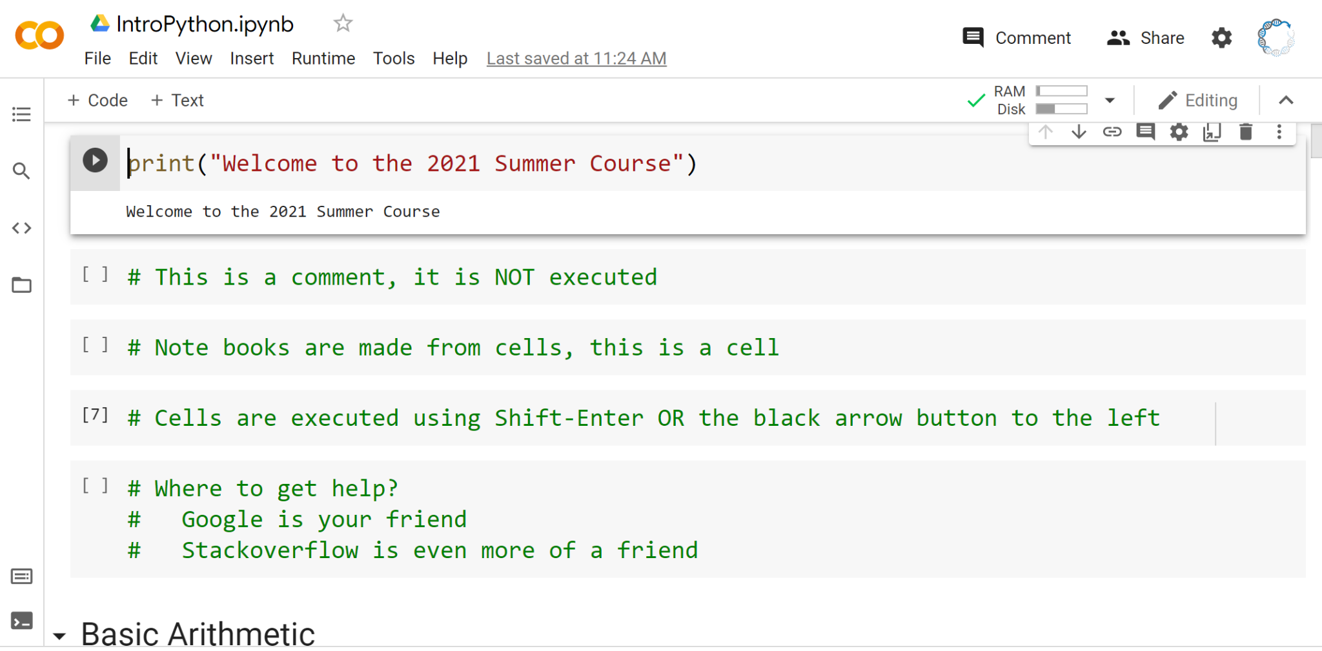
Let’s get Started
If you were successful you should see:

Slide 25
Let’s get Started
At this point let’s make sure everyone has the intro python notebook loaded.

