Slide 1


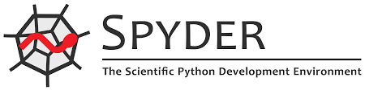







Model Construction/Simulation
Tellurium:
loada
plotArray
Tellurium makes certain things
easier to use with roadrunner
Roadrunner
All simulation methods
This is the actual simulator

Slide 2
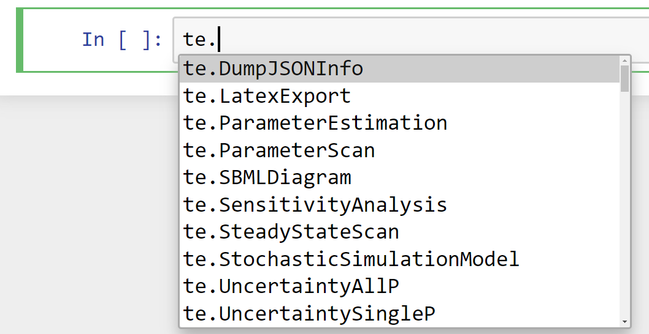
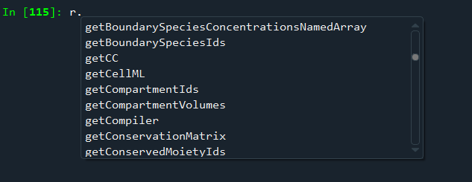
Getting Help: What methods are available?
Popup Help: Shift Tab on Jupyter; TAB on other platforms
Jupyter
Spyder

Slide 3
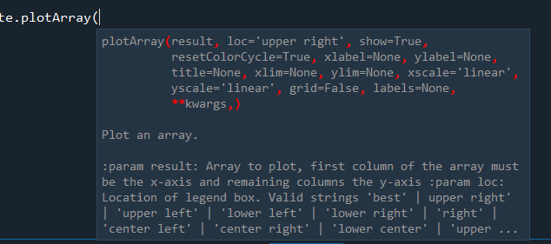
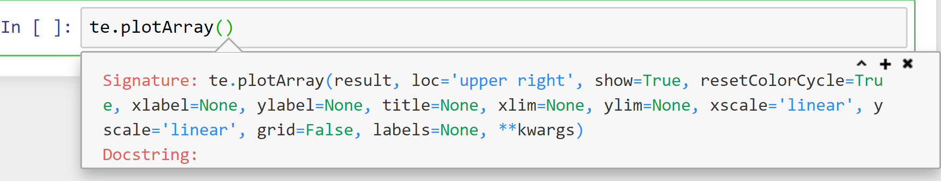
Getting Help: What are the options on a method call?
Name completion: Type r. and a popup help will appear
To get help use a ? mark, eg
r.simulate?

Slide 4
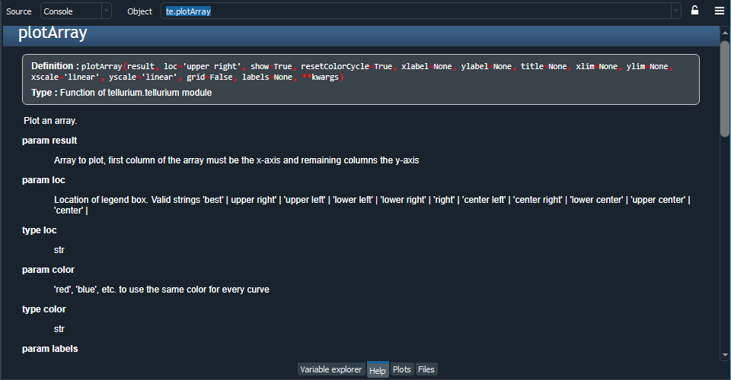
Getting Help: What about more help?
To get more help, either:
te.plotArray? <- Note the question mark at the end of the method name, works on spyder and Jupyter
Or in spyder you can type Ctrl-I
and you’ll get a nicely
rendered docs page
Spyder

Slide 5
Cheat Sheets
Lecture Materials
|
| - Cheatsheets
|
| - Day 1---|
| | - Session 1
| - Day 2 |
| | - Session 2
| etc
Tellurium Cheat sheet
Tellurium in a nutshell slides
Modeling
Python
https://drive.google.com/drive/u/2/folders/1g6y0D1pR9w41HYEsomvl2zmxwrUSSTVQ

Slide 6
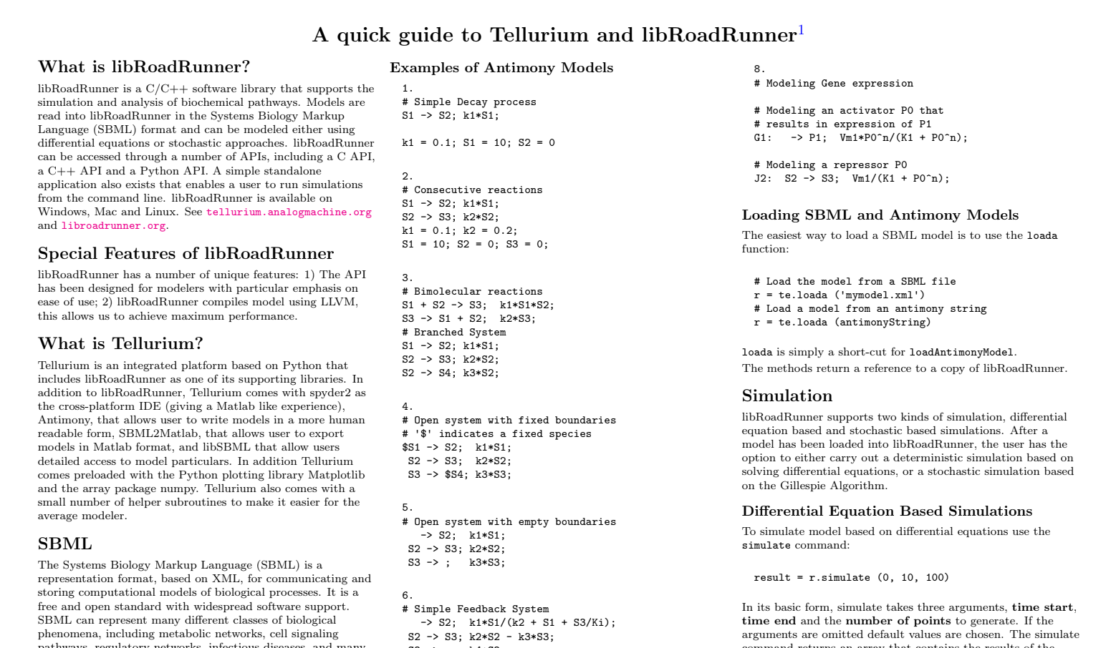
Cheat Sheets
Tellurium Cheat sheet
https://drive.google.com/drive/u/2/folders/1g6y0D1pR9w41HYEsomvl2zmxwrUSSTVQ

Slide 7
Setting and Getting Values
Setting and getting values:
print (r.k1)
r.k1 = 0.7
print (r.S1)
r.S1 = r.S1 + 0.1

Slide 8
Commands I tend to use
Setting and getting values:
te.loada
r.simulate(start, end, numpoints, [‘time’, ‘x’, ‘y’, etc]) r.steadyState() r.getFloatingSpeciesIds() r.getBoundarySpeciesIds() r.getReactionIds() r.getCurrentSBML() r.getRatesOfChange() r.getReactionRates() r.setValue (string, value) <- like r.k1 = 2, but you can use a string
Optional Selection List

Slide 9
Installing new Packages
How to install a package in Jupyter
We have utilities package called teUtils which contains a number of
useful methods. We’ll be using some of them today.
!pip install teUtils --user
or
pip install teUtils --user
for interfaces such as spyder

Slide 10
Installing new Packages
To check the teUtils installed ok, try the following:
import teUtils
print (teUtils.buildNetworks.getRandomNetwork(10, 12))
This will create a random network with 10 species and 12 reactions
Use Shift-TAB to help you find the methods, don’t type them by hand.

Slide 11
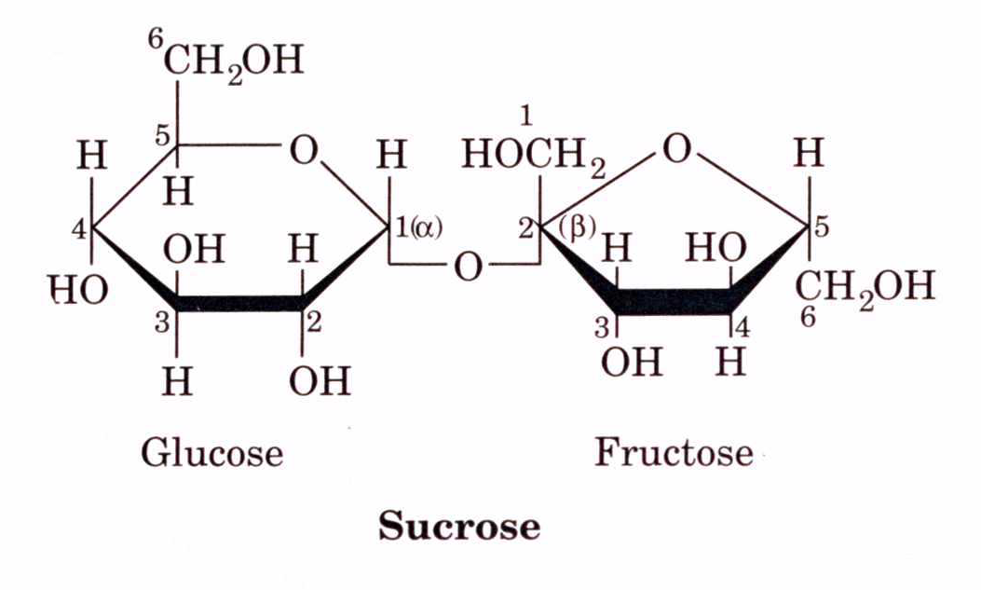
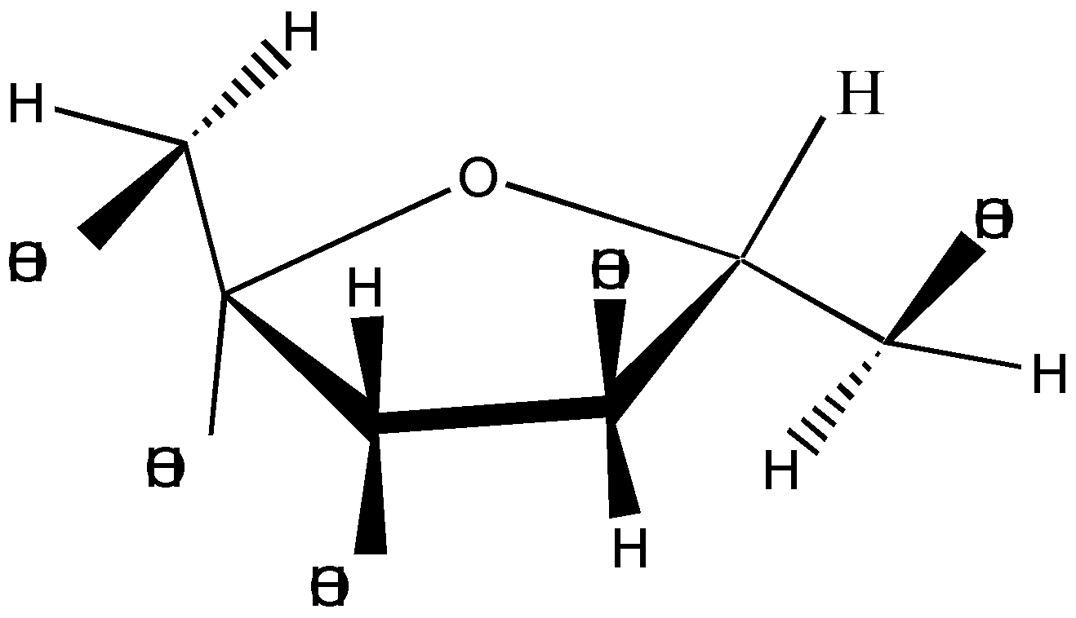
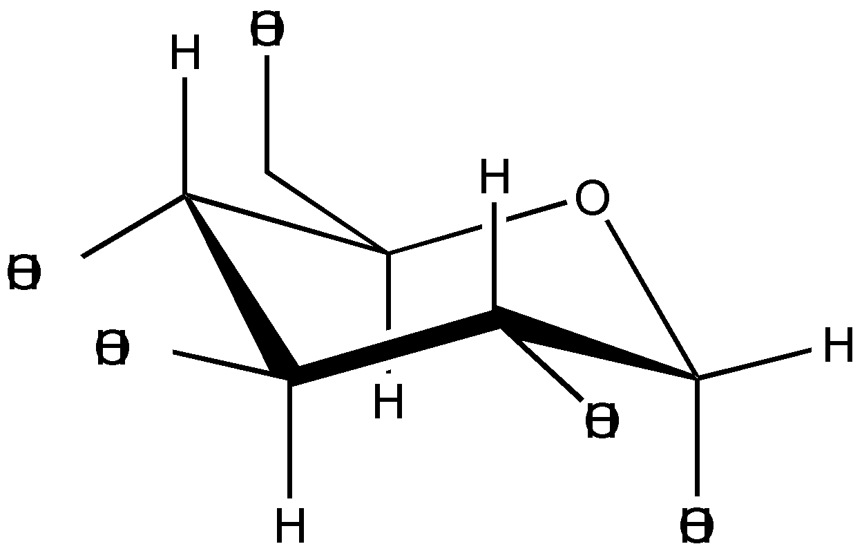
Enzyme Kinetics
One of the first enzymes to be discovered was sucrase
Sucrose + H₂0 Glucose + Fructose

Slide 12
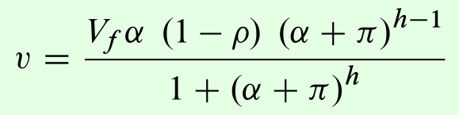
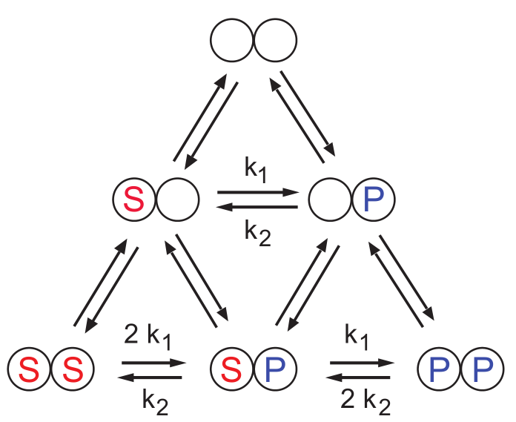
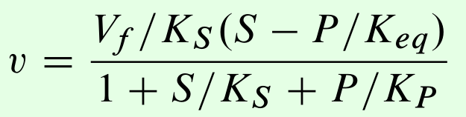
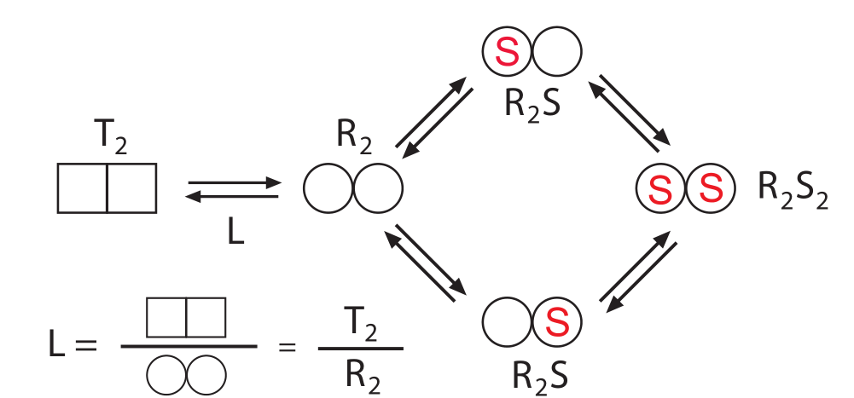

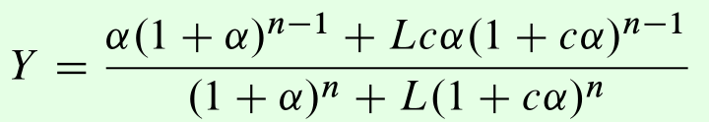
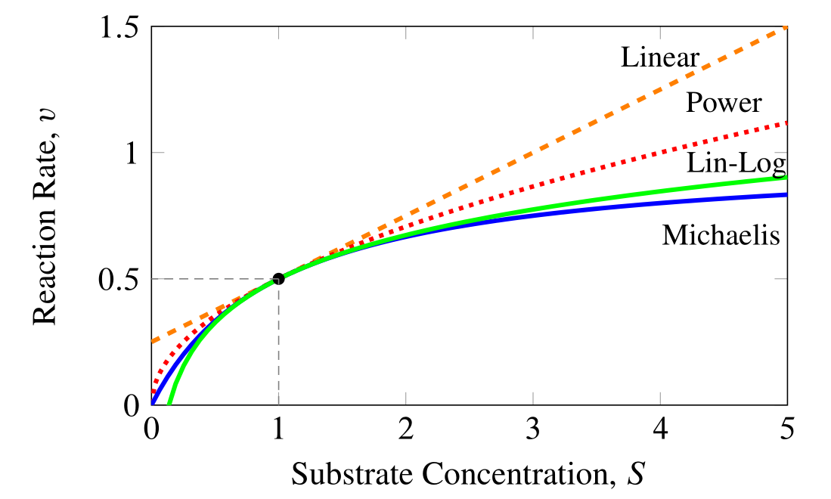
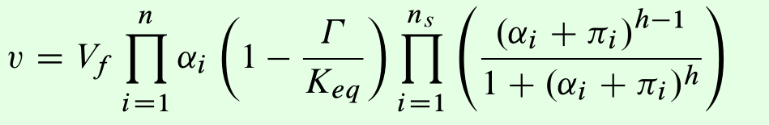
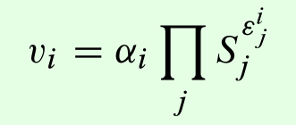
Enzyme Kinetics
Michaelis-Menten type Kinetics
Hill Based Cooperativity Kinetics
Mass-Action Kinetics
Rate Laws
MWC or KNF
Approximations: Power law or linlog
Generalized Enzyme Kinetic Laws
Hanekom or Liebermeister

Slide 13
Enzyme Kinetics
Michaelis-Menten type Kinetics
Hill Based Cooperativity Kinetics
Mass-Action Kinetics
Rate Laws
MWC or KNF
Approximations: Power law or linlog
Generalized Enzyme Kinetic Laws
Hanekom or Liebermeister

Slide 14
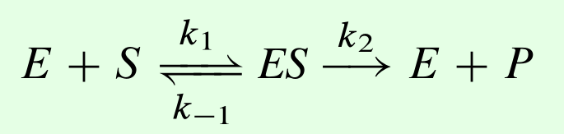
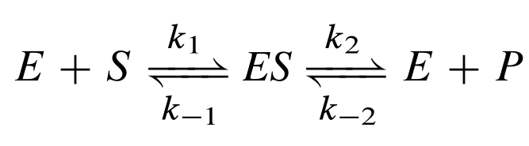
Enzyme Mechanism

Slide 15
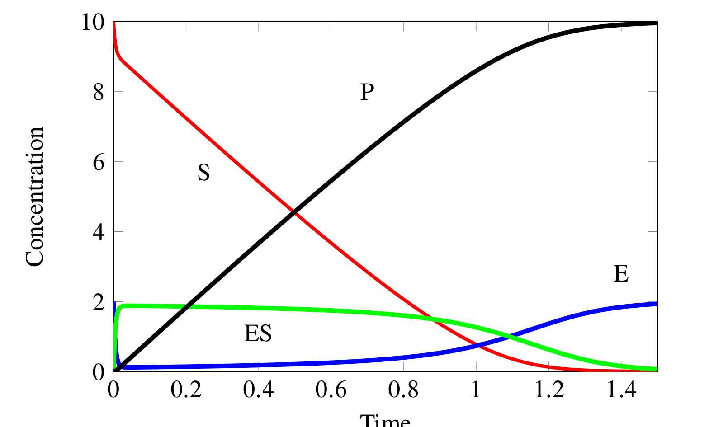
Time Course for Enzyme Catalysis

Slide 16
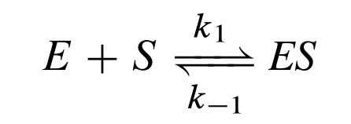
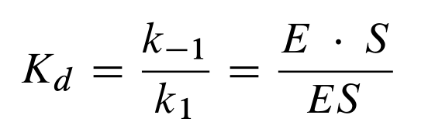
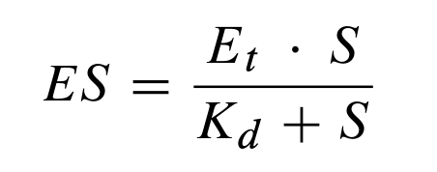
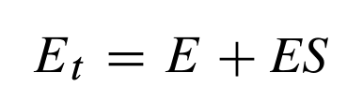
Derivation

Slide 17
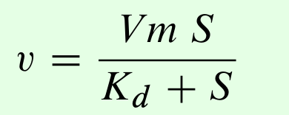
We end up with the Michaelis-Menten Equation

Slide 18
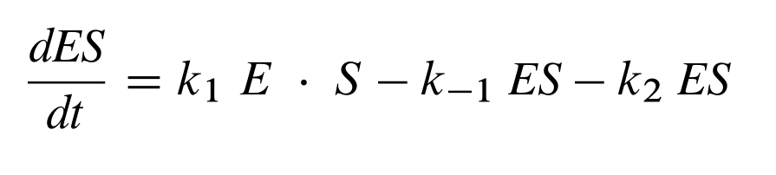
We can also assume steady-state instead

Slide 19
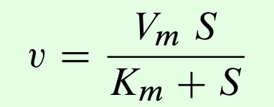
Obtain a Similar Equation

Slide 20
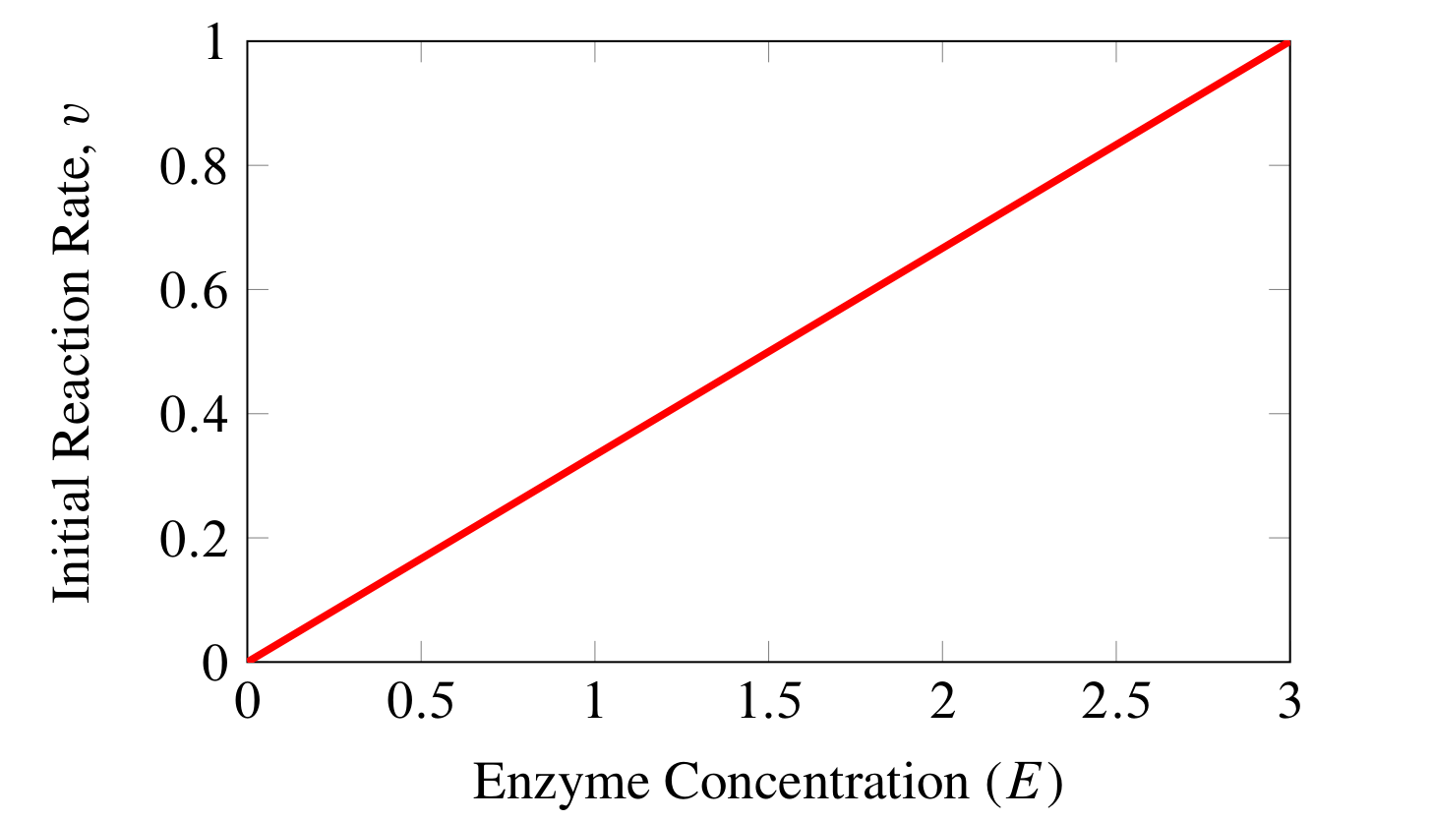
Basic Properties: v versus E

Slide 21
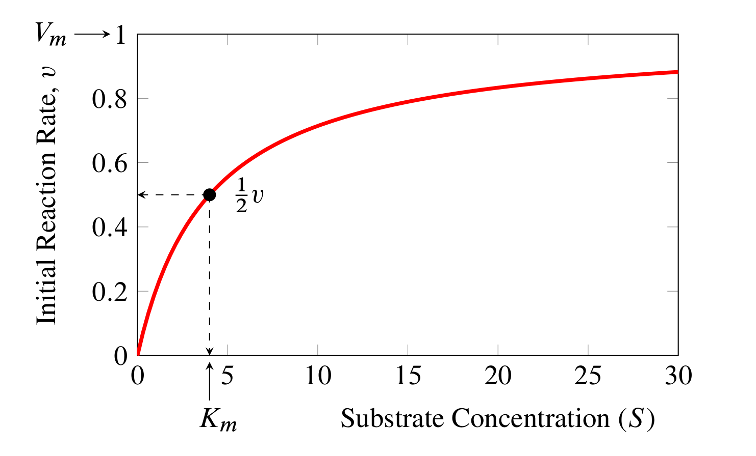
Basic Properties: v versus S

Slide 22
Avoid the Irreversible Case
Where possible, avoid the irreversible Michaelis-Menten rate law, it’s not realistic.
This is particularly the case for metabolism where almost
no reaction is fully irreversible or has no product inhibition.

Slide 23
Reversible Enzyme Rate Law

Slide 24
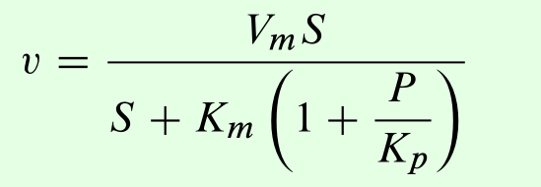
An Alternative: Product Inhibition
If you can’t use the reversible version, use this one instead (it models competitive inhibition by the product):

Slide 25
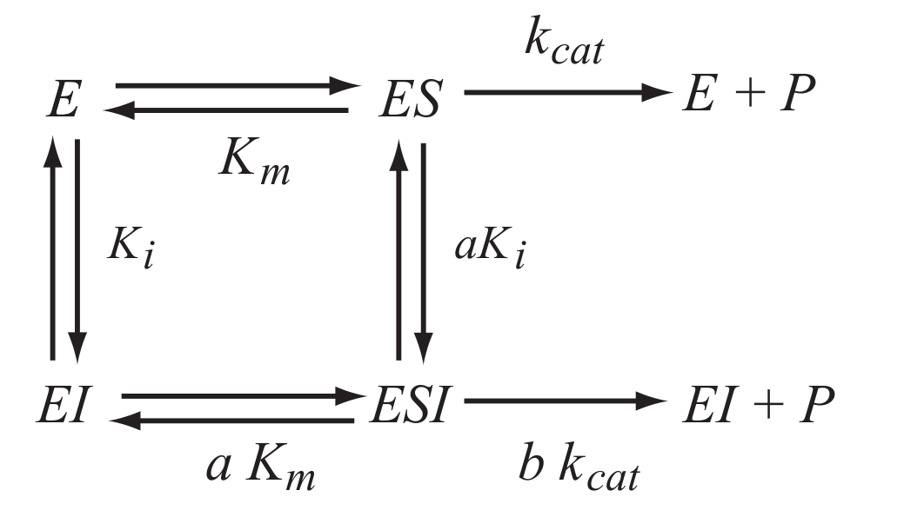
Simple Inhibition

Slide 26
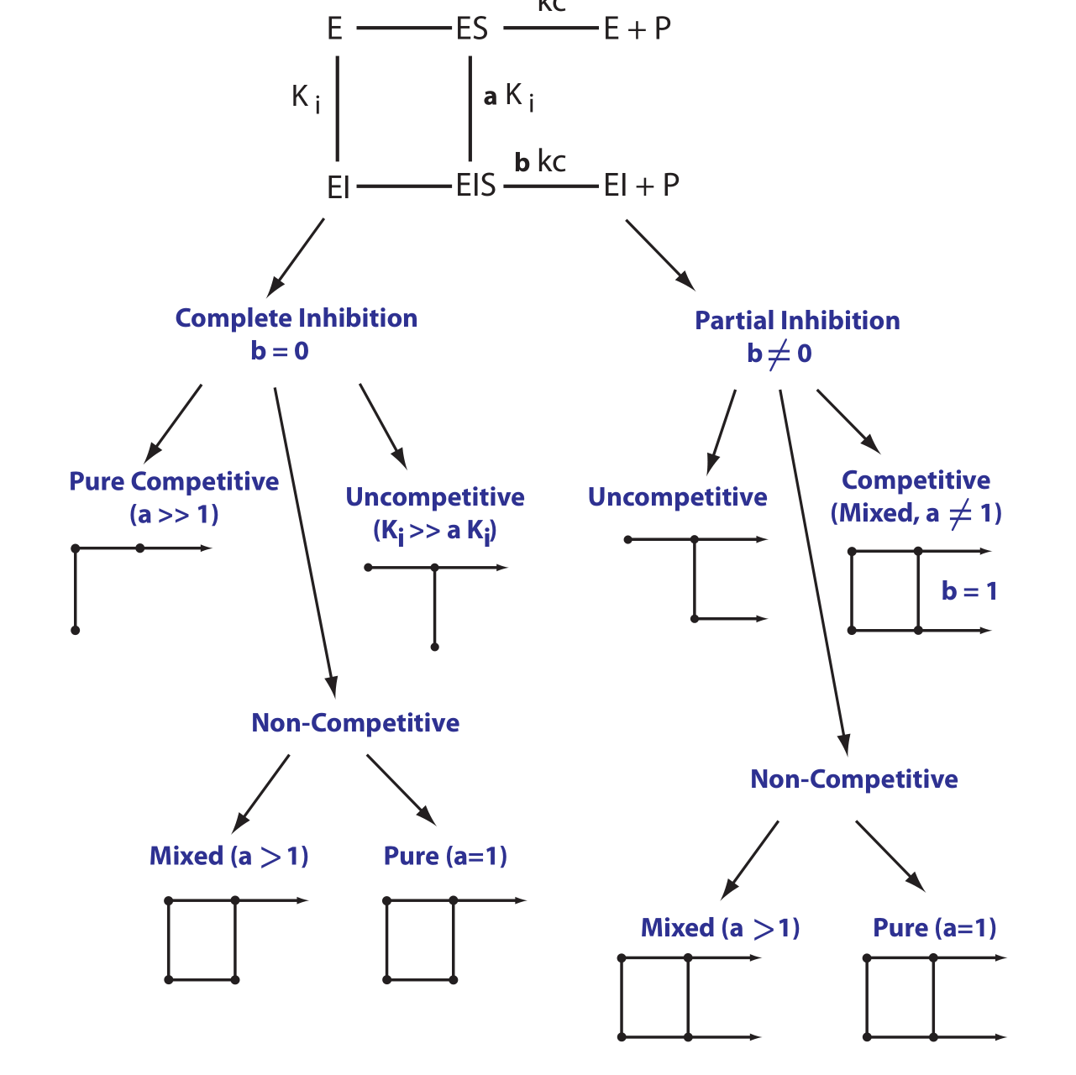
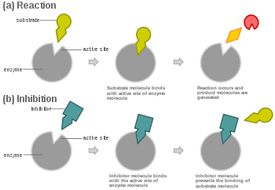
Family of Inhibition Types
Wikipedia

Slide 27
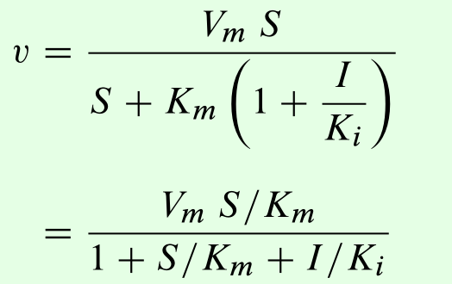
Competitive Inhibition

Slide 28
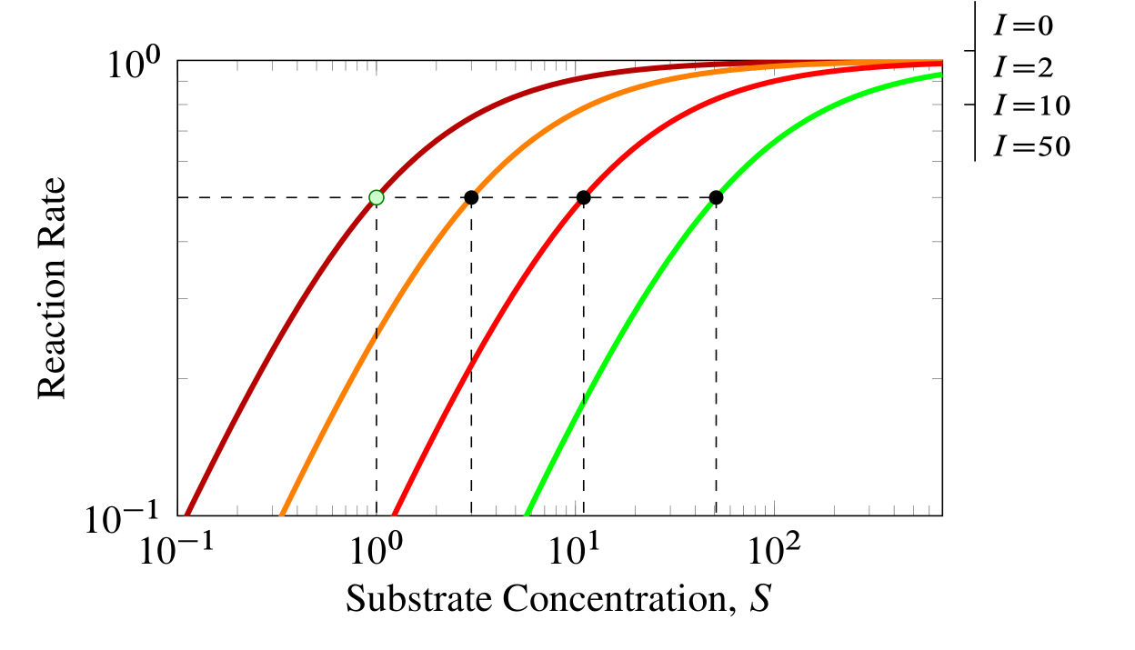
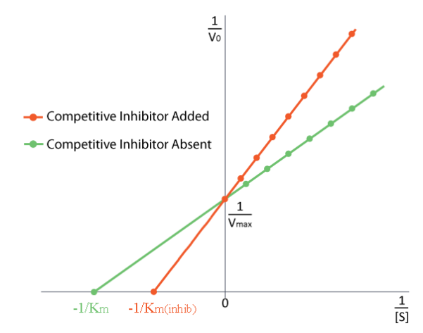
Competitive Inhibition

Slide 29
Enzyme Kinetics
Michaelis-Menten type Kinetics
Hill Based Cooperativity Kinetics
Mass-Action Kinetics
Rate Laws
MWC or KNF
Approximations: Power law or linlog
Generalized Enzyme Kinetic Laws
Hanekom or Liebermeister

Slide 30
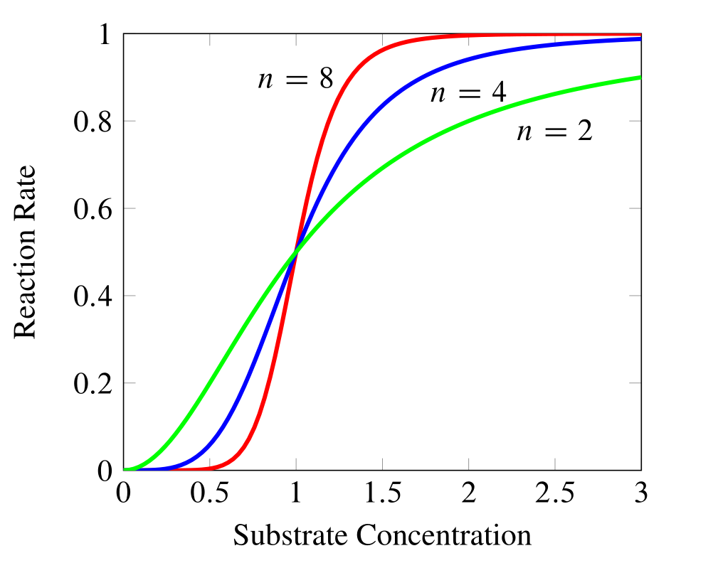

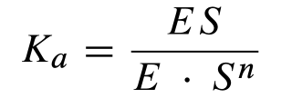

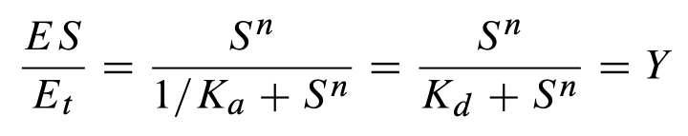
Sigmoidal Behavior: Hill Equation
Hill Equation

Slide 31
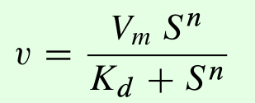
Sigmoidal Behavior

Slide 32
Enzyme Kinetics
Michaelis-Menten type Kinetics
Hill Based Cooperativity Kinetics
Mass-Action Kinetics
Rate Laws
MWC or KNF
Approximations: Power law or linlog
Generalized Enzyme Kinetic Laws
Hanekom or Liebermeister

Slide 33
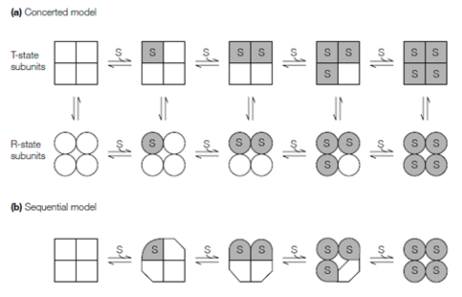
Sigmoidal Behavior: Monod Wyman Changeux and Koshland Models
Protein Structure and Function

Slide 34
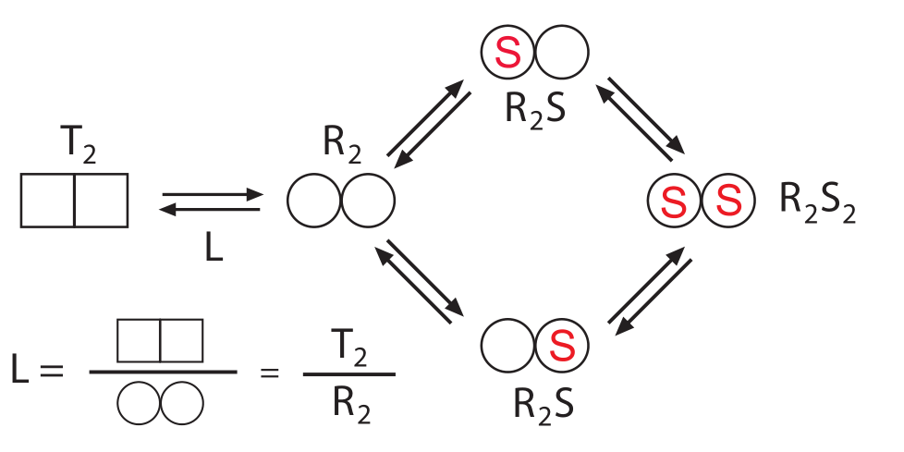
Sigmoidal Behavior: Monod Wyman Changeux Model

Slide 35
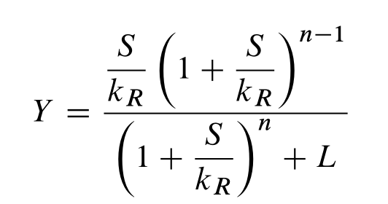
Sigmoidal Behavior: Monod Wyman Changeux Model
For a protein with n subunits
kR = microscopic dissociation constant
L = equilibrium constant between the tense and relaxed states.

Slide 36
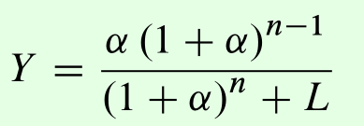
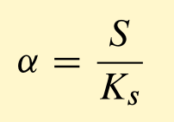
Sigmoidal Behavior: Monod Wyman Changeux Model
Normally written as
n = number of subunits
L = equilibrium constant between the tense and relaxed states.

Slide 37
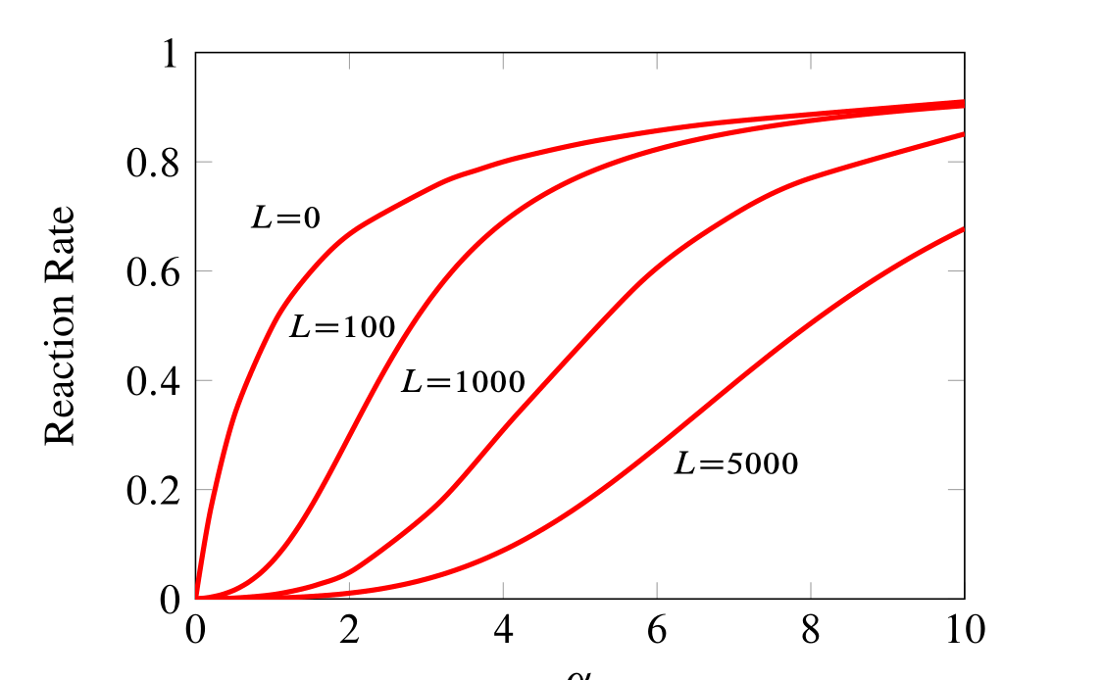
Sigmoidal Behavior: Monod Wyman Changeux Model

Slide 38
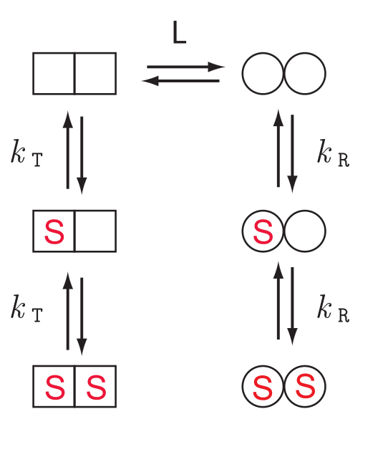
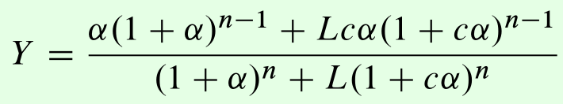
Sigmoidal Behavior: Monod Wyman Changeux Model

Slide 39
Enzyme Kinetics
Michaelis-Menten type Kinetics
Hill Based Cooperativity Kinetics
Mass-Action Kinetics
Rate Laws
MWC or KNF
Approximations: Power law or linlog
Generalized Enzyme Kinetic Laws
Hanekom or Liebermeister

Slide 40
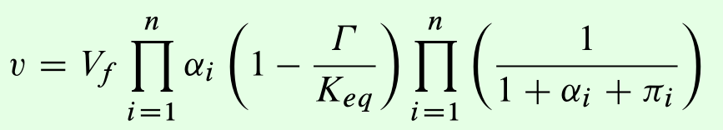

With so many rate laws what should we use?
Rohwer, J. M., A. J. Hanekom, and J. H. Hofmeyr. 2007. p. 175–187. In: Proc. 2nd Int. Symp. on Experimental Standard Conditions of Enzyme Characterizations (ESEC 2006) . Beilstein Institute, Frankfurt am Main, Germany
Generalized Hanekom Rate Laws

Slide 41


With so many rate laws what should we use?
Generalized Hanekom Cooperativity Rate Laws

Slide 42

With so many rate laws what should we use?
Generalized Hill Equation with activators and inhibitors
Hofmeyr, J.-H., and A. Cornish-Bowden. 1997. Comput Appl Biosci 13 (4):377–385.
A -> B

Slide 43





With so many rate laws what should we use?
Liebermeister Rate Laws
Liebermeister, W., J. Uhlendorf, and E. Klipp. 2010. Bioinformatics 26 (12):1528.
Thermodynamic Term
Non-Allosteric Regulation
Saturation Term
Allosteric Regulation

Slide 44
Do Exercises 1 and 2

Slide 45
Return to Discuss

Slide 46
Do Exercises 3 and 4

Slide 47
Return to Discuss

Slide 48

Steady State
This model was one we tried in Exercise 2 and it yielded the following solution:
r = te.loada("""
$S1 -> S2; k1*S1
S2 -> ; Vm2*S2/(Km + S2)
k1 = 0.1
S1 = 10
Vm2 = 0.5; Km = 0.5
""")
S1 appears to be trending to infinity

Slide 49
Steady State
Because the concentration doesn’t appear to be settling down, we say that the model doesn’t have a steady-state. Tellurium has a quick way to compute the steady-state by using the command:
r.steadyState()
However if you run this command, you’ll get the nasty error:
Traceback (most recent call last):
File "<ipython-input-46-453beb662922>", line 1, in <module>
r.steadyState()
File "C:\Tellurium-Winpython-3.7\python-3.7.7.amd64\lib\site-packages\roadrunner\roadrunner.py", line 3511, in steadyState
return _roadrunner.RoadRunner_steadyState(self, dict)
RuntimeError: Possible negative concentrations in solution (NLEQ)

Slide 50
Steady State
Errors from the steady-state solver usually mean the model has no steady-state, here is the model from Exercise 4. Let’s try calling r.steadyState(), another nasty error.
r = te.loada("""
$S1 -> S2; k1*S1
S2 -> S3; k2*S2
S3 -> S4; k3*S1
S4 -> ; k4*S4
k1 = 0.1; k2 = 0.2; k3 = 0.5; k4 = 1.3
S1 = 10
""")
RuntimeError: Jacobian matrix singular in NLEQ. Failed to converge to steady state. Check if Jacobian matrix is non-invertible or steady state solution does not exist.

Slide 51
Steady State
r = te.loada("""
$S1 -> S2; k1*S1
S2 -> S3; k2*S2
S3 -> S4; k3*S3
S4 -> ; k4*S4
k1 = 0.1; k2 = 0.2; k3 = 0.5; k4 = 1.3
S1 = 10
""")
print ('Distance from steady state = ', r.steadyState()
With the model fixed we now find a steady-state
Distance from steady state = 3.1401849173675503e-16

Slide 52




Steady State

Slide 53

Steady State

Slide 54



Deriving the Steady State Algebraically

Slide 55
Applying Perturbations in Tellurium
import tellurium as te
import numpy
r = te.loada ('''
# Model Definition
v1: $Xo -> S1; k1*Xo;
v2: S1 -> $w; k2*S1;
# Initialize constants
k1 = 1; k2 = 1; S1 = 15; Xo = 1;
''')
# Time course simulation
m1 = r.simulate (0, 15, 100, ["Time", "S1"]);
r.k1 = r.k1 * 6;
m2 = r.simulate (15, 40, 100, ["Time", "S1"]);
r.k1 = r.k1 / 6;
m3 = r.simulate (40, 60, 100, ["Time", "S1"]);
m = numpy.vstack ((m1, m2, m3)); # Merge data
r.plotArray (m, labels=["S1"])
m1
m
m2
vstack ((m1, m2)) -> m
(augment by row)
Selection list

Slide 56
Applying Perturbations: Easy Way
import tellurium as te
import numpy
r = te.loada ('''
# Model Definition
v1: $Xo -> S1; k1*Xo;
v2: S1 -> $w; k2*S1;
# Initialize constants
k1 = 1; k2 = 1; S1 = 15; Xo = 1;
at time > 15: k1 = k1*6
at time > 40: k1 = k1/6
''')
# Time course simulation
m = r.simulate (0, 60, 100, ["Time", "S1"]);
r.plot()

Slide 57

Perturbations to Parameters

Slide 58

plotArray (array, labels)
plotArray accepts a set of columns of data and uses the first column as the x variable and the remaining columns for the y axis.
import tellurium as te
te.plotArray (m, labels=[‘S1’, ‘S2’])

Slide 59


An Easier Way: Specifying Events
import tellurium as te
r = te.loada ('''
$Xo -> S1; k1*Xo;
S1 -> $X1; k2*S1;
k1 = 0.2; k2 = 0.4; Xo = 1; S1 = 0;
at (time > 20): S1 = S1 + 0.35
''')
# Simulate the first part up to 20-time units
m = r.simulate (0, 50, 100)
r.plot()

Slide 60
Solving ODEs
What if you only have a set of ODEs, such as:
dy/dt = -k*y
r = te.loada ('''
y' = -k*y; # Note the apostrophe
y = 1; k = 0.2;
''')
m = r.simulate (0, 50, 100)
r.plot()

Slide 61
Simulate the Chaotic Lorenz System
Simulate the Lorenz System.
dx/dt = sigma*(y – x)
dy/dt = x*(rho – z) – y
dz/dt = x*y – beta*z
x = 0.96259; y = 2.07272; z = 18.65888;
sigma = 10; rho = 28; beta = 2.67;
Simulate t=0 to t=20
http://en.wikipedia.org/wiki/Lorenz_system

Slide 62

Solving ODEs
import tellurium as te
r = te.loada ('''
x' = sigma*(y - x);
y' = x*(rho - z) - y;
z' = x*y - beta*z;
x = 0.96259; y = 2.07272; z = 18.65888;
sigma = 10; rho = 28; beta = 2.67;
''')
result = r.simulate (0, 20, 1000, ['time', 'x', 'y', 'z'])
r.plot (result)

Slide 63

Parameter Scans
import tellurium as te, numpy as np
r = te.loada ('''
J1: $X0 -> S1; k1*X0;
J2: S1 -> $X1; k2*S1;
X0 = 1.0; S1 = 0.0; X1 = 0.0;
k1 = 0.4; k2 = 2.3;
'‘’)
m = r.simulate (0, 4, 100, ["Time", "S1"])
label = ['k1=' + str (r.k1)]
for i in range (0,4):
r.k1 = r.k1 + 0.1
label.append ('k1=' + "{:.1f}".format(r.k1))
r.reset()
m = np.hstack ((m, r.simulate (0, 4, 100, ['S1'])))
te.plotArray (m, labels=label)

Slide 64

Parameter Scans: An Easier Way
Simple Parameter Scans
import tellurium as te
import teUtils
r = te.loada ('''
J1: $X0 -> S1; k1*X0;
J2: S1 -> $X1; k2*S1;
X0 = 1.0; S1 = 0.0; X1 = 0.0;
k1 = 0.4; k2 = 2.3;
'‘’)
teUtils.parameterScanning.simpleTimeCourseScan (r, 'k1', 'S1', 0.4, 0.8, 5, timeEnd=4, formatStr='{:.1f} ')

Slide 65

Parameter Scans: An Easier Way
import tellurium as te, numpy as np, teUtils
r = te.loada ('''
// Reactions:
J0: $X0 => S1; (VM1*(X0 - S1/Keq1))/(1 + X0 + S1 + S4^h);
J1: S1 => S2; (10*S1 - 2*S2)/(1 + S1 + S2);
J2: S2 => S3; (10*S2 - 2*S3)/(1 + S2 + S3);
J3: S3 => S4; (10*S3 - 2*S4)/(1 + S3 + S4);
J4: S4 => $X1; (V4*S4)/(KS4 + S4);
// Species initializations:
S1 = 0; S2 = 0;
S3 = 0; S4 = 0;
X0 = 10; X1 = 0;
// Variable initializations:
VM1 = 10; Keq1 = 10;
h = 1; V4 = 2.5;
KS4 = 0.5;
''')
teUtils.parameterScanning.simpleTimeCourseScan (r, 'h', 'S1', 1, 8, 8, timeEnd=20, formatStr='{:.1f}')

Slide 66
Do Exercise 5

Slide 67
End of First Session

