Slide 1
Exercises 1, 2, 3, 4 and 5 : Day 2 Morning

Slide 2
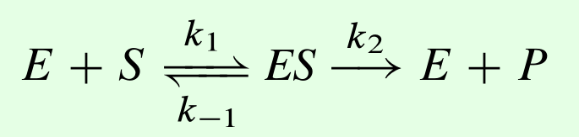
Exercise 1
Build a model to simulate the kinetics of a simple irreversible enzyme. Assume the following values for the parameters and initial value for E and S:
k1 = 20, k_1 = 1, k2 = 10, E = 2; S = 10
Run the simulation from 0 to 2 time units, you should see the
plots shown in slide 9.

Slide 3
Exercise 1
Using the enzyme model, speed up or slow down the binding and unbinding of substrate to enzyme.
Set k1 = 2 and k_1 = 0.1, does it take longer or shorter
time to reach steady state?
Set k1= 2000 and k_1 = 100, does that change anything?

Slide 4
Exercise 1
Name the reaction ES -> E + P and plot the rate of production of P against time. See slide 5 for a clue.
Eg
J2: ES -> E + P; k2*ES

Slide 5
Debugging Models: Exercise 2
Just like software, models can also have bugs. Run this model, what do you observe? Try running for a 1000 time unit., There a bug in the model. can you figure what it is?
r = te.loada("""
$S1 -> S2; k1*S1
S2 -> ; Vm2*S2/(Km + S2)
k1 = 0.1
S1 = 10
Vm2 = 0.5; Km = 0.5
""")
Don’t forget to import tellurium if you haven’t done so:
import tellurium as te
Don’t forget the dollar symbol to indicate a fixed species!

Slide 6
Debugging Models: Exercise 2
What is the error caused by and how would you fix it?
Hint: there are at least two ways to fix this error
Bugs can occur for at least two reasons:
The model is physically impossible
There a mistake (typo) in the model that make it behave incorrectly

Slide 7
Debugging Models: Exercise 3
Try this model, this has a mistake in it
r = te.loada("""
$S1 -> S2; k1*S1
S2 -> S3; k2
S3 -> S4; k3*S3
S4 -> ; k4*S4
k1 = 0.1; k2 = 0.2; k3 = 0.5; k4 = 1.3
S1 = 10
""")
m = r.simulate (0, 20, 100)
r.plot()
What is the error caused by and how would you fix it?

Slide 8
Debugging Models: Exercise 4
Try this model, the bug in this model is perhaps less easy to spot
r = te.loada("""
$S1 -> S2; k1*S1
S2 -> S3; k2*S2
S3 -> S4; k3*S1
S4 -> ; k4*S4
k1 = 0.1; k2 = -0.2; k3 = 0.5; k4 = 1.3
S1 = 10
""")
m = r.simulate (0, 20, 100)
r.plot()
What is the error caused by and how would you fix it?

Slide 9
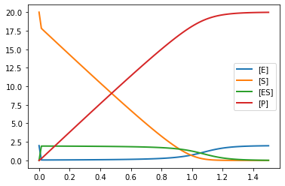
Expected plot for Ex. 1

Slide 10
Exercise 5: Parameter Scan
import tellurium as te, roadrunner, teUtils
import matplotlib.pyplot as plt
r = te.loada("""
$Xo -> S1; k1*Xo
S1 -> S2; k2*S1
S2 -> S3; k3*S2
S3 -> $S4; k4*S3
k1 = 0.1; k2 = 0.2; k3 = 0.15; k4 = 0.4;
Xo = 10
""")
for k in r.getGlobalParameterIds():
for S in r.getFloatingSpeciesIds():
teUtils.parameterScanning.simpleTimeCourseScan (r, k, S, 1, 8, 8, timeEnd=20, formatStr='{:.1f}')
plt.show()
Before running this script, discuss
what you think it will do

