Slide 1
BIOE 498 / BIOE 599 Biomedical Control Systems Engineering
Joseph L. Hellerstein
March, 2025
eScience Institute, Computer Science & Engineering
Allen School of Computer Science
BioEngineering
Notes:
Diverse students. Some with bio-backgrounds; some without. Some with CS background; some with very limited. Two separate courses combined because of a substantial shared curriculum.

Slide 2

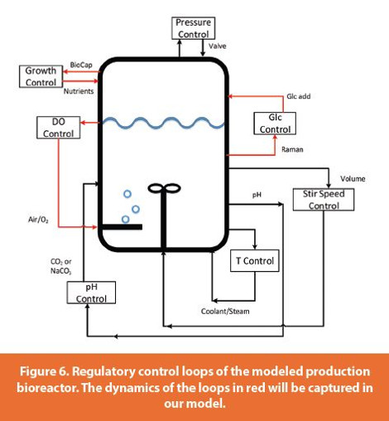
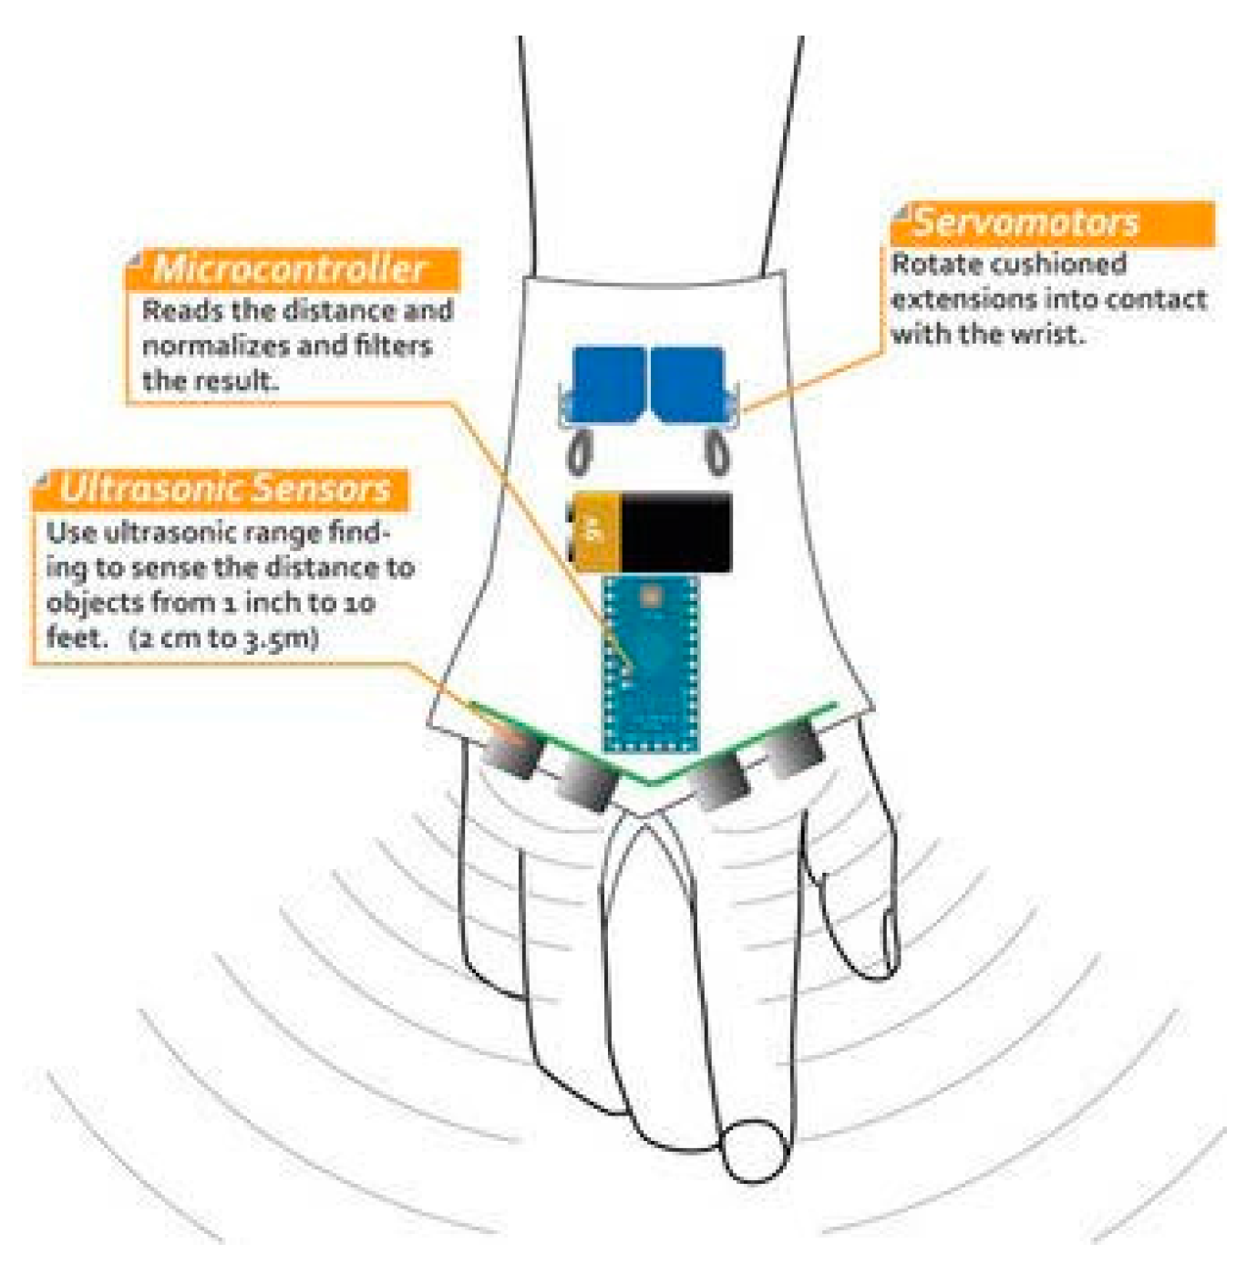
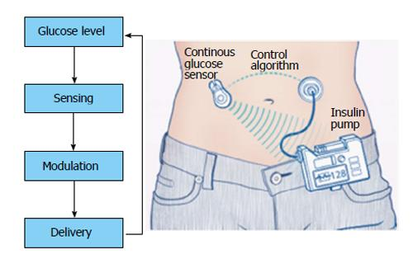



BIOEN 498/599: Biomedical Control Systems Engineering
Winter, 2025. MW 2:30-3:50.
Instructor: Joseph L. Hellerstein, Senior Fellow (eScience Institute), Affiliate Professor (Allen School of Computer Science)
jlheller@uw.edu
Bioreactor Control
Medical Device Control
Insulin Control
Closed loop design (control engineering) is essential to building robust systems from biochemical pathways and other open loop biological components that: regulate outputs to a setpoint; ensure stability; and minimize oscillations. This course teaches the essentials of closed loop design using mechanistic models of biochemical systems. Students will acquire the following skills:
determine appropriate control objectives for a closed loop system;
characterize the time domain behavior of a biological system;
develop closed loop architectures that make use of PID controllers, filters, and techniques for compensating biochemical systems;
computational techniques for finding designs that satisfy control objectives.
Students should have prior experience with programming in python (e.g., BIOEN 336, 437/537).

Slide 3



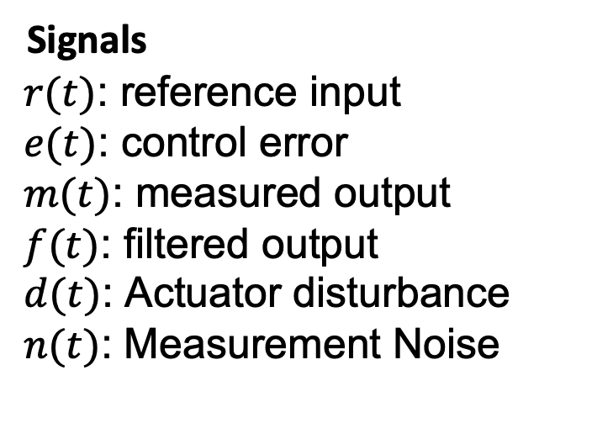









Control Architecture
Actuator
Disturbance
Measurement
Noise
$$d(t)$$
$$n(t)$$
$$e(t)$$
$$y(t)$$
$$r(t)$$
Controller
$$u(t)$$
C
m$(t)$
+
+
$$OLS$$
+
$$−$$
m$(t)$
f$(t)$
$$Filter$$
Signals
$r(t)$: reference input
$e(t)$: control error
$m(t)$: measured output
$f(t)$: filtered output
$d(t)$: Actuator disturbance
$n(t)$: Measurement Noise
Systems
Open loop system (OLS)
Controller
Filter
C (compensation)
Notes:
Why doesn’t a filter help with measurement noise? Verify transfer functions.

Slide 4
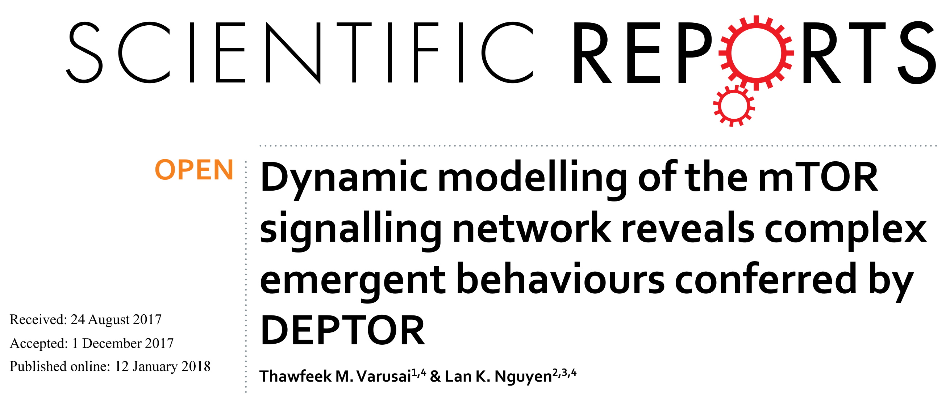
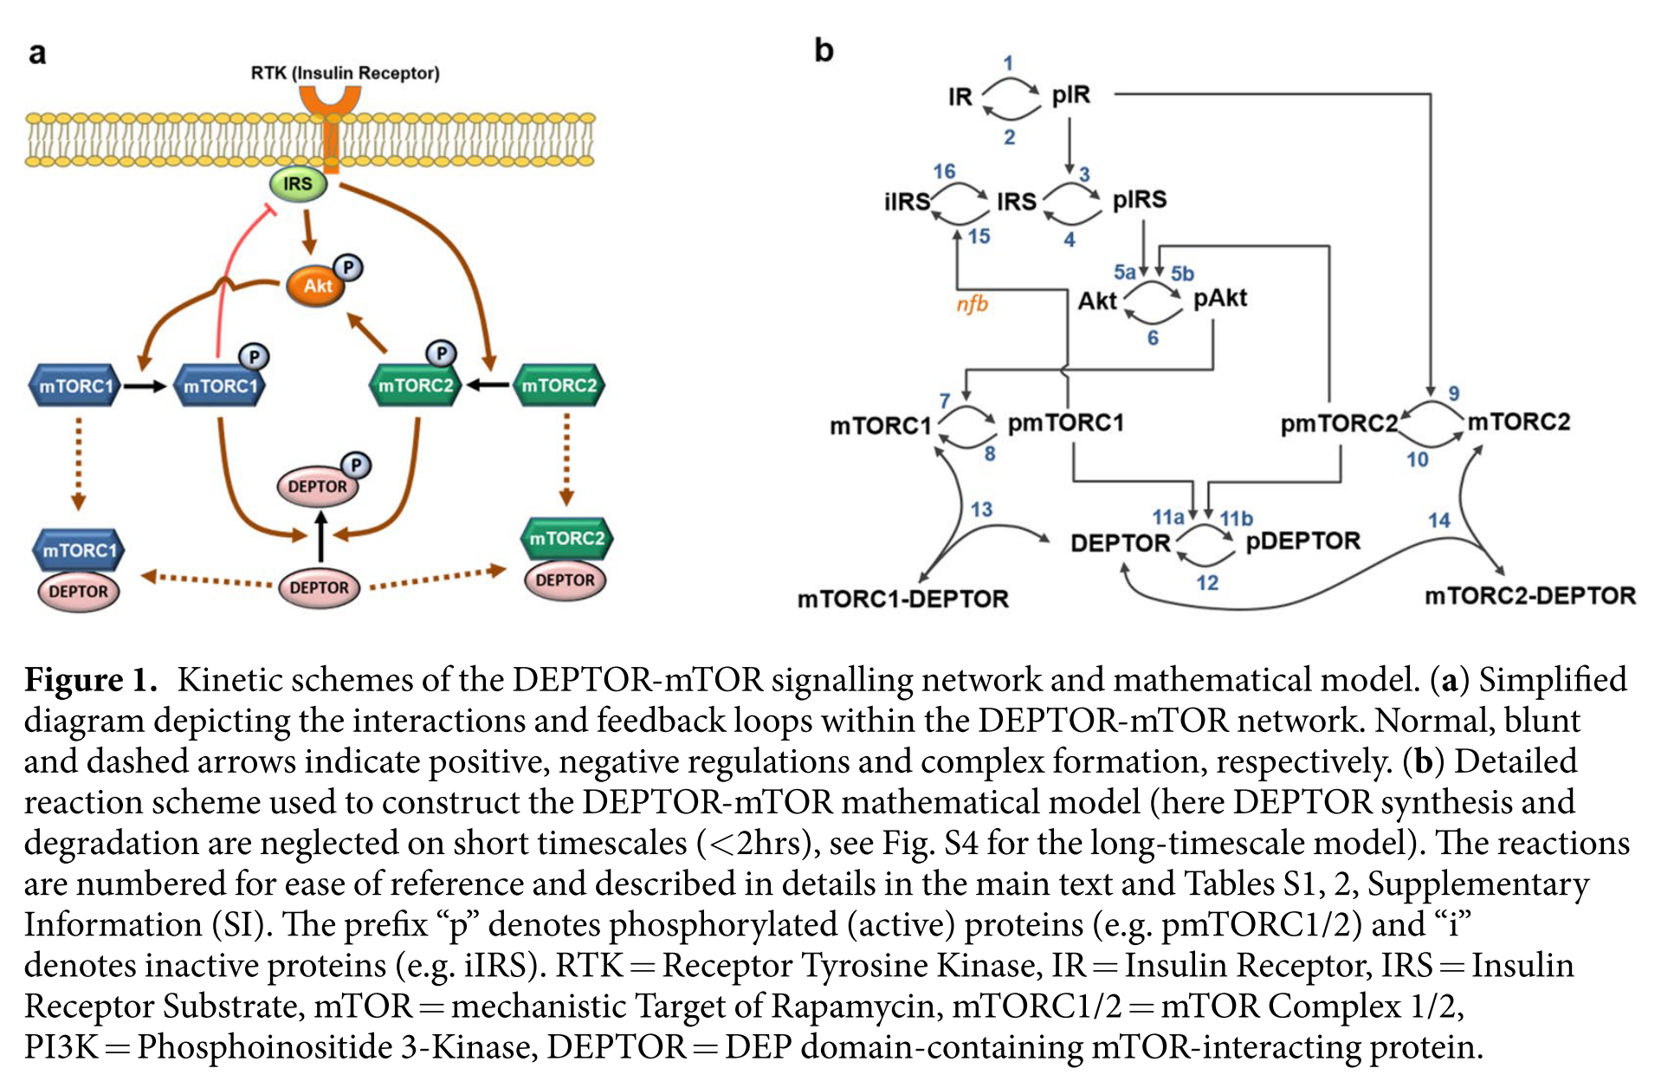
An OLS: mTOR Signaling

Slide 5
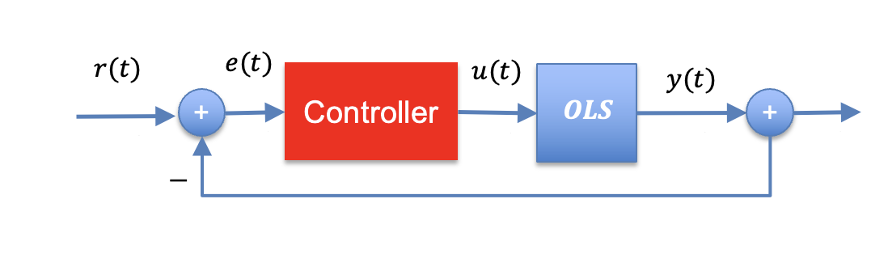

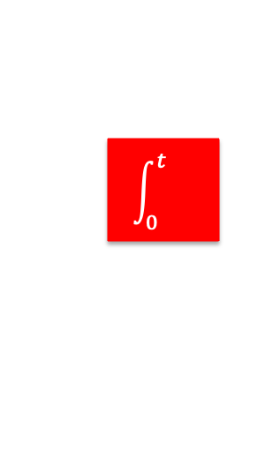















Common Controllers
PI Control
$$k_{P}$$
$$e(t)$$
$$u(t)$$
$$u(t)$$
$$k_{P}$$
$$e(t)$$
+
$$\int_{0}^{t}{}$$
$$k_{I}$$
P Control
$$K_{p}$$
PID Control
PI Control
$$k_{P}$$
$$e(t)$$
$$\int_{0}^{t}{}$$
$$k_{I}$$
$$u(t)$$
$$K_{p}$$
+
$$\frac{d}{dt}$$
$$k_{D}$$

Slide 6
Syllabus
Concepts (2 lectures)
Control objectives, controller architecture, design
Testbed construction (5 lectures)
Python review, building controllers w/Antimony,
controllability analysis
Theory (5 lectures)
Transfer function properties as they relate to
control objectives, deriving transfer functions for Antimony models, system identification
Root Locus (RL) analysis (4 lectures)
Interpreting RL plots, designing P-control with RL,
designing PID control with RL
Closing (3 lectures)
Summary of control engineering, student presentations of final projects

