Slide 1
BIOE 498 / BIOE 599 Advanced Biological Control Systems Lecture 2: Modeling Reaction Networks
Joseph L. Hellerstein
eScience Institute, Computer Science & Engineering
Allen School of Computer Science
BioEngineering
Notes:
Diverse students. Some with bio-backgrounds; some without. Some with CS background; some with very limited. Two separate courses combined because of a substantial shared curriculum.

Slide 2
Agenda
What is a reaction network (kinds of elements)
Concepts
Reaction, parameter, compartment
Kinetics
Relate reaction network to a system of nonlinear differential equations
BioModels

Slide 3
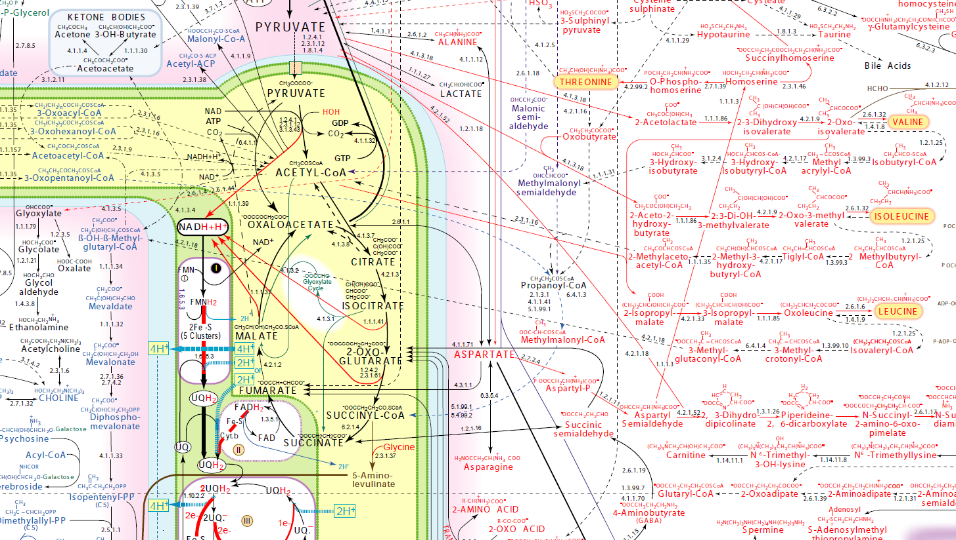
Detailed Metabolic Network
http://www.iubmb-nicholson.org/chart.html

Slide 4

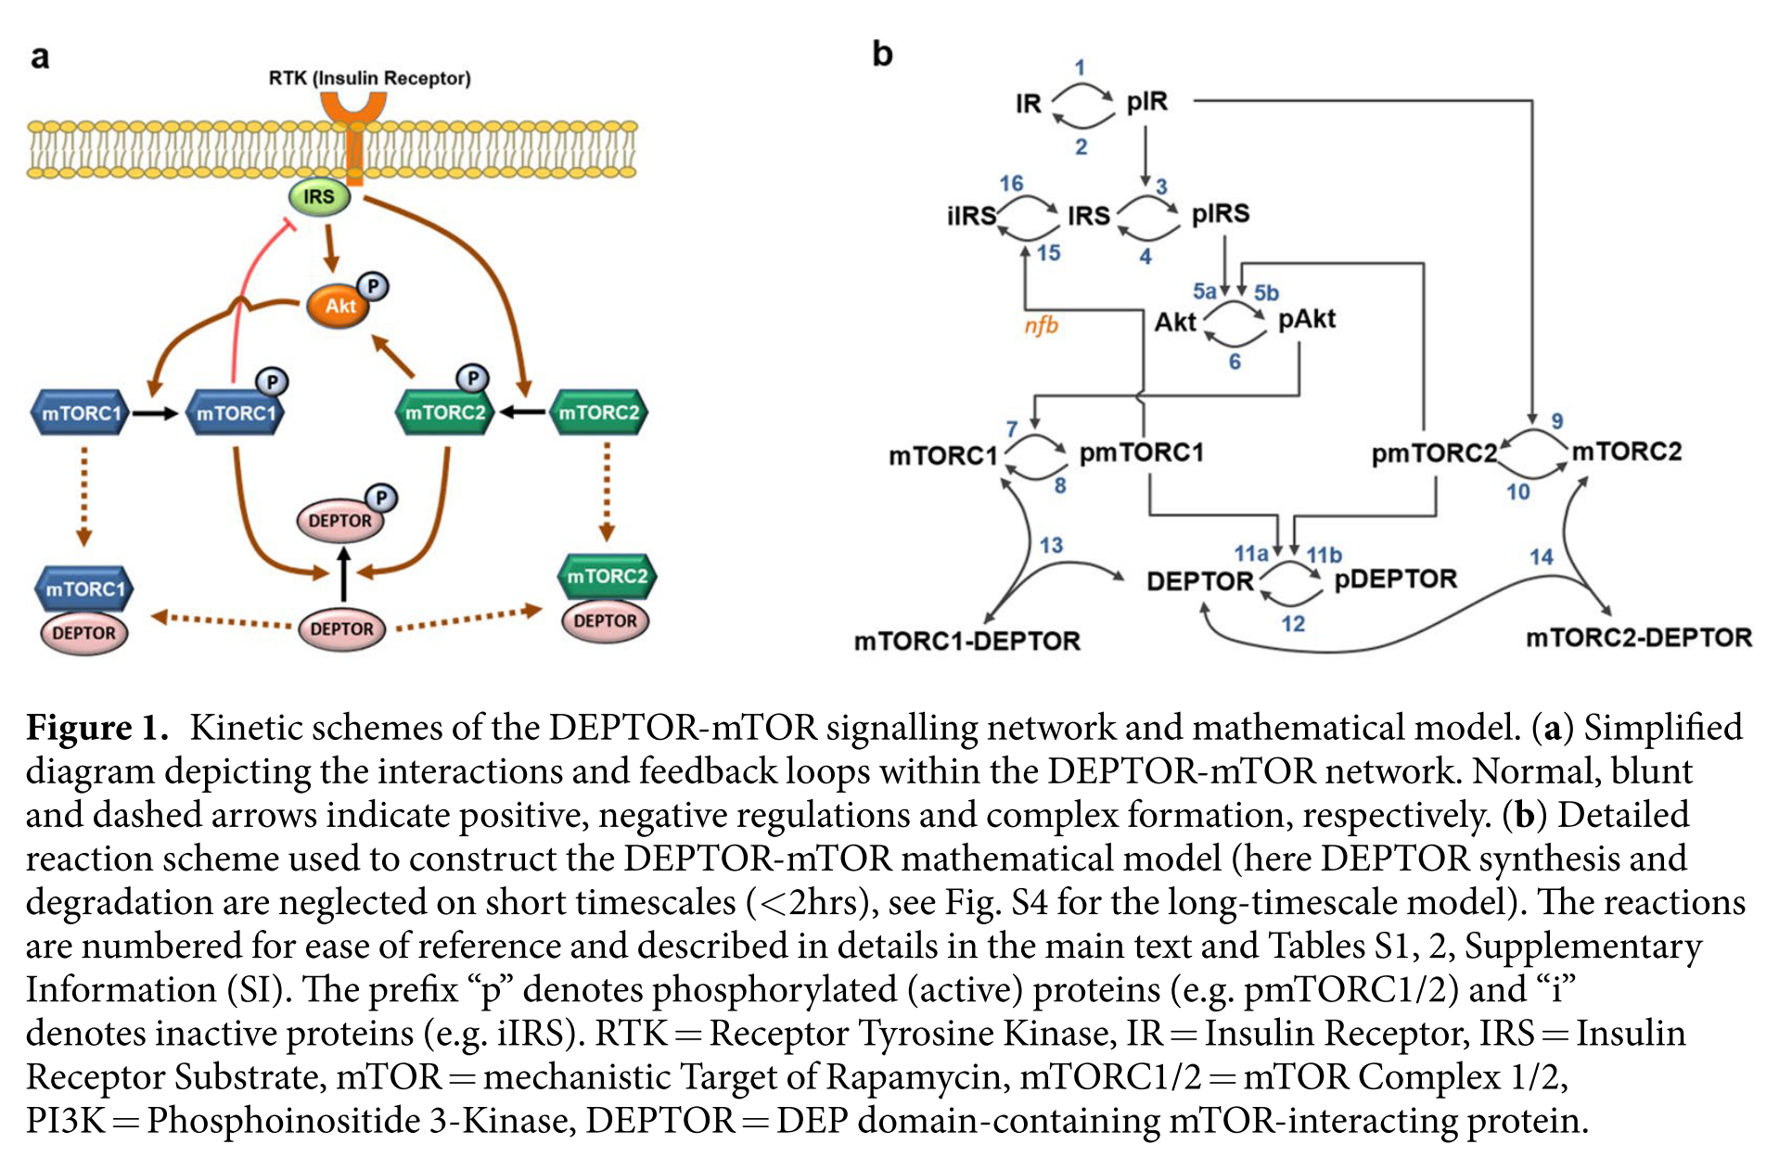
An Example: mTOR Signaling

Slide 5
Modeling mTOR Signaling
v1: IR => pIR; compartment_*Henri_Michaelis_Menten__irreversible(IR, Km1, V1);
v2: pIR => IR; compartment_*Henri_Michaelis_Menten__irreversible(pIR, Km2, V2);
v3: IRS => pIRS; compartment_*HMM_Mod(k3c, IRS, pIR, Km3);
v4: pIRS => IRS; compartment_*Henri_Michaelis_Menten__irreversible(pIRS, Km4, V4);
v5: Akt => pAkt; compartment_*Function_for_v5(k5ca, pIRS, Akt, Km5a, k5cb, pmTORC2, Km5b);
v6: pAkt => Akt; compartment_*Henri_Michaelis_Menten__irreversible(pAkt, Km6, V6);
v7: mTORC1 => pmTORC1; compartment_*HMM_Mod(k7c, mTORC1, pAkt, Km7); v8: pmTORC1 => mTORC1; compartment_*Henri_Michaelis_Menten__irreversible(pmTORC1, Km8, V8); v9: mTORC2 => pmTORC2; compartment_*HMM_Mod(k9c, mTORC2, pIR, Km9); v10: pmTORC2 => mTORC2; compartment_*Henri_Michaelis_Menten__irreversible(pmTORC2, Km10, V10); v11: DEPTOR => pDEPTOR; compartment_*Function_for_v11(k11ca, pmTORC1, DEPTOR, Km11a, pDEPTOR, k11cb, pmTORC2, Km11b); v12: pDEPTOR => DEPTOR; compartment_*Henri_Michaelis_Menten__irreversible(pDEPTOR, Km12, V12); v13: mTORC1 + DEPTOR -> mTORC1_DEPTOR; compartment_*(k13f*mTORC1*DEPTOR - k13r*mTORC1_DEPTOR); v14: mTORC2 + DEPTOR -> mTORC2_DEPTOR; compartment_*(k14f*mTORC2*DEPTOR - k14r*mTORC2_DEPTOR); v15: IRS => iIRS; compartment_*HMM_Mod(k15c, IRS, pmTORC1, Km15);
v16: iIRS => IRS; compartment_*Henri_Michaelis_Menten__irreversible(iIRS, Km16, V16); v17: => DEPTOR; compartment_*Constant_flux__irreversible(ks17); v18: pDEPTOR => ; compartment_*kd18*pDEPTOR;

Slide 6
Modeling mTOR Signaling
v1: IR => pIR; compartment_*Henri_Michaelis_Menten__irreversible(IR, Km1, V1); v2: pIR => IR; compartment_*Henri_Michaelis_Menten__irreversible(pIR, Km2, V2); v3: IRS => pIRS; compartment_*HMM_Mod(k3c, IRS, pIR, Km3); v4: pIRS => IRS; compartment_*Henri_Michaelis_Menten__irreversible(pIRS, Km4, V4); v5: Akt => pAkt; compartment_*Function_for_v5(k5ca, pIRS, Akt, Km5a, k5cb, pmTORC2, Km5b); v6: pAkt => Akt; compartment_*Henri_Michaelis_Menten__irreversible(pAkt, Km6, V6); v7: mTORC1 => pmTORC1; compartment_*HMM_Mod(k7c, mTORC1, pAkt, Km7); v8: pmTORC1 => mTORC1; compartment_*Henri_Michaelis_Menten__irreversible(pmTORC1, Km8, V8); v9: mTORC2 => pmTORC2; compartment_*HMM_Mod(k9c, mTORC2, pIR, Km9); v10: pmTORC2 => mTORC2; compartment_*Henri_Michaelis_Menten__irreversible(pmTORC2, Km10, V10); v11: DEPTOR => pDEPTOR; compartment_*Function_for_v11(k11ca, pmTORC1, DEPTOR, Km11a, pDEPTOR, k11cb, pmTORC2, Km11b); v12: pDEPTOR => DEPTOR; compartment_*Henri_Michaelis_Menten__irreversible(pDEPTOR, Km12, V12); v13: mTORC1 + DEPTOR -> mTORC1_DEPTOR; compartment_*(k13f*mTORC1*DEPTOR - k13r*mTORC1_DEPTOR); v14: mTORC2 + DEPTOR -> mTORC2_DEPTOR; compartment_*(k14f*mTORC2*DEPTOR - k14r*mTORC2_DEPTOR); v15: IRS => iIRS; compartment_*HMM_Mod(k15c, IRS, pmTORC1, Km15); v16: iIRS => IRS; compartment_*Henri_Michaelis_Menten__irreversible(iIRS, Km16, V16); v17: => DEPTOR; compartment_*Constant_flux__irreversible(ks17); v18: pDEPTOR => ; compartment_*kd18*pDEPTOR;

