Slide 1
Detecting Structurally Equivalent Chemical Reaction Networks

Slide 2
Notes
Define structurally identical. Relate to CRN lit.
Simple algorithm
June 9, 10,000. strong insight.
Computational complexity: theory, actuality. Time/num permutation vs. %clustered
Algorithm

Slide 3





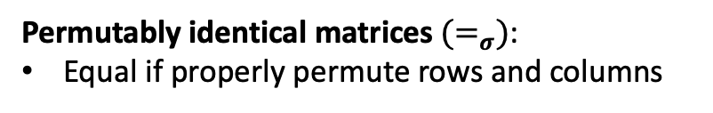



























(a)
$$R_{1}: A→B$$
$$R_{1}^{′}: Y→X$$
(c)
$$R_{1}^{′′}:T→S$$
$$R_{2}: B→A$$
$$R_{2}^{′}: →X$$
$$R_{2}^{′′}:S→$$
$$R_{3}: →B$$
$$R_{3}^{′}: X→Y$$
$$R_{3}^{′′}:S→T$$
(b)
$$M_{1}$$
 | A | B
 | -1 | 1
 | 1 | -1
 | 0 | 1
$$M_{2}$$
 | X | Y
 | 1 | -1
 | 1 | 0
 | -1 | 1
$$R_{1}$$
$$R_{1}^{′}$$
$$≠$$
$$R_{2}$$
$$R_{2}^{′}$$
$$R_{3}$$
$$R_{3}^{′}$$
$$M_{3}$$
 | S | T
 | 1 | -1
 | -1 | 0
 | -1 | 1
$$M_{1}$$
 | A | B
 | -1 | 1
 | 1 | -1
 | 0 | 1
$$M_{2}$$
 | X | Y
 | 1 | -1
 | 1 | 0
 | -1 | 1
$$≠_{σ}$$
$$R_{1}^{′′}$$
$$R_{1}$$
$$R_{1}^{′}$$
$$=_{σ}$$
swap
$$R_{2}^{′′}$$
$$R_{2}$$
$$R_{2}^{′}$$
$$R_{3}^{′′}$$
$$R_{3}$$
$$R_{3}^{′}$$
swap
Structurally identical reaction networks have stoichiometry matrices that are permutably identical.
Permutably identical matrices${ (=}_{σ})$:
Equal if properly permute rows and columns

Slide 4






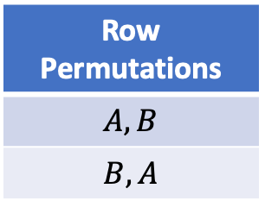





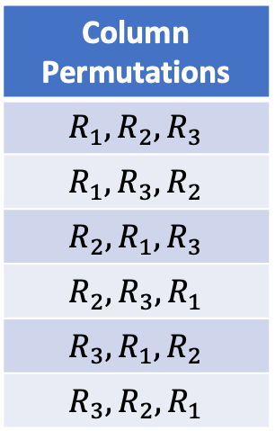









Example of Checking Permutably Identical
$$M_{1}$$
 | A | B
 | -1 | 1
 | 1 | -1
 | 0 | 1
$$M_{2}$$
 | X | Y
 | 1 | -1
 | 1 | 0
 | -1 | 1
$$R_{1}$$
?
$$R_{1}^{′}$$
$$=_{σ}$$
$$R_{2}$$
$$R_{2}^{′}$$
$$R_{3}$$
$$R_{3}^{′}$$
1. Find all of the permutations
2. For each permutation, check equality of matrices.
Column Permutations
$$R_{1},R_{2},R_{3}$$
$$R_{1},R_{3},R_{2}$$
$$R_{2},R_{1},R_{3}$$
$$R_{2},R_{3},R_{1}$$
$$R_{3},R_{1},R_{2}$$
$$R_{3},R_{2},R_{1}$$
Row Permutations
$$A, B$$
$$B, A$$
permuted $M_{1}$
 | B | A
 | 1 | -1
 | 0 | 1
 | -1 | 1
$$M_{2}$$
 | X | Y
 | 1 | -1
 | 1 | 0
 | -1 | 1
$$R_{1}$$
$$R_{1}^{′}$$
$$=$$
$$R_{3}$$
$$R_{2}^{′}$$
$$R_{2}$$
$$R_{3}^{′}$$
Reaction permutation: $R_{1},R_{3},R_{2}$
Column permutation: $B,A$
Total matrix permutations: 6*2=12

Slide 5
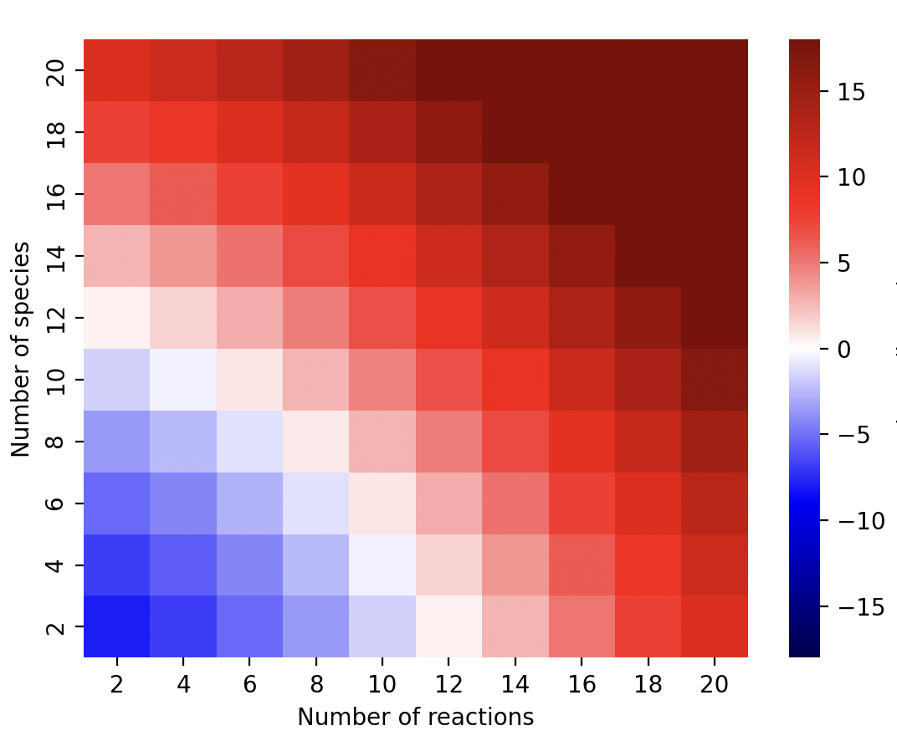
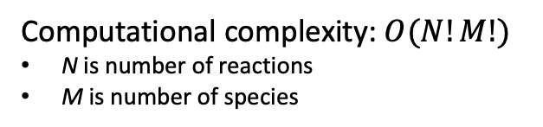
Computational Complexity of Naïve Algorithm to Detect if Two Reaction Networks are Structurally Identical Using Stoichiometry Matrices
Naïve Algorithm
def isPIdentical(M1:matrix, M2:matrix):
for rp in reaction_permutations
for sp in species_permutations
if M1[rp, sp] == M2;
return True
return False
--age of universe
--millennium
--century
--year
--day
Computational complexity: $O(N!M!)$
N is number of reactions
M is number of species
--hour
--second
Long compute times on modest size networks:
5 species, 10 reactions
1.5 hrs (Mac M1, 12 usec/comparison)
log₁₀ (hour) on mac M1

Slide 6










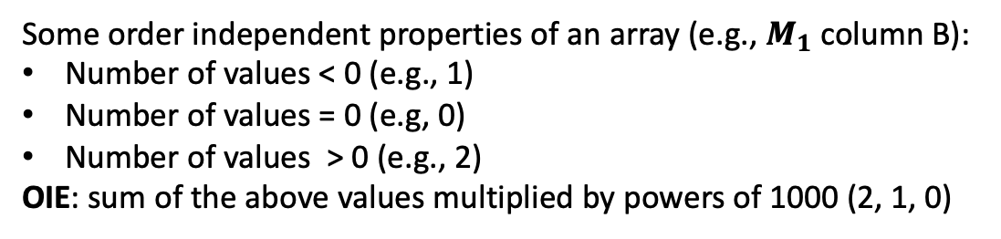








Order Independent Encoding (OIE) of Arrays
Some order independent properties of an array (e.g., $M_{1}$column B):
Number of values < 0 (e.g., 1)
Number of values = 0 (e.g, 0)
Number of values > 0 (e.g., 2)
OIE: sum of the above values multiplied by powers of 1000 (2, 1, 0)
$$M_{1}$$
 | A | B
 | -1 | 1
 | 1 | -1
 | 0 | 1
$$M_{2}$$
 | X | Y
 | 1 | -1
 | 1 | 0
 | -1 | 1
$$M_{3}$$
 | S | T
 | 1 | -1
 | -1 | 0
 | -1 | 1
$$R_{1}$$
$$R_{1}^{′}$$
$$R_{1}^{′′}$$
$$R_{2}$$
$$R_{2}^{′}$$
$$R_{2}^{′′}$$
$$R_{3}$$
$$R_{3}^{′}$$
$$R_{3}^{′′}$$
$R_{1}$: 1,000,001; $R_{2}:$1,000,001; $R_{3}:$1,001,000
$R_{1}^{′}$: 1,000,001; $R_{2}^{′}$: 1,001,000; $R_{3}^{′}:$1,000,001
$R_{1}^{′′}$: 1,000,001; $R_{2}^{′′}$1,001; $R_{3}^{′′}:$1,000,001
$A$: 1,001,001; $B:$2,000,001
$X$: 2,001,001; $Y:$1,000,001
$S$: 1,000,002; $T:$1,001,001

Slide 7


















DSIRN: Detecting Structurally Identical Reaction Networks: 1
Key insight: Only compare rows (columns) in $M_{1}$ with those in $M_{2}$that have the same order independent encoding (OIE).
1. Sort the rows of columns of the matrices by their order independent encodings.
$$M_{1}$$
 | A | B
 | -1 | 1
 | 1 | -1
 | 0 | 1
$$M_{2}$$
 | X | Y
 | 1 | -1
 | 1 | 0
 | -1 | 1
$$R_{1}$$
$$R_{1}^{′}$$
$$R_{2}$$
$$R_{2}^{′}$$
$$R_{3}$$
$$R_{3}^{′}$$
$R_{1}$: 1,000,001; $R_{2}:$1,000,001; $R_{3}:$1,001,000
$R_{1}^{′}$: 1,000,001; $R_{2}^{′}$: 1,001,000; $R_{3}^{′}:$1,000,001
$A$: 1,001,001; $B:$2,000,001
$X$: 2,001,001; $Y:$1,000,001
1,001,001
2,000,001
1,001,001
2,000,001
$$M_{1}$$
 | A | B
 | -1 | 1
 | 1 | -1
 | 0 | 1
$$M_{2}$$
 | Y | X
 | -1 | 1
 | 1 | -1
 | 0 | 1
1,000,001
$$R_{1}$$
1,000,001
$$R_{1}^{′}$$
1,000,001
$$R_{2}$$
1,000,001
$$R_{3}^{′}$$
1,001,000
$$R_{3}$$
1,001,000
$$R_{2}^{′}$$

Slide 8









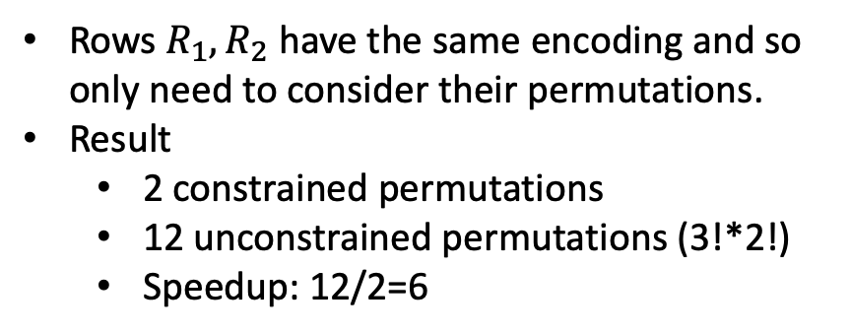








DSIRN: Detecting Structurally Identical Reaction Networks: 2
1,001,001
2,000,001
1,001,001
2,000,001
$$M_{1}$$
 | A | B
 | -1 | 1
 | 1 | -1
 | 0 | 1
$$M_{2}$$
 | Y | X
 | -1 | 1
 | 1 | -1
 | 0 | 1
Rows $R_{1},R_{2}$ have the same encoding and so only need to consider their permutations.
Result
2 constrained permutations
12 unconstrained permutations (3!*2!)
Speedup: 12/2=6
1,000,001
$$R_{1}$$
?
1,000,001
$$R_{1}^{′}$$
1,000,001
$$R_{2}$$
$$=$$
1,000,001
$$R_{3}^{′}$$
1,001,000
$$R_{3}$$
1,001,000
$$R_{2}^{′}$$
1,001,001
2,000,001
1,001,001
2,000,001
$$M_{1}$$
 | A | B
 | 1 | -1
 | -1 | 1
 | 0 | 1
$$M_{2}$$
 | Y | X
 | -1 | 1
 | 1 | -1
 | 0 | 1
1,000,001
$$R_{2}$$
?
1,000,001
$$R_{1}^{′}$$
1,000,001
$$R_{1}$$
$$=$$
1,000,001
$$R_{3}^{′}$$
1,001,000
$$R_{3}$$
1,001,000
$$R_{2}^{′}$$

Slide 9
Complexity of DSIRN Algorithm
Formula and plot
Need for threshold on maximum number of permutations

Slide 10
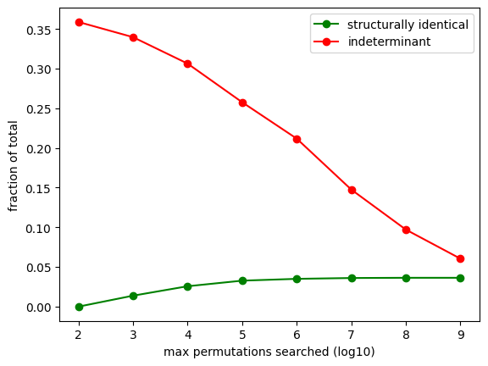
Effect of Deeper Search

Slide 11
BACKUP

Slide 12












DSIRN: Detecting Structurally Identical Reaction Networks: 2
1,001,001
2,000,001
1,001,001
2,000,001
$$M_{1}$$
 | A | B
 | -1 | 1
 | 1 | -1
 | 0 | 1
$$M_{2}$$
 | Y | X
 | -1 | 1
 | 1 | -1
 | 0 | 1
1,000,001
$$R_{1}$$
?
1,000,001
$$R_{1}^{′}$$
1,000,001
$$R_{2}$$
$$=$$
1,000,001
$$R_{3}^{′}$$
1,001,000
$$R_{3}$$
1,001,000
$$R_{2}^{′}$$
1,001,001
2,000,001
1,001,001
2,000,001
$$M_{1}$$
 | A | B
 | -1 | 1
 | 1 | -1
 | 0 | 1
$$M_{2}$$
 | Y | X
 | -1 | 1
 | 1 | -1
 | 0 | 1
1,000,001
$$R_{1}$$
?
1,000,001
$$R_{1}^{′}$$
1,000,001
$$R_{2}$$
$$=$$
1,000,001
$$R_{3}^{′}$$
1,001,000
$$R_{3}$$
1,001,000
$$R_{2}^{′}$$

