Slide 1
pySubnetSB: A Python Package for Finding Sub-Networks in SBML Models
Joe Hellerstein
Nov, 2024

Slide 2
Why Find Model Sub-Networks?
Example: Are there hidden oscillators in Biomodels?
Sampling without replacement
Understand higher level structures of chemical networks

Slide 3
A Related Problem: Clustering Structurally Identical CRNs

Slide 4
Related Work
Graphical analysis of chemical networks
Subnet problem requires considering directed, bipartite, hypergraphs; graph isomorphism does not. Example
Uri Alon

Slide 5
Constraint-Based Approach
Contribution – constraints for CRNs

Slide 6
Evaluation of Constraints

Slide 7
pySubnetSB
Usage example
Parallelism
Vectorization
Multiprocessing

Slide 8
Detailed Examples

Slide 9
Next Steps

Slide 10
BACKUP

Slide 11
Bipartite Hypergraphs Are Required to find Subnets
Consider the network with one reaction: R: A + B -> C + D
The bipartite hypergraph representation is depicted below. There are 5 nodes: 4 species nodes and 1 reaction node. There are two hyperarcs, (1) and (2).
A
C
(1)
R
(2)
B
D
The hyperarcs are required in order to have the correct semantics for finding a subset of the model. Below is a graph without hyperarcs. That is, the arc (1) represents (A, R), etc. In this case, the reaction A->C is a subgraph, which is not a correct interpretation of a subset of a reaction network.
(1)
(2)
A
C
R
B
D
(1a)
(2a)

Slide 12
Reference network
Construct constraints for reference network
Construct compatibility vector
Prune compatibility vector
Target network
Construct constraints for target network
Expand pruned compatibility vector into assignments
Calculate assignment pairs

Slide 13
Why Look for Structurally Identical Sub Networks (subnets)?
Identify features of a complex network (e.g., has an oscillator)
Identify functional similarities between reaction networks

Slide 14
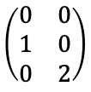
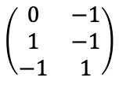
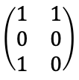
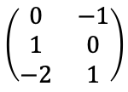
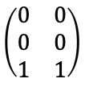
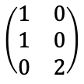
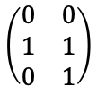
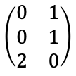
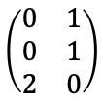
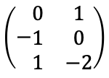
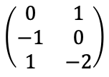
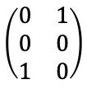
Defining Structurally Identical Networks
Network A
J1: S1 + S2 -> S1 + S3
J2: S3 + S3 -> S1
Network B
J1: S3 + S3 -> S2
J2: S1 + S2 -> S2 + S3
Network C
J1: S2 -> S3
J2: S3 + S3 -> S1
Network D
J1: S3 + S3 -> S3
J2: S1 + S2 -> S3
product
reactant
difference
product
reactant
difference
product
reactant
difference
product
reactant
difference
$$\left(\begin{matrix}1 & 1 \\ 0 & 0 \\ 1 & 0\end{matrix}\right)$$
$$\left(\begin{matrix}1 & 0 \\ 1 & 0 \\ 0 & 2\end{matrix}\right)$$
$$\left(\begin{matrix}0 & 1 \\ −1 & 0 \\ 1 & −2\end{matrix}\right)$$
$$\left(\begin{matrix}0 & 0 \\ 1 & 1 \\ 0 & 1\end{matrix}\right)$$
$$\left(\begin{matrix}0 & 1 \\ 0 & 1 \\ 2 & 0\end{matrix}\right)$$
$$\left(\begin{matrix}0 & −1 \\ 1 & 0 \\ −2 & 1\end{matrix}\right)$$
$$\left(\begin{matrix}0 & 1 \\ 0 & 0 \\ 1 & 0\end{matrix}\right)$$
$$\left(\begin{matrix}0 & 0 \\ 1 & 0 \\ 0 & 2\end{matrix}\right)$$
$$\left(−\begin{matrix}0 & 1 \\ 1 & 0 \\ 1 & −2\end{matrix}\right)$$
$$\left(\begin{matrix}0 & 0 \\ 0 & 0 \\ 1 & 1\end{matrix}\right)$$
$$\left(\begin{matrix}0 & 1 \\ 0 & 1 \\ 2 & 0\end{matrix}\right)$$
$$\left(\begin{matrix}0 & −1 \\ 1 & −1 \\ −1 & 1\end{matrix}\right)$$
Strong Identity: Renaming
Weak Identity: Capable of the Same Behavior
Networks have permutably identical product stoichiometry matrices and reactant stoichiometry matrices with the same permutation
Ex: A & B (B is A swapping S1, S2 & J1, J2)
Networks have permutably identical matrices for the difference between product stoichiometries and reactant stoichiometry matrices
Ex: A & C, B & C
Network D has no identity relationship with A, B, C

Slide 15
Detecting Subnets

Slide 16






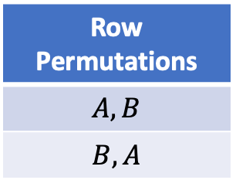





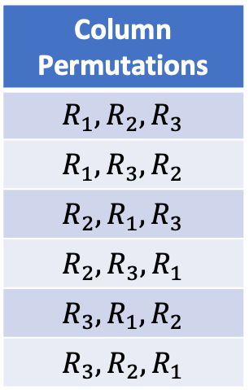









Example of Checking Permutably Identical Matrices
$$M_{1}$$
 | A | B
 | -1 | 1
 | 1 | -1
 | 0 | 1
$$M_{2}$$
 | X | Y
 | 1 | -1
 | 1 | 0
 | -1 | 1
$$R_{1}$$
?
$$R_{1}^{′}$$
$$=_{σ}$$
$$R_{2}$$
$$R_{2}^{′}$$
$$R_{3}$$
$$R_{3}^{′}$$
1. Find all of the permutations
2. For each permutation, check equality of matrices.
Column Permutations
$$R_{1},R_{2},R_{3}$$
$$R_{1},R_{3},R_{2}$$
$$R_{2},R_{1},R_{3}$$
$$R_{2},R_{3},R_{1}$$
$$R_{3},R_{1},R_{2}$$
$$R_{3},R_{2},R_{1}$$
Row Permutations
$$A, B$$
$$B, A$$
permuted $M_{1}$
 | B | A
 | 1 | -1
 | 0 | 1
 | -1 | 1
$$M_{2}$$
 | X | Y
 | 1 | -1
 | 1 | 0
 | -1 | 1
$$R_{1}$$
$$R_{1}^{′}$$
$$=$$
$$R_{3}$$
$$R_{2}^{′}$$
$$R_{2}$$
$$R_{3}^{′}$$
Reaction permutation: $R_{1},R_{3},R_{2}$
Column permutation: $B,A$
Total matrix permutations: 6*2=12

Slide 17
Search Space for Strong Identity
Network A
J1: S1 + S2 -> S1 + S3
J2: S3 + S3 -> S1
Network B
J1’: S1’ + S1’ -> S2’
J2’: S3’ + S2’ -> S2’ + S1’
Objective: Find an assignment of J1’, J2’ to J1, J2 and an assignment of S1’, S2’, S3’ to S1, S2, S3 so that the reaction networks are identical if we substitute the assignments.
Network A
Network B
J1
J1’
J2’
J2
J2’
J1’
S1
S1’
S2’
S3’
S1’
S2’
S3’
S2
S2’
S3’
S1’
S3’
S1’
S2’
S2’
S3’
S1’
S3’
S1’
S2’
S3
S3’
S2’
S3’
S1’
S2’
S1’
S3’
S2’
S3’
S1’
S2’
S1’
J1’
J1’
J1’
J1’
J1’
J1’
J2’
J2’
J2’
J2’
J2’
J2’
Assignments
J2’
J2’
J2’
J2’
J2’
J2’
J1’
J1’
J1’
J1’
J1’
J1’
S1’
S1’
S2’
S2’
S3’
S3’
S1’
S1’
S2’
S2’
S3’
S3’
S2’
S3’
S1’
S3’
S1’
S2’
S2’
S3’
S1’
S3’
S1’
S2’
S3’
S2’
S3’
S1’
S2’
S1’
S3’
S2’
S3’
S1’
S2’
S1’

Slide 18
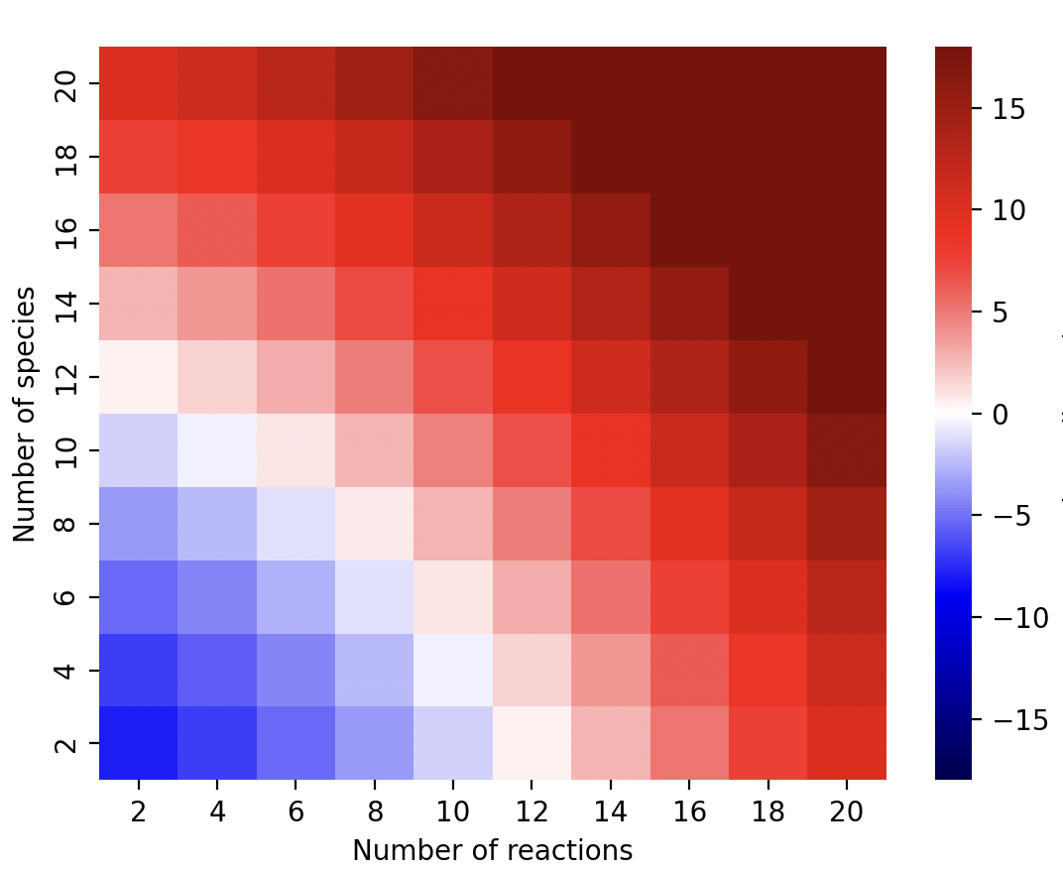
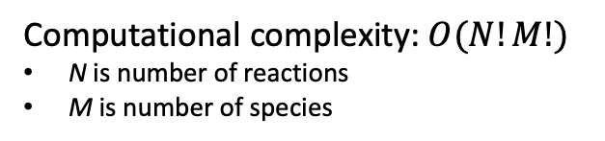
Computational Complexity of Naïve Algorithm to Detect Weak Structural Identical
Naïve Algorithm
def isPIdentical(M1:matrix, M2:matrix):
for rp in reaction_permutations
for sp in species_permutations
if M1[rp, sp] == M2;
return True
return False
--age of universe
--millennium
--century
--year
--day
Computational complexity: $O(N!M!)$
N is number of reactions
M is number of species
--hour
--second
Long compute times on modest size networks:
5 species, 10 reactions
1.5 hrs (Mac M1, 12 usec/comparison)
log₁₀ (hour) on mac M1

Slide 19
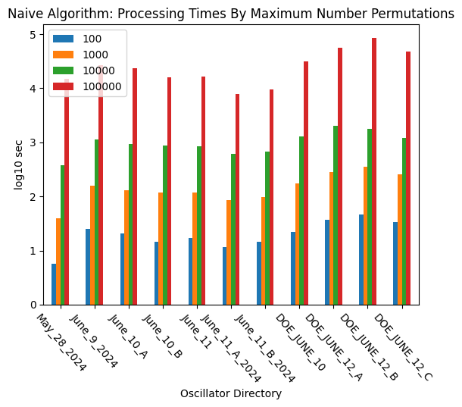
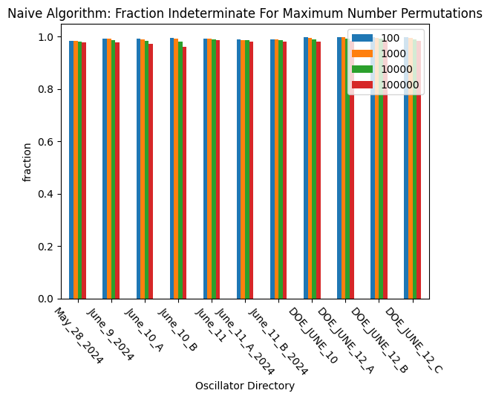
Applying Naïve Algorithm to OscillatorDatabase
1 day
3 hours
30 min
Indeterminate network: Too many permutations to determine structural identical
Have been running naïve algorithm with maximum number permutations of 1,000,000 for a week.
Conclusion: Can evaluate only a small fraction of models for structural identity using the naïve algorithm.

Slide 20
Incompatible Assignments
Network A
J1: S1 + S2 -> S1 + S3
J2: S3 + S3 -> S1
Network B
J1’: S1’ + S1’ -> S2’
J2’: S3’ + S2’ -> S2’ + S1’
A reaction assignment is incompatible if the target reaction has a different number of reactants or products than the reference reaction.
Ex: J1 is incompatible with J1’.
A species assignment is incompatible for strong identity if the target species differs in its number of stoichiometries as either a reactant or a product.
Ex: S1 is incompatible with S1’.
A species assignment is incompatible for weak identity if the target species differs in the difference between its stoichiometries as a product and as a reactant.

Slide 21
Improved Search Space for Strong Identity
Network A
J1: S1 + S2 -> S1 + S3
J2: S3 + S3 -> S1
Network B
J1’: S1’ + S1’ -> S2’
J2’: S3’ + S2’ -> S2’ + S1’
X
Approach: Discard subtrees with incompatible assignments.
Network A
Network B
J1 is incompatible with J1’
J1
J1’
J2’
Result: Search space is reduced from 12 assignments to 4 assignments.
J2
J2’
X
J1’
S1 is incompatible with S1’
S1
S1’
S2’
S3’
S1’
S2’
S3’
S2
S2’
S3’
S1’
S3’
S1’
S2’
S2’
S3’
S1’
S3’
S1’
S2’
S3
S3’
S2’
S3’
S1’
S2’
S1’
S3’
S2’
S3’
S1’
S2’
S1’
J1’
J1’
J1’
J1’
J1’
J1’
J2’
J2’
J2’
J2’
J2’
J2’
J2’
J2’
J2’
J2’
J2’
J2’
J1’
J1’
J1’
J1’
J1’
J1’
S1’
S1’
S2’
S2’
S3’
S3’
S1’
S1’
S2’
S2’
S3’
S3’
S2’
S3’
S1’
S3’
S1’
S2’
S2’
S3’
S1’
S3’
S1’
S2’
S3’
S2’
S3’
S1’
S2’
S1’
S3’
S2’
S3’
S1’
S2’
S1’

Slide 22
Finding Compatible Assignments

Slide 23










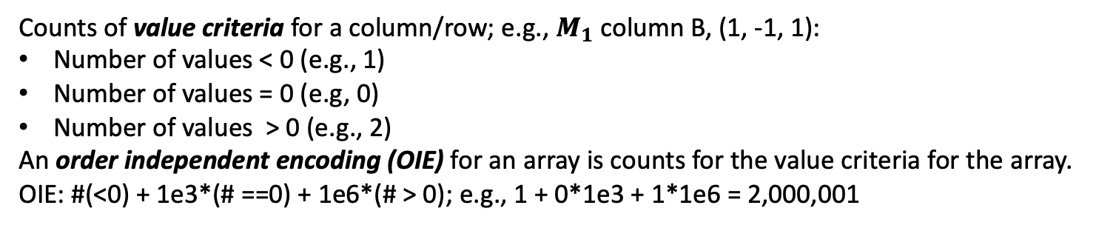








Order Independent Encoding (OIE) of Arrays
Counts of value criteria for a column/row; e.g., $M_{1}$column B, (1, -1, 1):
Number of values < 0 (e.g., 1)
Number of values = 0 (e.g, 0)
Number of values > 0 (e.g., 2)
An order independent encoding (OIE) for an array is counts for the value criteria for the array.
OIE: #(<0) + 1e3*(# ==0) + 1e6*(# > 0); e.g., 1 + 0*1e3 + 1*1e6 = 2,000,001
$$M_{1}$$
 | A | B
 | -1 | 1
 | 1 | -1
 | 0 | 1
$$M_{2}$$
 | X | Y
 | 1 | -1
 | 1 | 0
 | -1 | 1
$$M_{3}$$
 | S | T
 | 1 | -1
 | -1 | 0
 | -1 | 1
$$R_{1}$$
$$R_{1}^{′}$$
$$R_{1}^{′′}$$
$$R_{2}$$
$$R_{2}^{′}$$
$$R_{2}^{′′}$$
$$R_{3}$$
$$R_{3}^{′}$$
$$R_{3}^{′′}$$
$R_{1}$: 1,000,001; $R_{2}:$1,000,001; $R_{3}:$1,001,000
$R_{1}^{′}$: 1,000,001; $R_{2}^{′}$: 1,001,000; $R_{3}^{′}:$1,000,001
$R_{1}^{′′}$: 1,000,001; $R_{2}^{′′}$1,001; $R_{3}^{′′}:$1,000,001
$A$: 1,001,001; $B:$2,000,001
$X$: 2,001,001; $Y:$1,000,001
$S$: 1,000,002; $T:$1,001,001

Slide 24




















DSIRN: Detecting Structurally Identical Reaction Networks: 1
Step 1. Sort the rows of columns of the matrices by their order independent encodings.
$$M_{1}$$
 | A | B
 | -1 | 1
 | 1 | -1
 | 0 | 1
$$M_{2}$$
 | X | Y
 | 1 | -1
 | 1 | 0
 | -1 | 1
$$R_{1}$$
$$R_{1}^{′}$$
$$R_{2}$$
$$R_{2}^{′}$$
$$R_{3}$$
$$R_{3}^{′}$$
$R_{1}$: 1,000,001; $R_{2}:$1,000,001; $R_{3}:$1,001,000
$R_{1}^{′}$: 1,000,001; $R_{2}^{′}$: 1,001,000; $R_{3}^{′}:$1,000,001
$A$: 1,001,001; $B:$2,000,001
$X$: 2,001,001; $Y:$1,000,001
1,001,001
2,000,001
1,001,001
2,000,001
$$M_{1}$$
 | A | B
 | -1 | 1
 | 1 | -1
 | 0 | 1
$$M_{2}$$
 | Y | X
 | -1 | 1
 | 1 | -1
 | 0 | 1
1,000,001
$$R_{1}$$
1,000,001
$$R_{1}^{′}$$
1,000,001
$$R_{2}$$
1,000,001
$$R_{3}^{′}$$
1,001,000
$$R_{3}$$
1,001,000
$$R_{2}^{′}$$

Slide 25









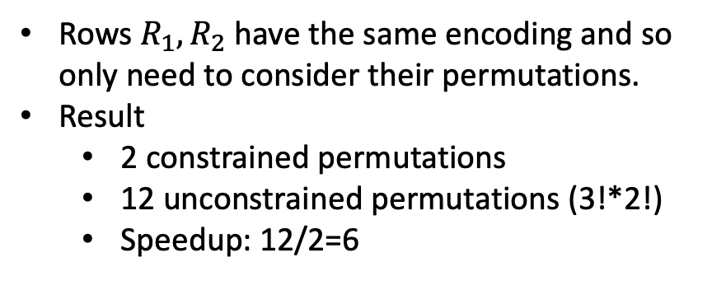






DSIRN: Detecting Structurally Identical Reaction Networks: 2
Step 2: Do encoding constrained permutation and comparisons for equality
Only compare rows (columns) in $M_{1}$ with those in $M_{2}$that have the same order independent encoding (OIE).
1,001,001
2,000,001
1,001,001
2,000,001
$$M_{1}$$
 | A | B
 | -1 | 1
 | 1 | -1
 | 0 | 1
$$M_{2}$$
 | Y | X
 | -1 | 1
 | 1 | -1
 | 0 | 1
Rows $R_{1},R_{2}$ have the same encoding and so only need to consider their permutations.
Result
2 constrained permutations
12 unconstrained permutations (3!*2!)
Speedup: 12/2=6
1,000,001
$$R_{1}$$
?
1,000,001
$$R_{1}^{′}$$
1,000,001
$$R_{2}$$
$$=$$
1,000,001
$$R_{3}^{′}$$
1,001,000
$$R_{3}$$
1,001,000
$$R_{2}^{′}$$
1,001,001
2,000,001
1,001,001
2,000,001
$$M_{1}$$
 | A | B
 | 1 | -1
 | -1 | 1
 | 0 | 1
$$M_{2}$$
 | Y | X
 | -1 | 1
 | 1 | -1
 | 0 | 1
1,000,001
$$R_{2}$$
?
1,000,001
$$R_{1}^{′}$$
1,000,001
$$R_{1}$$
$$=$$
1,000,001
$$R_{3}^{′}$$
1,001,000
$$R_{3}$$
1,001,000
$$R_{2}^{′}$$

Slide 26
DSIRN Algorithm for Strong Identity
Inputs
Network 1 reactant stoichiometry matrix, product stoichiometry matrix
Network 2 reactant stoichiometry matrix, product stoichiometry matrix
Steps
Construct order independent encodings of all matrices, sorting the rows and columns by increasing values of their OIEs.
Evaluate all encoding constrained permutations for the reactant stoichiometry matrices. If no identity is found, return False.
For each instance identity permutation, compare the product stoichiometry matrices. If identical, return True.
If no permutation produces identical reactant and product stoichiometry matrices, return False.
Weak identity
Use difference between product and reactant stoichiometry matrices
Only need steps 1 & 2.

Slide 27
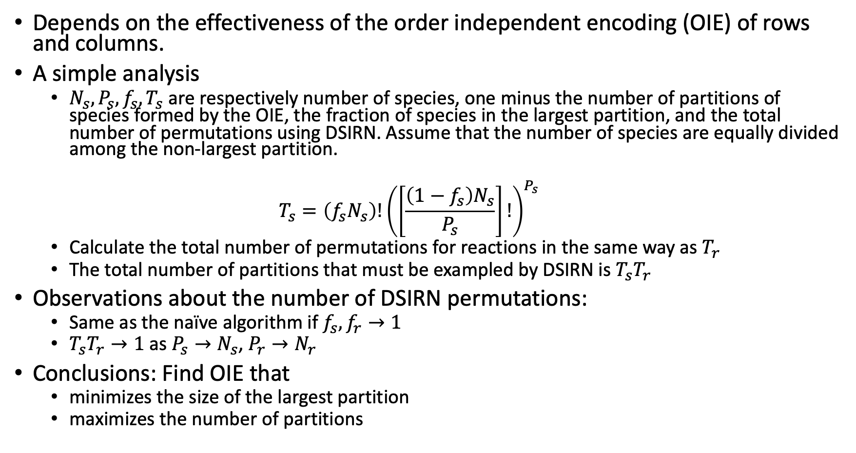
Analysis of DSIRN Algorithm
Depends on the effectiveness of the order independent encoding (OIE) of rows and columns.
A simple analysis
$N_{s}, P_{s}, f_{s}, T_{s}$ are respectively number of species, one minus the number of partitions of species formed by the OIE, the fraction of species in the largest partition, and the total number of permutations using DSIRN. Assume that the number of species are equally divided among the non-largest partition.
$$T_{s}=\left(f_{s}N_{s}\right)!{\left(\left[\frac{\left(1−f_{s}\right)N_{s}}{P_{s}}\right]!\right)}^{P_{s}}$$
Calculate the total number of permutations for reactions in the same way as $T_{r}$
The total number of partitions that must be exampled by DSIRN is $T_{s}T_{r}$
Observations about the number of DSIRN permutations:
Same as the naïve algorithm if $f_{s}, f_{r}→1$
$T_{s}T_{r}→1$ as $P_{s}→N_{s}$, $P_{r}→N_{r}$
Conclusions: Find OIE that
minimizes the size of the largest partition
maximizes the number of partitions

Slide 28
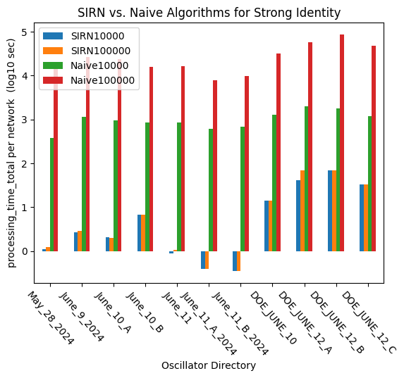
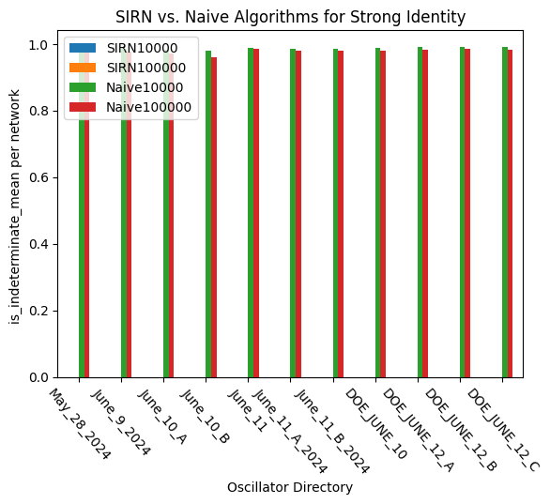
DSIRN Efficiently Clusters Structurally Identical Networks.
1 day
3 hours
30 min
10 sec

Slide 29
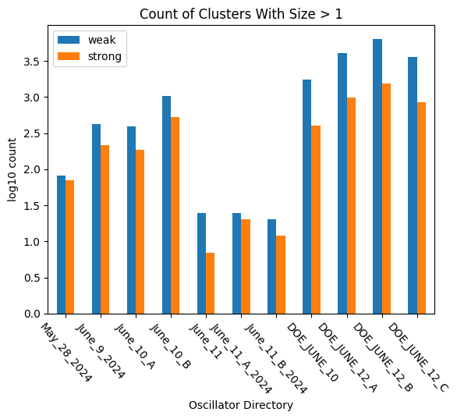
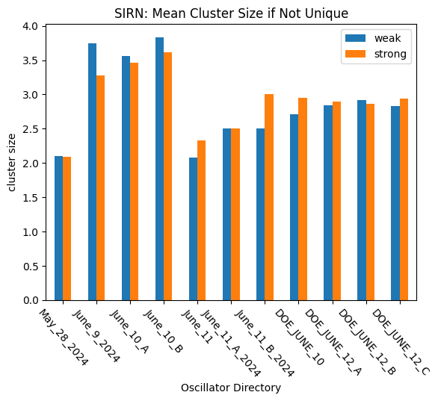
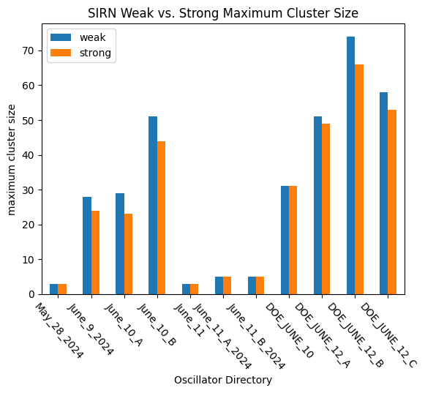
Preliminary Analysis of OscillatorDatabase

Slide 30
Detecting Structurally Identical Subsets
Problem description
Why it’s interesting
Are simple oscillators embedded in complex oscillators?
Computational complexity

Slide 31
Structural Subnets
Definition: B is a structural subnet of A if there is a subset of species and reactions in A that are structurally identical to B.
Network A
Network B
J1: S1 -> S2 + S3
J2: S1 + S3 -> S2
J3: S2 -> S1
J4: -> S2
Jp1: Sp1 -> Sp2
Jp2: -> Sp1
Reaction
Network
B is a subnet of A with
S1=Sp2, S2=Sp2
J3=Jp1, J4=Jp2
J1
J2
J3
J4
Jp1
Jp2
S1
-1
-1
1
0
-1
1
Stoichiometry
Matrix
Sp1
S2
1
1
-1
1
1
0
Sp2
S3
1
-1
0
0

Slide 32
Why are subnets interesting?
Understand the structure of complex reaction networks
Ex: Explore simple oscillators embedded in complex oscillators
Better network visualizations
Ex: Hierarchical decomposition by subnet.

Slide 33
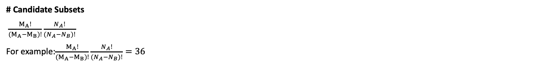
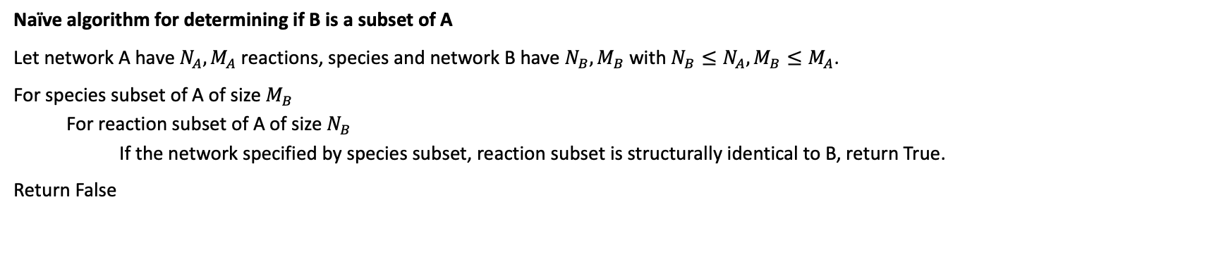
Naïve Algorithm for Detecting Subnets
J1
J2
J3
J4
Jp1
Jp2
S1
-1
-1
1
0
-1
1
Sp1
S2
1
1
-1
1
1
0
Sp2
S3
1
-1
0
0
Naïve algorithm for determining if B is a subset of A
Let network A have $N_{A},M_{A}$ reactions, species and network B have $N_{B}, M_{B}$ with $N_{B}≤N_{A}, M_{B}≤M_{A}$.
For species subset of A of size $M_{B}$
For reaction subset of A of size $N_{B}$
If the network specified by species subset, reaction subset is structurally identical to B, return True.
Return False
# Candidate Subsets
$\frac{M_{A}!}{{(M_{A}−M}_{B})!}\frac{N_{A}!}{{(N_{A}−N}_{B})!}$
For example:$\frac{M_{A}!}{{(M_{A}−M}_{B})!}\frac{N_{A}!}{{(N_{A}−N}_{B})!}=36$

Slide 34
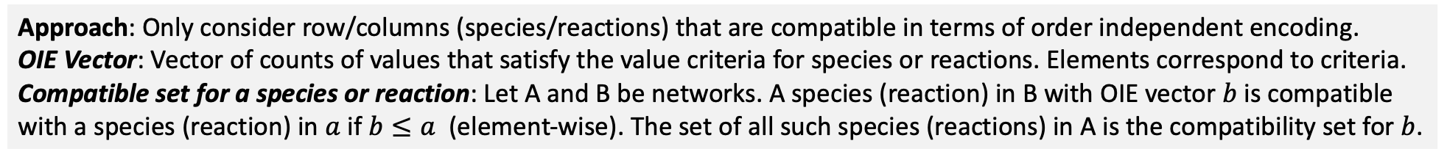
Order Independent Encodings Can Reduce The Complexity of Finding Subsets.
Approach: Only consider row/columns (species/reactions) that are compatible in terms of order independent encoding.
OIE Vector: Vector of counts of values that satisfy the value criteria for species or reactions. Elements correspond to criteria.
Compatible set for a species or reaction: Let A and B be networks. A species (reaction) in B with OIE vector $b$ is compatible with a species (reaction) in $a$ if $b≤a$ (element-wise). The set of all such species (reactions) in A is the compatibility set for $b$.
Stoichiometry
OIE Vectors
Compatibility Sets for
Network B
S1 OIE
species
J1 OIE
reactions
J1
J2
J3
J4
#<0
#=0
#>0
#<0
#=0
#>0
Sp1: {S1, S2, S3}
Sp2: {S1, S3}
Jp1: {J1, J2, J3}
Jp2: {J3, J4}
S1
-1
-1
1
0
S1
2
1
1
J1
2
0
2
S2
1
1
-1
1
S2
1
0
3
J2
2
0
2
S3
1
-1
0
0
S3
1
2
1
J3
1
1
1
J4
0
1
2
Jp1
Jp2
#<0
#=0
#>0
#<0
#=0
#>0
-1
1
Sp1
1
0
1
Jp1
1
0
1
Sp1
1
0
Sp2
0
1
1
Jp2
0
1
1
Sp2

Slide 35
Compatibility sets consider reactants and products separately.
Using the stoichiometry matrix masks some features of reaction networks because it is the difference between product and reactant stoichiometries.
Network A
Stoichiometry Matrix A
Network A’
Stoichiometry Matrix A’
J1
J2
J3
J4
J1
J2
J3
J4
J1: S1 -> S2 + S3
J2: S1 + S3 -> S2
J3: S2 -> S1
J4: -> S2
S1
-1
-1
1
0
J1: 2 S1 -> S1 + S2 + S3
J2: S1 + S3 -> S2
J3: S2 -> S1
J4: -> S2
S1
-1
-1
1
0
S2
1
1
-1
1
S2
1
1
-1
1
S3
1
-1
0
0
S3
1
-1
0
0
J1
J2
J3
J4
J1
J2
J3
J4
S1
1
1
0
0
S1
2
1
0
0
Reactant Stoichiometry Matrix A
S2
0
0
1
0
Reactant Stoichiometry Matrix A’
S2
0
0
1
0
S3
0
1
0
0
S3
0
1
0
0
S1
0
0
1
0
S1
1
0
1
0
Product Stoichiometry Matrix A
S2
1
1
0
1
Product Stoichiometry Matrix A’
S2
1
1
0
1
S3
1
0
0
0
S3
1
0
0
0
Networks A and A’ have the identical stoichiometry matrices, but different reactant & product stoichiometries.
Final compatibility set is the intersection of the compatibility set for reactants and for products stoichiometries.

Slide 36

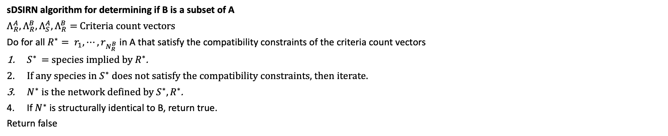
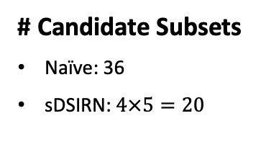

Initial sDSIRN Algorithm for Detecting Subnets
Network A
Network B
J1: S1 -> S2 + S3
J2: S1 + S3 -> S2
J3: S2 -> S1
J4: -> S2
Jp1: Sp1 -> Sp2
Jp2: -> Sp1
sDSIRN algorithm for determining if B is a subset of A
$Λ_{R}^{A},Λ_{R}^{B}, Λ_{S}^{A},Λ_{R}^{B}=$Criteria count vectors
Do for all ${R^{∗}= r}_{1},⋯,r_{N_{R}^{B}}$in A that satisfy the compatibility constraints of the criteria count vectors
$S^{∗}$ = species implied by $R^{∗}$.
If any species in $S^{∗}$ does not satisfy the compatibility constraints, then iterate.
$N^{∗}$ is the network defined by $S^{∗}, R^{∗}$.
If $N^{∗}$ is structurally identical to B, return true.
Return false
# Candidate Subsets
(# species subsets)(# reaction subsets)
Compatibility Sets
$$S^{∗}$$
$$R^{∗}$$
# Candidate Subsets
Naïve: 36
sDSIRN: $4×5=20$
Sp1: {S1, S2, S3}
Sp2: {S1, S3}
Jp1: {J1, J2, J3}
Jp2: {J3, J4}
(J1, J3)
(J1, J4)
(J2, J3)
(J2, J4)
(J3, J4)
# reaction subsets: 5
(S1, S3)
(S2, S1)
(S2, S3)
(S3, S1)
# species subsets: 4
Reduces subset size but not a large reduction in subset size.

Slide 37
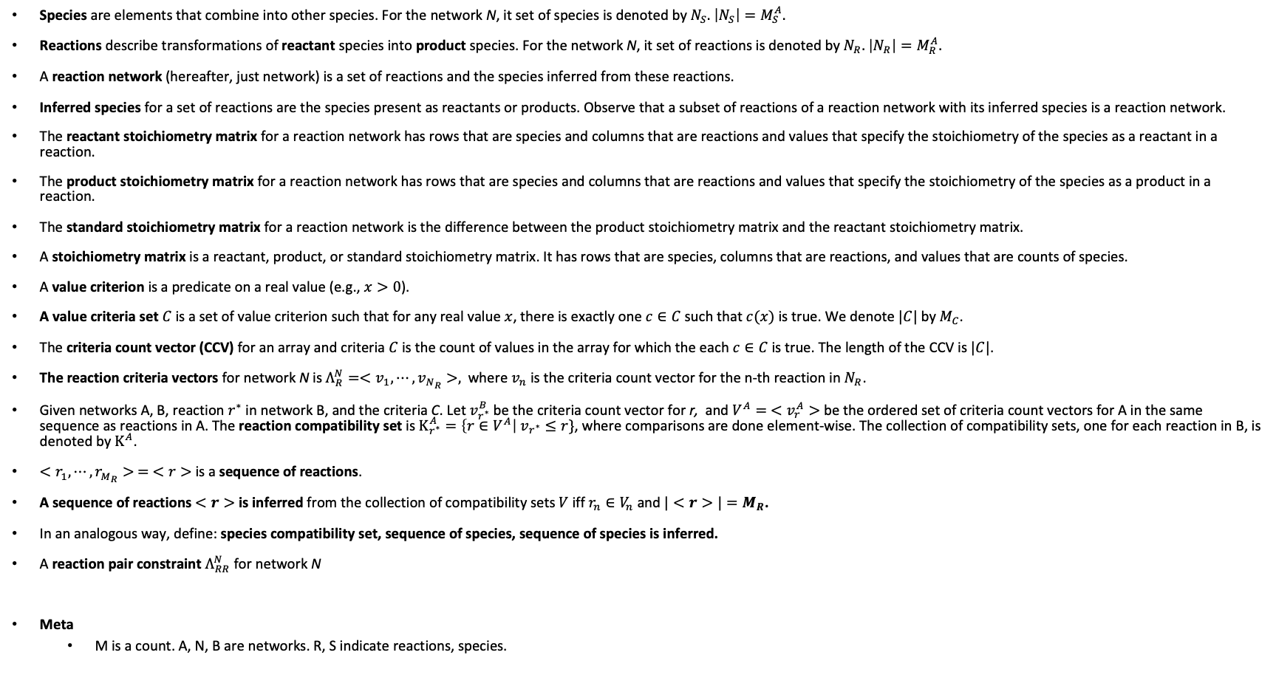
Key Concepts
Species are elements that combine into other species. For the network N, it set of species is denoted by $N_{S}.$ $\left|N_{S}\right|=M_{S}^{A}.$
Reactions describe transformations of reactant species into product species. For the network N, it set of reactions is denoted by $N_{R}.$ $\left|N_{R}\right|=M_{R}^{A}.$
A reaction network (hereafter, just network) is a set of reactions and the species inferred from these reactions.
Inferred species for a set of reactions are the species present as reactants or products. Observe that a subset of reactions of a reaction network with its inferred species is a reaction network.
The reactant stoichiometry matrix for a reaction network has rows that are species and columns that are reactions and values that specify the stoichiometry of the species as a reactant in a reaction.
The product stoichiometry matrix for a reaction network has rows that are species and columns that are reactions and values that specify the stoichiometry of the species as a product in a reaction.
The standard stoichiometry matrix for a reaction network is the difference between the product stoichiometry matrix and the reactant stoichiometry matrix.
A stoichiometry matrix is a reactant, product, or standard stoichiometry matrix. It has rows that are species, columns that are reactions, and values that are counts of species.
A value criterion is a predicate on a real value (e.g., $x>0$).
A value criteria set $C$ is a set of value criterion such that for any real value $x$, there is exactly one $c∈C$ such that $c(x)$ is true. We denote $|C|$ by $M_{C}$.
The criteria count vector (CCV) for an array and criteria $C$ is the count of values in the array for which the each $c∈C$is true. The length of the CCV is $|C|$.
The reaction criteria vectors for network N is $Λ_{R}^{N}=<v_{1},⋯,v_{N_{R}}>,$ where $v_{n}$ is the criteria count vector for the n-th reaction in $N_{R}$.
Given networks A, B, reaction $r^{∗}$ in network B, and the criteria C. Let $v_{r^{∗}}^{B}$ be the criteria count vector for r, and ${V^{A}= <v}_{r}^{A}>$ be the ordered set of criteria count vectors for A in the same sequence as reactions in A. The reaction compatibility set is $Κ_{r^{∗}}^{A}=\left\{r∈V^{A}\right|$ $v_{r^{∗}}≤r\}$, where comparisons are done element-wise. The collection of compatibility sets, one for each reaction in B, is denoted by $Κ^{A}$.
$<r_{1},⋯,r_{M_{R}}> = <r>$ is a sequence of reactions.
A sequence of reactions $<r>$ is inferred from the collection of compatibility sets $V$ iff $r_{n}∈V_{n}$ and $|<r>|=M_{R}$.
In an analogous way, define: species compatibility set, sequence of species, sequence of species is inferred.
A reaction pair constraint $Λ_{RR}^{N}$ for network N
Meta
M is a count. A, N, B are networks. R, S indicate reactions, species.

Slide 38
Validate that S* is exactly the species set implied by R*. Just using S* implied by R* is too permissive.
Sequence
Select R*
S* = species implied by R*
Check pairwise compatibility

Slide 39
Pairs of Order Independent Encodings
Approach: Consider pairs or OIEs for both species and reactions by counting criteria pairs for values in the same position in a pair of arrays.
Individual Species OIE Vectors
Pairs of Species OIE Vectors
Stoichiometry*
a,a
a,a
a,b
a,b
a,c
a,c
b, a
b, a
b, b
b, b
b, c
b, c
c, a
c, a
c, b
c, b
c, c
b
c
c, c
J1
J2
J3
J4
a
0
0
0
1
0
0
1
0
1
0
1
0
0
0
2
0
2
S1,S2
0
1
S1,S2
1
1
2
1
-1
-1
1
0
S1
2
S1
S1
1
1
0
0
0
1
0
1
0
0
0
0
0
0
1
1
0
1
0
1
1
S1,S3
1
0
S1,S3
0
3
1
3
1
1
-1
1
S2
1
S2
S2
1
1
1
1
1
1
0
0
1
0
1
0
0
0
0
0
0
S2,S3
0
2
S2,S3
2
1
1
1
1
-1
0
0
S3
1
S3
S3
1
0
0
2
0
0
0
0
0
0
0
0
1
S2,S1
0
Labels
0
0
1
1
0
0
1
1
0
0
0
0
0
1
0
1
1
a = #<0
b: #=0
c: #>0
S3,S1
1
0
0
1
0
1
0
0
1
S3,S2
0
1
Jp1
Jp2
a
b
c
a,a
a,b
a,c
b, a
b, b
b, c
c, a
c, b
c, c
Sp1
-1
1
Sp1
1
0
1
Sp1,Sp2
0
0
1
0
0
0
1
0
0
Sp2
1
0
Sp2
0
1
1
The permitted sequences for(Sp1, Sp2)are: (S1,S2), (S2, S1). We have 2 subsets, not 4.
*For simplicity, the example uses the stoichiometry matrix. In actuality, the expanded stoichiometry matrix is used.

Slide 40
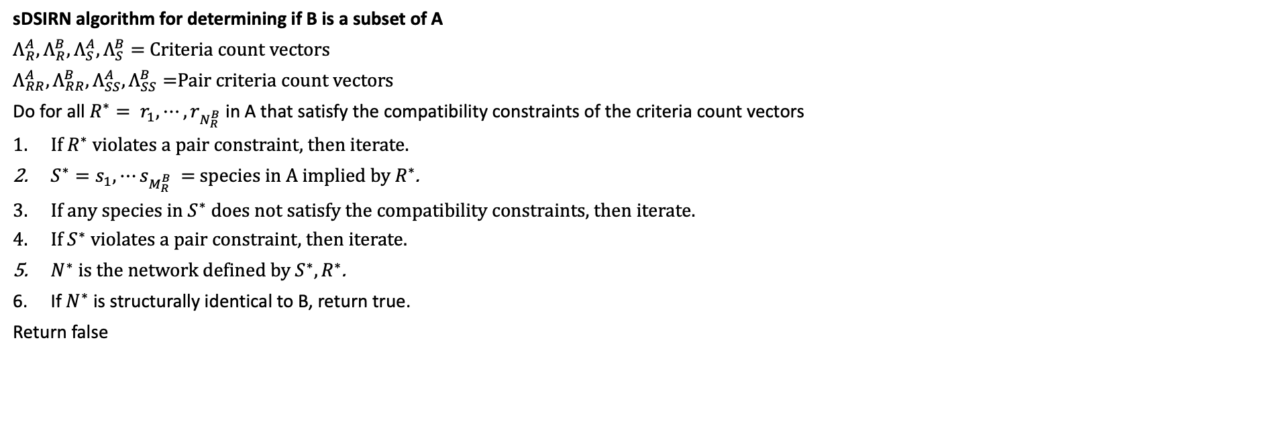
sDSIRN Algorithm for Detecting Subnets With Pair Constraints
Network A
Network B
J1: S1 -> S2 + S3
J2: S1 + S3 -> S2
J3: S2 -> S1
J4: -> S2
Jp1: Sp1 -> Sp2
Jp2: -> Sp1
sDSIRN algorithm for determining if B is a subset of A
$Λ_{R}^{A},Λ_{R}^{B}, Λ_{S}^{A},Λ_{S}^{B}=$Criteria count vectors
$Λ_{RR}^{A},Λ_{RR}^{B}, Λ_{SS}^{A},Λ_{SS}^{B}=$Pair criteria count vectors
Do for all ${R^{∗}= r}_{1},⋯,r_{N_{R}^{B}}$in A that satisfy the compatibility constraints of the criteria count vectors
If $R^{∗}$ violates a pair constraint, then iterate.
$S^{∗}=s_{1},⋯s_{M_{R}^{B}}$ = species in A implied by $R^{∗}$.
If any species in $S^{∗}$ does not satisfy the compatibility constraints, then iterate.
If $S^{∗}$ violates a pair constraint, then iterate.
$N^{∗}$ is the network defined by $S^{∗}, R^{∗}$.
If $N^{∗}$ is structurally identical to B, return true.
Return false

Slide 41
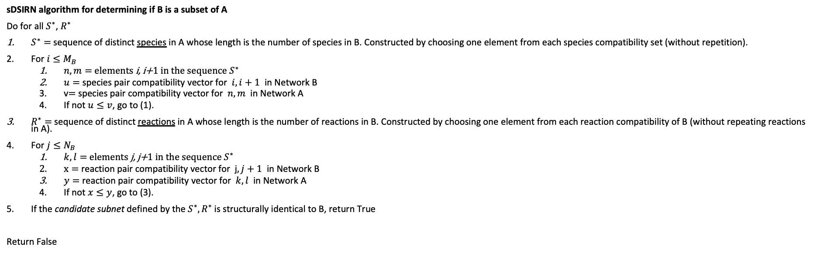
sDSIRN Algorithm for Detecting Subnets
Network A
Network B
J1: S1 -> S2 + S3
J2: S1 + S3 -> S2
J3: S2 -> S1
J4: -> S2
Jp1: Sp1 -> Sp2
Jp2: -> Sp1
sDSIRN algorithm for determining if B is a subset of A
Do for all $S^{∗}$, $R^{∗}$
$S^{∗}=$sequence of distinct species in A whose length is the number of species in B. Constructed by choosing one element from each species compatibility set (without repetition).
For $i≤M_{B}$
$n,m=$ elements i, i+1 in the sequence $S^{∗}$
$u=$ species pair compatibility vector for $i,i+1$ in Network B
v$=$ species pair compatibility vector for $n,m$ in Network A
If not $u≤v$, go to (1).
$R^{∗}=$ sequence of distinct reactions in A whose length is the number of reactions in B. Constructed by choosing one element from each reaction compatibility of B (without repeating reactions in A).
For $j≤N_{B}$
$k,l=$ elements j, j+1 in the sequence $S^{∗}$
$x=$ reaction pair compatibility vector for j$,j+1$ in Network B
$y=$ reaction pair compatibility vector for $k,l$ in Network A
If not $x≤y$, go to (3).
If the candidate subnet defined by the $S^{∗},R^{∗}$ is structurally identical to B, return True
Return False

Slide 42
Must Consider the Reactant and Product Stoichiometries

Slide 43
Next Steps
Continued analysis of structural identity in OscillatorDatabase. Others are welcome to join.
Publish DSIRN.

Slide 44
BACKUP

Slide 45
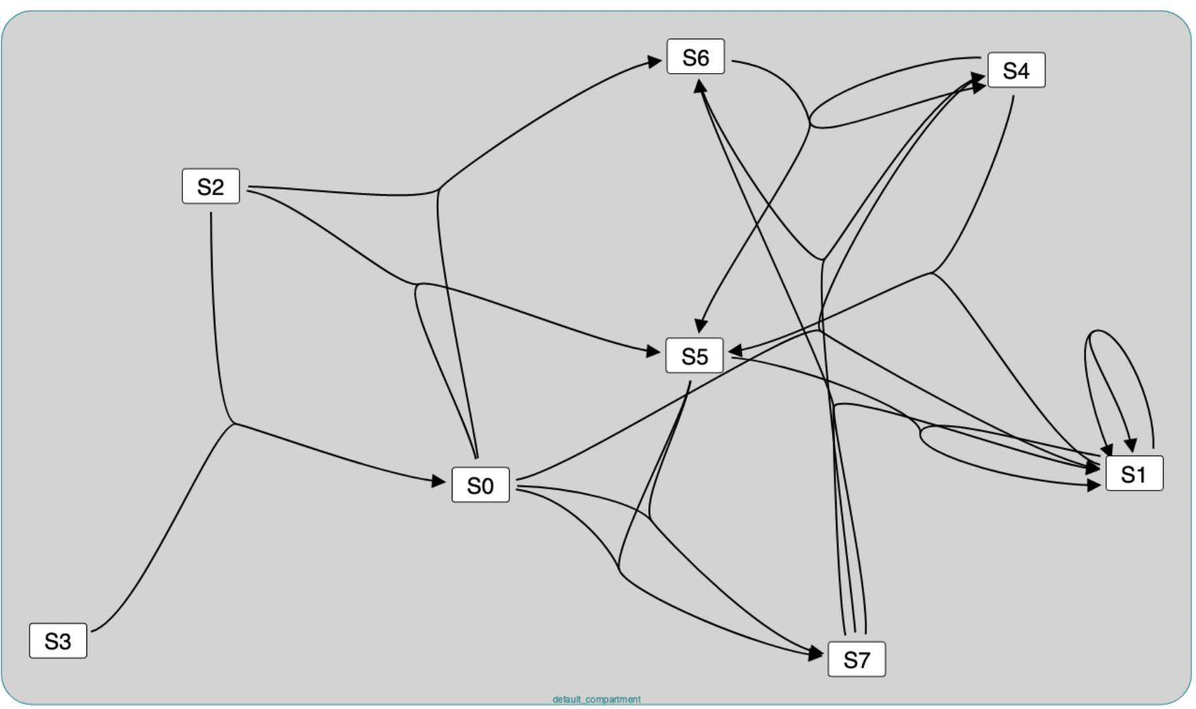
Challenging to Detect Structurally Identical Networks
S4 + S0 -> S1; S4*S0*37.7493737973273; S0 + $S2 -> S6; S0*S2*35.0428546214942; $S2 + $S3 -> S0; S2*S3*38.0495574990753; S4 + S1 -> S5; S4*S1*21.0195844085421; S6 + S7 -> S4; S6*S7*0.018191490881145; S7 + S7 -> S6 + S1; S7*S7*0.966901054093614; S5 + S0 -> S7; S5*S0*1.34591737547889; $S2 + S0 -> S5; S2*S0*0.202525362744927; S1 -> S1 + S1; S1*0.696320992102846; S4 + S6 -> S5 + S4; S4*S6*0.196191486017778; S5 + S1 -> S1; S5*S1*0.0931307581719011; S5 + S0 -> S7; S5*S0*0.99658994381316; S0 = 2; S1 = 5; S2 = 7; S3 = 10; S4 = 1; S5 = 0.5; S6 = 3; S7 = 7;

Slide 46





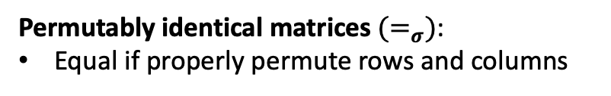



























(a)
$$R_{1}: A→B$$
$$R_{1}^{′}: Y→X$$
(c)
$$R_{1}^{′′}:T→S$$
$$R_{2}: B→A$$
$$R_{2}^{′}: →X$$
$$R_{2}^{′′}:S→$$
$$R_{3}: →B$$
$$R_{3}^{′}: X→Y$$
$$R_{3}^{′′}:S→T$$
(b)
$$M_{1}$$
 | A | B
 | -1 | 1
 | 1 | -1
 | 0 | 1
$$M_{2}$$
 | X | Y
 | 1 | -1
 | 1 | 0
 | -1 | 1
$$R_{1}$$
$$R_{1}^{′}$$
$$≠$$
$$R_{2}$$
$$R_{2}^{′}$$
$$R_{3}$$
$$R_{3}^{′}$$
$$M_{3}$$
 | S | T
 | 1 | -1
 | -1 | 0
 | -1 | 1
$$M_{1}$$
 | A | B
 | -1 | 1
 | 1 | -1
 | 0 | 1
$$M_{2}$$
 | X | Y
 | 1 | -1
 | 1 | 0
 | -1 | 1
$$≠_{σ}$$
$$R_{1}^{′′}$$
$$R_{1}$$
$$R_{1}^{′}$$
$$=_{σ}$$
swap
$$R_{2}^{′′}$$
$$R_{2}$$
$$R_{2}^{′}$$
$$R_{3}^{′′}$$
$$R_{3}$$
$$R_{3}^{′}$$
swap
Structurally identical reaction networks have stoichiometry matrices that are permutably identical.
Permutably identical matrices${ (=}_{σ})$:
Equal if properly permute rows and columns

Slide 47
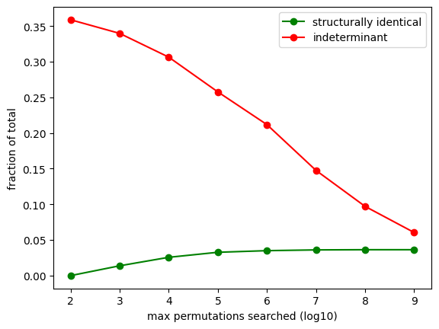
Effect of Deeper Search

Slide 48











DSIRN: Detecting Structurally Identical Reaction Networks: 2
1,001,001
2,000,001
1,001,001
2,000,001
$$M_{1}$$
 | A | B
 | -1 | 1
 | 1 | -1
 | 0 | 1
$$M_{2}$$
 | Y | X
 | -1 | 1
 | 1 | -1
 | 0 | 1
1,000,001
$$R_{1}$$
?
1,000,001
$$R_{1}^{′}$$
1,000,001
$$R_{2}$$
$$=$$
1,000,001
$$R_{3}^{′}$$
1,001,000
$$R_{3}$$
1,001,000
$$R_{2}^{′}$$
1,001,001
2,000,001
1,001,001
2,000,001
$$M_{1}$$
 | A | B
 | -1 | 1
 | 1 | -1
 | 0 | 1
$$M_{2}$$
 | Y | X
 | -1 | 1
 | 1 | -1
 | 0 | 1
1,000,001
$$R_{1}$$
?
1,000,001
$$R_{1}^{′}$$
1,000,001
$$R_{2}$$
$$=$$
1,000,001
$$R_{3}^{′}$$
1,001,000
$$R_{3}$$
1,001,000
$$R_{2}^{′}$$

