Slide 1
Detecting Structurally Equivalent Chemical Reaction Networks

Slide 2





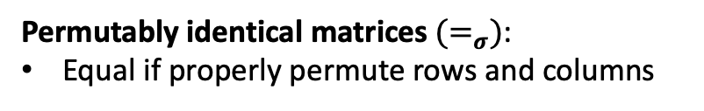



























(a)
$$R_{1}: A→B$$
$$R_{1}^{′}: Y→X$$
(c)
$$R_{1}^{′′}:T→S$$
$$R_{2}: B→A$$
$$R_{2}^{′}: →X$$
$$R_{2}^{′′}:S→$$
$$R_{3}: →B$$
$$R_{3}^{′}: X→Y$$
$$R_{3}^{′′}:S→T$$
(b)
$$M_{1}$$
 | A | B
 | -1 | 1
 | 1 | -1
 | 0 | 1
$$M_{2}$$
 | X | Y
 | 1 | -1
 | 1 | 0
 | -1 | 1
$$R_{1}$$
$$R_{1}^{′}$$
$$≠$$
$$R_{2}$$
$$R_{2}^{′}$$
$$R_{3}$$
$$R_{3}^{′}$$
$$M_{3}$$
 | S | T
 | 1 | -1
 | -1 | 0
 | -1 | 1
$$M_{1}$$
 | A | B
 | -1 | 1
 | 1 | -1
 | 0 | 1
$$M_{2}$$
 | X | Y
 | 1 | -1
 | 1 | 0
 | -1 | 1
$$≠_{σ}$$
$$R_{1}^{′′}$$
$$R_{1}$$
$$R_{1}^{′}$$
$$=_{σ}$$
swap
$$R_{2}^{′′}$$
$$R_{2}$$
$$R_{2}^{′}$$
$$R_{3}^{′′}$$
$$R_{3}$$
$$R_{3}^{′}$$
swap
Structurally identical reaction networks have stoichiometry matrices that are permutably identical.
Permutably identical matrices${ (=}_{σ})$:
Equal if properly permute rows and columns

Slide 3
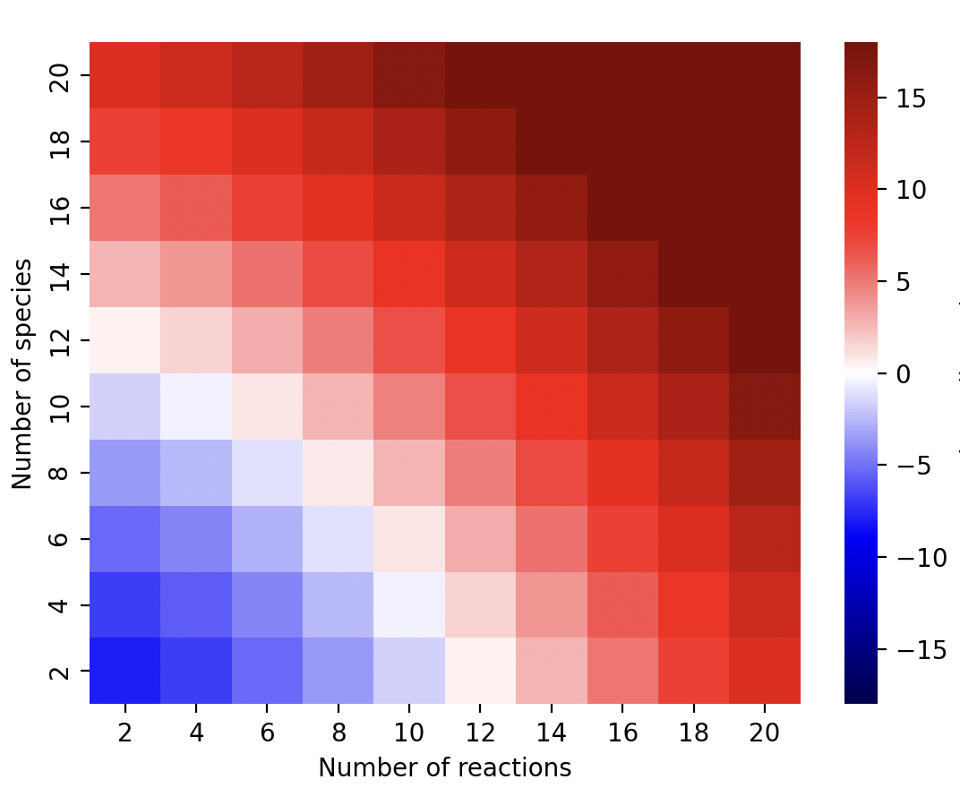
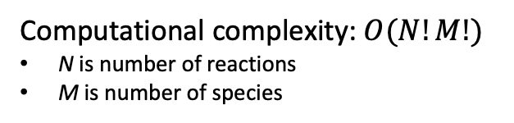
Computational Complexity of Naïve Algorithm for Permutably Identical Reaction Networks
Naïve Algorithm
def isPIdentical(M1:matrix, M2:matrix):
for rp in reaction_permutations
for sp in species_permutations
if M1[rp, sp] == M2;
return True
return False
age of universe
millennium
century
year
day
hour
Computational complexity: $O(N!M!)$
N is number of reactions
M is number of species
second
Long compute times on modest size networks:
5 species, 10 reactions
2 yrs (Mac M1, 12 usec/comparison)
log₁₀ (hour) on mac M1

