Slide 1
Detecting Structurally Equivalent Chemical Reaction Networks

Slide 2
Notes
Define structurally identical. Relate to CRN lit.
Simple algorithm
June 9, 10,000. strong insight.
Computational complexity: theory, actuality. Time/num permutation vs. %clustered
Algorithm

Slide 3
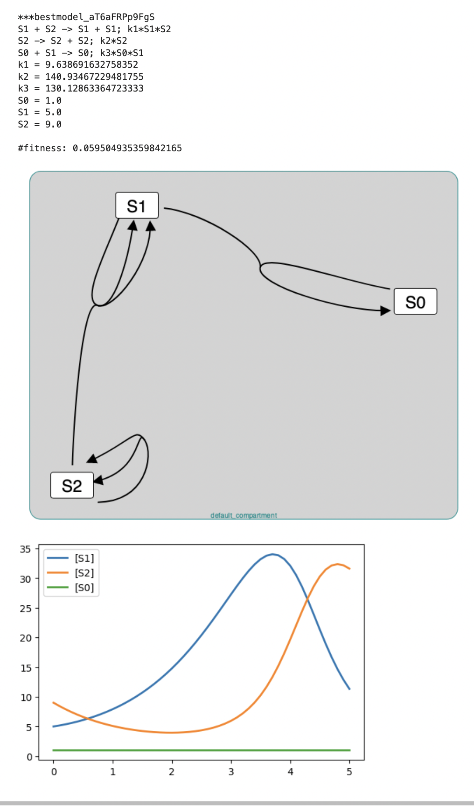
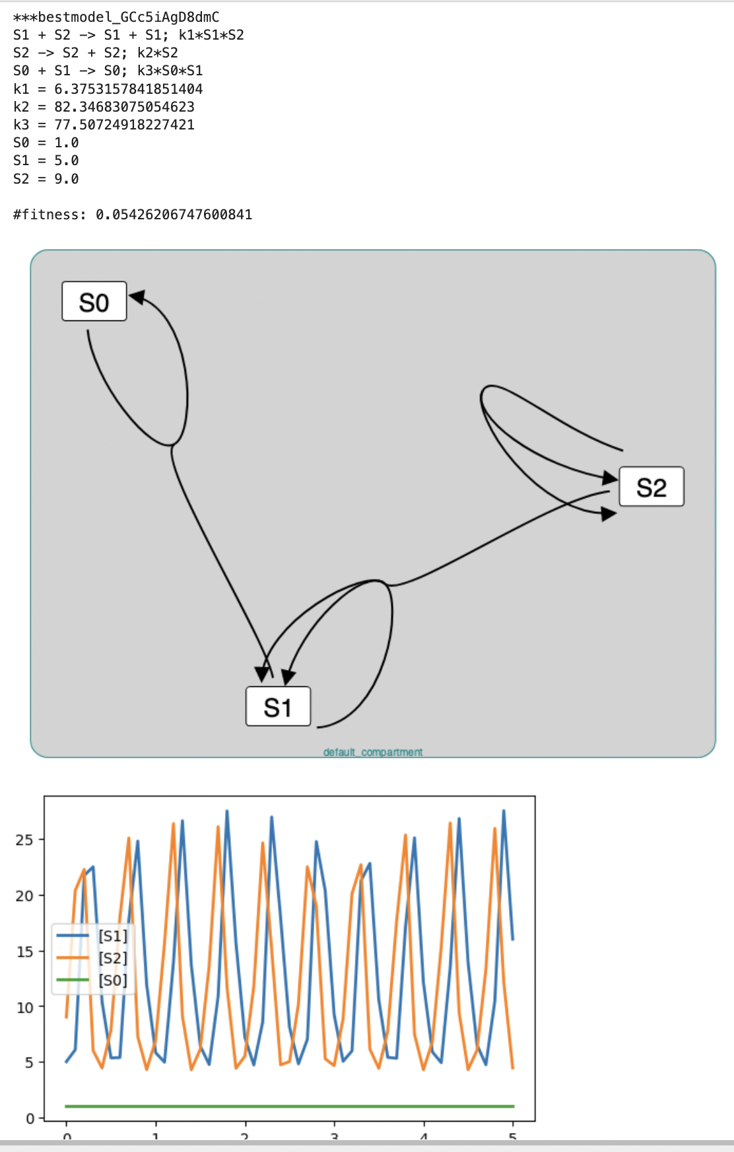
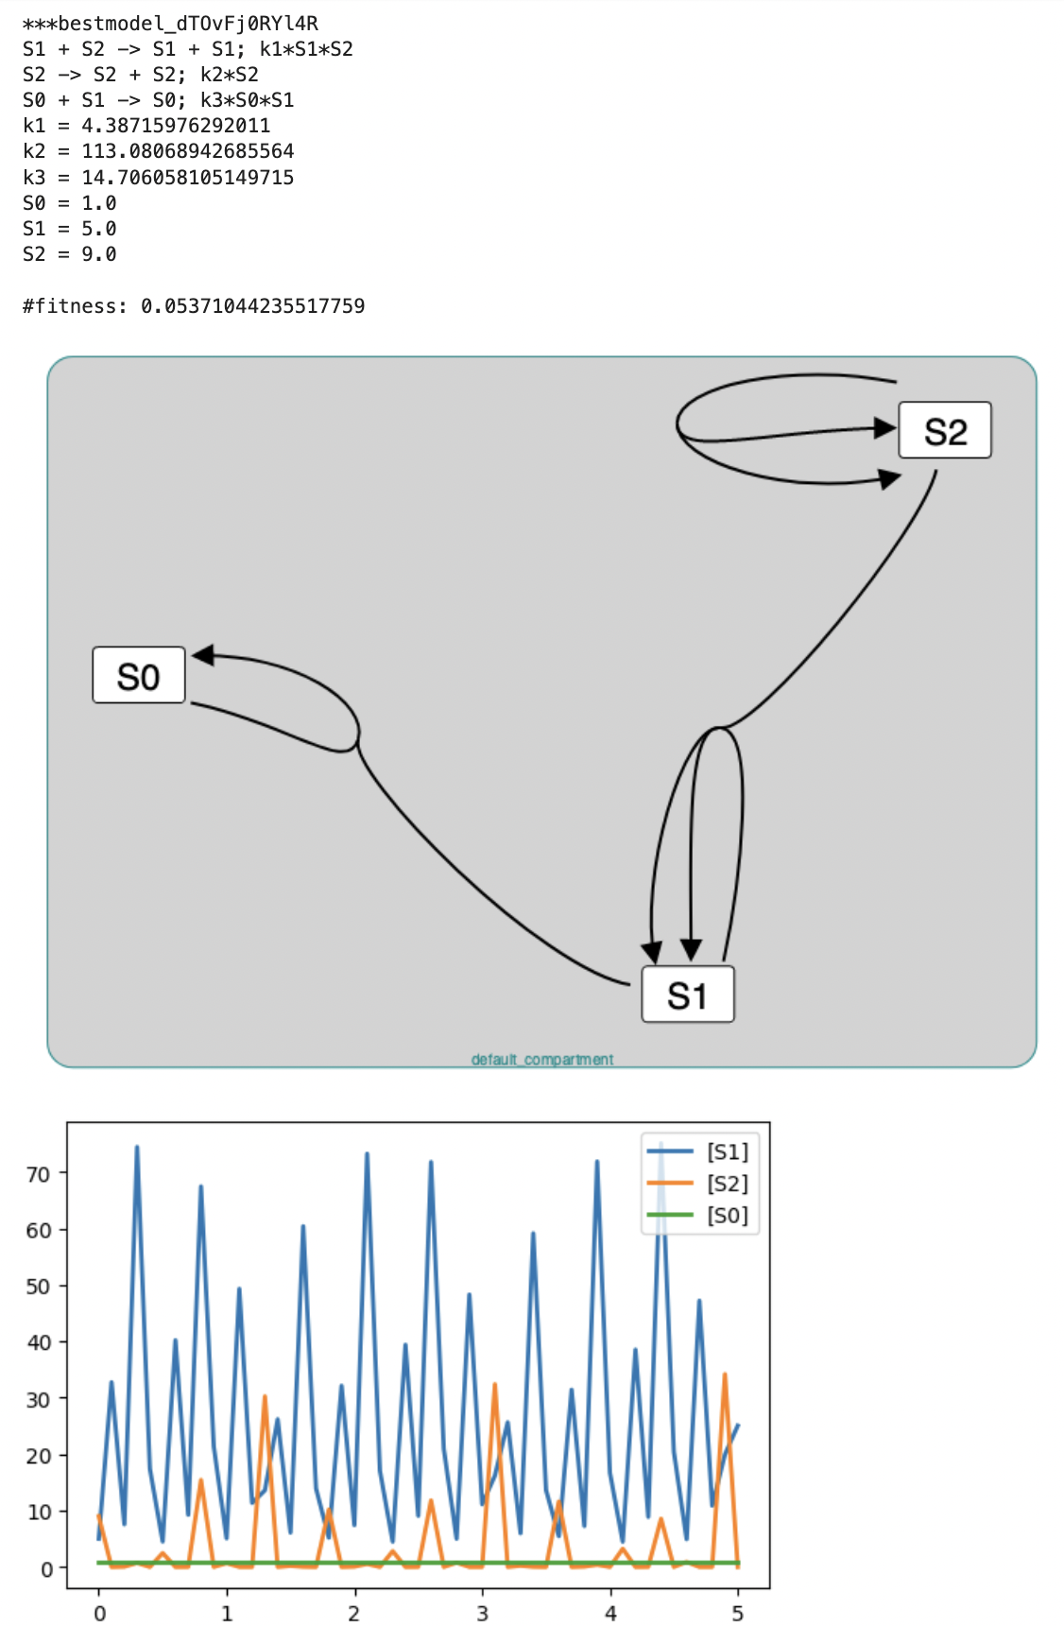
Structurally Identical Networks + Different Parameters = Different Oscillations (Oscillators_DOE_JUNE_12_B_41373)

Slide 4
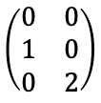
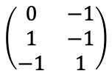
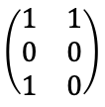
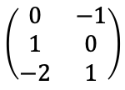
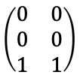
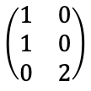
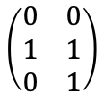
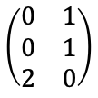
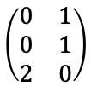
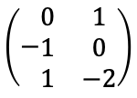
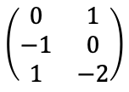
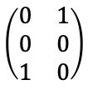
Structurally Identical Reaction Networks
Network A
J1: S1 + S2 -> S1 + S3
J2: S3 + S3 -> S1
Network B
J1: S3 + S3 -> S2
J2: S1 + S2 -> S2 + S3
Network C
J1: S2 -> S3
J2: S3 + S3 -> S1
Network D
J1: S3 + S3 -> S3
J2: S1 + S2 -> S3
product
reactant
difference
product
reactant
difference
product
reactant
difference
product
reactant
difference
$$\left(\begin{matrix}1 & 1 \\ 0 & 0 \\ 1 & 0\end{matrix}\right)$$
$$\left(\begin{matrix}1 & 0 \\ 1 & 0 \\ 0 & 2\end{matrix}\right)$$
$$\left(\begin{matrix}0 & 1 \\ −1 & 0 \\ 1 & −2\end{matrix}\right)$$
$$\left(\begin{matrix}0 & 0 \\ 1 & 1 \\ 0 & 1\end{matrix}\right)$$
$$\left(\begin{matrix}0 & 1 \\ 0 & 1 \\ 2 & 0\end{matrix}\right)$$
$$\left(\begin{matrix}0 & −1 \\ 1 & 0 \\ −2 & 1\end{matrix}\right)$$
$$\left(\begin{matrix}0 & 1 \\ 0 & 0 \\ 1 & 0\end{matrix}\right)$$
$$\left(\begin{matrix}0 & 0 \\ 1 & 0 \\ 0 & 2\end{matrix}\right)$$
$$\left(−\begin{matrix}0 & 1 \\ 1 & 0 \\ 1 & −2\end{matrix}\right)$$
$$\left(\begin{matrix}0 & 0 \\ 0 & 0 \\ 1 & 1\end{matrix}\right)$$
$$\left(\begin{matrix}0 & 1 \\ 0 & 1 \\ 2 & 0\end{matrix}\right)$$
$$\left(\begin{matrix}0 & −1 \\ 1 & −1 \\ −1 & 1\end{matrix}\right)$$
Strong Identity: Renaming
Weak Identity: Capable of the Same Behavior
Networks have permutably identical
product stoichiometry matrices
reactant stoichiometry matrices
Ex: A & B (B is A swapping S1, S2 & J1, J2)
Networks have permutably identical matrices for the difference between
product stoichiometries
reactant stoichiometry matrices
Ex: A & C
Network D has no identity relationship with A, B, C

Slide 5






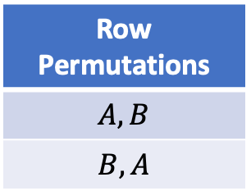





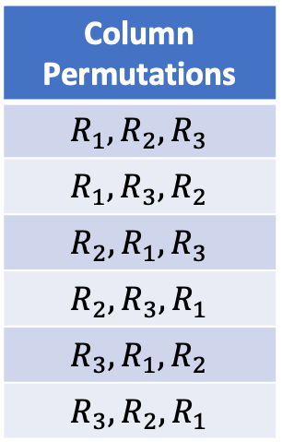









Example of Checking Permutably Identical
$$M_{1}$$
 | A | B
 | -1 | 1
 | 1 | -1
 | 0 | 1
$$M_{2}$$
 | X | Y
 | 1 | -1
 | 1 | 0
 | -1 | 1
$$R_{1}$$
?
$$R_{1}^{′}$$
$$=_{σ}$$
$$R_{2}$$
$$R_{2}^{′}$$
$$R_{3}$$
$$R_{3}^{′}$$
1. Find all of the permutations
2. For each permutation, check equality of matrices.
Column Permutations
$$R_{1},R_{2},R_{3}$$
$$R_{1},R_{3},R_{2}$$
$$R_{2},R_{1},R_{3}$$
$$R_{2},R_{3},R_{1}$$
$$R_{3},R_{1},R_{2}$$
$$R_{3},R_{2},R_{1}$$
Row Permutations
$$A, B$$
$$B, A$$
permuted $M_{1}$
 | B | A
 | 1 | -1
 | 0 | 1
 | -1 | 1
$$M_{2}$$
 | X | Y
 | 1 | -1
 | 1 | 0
 | -1 | 1
$$R_{1}$$
$$R_{1}^{′}$$
$$=$$
$$R_{3}$$
$$R_{2}^{′}$$
$$R_{2}$$
$$R_{3}^{′}$$
Reaction permutation: $R_{1},R_{3},R_{2}$
Column permutation: $B,A$
Total matrix permutations: 6*2=12

Slide 6
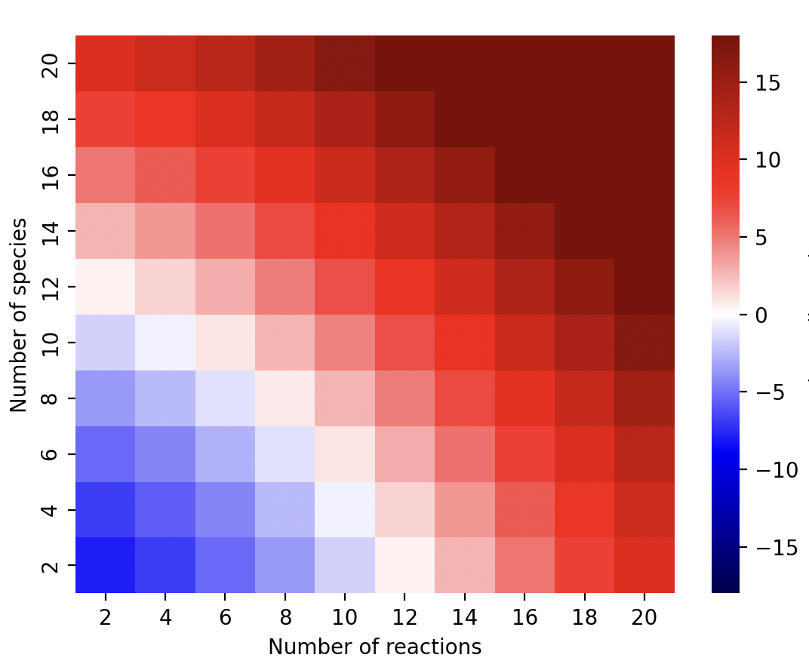
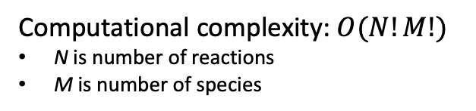
Computational Complexity of Naïve Algorithm to Detect if Two Reaction Networks are Structurally Identical Using Stoichiometry Matrices
Naïve Algorithm
def isPIdentical(M1:matrix, M2:matrix):
for rp in reaction_permutations
for sp in species_permutations
if M1[rp, sp] == M2;
return True
return False
--age of universe
--millennium
--century
--year
--day
Computational complexity: $O(N!M!)$
N is number of reactions
M is number of species
--hour
--second
Long compute times on modest size networks:
5 species, 10 reactions
1.5 hrs (Mac M1, 12 usec/comparison)
log₁₀ (hour) on mac M1

Slide 7
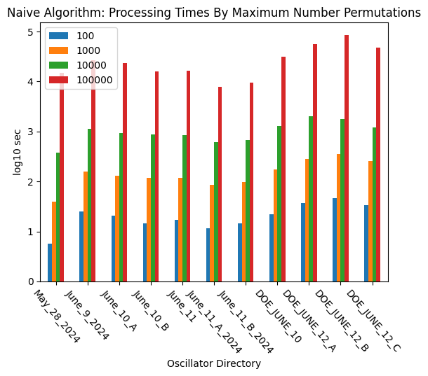
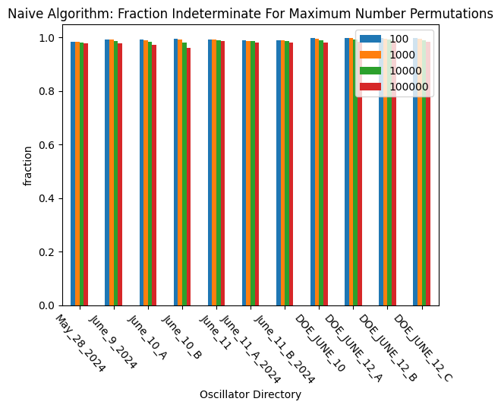
Applying Naïve Algorithm to OscillatorDatabase
1 day
3 hours
30 min
Have been running naïve algorithm with maximum number permutations of 1,000,000 for a week.
Conclusion: Can evaluate only a small fraction of models for structural identity using the naïve algorithm.

Slide 8










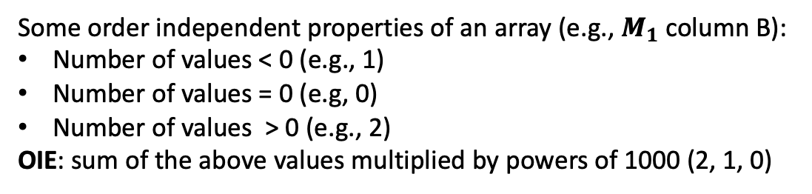








Order Independent Encoding (OIE) of Arrays
Some order independent properties of an array (e.g., $M_{1}$column B):
Number of values < 0 (e.g., 1)
Number of values = 0 (e.g, 0)
Number of values > 0 (e.g., 2)
OIE: sum of the above values multiplied by powers of 1000 (2, 1, 0)
$$M_{1}$$
 | A | B
 | -1 | 1
 | 1 | -1
 | 0 | 1
$$M_{2}$$
 | X | Y
 | 1 | -1
 | 1 | 0
 | -1 | 1
$$M_{3}$$
 | S | T
 | 1 | -1
 | -1 | 0
 | -1 | 1
$$R_{1}$$
$$R_{1}^{′}$$
$$R_{1}^{′′}$$
$$R_{2}$$
$$R_{2}^{′}$$
$$R_{2}^{′′}$$
$$R_{3}$$
$$R_{3}^{′}$$
$$R_{3}^{′′}$$
$R_{1}$: 1,000,001; $R_{2}:$1,000,001; $R_{3}:$1,001,000
$R_{1}^{′}$: 1,000,001; $R_{2}^{′}$: 1,001,000; $R_{3}^{′}:$1,000,001
$R_{1}^{′′}$: 1,000,001; $R_{2}^{′′}$1,001; $R_{3}^{′′}:$1,000,001
$A$: 1,001,001; $B:$2,000,001
$X$: 2,001,001; $Y:$1,000,001
$S$: 1,000,002; $T:$1,001,001

Slide 9


















DSIRN: Detecting Structurally Identical Reaction Networks: 1
Key insight: Only compare rows (columns) in $M_{1}$ with those in $M_{2}$that have the same order independent encoding (OIE).
1. Sort the rows of columns of the matrices by their order independent encodings.
$$M_{1}$$
 | A | B
 | -1 | 1
 | 1 | -1
 | 0 | 1
$$M_{2}$$
 | X | Y
 | 1 | -1
 | 1 | 0
 | -1 | 1
$$R_{1}$$
$$R_{1}^{′}$$
$$R_{2}$$
$$R_{2}^{′}$$
$$R_{3}$$
$$R_{3}^{′}$$
$R_{1}$: 1,000,001; $R_{2}:$1,000,001; $R_{3}:$1,001,000
$R_{1}^{′}$: 1,000,001; $R_{2}^{′}$: 1,001,000; $R_{3}^{′}:$1,000,001
$A$: 1,001,001; $B:$2,000,001
$X$: 2,001,001; $Y:$1,000,001
1,001,001
2,000,001
1,001,001
2,000,001
$$M_{1}$$
 | A | B
 | -1 | 1
 | 1 | -1
 | 0 | 1
$$M_{2}$$
 | Y | X
 | -1 | 1
 | 1 | -1
 | 0 | 1
1,000,001
$$R_{1}$$
1,000,001
$$R_{1}^{′}$$
1,000,001
$$R_{2}$$
1,000,001
$$R_{3}^{′}$$
1,001,000
$$R_{3}$$
1,001,000
$$R_{2}^{′}$$

Slide 10









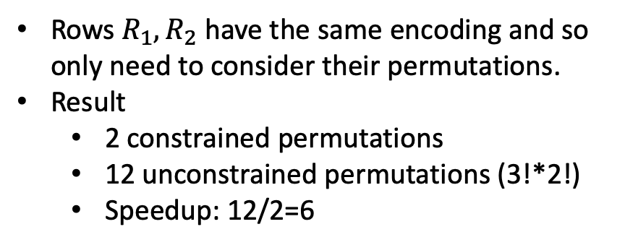








DSIRN: Detecting Structurally Identical Reaction Networks: 2
1,001,001
2,000,001
1,001,001
2,000,001
$$M_{1}$$
 | A | B
 | -1 | 1
 | 1 | -1
 | 0 | 1
$$M_{2}$$
 | Y | X
 | -1 | 1
 | 1 | -1
 | 0 | 1
Rows $R_{1},R_{2}$ have the same encoding and so only need to consider their permutations.
Result
2 constrained permutations
12 unconstrained permutations (3!*2!)
Speedup: 12/2=6
1,000,001
$$R_{1}$$
?
1,000,001
$$R_{1}^{′}$$
1,000,001
$$R_{2}$$
$$=$$
1,000,001
$$R_{3}^{′}$$
1,001,000
$$R_{3}$$
1,001,000
$$R_{2}^{′}$$
1,001,001
2,000,001
1,001,001
2,000,001
$$M_{1}$$
 | A | B
 | 1 | -1
 | -1 | 1
 | 0 | 1
$$M_{2}$$
 | Y | X
 | -1 | 1
 | 1 | -1
 | 0 | 1
1,000,001
$$R_{2}$$
?
1,000,001
$$R_{1}^{′}$$
1,000,001
$$R_{1}$$
$$=$$
1,000,001
$$R_{3}^{′}$$
1,001,000
$$R_{3}$$
1,001,000
$$R_{2}^{′}$$

Slide 11
DSIRN Algorithm for Strong Identity
Inputs
Network 1 reactant stoichiometry matrix M1r, product stoichiometry matrix M1p
Network 2 reactant stoichiometry matrix M2r, product stoichiometry matrix M2p
Steps
Construct order independent encodings of all matrices, sorting the rows and columns by increasing values of their OIEs.
Evaluate all encoding constrained permutations for the reactant stoichiometry matrices. If no identity is found, return False.
For each instance identity permutation, compare the product stoichiometry matrices. If identical, return True.
If no permutation produces identical reactant and product stoichiometry matrices, return False.

Slide 12
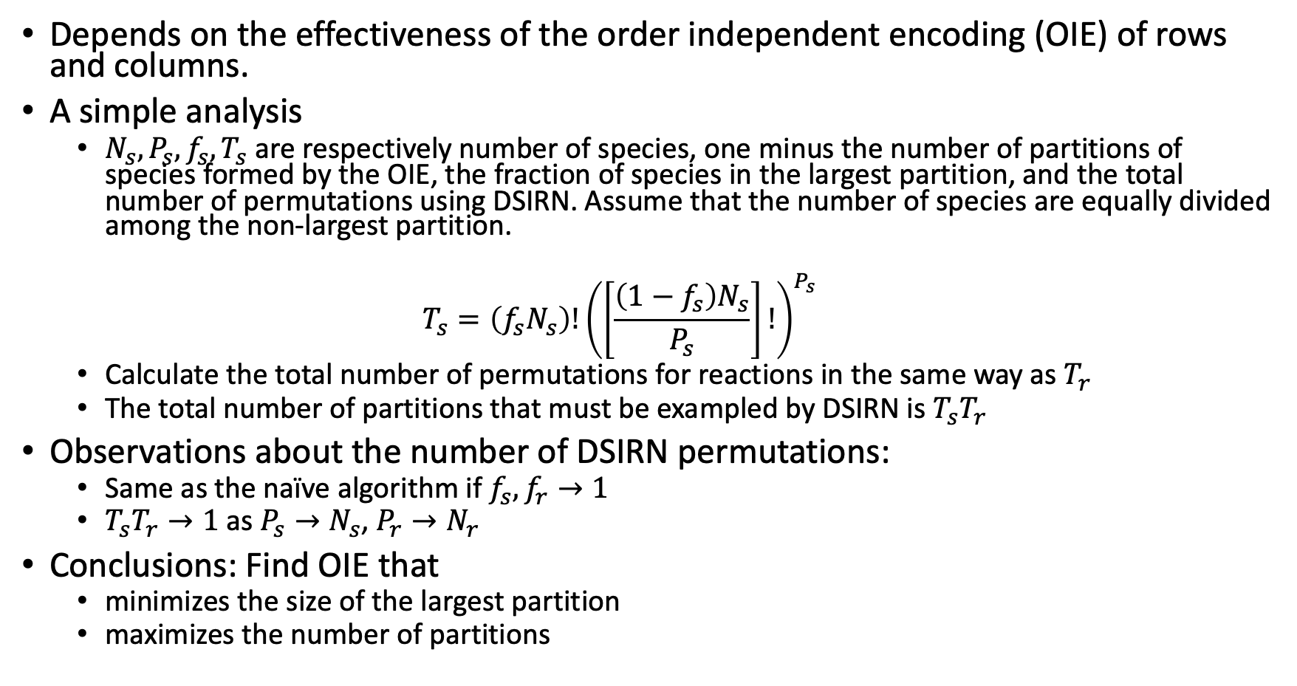
Analysis of DSIRN Algorithm
Depends on the effectiveness of the order independent encoding (OIE) of rows and columns.
A simple analysis
$N_{s}, P_{s}, f_{s}, T_{s}$ are respectively number of species, one minus the number of partitions of species formed by the OIE, the fraction of species in the largest partition, and the total number of permutations using DSIRN. Assume that the number of species are equally divided among the non-largest partition.
$$T_{s}=\left(f_{s}N_{s}\right)!{\left(\left[\frac{\left(1−f_{s}\right)N_{s}}{P_{s}}\right]!\right)}^{P_{s}}$$
Calculate the total number of permutations for reactions in the same way as $T_{r}$
The total number of partitions that must be exampled by DSIRN is $T_{s}T_{r}$
Observations about the number of DSIRN permutations:
Same as the naïve algorithm if $f_{s}, f_{r}→1$
$T_{s}T_{r}→1$ as $P_{s}→N_{s}$, $P_{r}→N_{r}$
Conclusions: Find OIE that
minimizes the size of the largest partition
maximizes the number of partitions

Slide 13
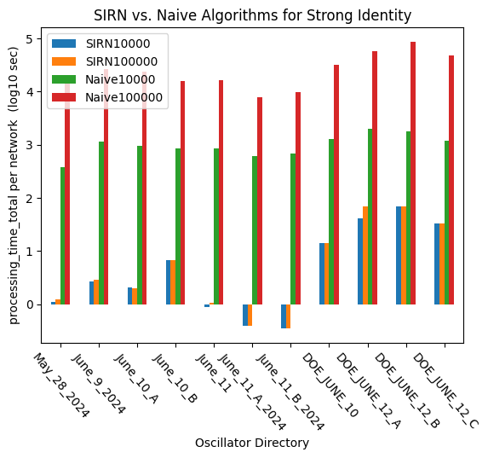
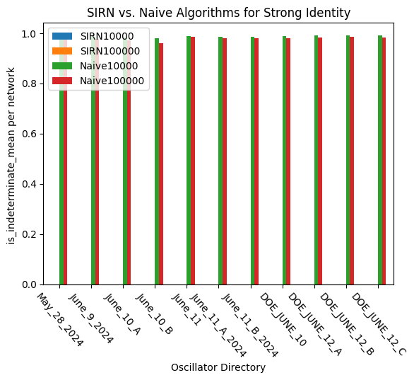
DSIRN Efficiently Clusters Structurally Identical Networks.
1 day
3 hours
30 min

Slide 14
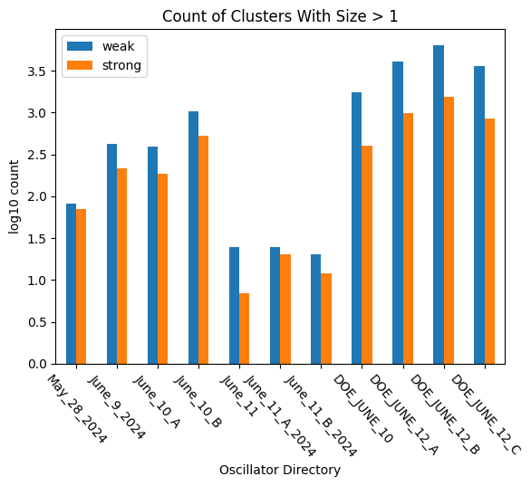
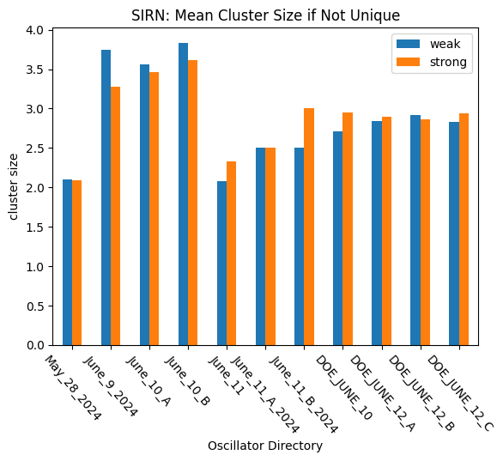
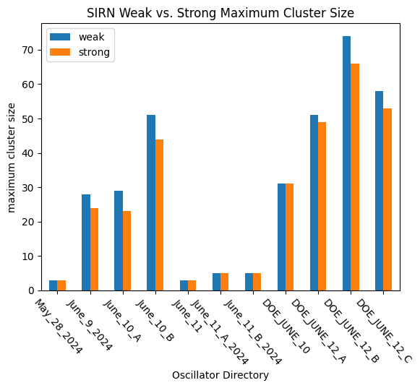
Preliminary Analysis for OscillatorDatabase

Slide 15
Next Steps
Continued analysis of structural identity in OscillatorDatabase. Others are welcome to join.
Publish DSIRN.

Slide 16
BACKUP

Slide 17





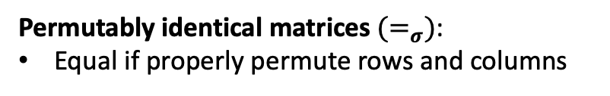



























(a)
$$R_{1}: A→B$$
$$R_{1}^{′}: Y→X$$
(c)
$$R_{1}^{′′}:T→S$$
$$R_{2}: B→A$$
$$R_{2}^{′}: →X$$
$$R_{2}^{′′}:S→$$
$$R_{3}: →B$$
$$R_{3}^{′}: X→Y$$
$$R_{3}^{′′}:S→T$$
(b)
$$M_{1}$$
 | A | B
 | -1 | 1
 | 1 | -1
 | 0 | 1
$$M_{2}$$
 | X | Y
 | 1 | -1
 | 1 | 0
 | -1 | 1
$$R_{1}$$
$$R_{1}^{′}$$
$$≠$$
$$R_{2}$$
$$R_{2}^{′}$$
$$R_{3}$$
$$R_{3}^{′}$$
$$M_{3}$$
 | S | T
 | 1 | -1
 | -1 | 0
 | -1 | 1
$$M_{1}$$
 | A | B
 | -1 | 1
 | 1 | -1
 | 0 | 1
$$M_{2}$$
 | X | Y
 | 1 | -1
 | 1 | 0
 | -1 | 1
$$≠_{σ}$$
$$R_{1}^{′′}$$
$$R_{1}$$
$$R_{1}^{′}$$
$$=_{σ}$$
swap
$$R_{2}^{′′}$$
$$R_{2}$$
$$R_{2}^{′}$$
$$R_{3}^{′′}$$
$$R_{3}$$
$$R_{3}^{′}$$
swap
Structurally identical reaction networks have stoichiometry matrices that are permutably identical.
Permutably identical matrices${ (=}_{σ})$:
Equal if properly permute rows and columns

Slide 18
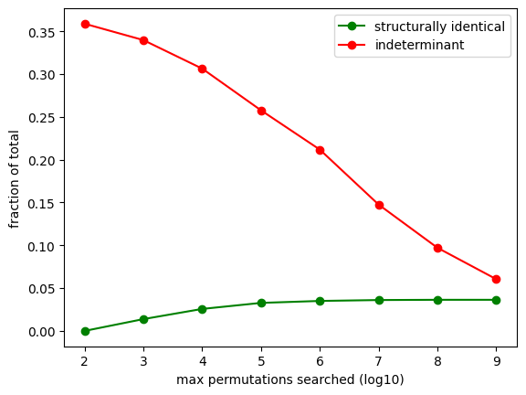
Effect of Deeper Search

Slide 19












DSIRN: Detecting Structurally Identical Reaction Networks: 2
1,001,001
2,000,001
1,001,001
2,000,001
$$M_{1}$$
 | A | B
 | -1 | 1
 | 1 | -1
 | 0 | 1
$$M_{2}$$
 | Y | X
 | -1 | 1
 | 1 | -1
 | 0 | 1
1,000,001
$$R_{1}$$
?
1,000,001
$$R_{1}^{′}$$
1,000,001
$$R_{2}$$
$$=$$
1,000,001
$$R_{3}^{′}$$
1,001,000
$$R_{3}$$
1,001,000
$$R_{2}^{′}$$
1,001,001
2,000,001
1,001,001
2,000,001
$$M_{1}$$
 | A | B
 | -1 | 1
 | 1 | -1
 | 0 | 1
$$M_{2}$$
 | Y | X
 | -1 | 1
 | 1 | -1
 | 0 | 1
1,000,001
$$R_{1}$$
?
1,000,001
$$R_{1}^{′}$$
1,000,001
$$R_{2}$$
$$=$$
1,000,001
$$R_{3}^{′}$$
1,001,000
$$R_{3}$$
1,001,000
$$R_{2}^{′}$$

