Slide 1
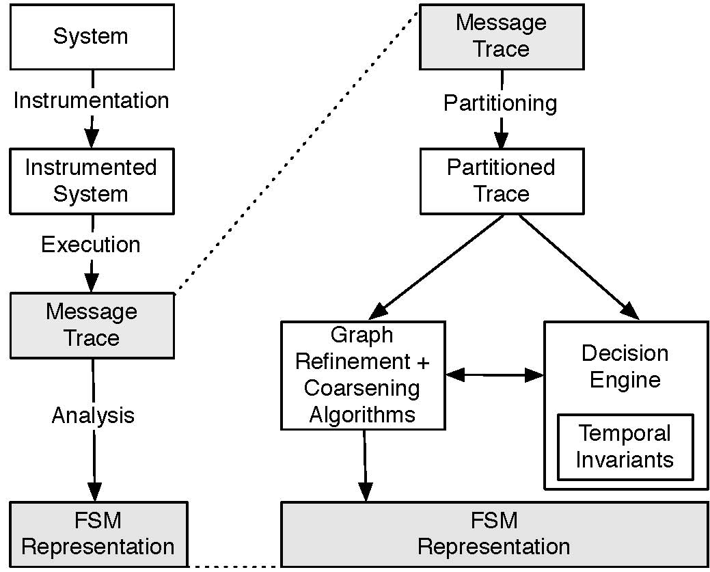
The Synoptic Analysis Pipeline

Slide 2
Trace Partitioning
User choses a predicate
Examples (Source, Timestamp range, Parameter, etc)
Trace is partitioned on the predicate into a set of trace partitions.
Crucial to encode domain knowledge.
Example: For 2-Phase Commit each partition is an instance of the protocol execution.

Slide 3
Trace Partitioning Example with NFS
Unparitioned:
Partitioned by file ID:
Lookup file1
Lookup file2
Access file2
Access file1
Access file1
Read file2
Read file1
Getattr file2
Read file1
Write file2
Could infer invariant:
“lookup file1”
always precedes
“access file 2”
But this doesn’t make sense.
p₀ p₁
Lookup file1 Lookup file2
Access file1 Access file2
Access file1 Read file2
Read file1 Getattr file2
Read file1 Write file2
Invariants inferred from these traces will be over access patterns to a particular file.

Slide 4
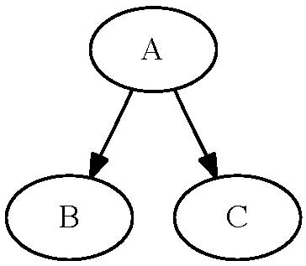
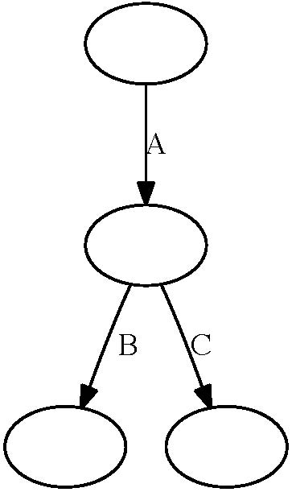
Interpreting Traces As Graphs
Relational Representation
System State Representation
Captures the notion that messages are temporally related.
Captures the notion that messages represent change in system state.
Note that we can convert one representation to the other

Slide 5
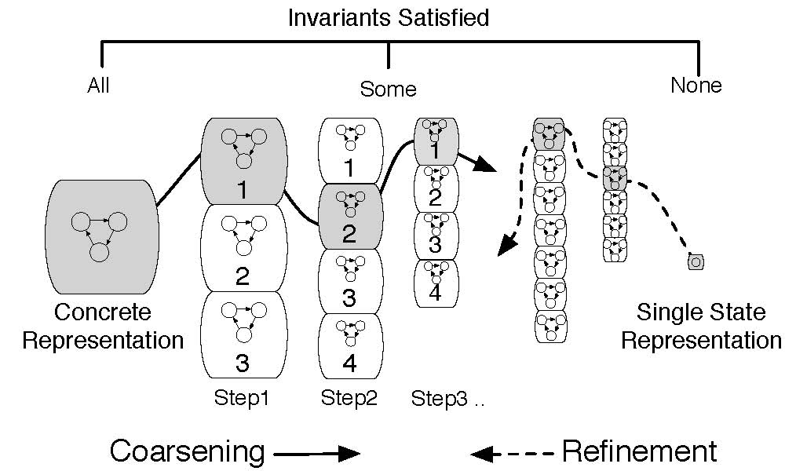
Exploring the Representations
Converge on the answer using either graph coarsening or graph refinement

Slide 6

Coarsening
Starts of with the most precise trace description - a linear graph for each trace partition:
Graph is the system state representation of the trace.
Tries to compress the graph to get a concise representation.

Slide 7
Coarsening Algorithm: GK-Tail [1]
Given a state in the graph we define its k-Tail as the subgraph made by the frontier k edges out
The 2-tail of the state S in the graph below is in blue:
S

Slide 8
Coarsening Algorithm: GK-Tail [2]
GK-Tail algorithm idea: if two states have equivalent k-Tails, we merge them.
Repeat until there are no more states to merge.
baz
bees
baz
bees
S
S’
S
bar
foo
bar
foo
GK-Tail
bar
foo
booze
booze
booze

Slide 9
GK-Tail: What Is Equivalent?
Strict notion of equivalence: k-Tails exactly equal.
Advantage: True equivalence relation – algorithm result is deterministic.
Disadvantage: Often too strict for meaningful data reduction.
Subsumption equivalence: k-Tail of S’ contained within the k-Tail of S
Advantage: Reduces representation much more efficiently
Disadvantage: Not an equivalence relation – output of algorithm is a local optimum, may not be global.

Slide 10
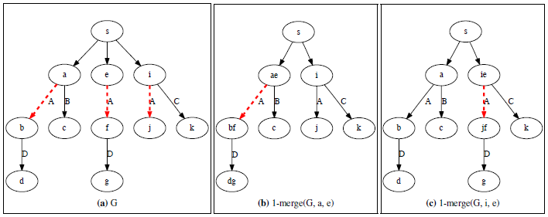
GK-Tail: Subsumption Nondeterminsim
Multiple merge candidates for e: a and i both work.
After merge, algorithm produces distinct results - both local optima.
Result of 1-merge on (a) can be either (b) or (c)
If we chose to merge at e and a we get (b)
If we chose to merge at e and i we get (c)

Slide 11
GK-Tail: When can we merge? [1]
The notion of k-Tails does not capture all desired properties of the trace.
Example: Messages more than k apart are temporally related.
One solution: Make k bigger
Problem: If we make k too big summarization will be weak
Another problem: There could be other relationships.
How do we chose the right value of k?
In general, this is hard – encodes domain knowledge.

Slide 12
GK-Tail: When can we merge? [2]
Our Solution: Compute and encode invariants about the trace
We call a graph valid if it satisfies the invariants of the original trace.
When performing the GK-Tail algorithm make sure that each merge produces a valid graph.
GK-Tail now repeats until there are no more states to merge with matching k-Tails OR no ones that will lead to a valid graph.

Slide 13
GK-Tail Performance
Trivial implementation is O(n³)
For current graph have to consider at most merging every state to every other state (n²)
Each merge removes a state – can do at most n merges.
Can we do better?

Slide 14
Scalable GK-Tail
Key Idea: Divide and Conquer.
We can perform GK-Tail on subgraphs and then perform GK-Tail on the resulting graph if we pick the subgraphs carefully.
DSF
DSF
DSF
GK-Tail
GK-Tail
Theoretical complexity is the same – O(n³)
Worst case: no chosen sub-graph is mergeable.
In practice, the expectation is that each sub-graph will have approximately the same distribution of messages as the complete graph.

Slide 15
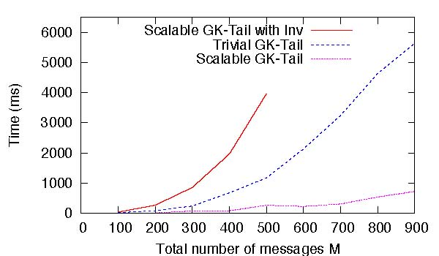
GK-Tail Performance
Input is a repeated sequence of messages
GK-Tail performance is polynomial
Scalable GK-Tail performance is roughly linear
Still slow when we use Invariants.

