Slide 1
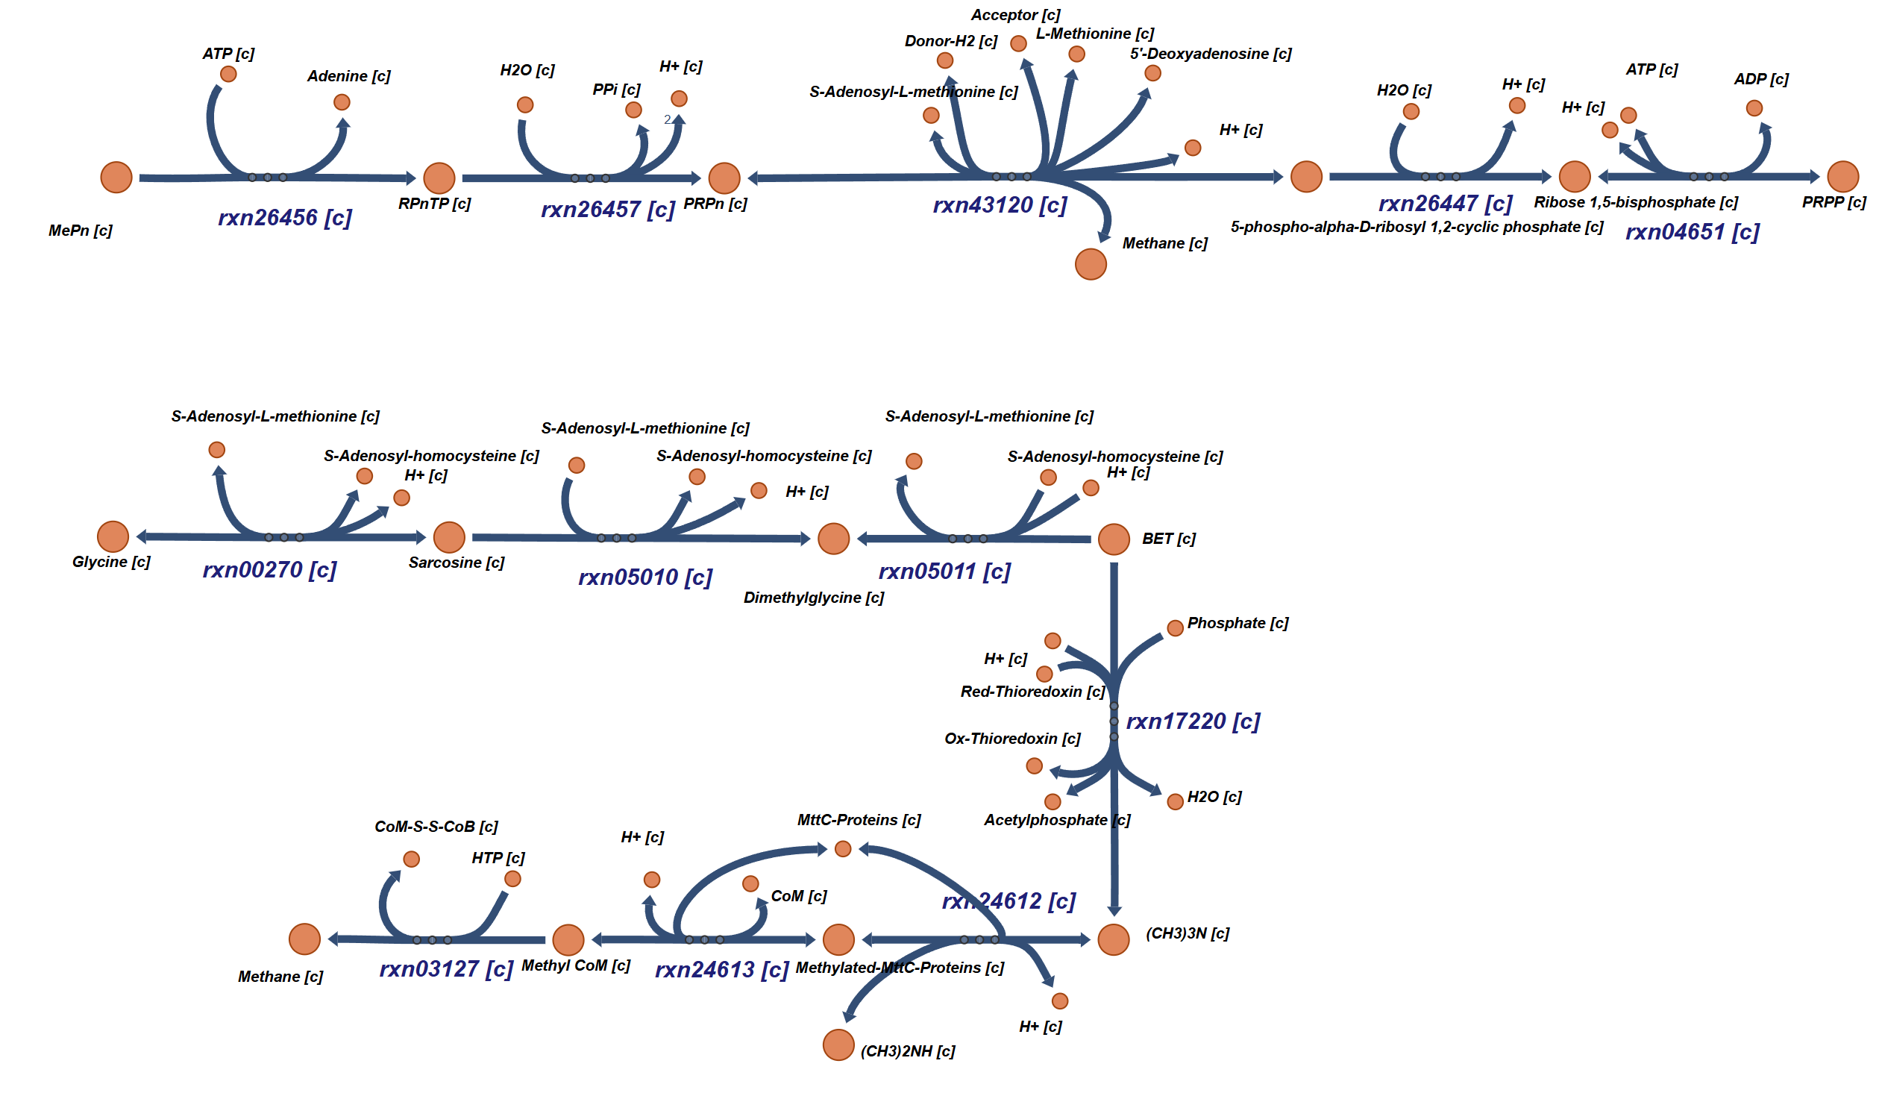
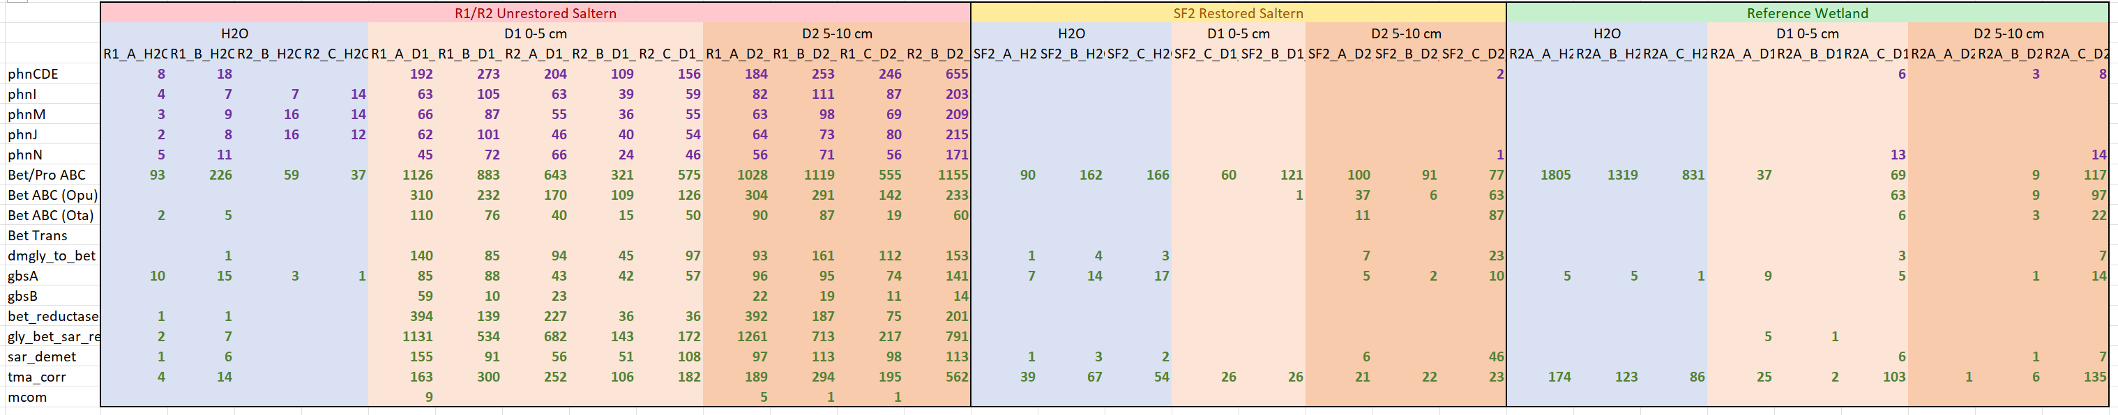
Unrestored Saltern
Restored Saltern
Natural Wetland
H2O
f__Haloferacaceae
f__Actinomarinaceae
f__Nitrincolaceae
5 cm
D1
Methylphosphonate
D2
10 cm
Betaine

Slide 2
R1/R2
6.43%
Unrestored Saltern R1/R2
19.13%
Restored Saltern SF2
Methylphosphonate
29.82%
Natural Wetland R2A
Betaine
0.05% SF2
0.27% R2A
H2O
R1/R2
3.8%
0.76%
5 cm
21.27%
9.41% SF2
13.47% R2A
26.33% SF2
4.46% R2A
0.03%
0.0% SF2
0.17% R2A
D1
25.07%
27.67%
21.72%
18.34%
D2
17.77%
10 cm
0.0%/0.65%/0.61%
1.33%/34.82%/40.98%
56.99% SF2
24.70% R2A
0% SF2 0% R2A
Trimethylamine methyltransferase
Not much happening in unrestored H2O which is dominated by
66-90% f__Haloferacaceae (A)

Slide 3
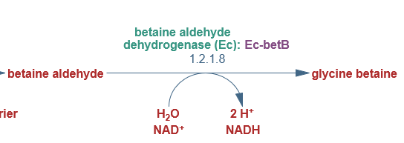
R1/R2
R1/R2
R1/R2
R1/R2
0.01%
3.8%
1.33%
0.76%
7.07%
21.27%
34.82%
25.07%
GbsB
2.7%
27.67%
40.98%
21.72%
0.00% SF2
0.00% R2A
9.41% SF2
13.47% R2A
56.99% SF2
24.70% R2A
26.33% SF2
4.46% R2A
Trimethylamine methyltransferase
Methyl coenzyme M reductase gamma subunit (EC 2.8.4.1) Methyl coenzyme M reductase beta subunit (EC 2.8.4.1) Methyl coenzyme M reductase alpha subunit (EC 2.8.4.1)
0.65
H2O 0.0
D1 0.65
D2 0.61
0.0 0.0
0.0%/0.65%/0.61%

