Slide 1
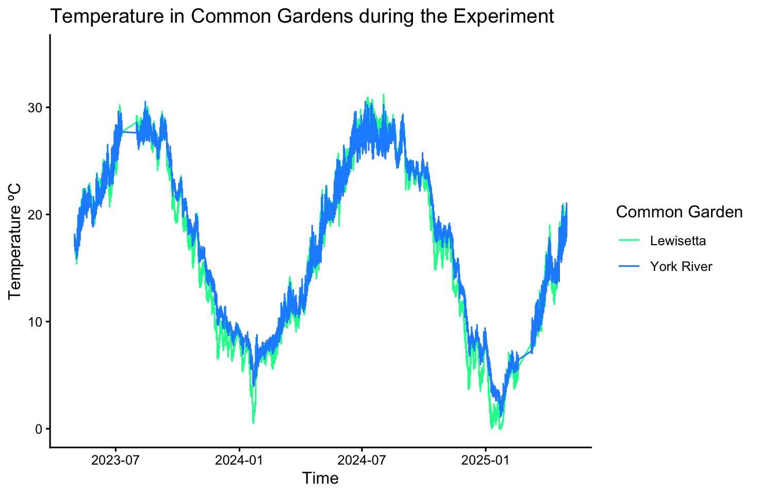

Slide 2
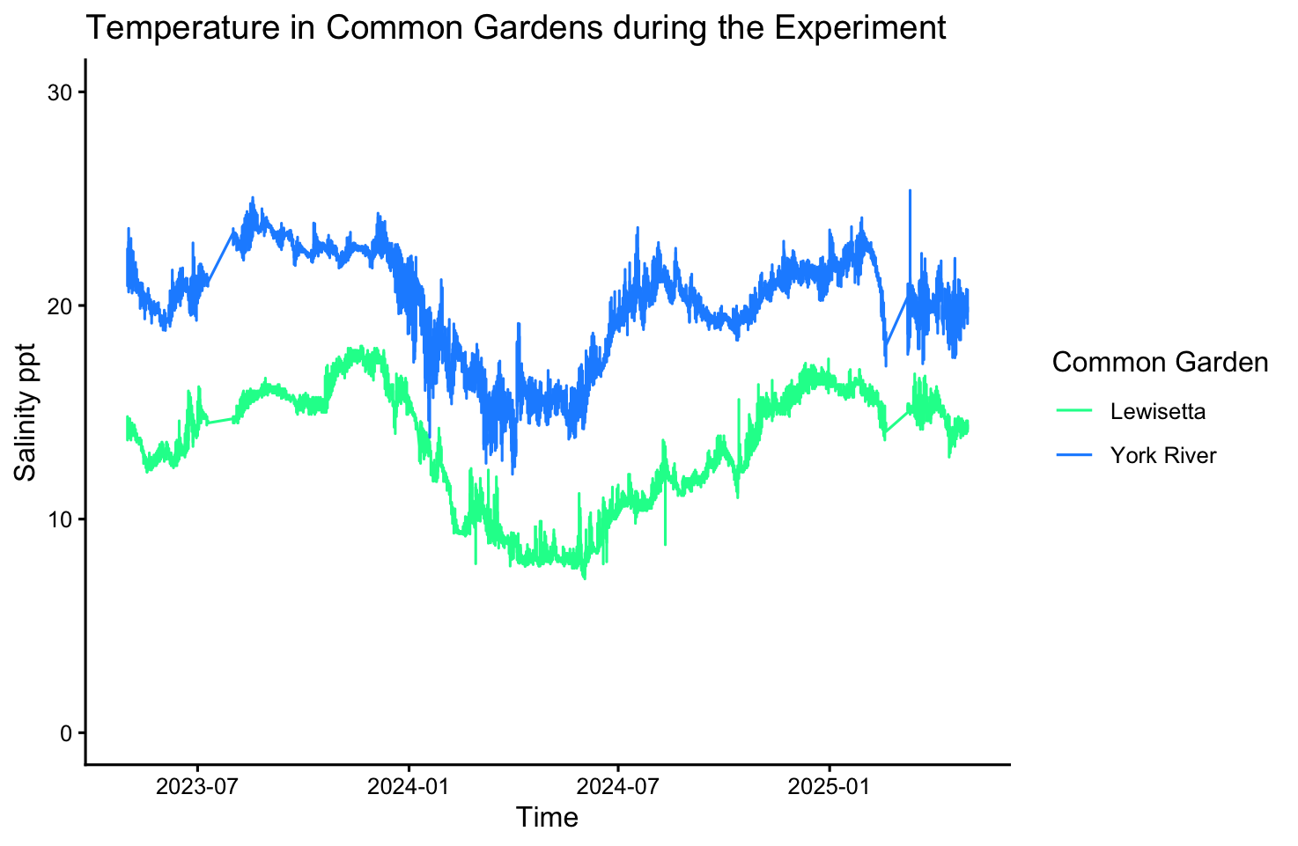

Slide 3
Temperature in Common Gardens over
Experimental Period
Common Garden
Lewisetta
Temperature (ºC)
York River
Date
(B) Salinity in Common Gardens over
Experimental Period
Salinity (ppt)
Date

Slide 4
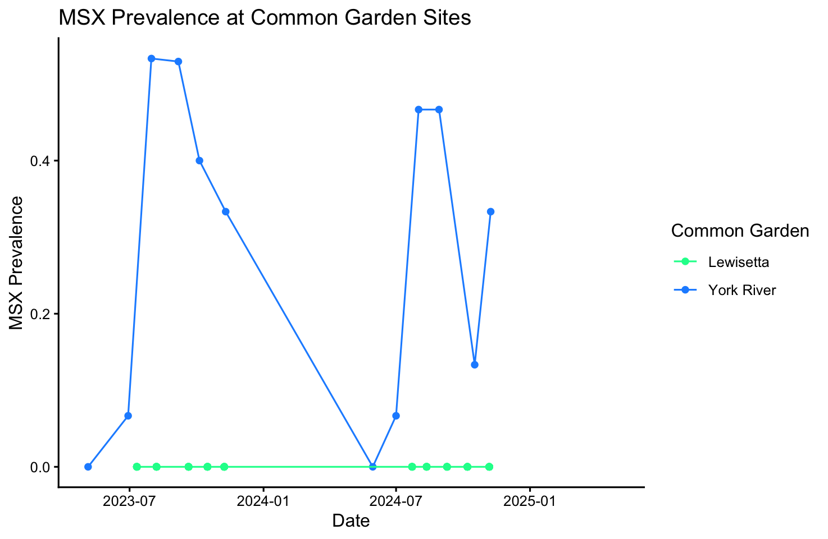

Slide 5
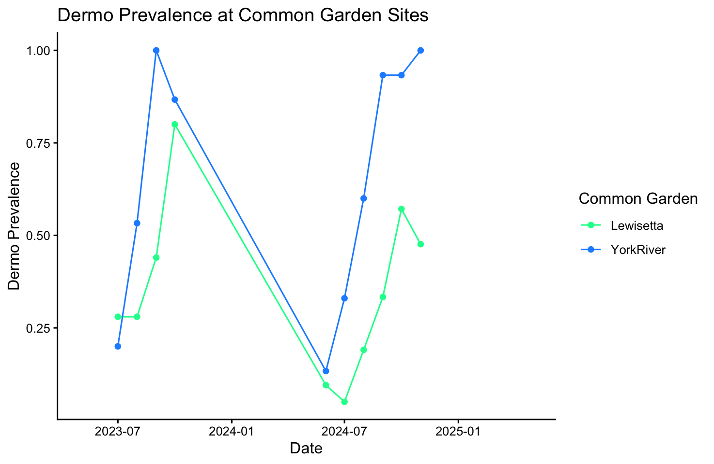

Slide 6
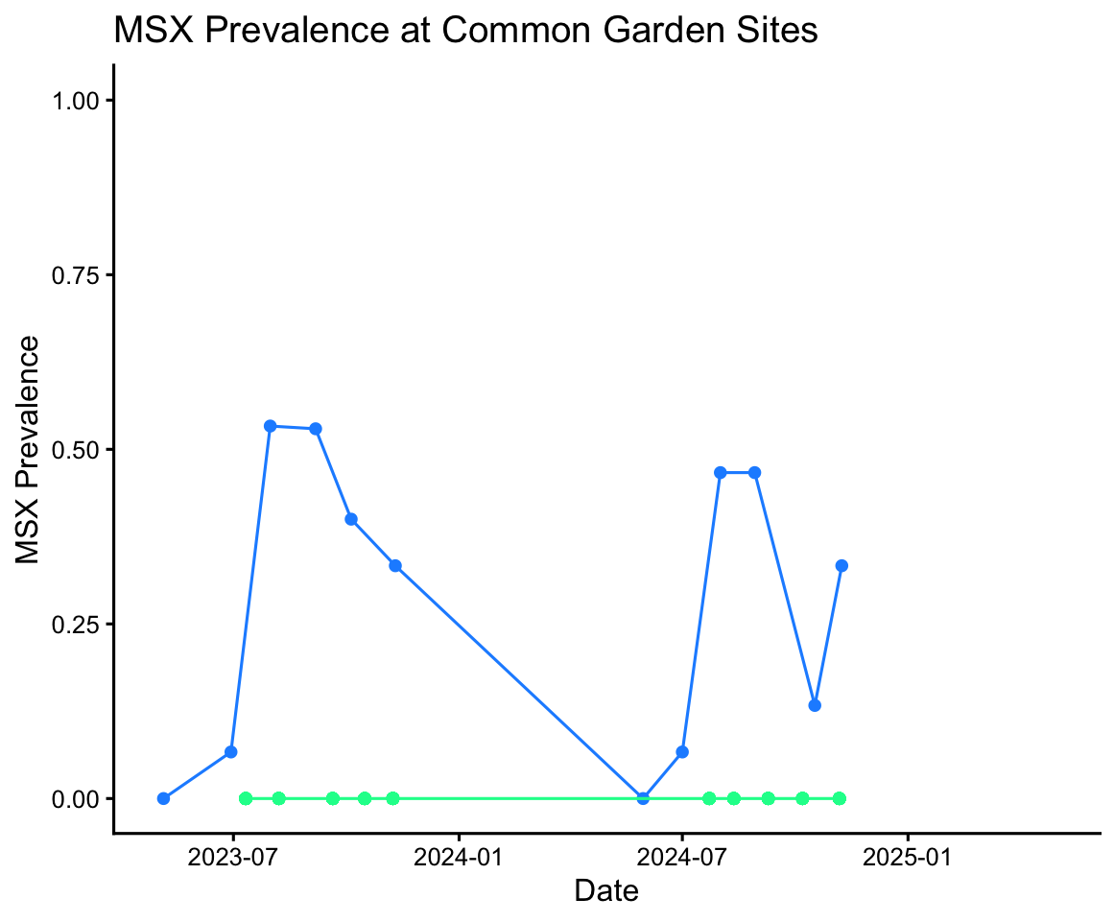
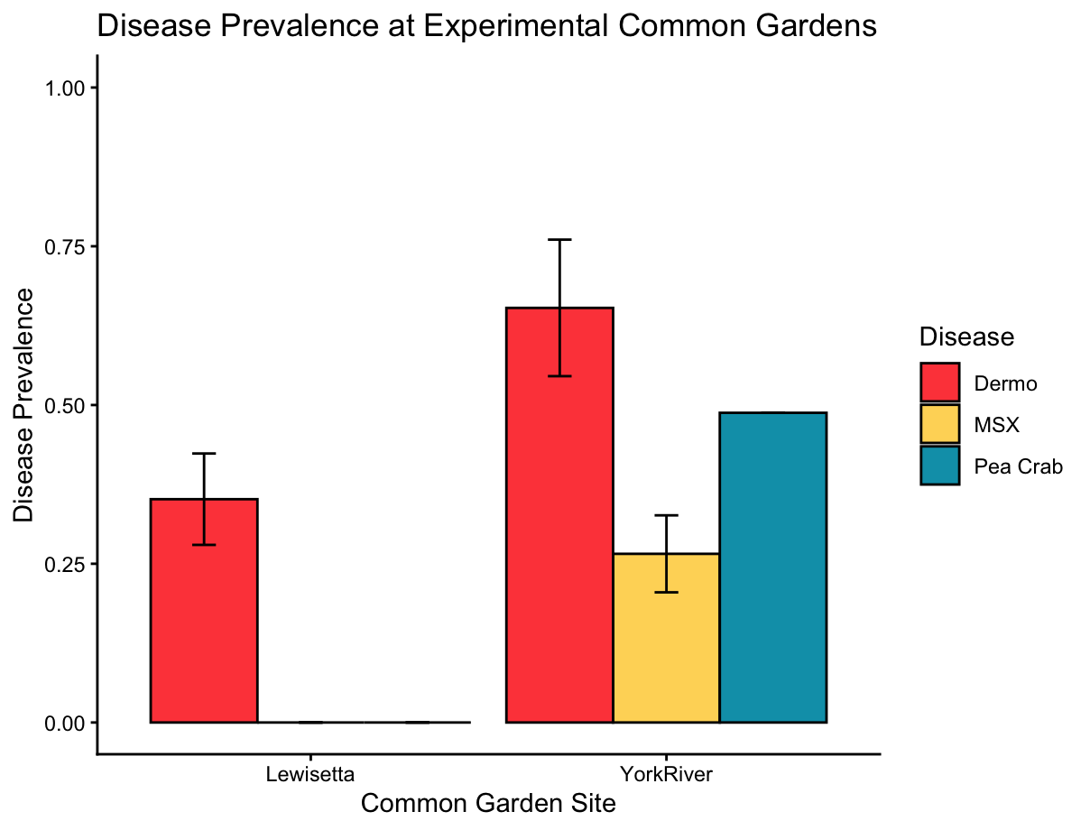
MSX Prevalence in Common Gardens
over Experimental Period
(B) Dermo Prevalence in Common Gardens
over Experimental Period
Common Garden
Lewisetta
York River
MSX Prevalence
Dermo Prevalence
Date
Date
(C) Median Disease Pressure By Common Garden Site
Disease Prevalence
Lewisetta
York River
Common Garden Site

