Slide 1
(A) Predicted LEA_{offset} vs Survival
1.00
Common
Garden
Lewisetta
0.75
York River
0.50
Survival
τ = -0.546
**
τ = -0.177
0.25
0.00
0.00
0.02
0.04
0.06
LEA Offset

Slide 2
(B) Predicted RDA_{offset} vs Survival
1.00
Common
Garden
Lewisetta
0.75
York River
0.50
τ = -0.501
*
Survival
τ = -0.258
0.25
0.00
0.00
1.00
2.00
3.00
RDA Offset

Slide 3
(C) Predicted GF_{offset} vs Survival
1.00
Common
Garden
Lewisetta
0.75
τ = -0.137
York River
0.50
Survival
0.25
τ = -0.285
0.00
0.00
0.01
0.02
0.03
GF Offset

Slide 4
(D) Environmental Distance vs Survival
1.00
Common
Garden
Lewisetta
0.75
τ = -0.273
York River
0.50
Survival
τ = -0.131
0.25
0.00
0.00
1.00
2.00
3.00
4.00
5.00
Euclidean Environmental Distance

Slide 5
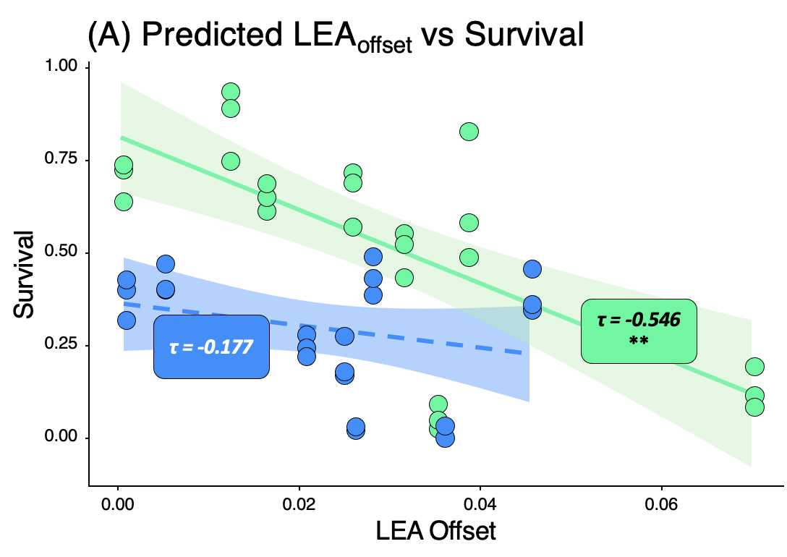
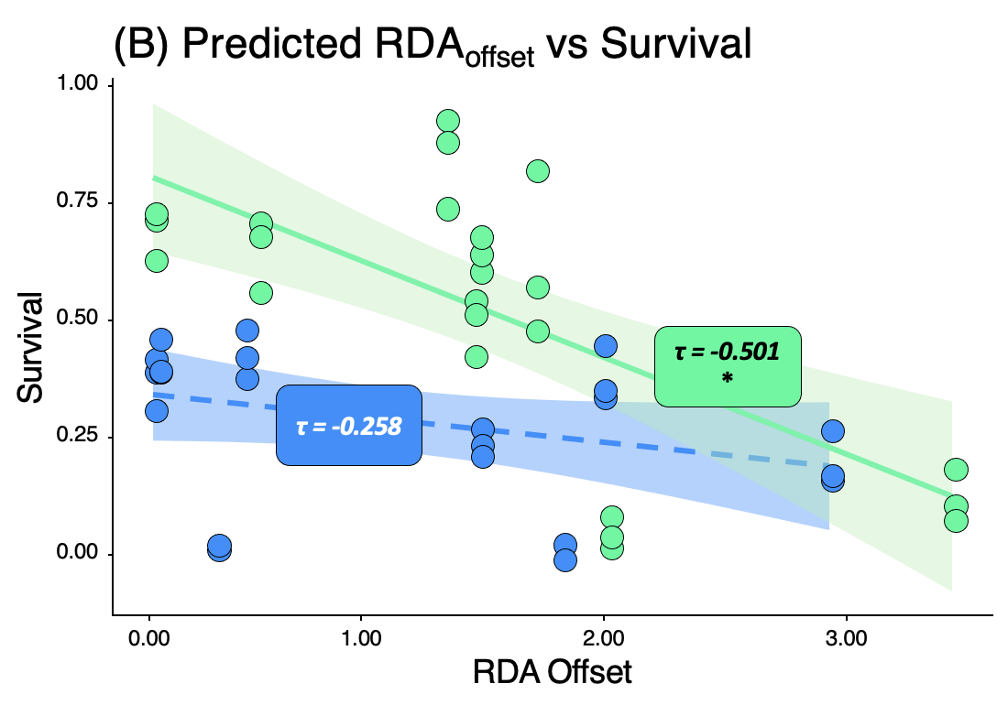
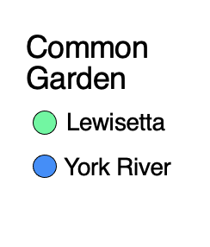
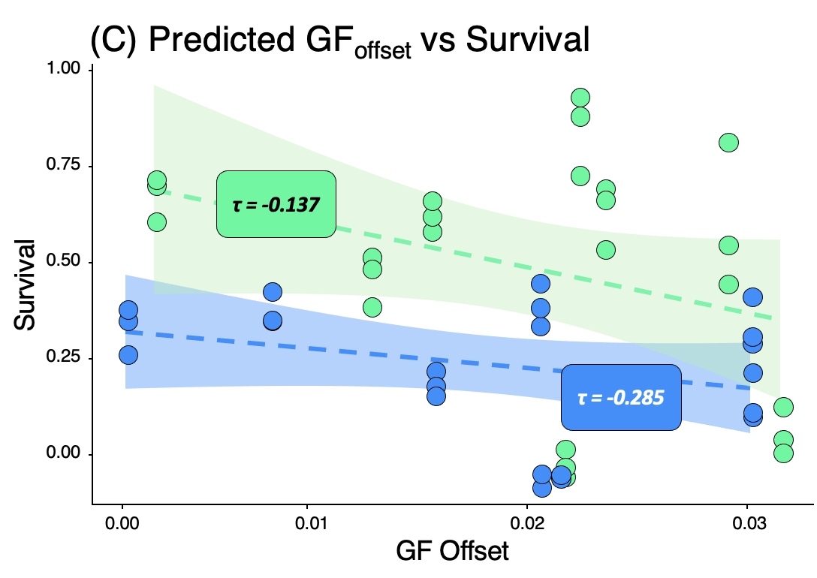
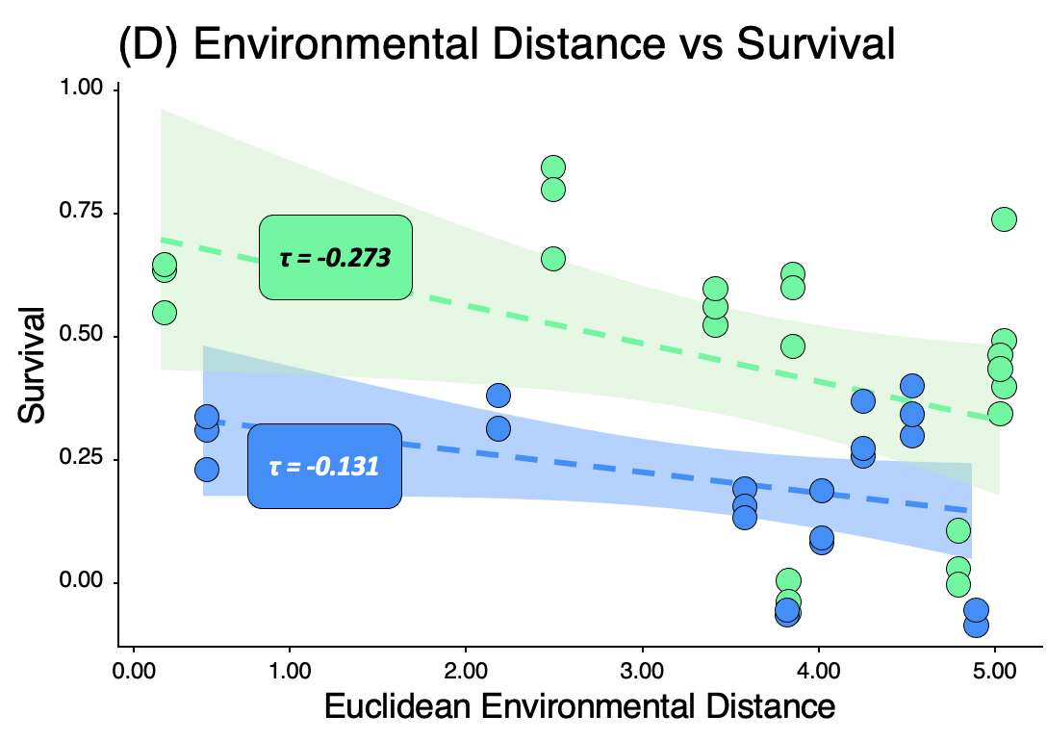

Slide 6
(A) Predicted LEA_{offset} vs Length
Common
Garden
100
Lewisetta
York River
80
τ = -0.660
***
Length (mm)
60
τ = -0.457
*
40
0.00
0.02
0.04
0.06
LEA Offset

Slide 7
(B) Predicted RDA_{offset} vs Length
Common
Garden
100
Lewisetta
York River
80
τ = -0.523
**
Length (mm)
60
τ = -0.268
40
0.00
1.00
2.00
3.00
RDA Offset

Slide 8
(C) Predicted GF_{offset} vs Length
Common
Garden
100
τ = -0.447
*
Lewisetta
York River
80
Length (mm)
60
τ = -0.494
*
40
0.00
0.01
0.02
0.03
GF Offset

Slide 9
(D) Environmental Distance vs Length
Common
Garden
100
Lewisetta
τ = -0.387
*
York River
80
Length (mm)
τ = -0.303
60
40
0.00
1.00
2.00
3.00
4.00
5.00
Euclidean Environmental Distance

Slide 10
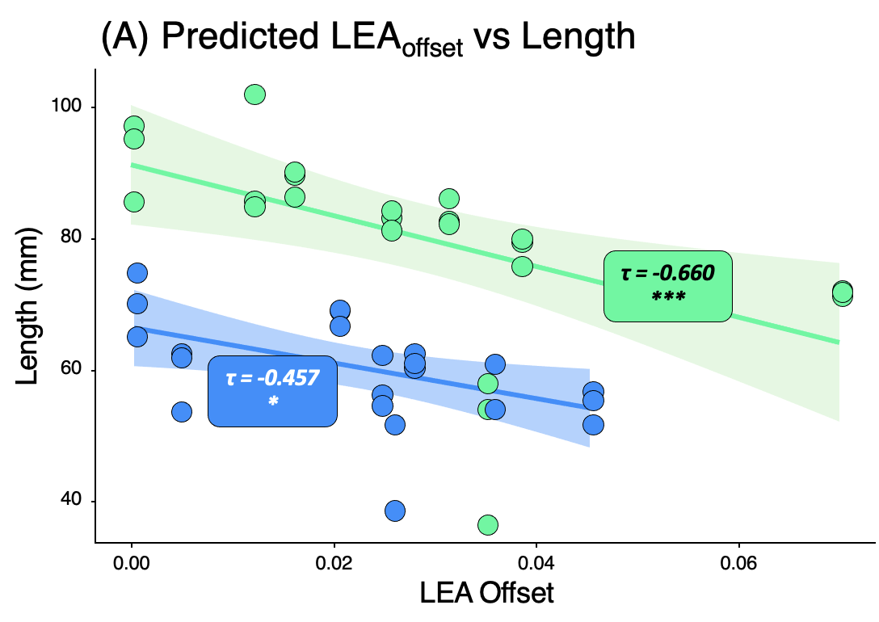
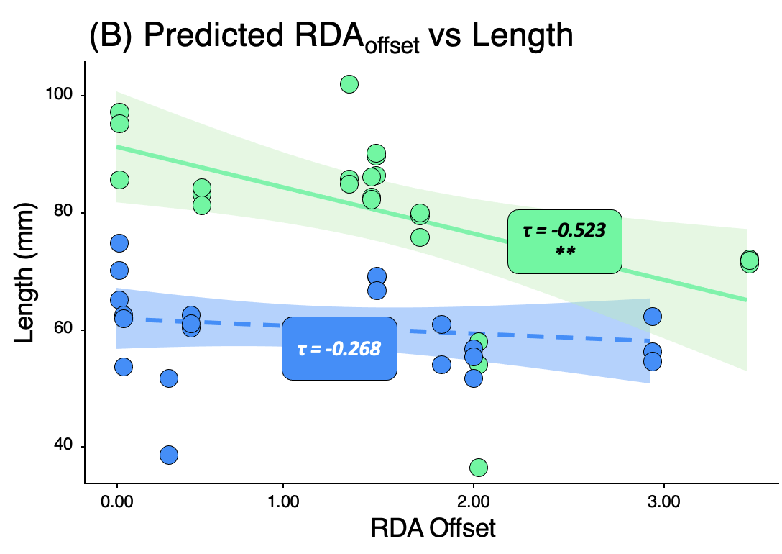
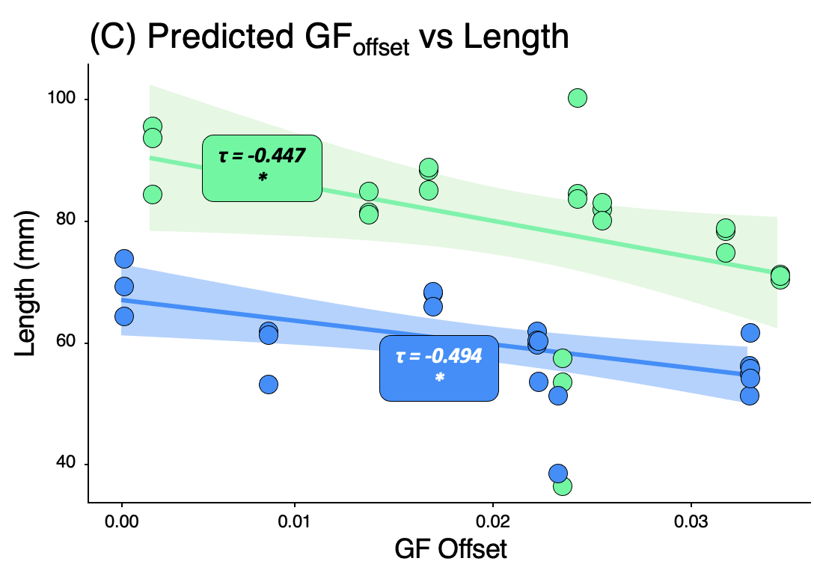
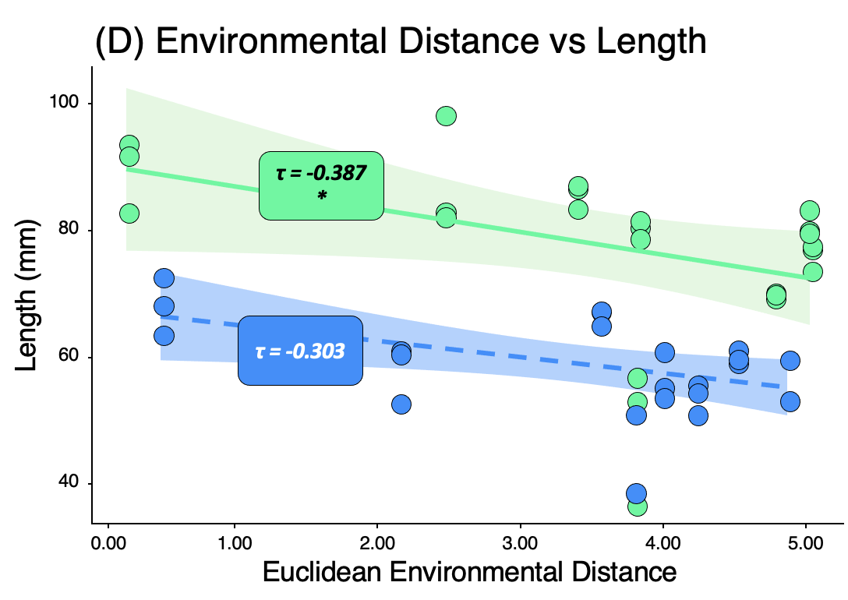

Slide 11
Predicted GO (LEA) vs Survival at Lewisetta
1.00
0.75
Monitoring Events
Fall'23
0.50
Survival
Spring'24
Fall'24
Spring'25
0.25
0.00
0.00
0.02
0.04
0.06
LEA Offset

Slide 12
Predicted GO (LEA) vs Survival at York River
1.00
0.75
Monitoring Events
Fall'23
0.50
Survival
Spring'24
Fall'24
Spring'25
0.25
0.00
0.00
0.01
0.02
0.03
0.04
LEA Offset

Slide 13
Predicted GO (RDA) vs Survival at Lewisetta
1.00
0.75
Monitoring Events
Fall'23
0.50
Survival
Spring'24
Fall'24
Spring'25
0.25
0.00
0
1
2
3
RDA Offset

Slide 14
Predicted GO (RDA) vs Survival at York River
1.00
0.75
Monitoring Events
Fall'23
Survival
Spring'24
0.50
Fall'24
Spring'25
0.25
0.00
1
2
3
RDA Offset

Slide 15
Predicted GO (GFgeno) vs Survival at Lewisetta
1.00
0.75
Monitoring Events
Fall'23
Survival
Spring'24
0.50
Fall'24
Spring'25
0.25
0.00
0.01
0.02
0.03
GF Offset

Slide 16
Predicted GO (GFgeno) vs Survival at York River
1.00
0.75
Monitoring Events
Fall'23
0.50
Survival
Spring'24
Fall'24
Spring'25
0.25
0.00
0.01
0.02
0.03
GF Offset

Slide 17
Environmental Distance vs Survival at Lewisetta
0.9
Monitoring Events
Fall'23
0.6
Survival
Spring'24
Fall'24
Spring'25
0.3
0.0
1
2
3
4
5
Environmental Distance

Slide 18
Environmental Distance vs Survival at York River
1.00
0.75
Monitoring Events
Fall'23
0.50
Survival
Spring'24
Fall'24
Spring'25
0.25
0.00
1
2
3
4
5
Environmental Distance

Slide 19
Predicted GO (LEA) vs Size at Lewisetta
100
80
Monitoring Events
Fall'23
Length (mm)
Spring'24
60
Fall'24
Spring'25
40
20
0.00
0.02
0.04
0.06
LEA Offset

Slide 20
Predicted GO (LEA) vs Size at York River
70
60
Monitoring Events
50
Fall'23
Length (mm)
Spring'24
Fall'24
Spring'25
40
30
0.00
0.01
0.02
0.03
0.04
LEA Offset

Slide 21
Predicted GO (RDA) vs Size at Lewisetta
100
80
Monitoring Events
Fall'23
Length (mm)
Spring'24
60
Fall'24
Spring'25
40
20
0
1
2
3
RDA Offset

Slide 22
Predicted GO (RDA) vs Size at York River
70
60
Monitoring Events
50
Fall'23
Length (mm)
Spring'24
Fall'24
Spring'25
40
30
1
2
3
RDA Offset

Slide 23
Predicted GO (GF) vs Size at Lewisetta
100
80
Monitoring Events
Fall'23
Length (mm)
Spring'24
60
Fall'24
Spring'25
40
20
0.01
0.02
0.03
GF Offset

Slide 24
Predicted GO (GF) vs Size at York River
70
60
Monitoring Events
50
Fall'23
Length (mm)
Spring'24
Fall'24
Spring'25
40
30
0.01
0.02
0.03
GF Offset

Slide 25
Environmental Distance vs Size at Lewisetta
100
80
Monitoring Events
Fall'23
Length (mm)
Spring'24
60
Fall'24
Spring'25
40
20
1
2
3
4
5
Environmental Distance

Slide 26
Environmental Distance vs Size at York River
70
60
Monitoring Events
Fall'23
50
Length (mm)
Spring'24
Fall'24
Spring'25
40
30
1
2
3
4
5
Environmental Distance

