Slide 1
Model Writer Collaboration Tools
Github – egit – waffle.io
Marwa Rostren - 10/12/2014
http://www.obeo.fr

Slide 2
Summary
GitHub
EGit
Waffle.io

Slide 3
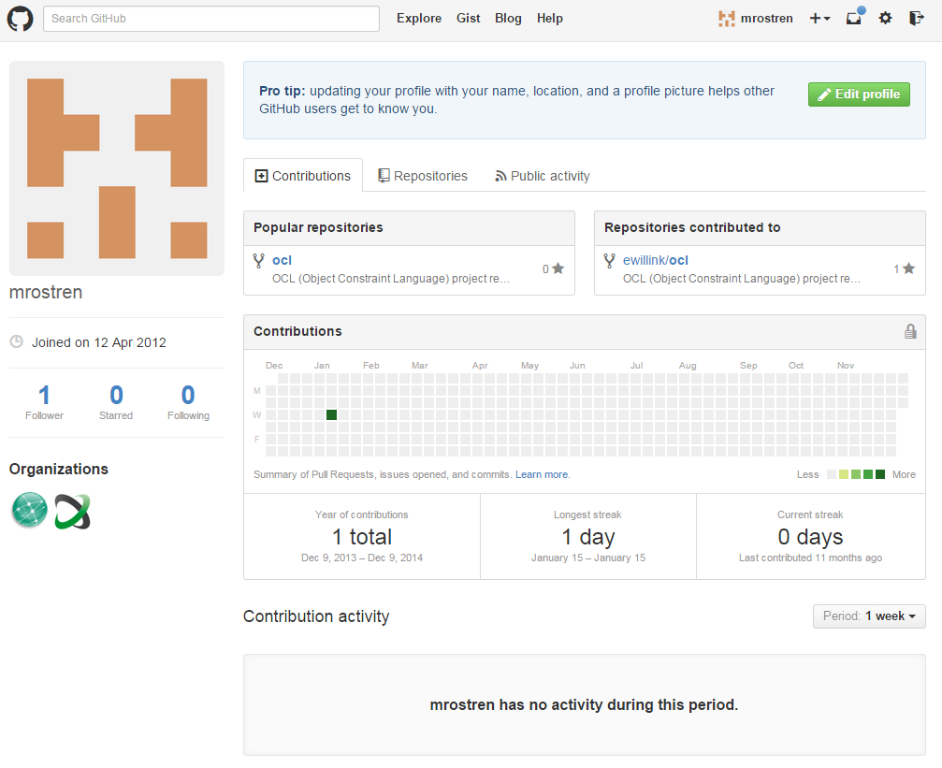
GitHub - https://github.com/
A web service for hosting and for management of software development
Git : an open-source system for version control
Hub: social network built around the Git system
Notifications
My own repositories
My contributions in
another repositories
Organizations
subscriptions

Slide 4
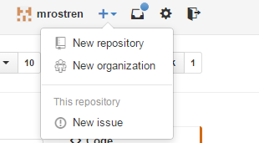
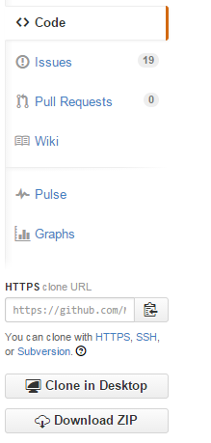
GitHub - https://github.com/
Create a new work repository :
Create New … -> New Repository
Create a new issue:
Create New… -> New issue
To consult the shared code
To consult the list of issues in the current repository
To Consult the wiki
The URL of the working directory to be cloned into eclipse

Slide 5
GitHub - https://github.com/
Do not forget to transmit your GitHub account identifier or connect by yourself to be a member of the ModelWriter project organization :
https://github.com/ModelWriter

Slide 6
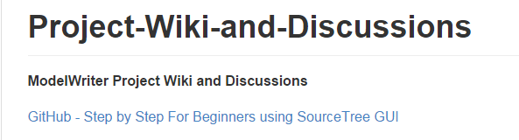
GitHub - https://github.com/ModelWriter
Repositories links and ModelWriter Guides links:
https://github.com/ModelWriter/Workshops (dates, Workshops programs)
https://github.com/ModelWriter/Project-Management
https://github.com/ModelWriter/WP1
https://github.com/ModelWriter/WP2
https://github.com/ModelWriter/WP3
https://github.com/ModelWriter/WP4
https://github.com/ModelWriter/WP5
https://github.com/ModelWriter/WP6
https://github.com/ModelWriter/WP7
https://github.com/ModelWriter/Project-Collaboration
wiki + discussions
GitHub Notifications
Egit Manual
https://drive.google.com/file/d/0ByqTKXWo8cT7VFN4WFIwZmFjbHc/view?usp=sharing
GitHub Manual
https://drive.google.com/file/d/0ByqTKXWo8cT7TG1vdGxQbkRqTWc/view?usp=sharing
Waffle Manual
https://drive.google.com/file/d/0ByqTKXWo8cT7N09MOEFOZTZ1WG8/view?usp=sharing
SourceTree Manual
https://drive.google.com/file/d/0ByqTKXWo8cT7aEtHcDBlenBUX3M/view?usp=sharing

Slide 7
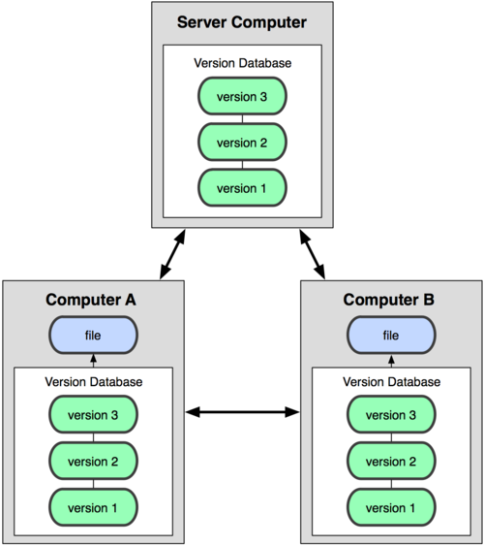
Git
Git – What is It?
Decentralized system for version control
Git – Why using It?
Faster & Trustworthy
Flexible & Powerful
Ensures good branches management
Decentralized
Allows effective ways of working
Each person has a full local copy of all the project history
The central server is just a convention
Adds an additional level for each “commit”
synchronized from/to a remote repository

Slide 8

Git – Concepts : Les différentes zones
Repository: The .git repository
Contains all history, tags, branches, etc.
Working Copy: The current working version
Completely regular files, alterable, movable, etc.
without any concern for Git
A potentially changed state since the last checkout
Staging Area (Index): intermediate zone
Stored in .git
Fundamental to understand the Git behavior
Git handles only files, not directories
An empty directory does not exist for Git

Slide 9
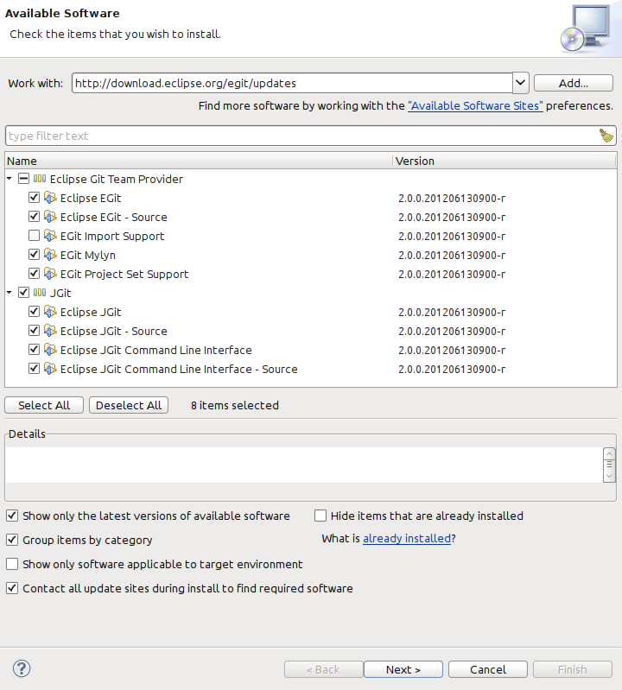
Egit – Git integrated as a Team Provider Eclipse
Installation
http://download.eclipse.org/egit/updates
Do not check « EGit Import Support »
Configuration
After the installation restart eclipse and access the Preferences
Git > Configuration
Enter the default path to the git clone directory
Team > Git > Configuration
Enter your own contact information in the « user » tab, this will be visible in GitHub to identify all “commits” authors

Slide 10
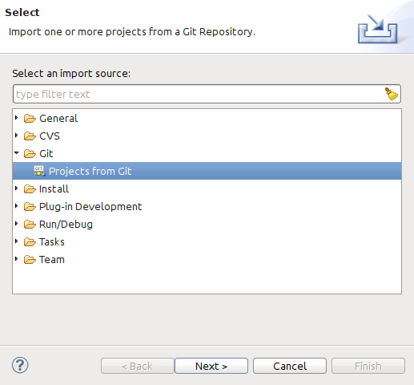
Egit – Git integrated as a Team Provider Eclipse
Git’s Repos & Eclipse Workspaces
Keep your Git’s repositories outside any workspace !
By default, in ~/git for all repositories created by EGit
DO NOT import It « manually » or copy projects physically to the workspace
Use always:
Import > Git > Projects from Git

Slide 11
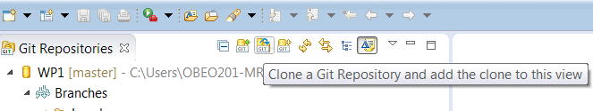
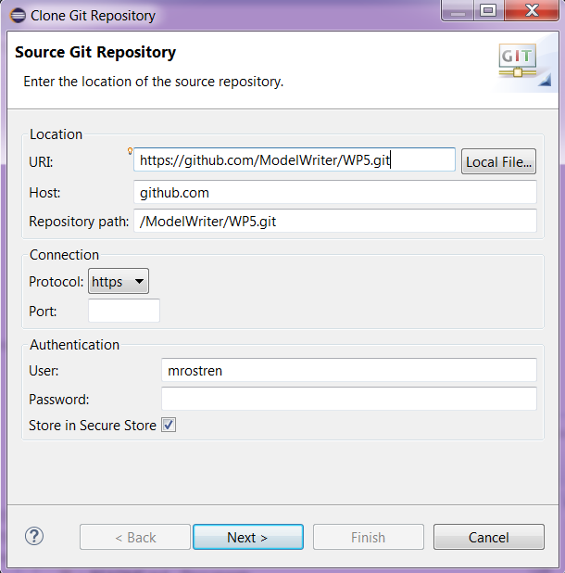
Egit – Git integrated as a Team Provider Eclipse
Clone a repository
clone: initializes a local repository from a remote
Copies the entire history (including branches & tags)
Can be long if the we clone a huge project
Need to be done only once
The origin cloned repository becomes
The origin
Authentication is done using your
GitHub account

Slide 12
Egit – Git integrated as a Team Provider Eclipse
Clone with EGit
Go to the Git perspective
Choose "Clone a Git repository and add the clone to this view"
Enter The URL of the remote repository
Choose which remote branches you want to get locally
By default, all of It
Choose location of the local cloned repository
Optionally, you can import the repository projects from the clone wizard.

Slide 13
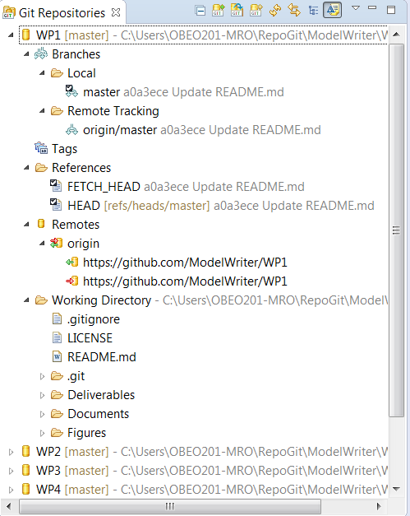
Egit – Git integrated as a Team Provider Eclipse
« Git Repositories » view
Shows the internal state of the local repository
Branches
locales/personal
Cloned repository issues
Tags
Known remote repositories
Working directory
Obtained by "checkout“-ing a branch, a remote or a tag

Slide 14
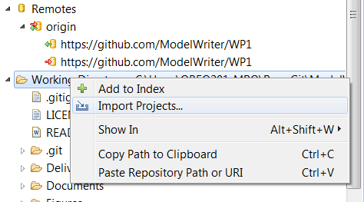
Egit – Git integrated as a Team Provider Eclipse
Import projects to the workspace
File > Importer > Git > Projects from Git
Or « Import Projects » by right click on the repository in the “Git Repositories” View
Basic local Workflow
Edit files in your workspace
Without any concern for git
edit, add, delete, rename, move....
Decide which modification must be concerned by your future commit(s)
In the « Git Staging » View
Commit with a significant message
In the « Git Staging » View

Slide 15
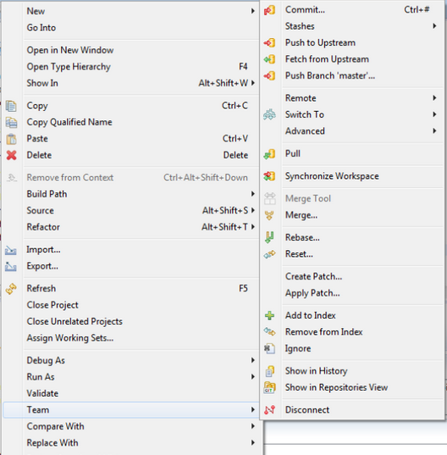
Egit – Git integrated as a Team Provider Eclipse
Git Operations
You can reach the operation list by right click on a file, a directory, or a project in your workspace
Add to index
Commit
Create Patch
Apply patch
Ignore
Show in history
Pull
Fetch
Switch To
Push
A scenario for each operation is illustrated in:
https://drive.google.com/file/d/0ByqTKXWo8cT7VFN4WFIwZmFjbHc/view

Slide 16
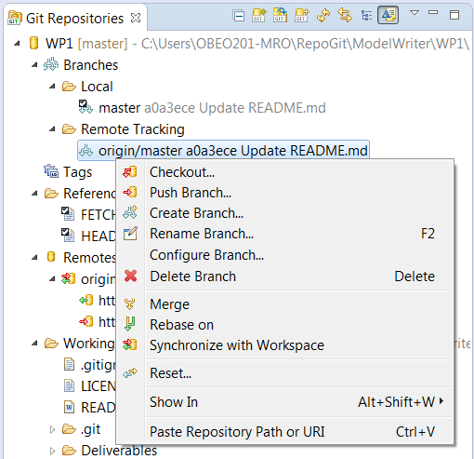
Egit – Git integrated as a Team Provider Eclipse
Git Operations
You can reach the operation list by right click on a tag or on a branch in the “Git Repositories” View
Checkout
Push Branch
Create Branch
Merge
Rebase On
Synchronize with workspace
Reset
A scenario for each operation is illustrated in:
https://drive.google.com/file/d/0ByqTKXWo8cT7VFN4WFIwZmFjbHc/view

Slide 17
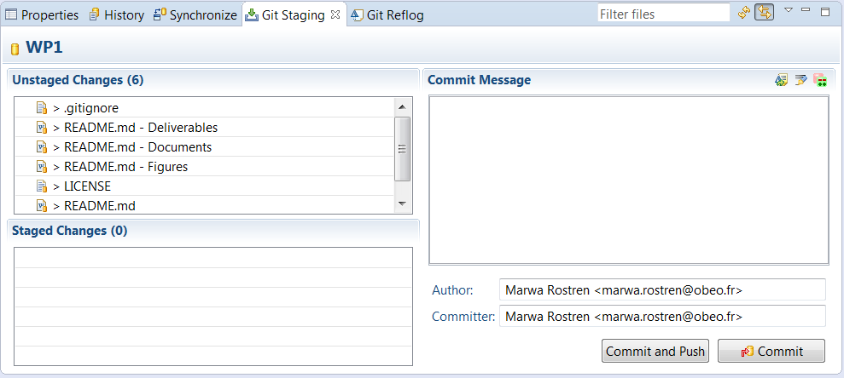
Egit – Git integrated as a Team Provider Eclipse
Git Operations
Amend a commit – Be careful, to amend (rewrite) a commit, the commit must be a local one… never ever amend a shared commit on origin ( GitHub server)
Useful for correcting a typo, a forgotten file, etc..
Including the commit message
Overwrite the last commit
In EGit use the "Amend“ action
By default, the amend action uses the previous commit’s message

Slide 18
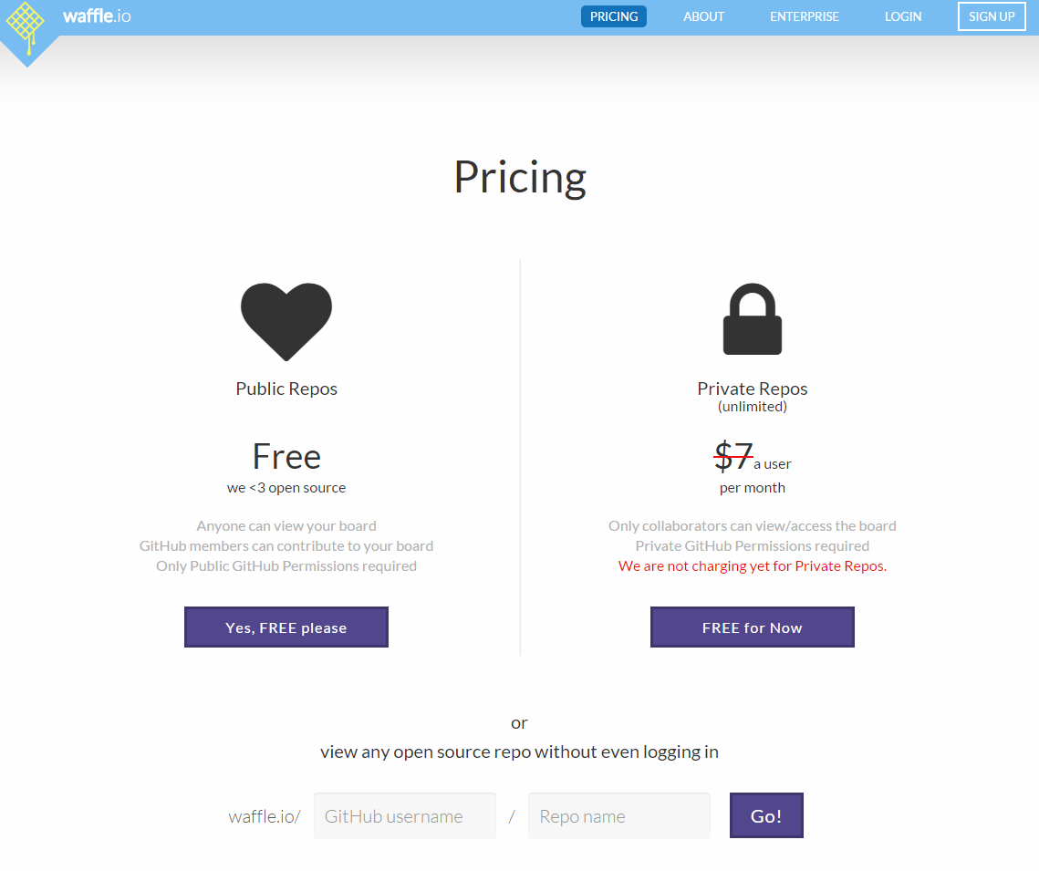
Waffle - https://waffle.io/
A project management service
Can be linked to GitHub
Waffle board Issues <=> GitHub Issues in real time
Ensures an automatic synchronization of issues states with GitHub

Slide 19
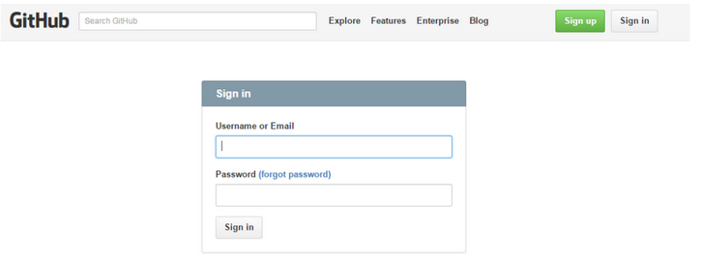
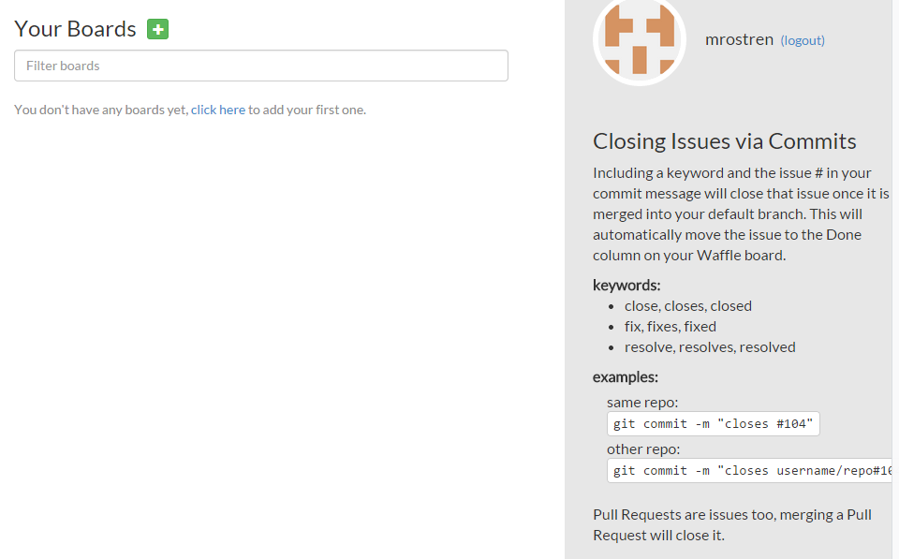
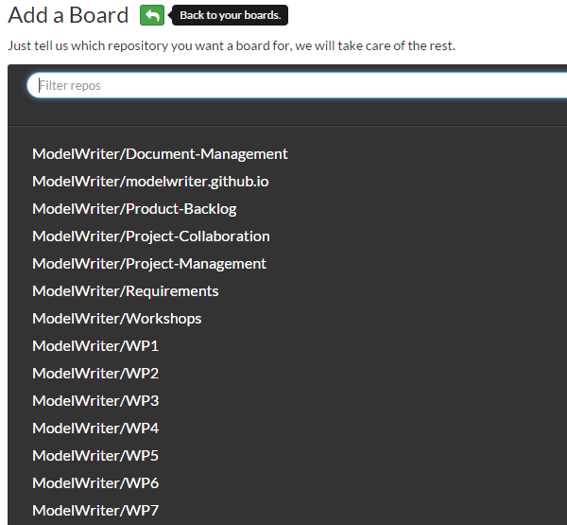
Waffle - https://waffle.io/
Claim the GitHub account
When you sign in GitHub
Waffle displays the boards list and
Allow you to create new boards by suggesting
existing GitHub repositories

Slide 20
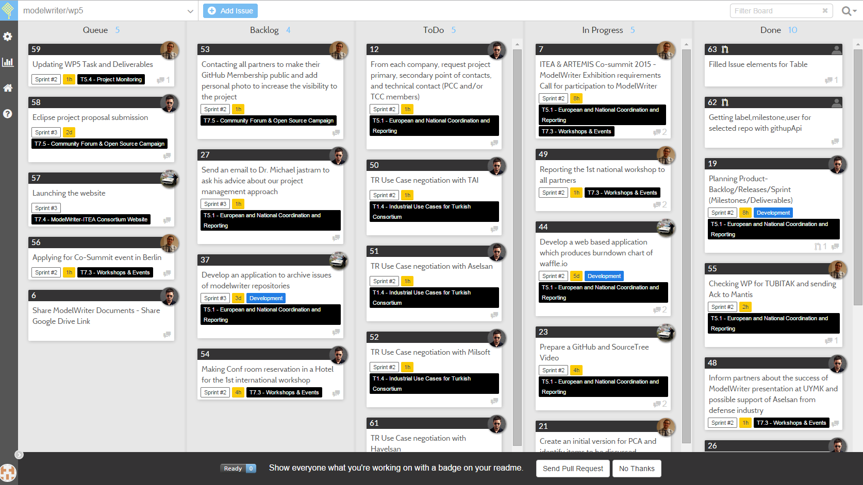
Waffle - https://waffle.io/
Notes:
Queue : liste des tâches
Backlog : liste des tâches importées depuis GitHub
ToDo :
In Progress : quelqu’un travaille sur la tâche
Done : Tâches réalisées

Slide 21
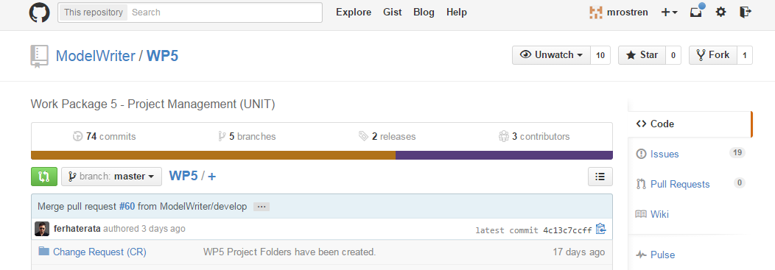
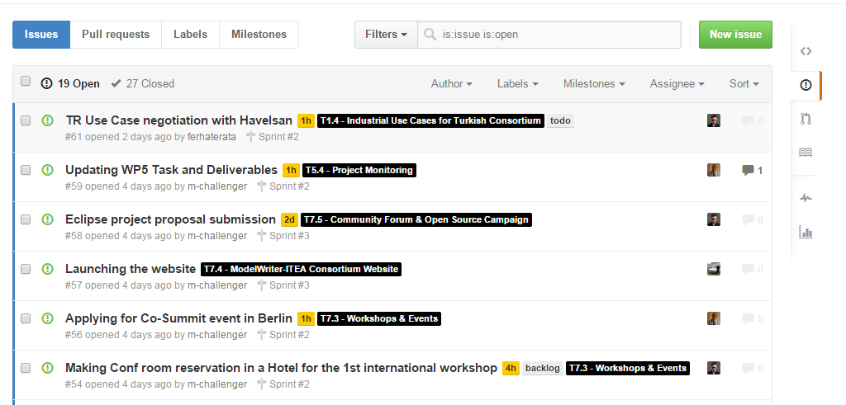
Waffle - https://waffle.io/
Notes:
Queue : liste des tâches
Backlog : liste des tâches importées depuis GitHub
ToDo :
In Progress : quelqu’un travaille sur la tâche
Done : Tâches réalisées

Slide 22
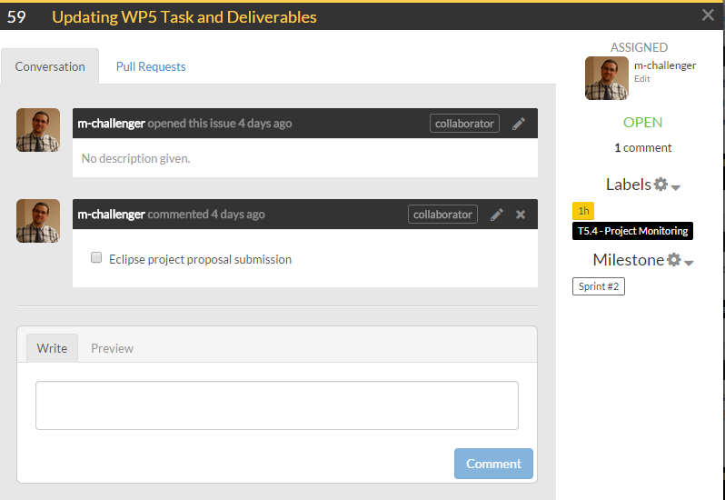
Waffle - https://waffle.io/
Waffle does not allow to create new labels or milestones
Waffle allow you to:
Assign an issue to one or more person
Add labels
Link to a milestone
All modifications will be displayed in the concerned GitHub issue

Slide 23
For more information
https://github.com/ModelWriter/Project-Collaboration#github-manual
https://github.com/ModelWriter/Project-Collaboration#egit-manualgithub-eclipse-integration
https://github.com/ModelWriter/Project-Collaboration#waffle-manualgithub-waffle-integration
Link to google drive :
https://drive.google.com/open?id=0B115qHHFY_rud1YzdGxiWlZPeFk&authuser=0

