Slide 1
Doc2model

Slide 2
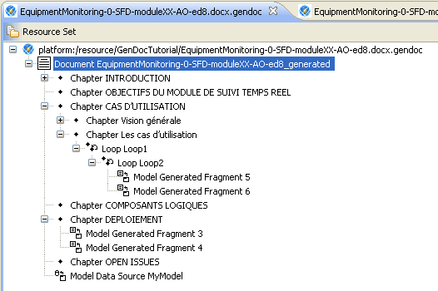
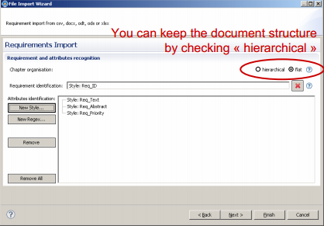
History/Overview
TOPCASED Doc2Model
Eclipse Doc2Model
Polarsys Doc2Model
TOPCASED Doc2Model : https://gforge.enseeiht.fr/projects/doc2model/
First prototype in TOPCASED context in 2008
need a generic tool to have a model vision of a document
format agnostic
First usage
TOPCASED GENDOC v1 tool
Then
TOPCASED REQ tool importer
Create models from
regular expression
styles
« XML like tags »

Slide 3
History/Overview
TOPCASED Doc2Model
Eclipse Doc2Model
Polarsys Doc2Model
Eclipse Doc2Model : https://github.com/ModelWriter/WP3/tree/master/doc2model/plugins
desire to migrate TOPCASED Doc2Model to Eclipse foundation
API change, big refactoring
Objective
define document transformation as a « dataflow »
some text in a document is matched it can be transformed along several functions
Abandoned
lack of resources
modification of paradigm
No known users

Slide 4
History/Overview
TOPCASED Doc2Model
Eclipse Doc2Model
Polarsys Doc2Model
Polarsys Doc2Model
Statement
it is difficult to provide a DSL implementing all our desired features
different matching
complex reference between elements
complex conditions
reuse of models
be adapted to « specific » MM like UML
Goal
Provide basic (but not simplist) metamodels for MDE activities on document
Currently 2 MM (Doc, Spreadsheet). In the future : slides …
The document is transformed into an instance of doc2model metamodel
Provide AI algorithm to recognize « true » structure of spreadsheets
Usage
ReqCycle document importer

Slide 5
Architecture
Polarsys Doc2Model
TIKA
transforms a document into a xhtml
EMF
transforms the xhtml into a model
Doc2Model feature
ReqCycle Utils
MM
ui
inject
common
core
<<extends>>
emf
tika
SpreadSheet
wordprocessor
Tika

Slide 6
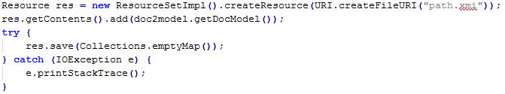
Usage
To transform :
To save :

Slide 7
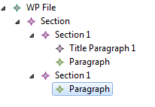
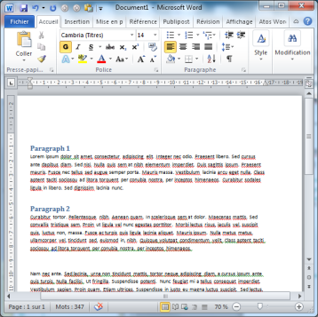
Current capabilities and feature
Feature
Transform a document into a model
Capabilities
txt
PDF
Word (.doc)
DOCUMENT
MODEL

Slide 8
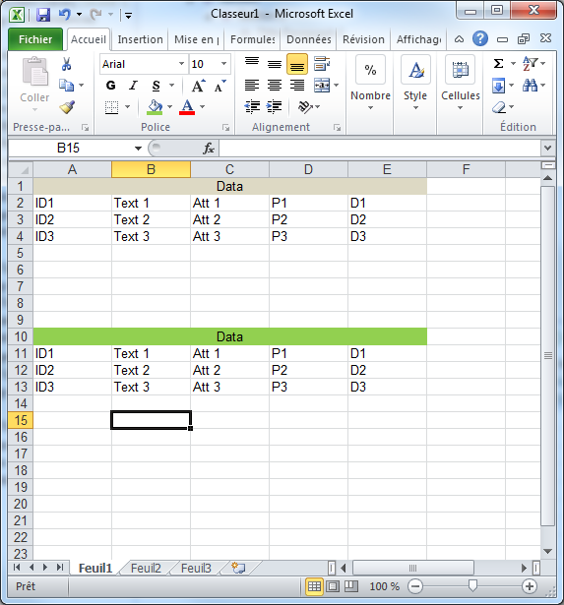
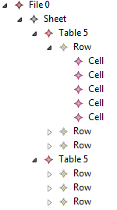
Current capabilities and feature
Capabilities
Excel (.xls)
DOCUMENT
MODEL

Slide 9
Current capabilities and feature
MM API
Regular expression built in
self.regex (‘ID(\d*)’).g0
→ 1
→ 2
→ 3

Slide 10

Current capabilities and feature
MM API
Spreadsheet
inspired by « VBA »
offset (1, 1)
offset (-1,0)
offset (1,0)
offset (0,-1)

Slide 11
Next Phases
Integration of new format
full migration from polarsys/reqcycle to polarsys/kitalpha
openxml, opendocument
extend API
save HTML content in the model (keep style)

