Slide 1
Doc2Model project
A generic way to import Business Documents into Models
Raphaël Faudou, Atos Origin
Tristan Faure, Atos Origin
Werner Keil, Creative Arts & Technologies

Slide 2
Why Doc2Model ?
Many business input data come from documents…
… and we want to work in the eclipse “modeling world”
  EMF, UML2, M2M, M2T,…
So we need to code many parsers …
  To import requirements (for traceability), a developer shall code a parser transforming a doc into a model
  To import a test plan, a developer shall code another parser transforming a doc into a model
  …
Solution
  Create a generic parser transforming any doc into model
  = Doc2Model ☺

Slide 3
Why do we need a new language ?
Grammar analyzer may be a good choice but …
  A document is not always made of raw text only
      Styles, images, comments, a column number, a row number…
What Doc2Model can do ?
  Identify « metadata » from a document
  Consume associated data
  Produce model from those data
What does Doc2Model provide ?
  API to parse different kinds of documents (datasources)
    If somebody wants to plug a new grammar analyzer for a specific document it’s possible ;)
Notes:
Why not XText? For third bullet

Slide 4
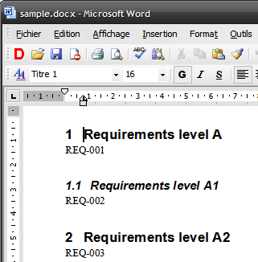
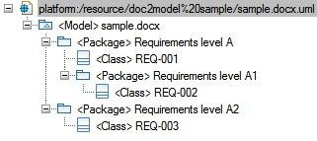
Can i see a demo ?
Contract :
extracting doc requirements
create requirements as Classes
Keep document structure (titles)
Notes:
1 Heading one
Heading 2
ID style for requirement

Slide 5
What can be done with Doc2Model ?
Match some « rules »
  If a regular expression is matched then …
  if a style is present in the document then …
  if there is a text in a specific column, row then…
  …
Run an action language
  If … then …
    I create a class
    I fill an attribute value
Inject elements from an existing model
  Note: planned and defined but not yet implemented
Notes:
Rules are open
If a regular… => load the regex module

Slide 6
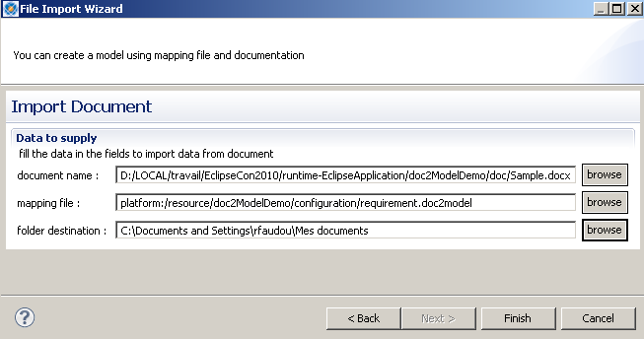
Who is concerned ?
End User:
  Chooses an input document
  Loads a Doc2Model mapping model
  Imports a document and works with models ☺
Notes:
New kind = PPT, Wiki,…

Slide 7
Who is concerned ?
Doc2Model designer:
  Knows target meta-model
  Knows the recognition
  Designs Doc2Model mapping model
Notes:
New kind = PPT, Wiki,…

Slide 8


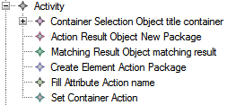


Configuration
Define a configuration
Set extension to uml
Match
Styles Matching = heading 2 style
Heading 2 is lower than Heading 1 (in hierarchy order)
Action language
Get a container according to order
Create a package and fill attribute name
The new element is a container
Rule
a rule links a group of actions and a match
Notes:
Action language = object flow (create, add, fill, transformString…)
Activity = coherent group of actions
Rule = assembly of Match and Activity

Slide 9
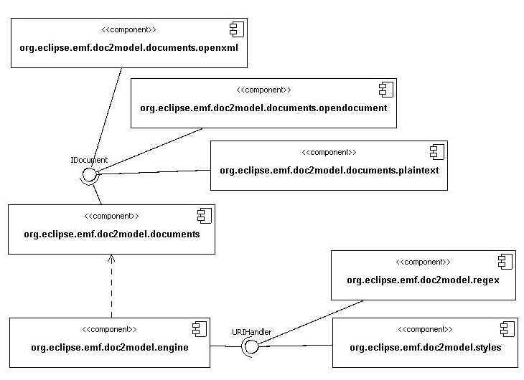
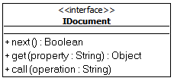
Architecture
Can manage different kinds of doc
Different matching handlers
Intercommunication between handlers and document
Notes:
Next => doc iterator. new element of the document. Iterator. paragraph for Word, colonne for Excel
Get => some predefined properties (getText =>regex, getStyle=>styleHandler). Open.
Call => some predefined operations (clean, comeBackToStart,..)
Ex : wikiDocument => regex handler should work. If need of HrefValue => HRefHandler to implement (URIHandler)..

Slide 10
Who is concerned ?
IDocument designer:
  Manages new kind of documents
  Develops plug-ins and implements IDocument interface
Notes:
New kind = PPT, Wiki,…

Slide 11
What can I expect for the future ?
A roadmap
  Need to end migration from TOPCASED forge
    ➔ same level of functionalities, regex handlers
  Gather community needs
    E.g. as Doc2Model style requirement doc ☺
Documentation
  Not only a blog
Interceptor mechanism
Improve UI (more intuitive)
  For instance, GMF editor for action language…
E4 style Injection where applicable
Notes:
Extension point on all API

Slide 12
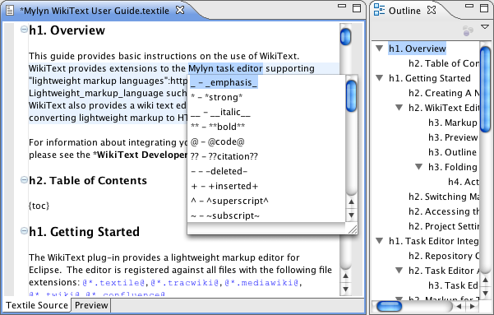
What else to expect for the future ?
More document formats
  Wiki
    Facilitating Mylyn WikiText
    Other sources like HTML via
    HTML2Wiki
    DocBook/Xtext or Maven Doxia
  Complete Office format (pptx),…
  Using the connector paradigm
  known from Mylyn, Pulsar,…
TaskTop / Mylyn integration for Requirements Phase
  Add requirements management to ALM
Notes:
Extension point on all API

Slide 13
Are you talking to me ?

