Slide 1
ModelWriter Text & Model-Synchronized Document Engineering Platform http://www.modelwriter.eu https://github.com/modelwriter 5. National Software Architecture Conference, Dec 3-4, 2014, Ankara, Turkey Speaker: Ferhat Erata, ModelWriter Project Leader

Slide 2
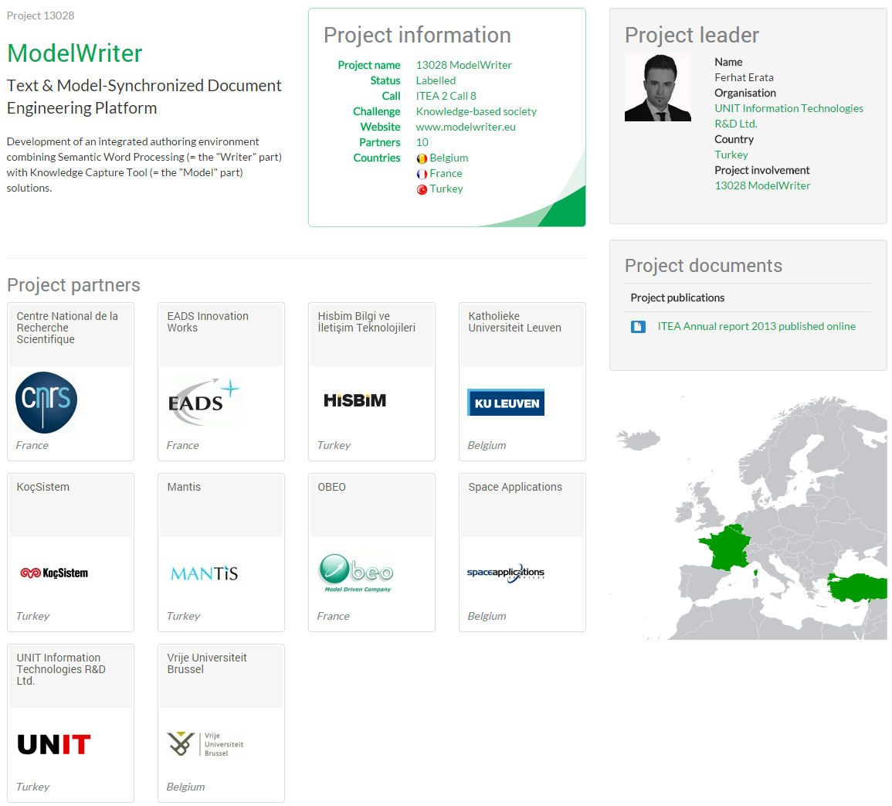
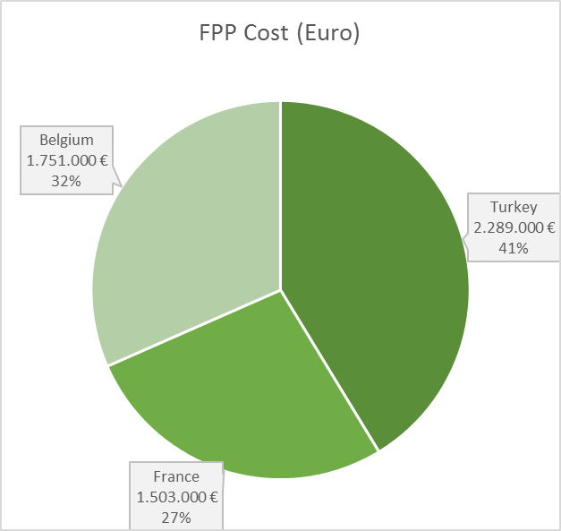
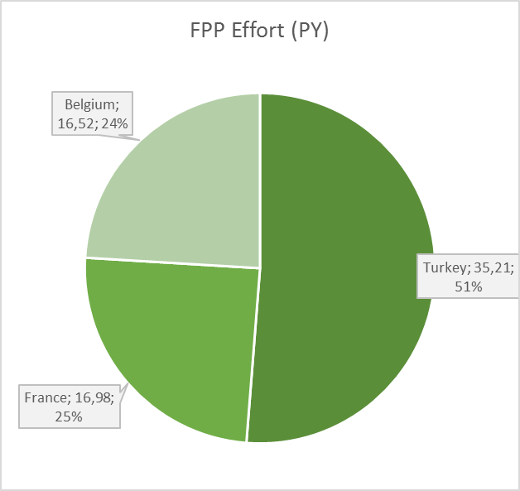
ModelWriter Project Overview

Slide 3
ModelWriter Project Overview
Resource Allocation: 68,71 person year
Project Duration: 36 months
Planned Budget: 5,543,000 Euro
Start and Finish Date: 01 Oct 2014 – 30 Sep 2017
Open-Source Software leading by a Turkish SME

Slide 4
ModelWriter Project Consortium
No | Partner Name | Organization Type | Country
01 | Space Applications | Small & Medium sized Enterprise | Belgium
02 | Katholieke Universiteit Leuven | University | Belgium
03 | Vrije Universiteit Brussel | University | Belgium
04 | AIRBUS-EADS Innovation Works | Large Industry | France
05 | LORIA | Research Institute | France
06 | OBEO | Small & Medium sized Enterprise | France
07 | MANTIS | Small & Medium sized Enterprise | Turkey
08 | UNIT | Small & Medium sized Enterprise | Turkey
09 | KOCSISTEM | Large Industry | Turkey
10 | HISBIM | Small & Medium sized Enterprise | Turkey

Slide 5
ModelWriter Today’s Knowledge Capture
Knowledge Capture with Word Processors
Document-centric,
Knowledge Capture with Modelling Tools
Model-centric, Structural and formal
Seamless Knowledge Capture with ModelWriter
ModelWriter as integrated product
Technical Documents
Natural Language
(2) multiple information modelling and exploitation tools (=the “Model” part),
(3) and keeps both views/components seamlessly synchronized with each other.
(1) a Word Processor (=the “Writer” part)
Requirements, Architectural Design Documents..
Very Informal ones (mind maps, text tables, spreadsheets)
Formal ones (UML, SysML, ECore)
Text-based

Slide 6
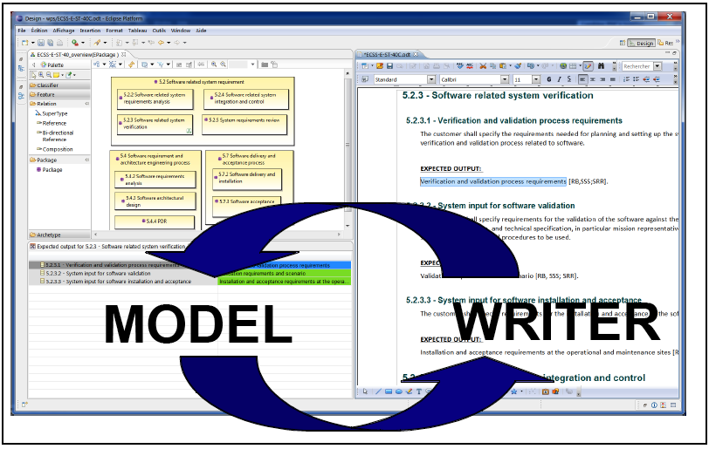
ModelWriter bi-directional Knowledge Capture tool

Slide 7
ModelWriter Text-Based Knowledge Extraction
Understands the various textual parts of a document expressed in NL
Reveals concepts and relationships between them (“Model”-part)
Semantic Word Processor
(Text-Based Knowledge Extractor)
Notes:
2. (e.g. formal Requirements on a product expressed in English).
exploit any presentation & formatting hints as well as any industry standard document structures and conventions
(incl. standard glossary of terms)
to semi-automatically and accurately transform pieces of text into a further processable knowledge model counter-part

Slide 8
ModelWriter Further Knowledge Valorizations
“Everywhere” Document Regeneration: "tell once, show everywhere“:
recycling knowledge from (1) the same document, or of (2) another related document
Open API for Future Dissemination and Exploitation to further extend the Business Value Chain
Consistency Checking: the objective to provide a Consistency Checker that automates Quality Reviews of Requirements Engineering
“MW” Knowledge Dissemination Standard (.mw ModelWriter exchange format)
Notes:
OPEN API: plug-ins (e.g. for a future Natural Language Question Answering System plug-in, domain-specific checkers or generators, etc.)

Slide 9
Turkish Consortium University Collaboration
Modeling, Design & Simulation Lab.
Prof. Hans Vangheluwe
Asst. Prof. Dr. Geylani Kardaş
Asst. Prof. Dr. Erhan Mengüsoğlu
ModelWriter TR Consortium
McGill University & University of Antwerp
UNIT
Multi-Paradigm Modeling, Formalism Transformation,
Interaction in communication with European partners
Mantis
Multi Agent Software Lab.
Ege University
Domain Specific Modeling Languages
Computer Engineering
Department TED University
KoçSistem
Knowledge Base Design, Ontology Development

Slide 10
ModelWriter technological components and their interactions
Notes:
ModelWriter teknolojik bileşenleri ve birbiri ile etkileşimleri
Her bir bileşenin gerçekleştirimi teknik bir iş paketi ile yönetiliyor.
Model part, Writer part,
Model Tooling, Writer Tooling,
Knowledge Base,

Slide 11
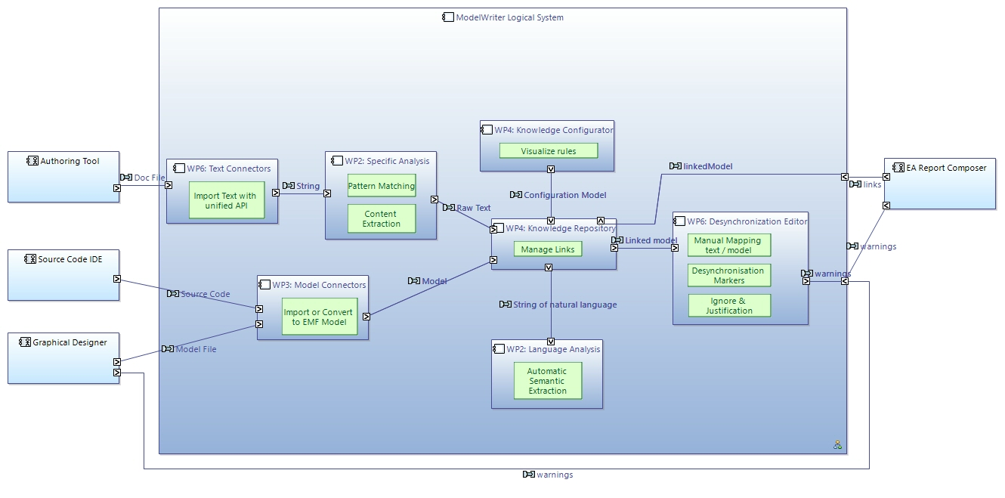

Slide 12
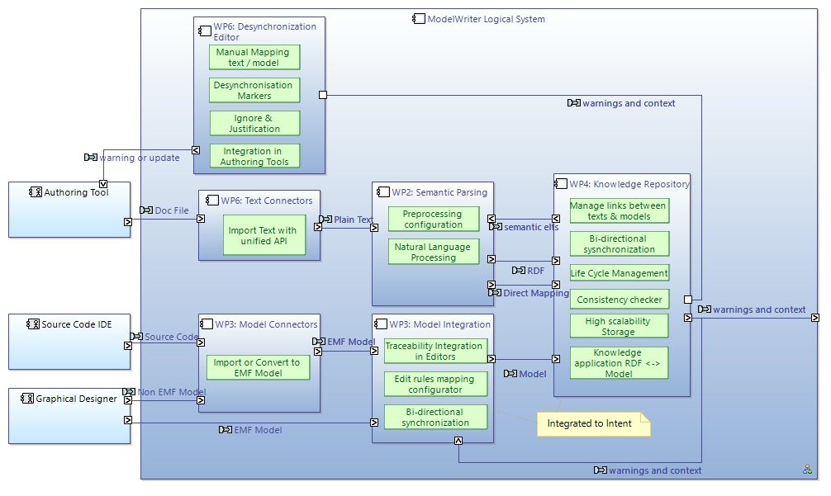
Logical Architecture

Slide 13
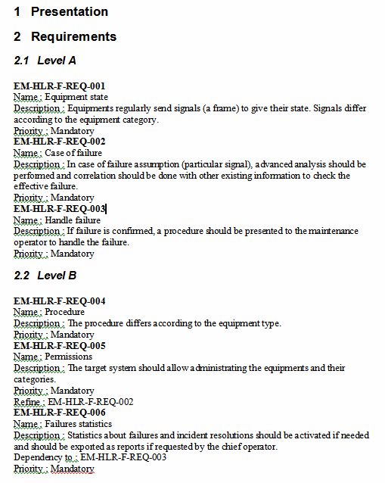
ModelWriter technological components and their interactions
Notes:
ModelWriter teknolojik bileşenleri ve birbiri ile etkileşimleri
Her bir bileşenin gerçekleştirimi teknik bir iş paketi ile yönetiliyor.
Model part, Writer part,
Model Tooling, Writer Tooling,
Knowledge Base,

Slide 14
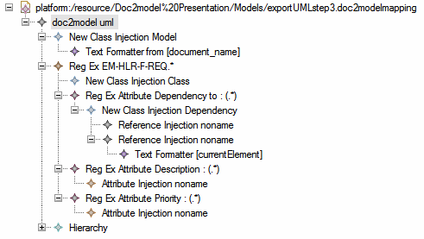
ModelWriter technological components and their interactions
Notes:
ModelWriter teknolojik bileşenleri ve birbiri ile etkileşimleri
Her bir bileşenin gerçekleştirimi teknik bir iş paketi ile yönetiliyor.
Model part, Writer part,
Model Tooling, Writer Tooling,
Knowledge Base,

Slide 15
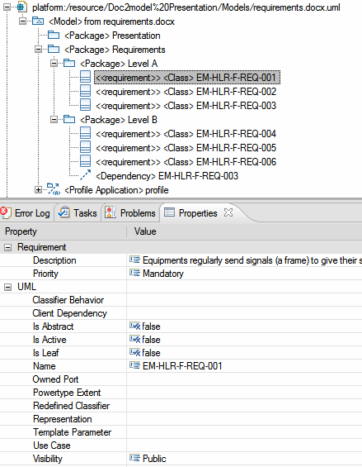
ModelWriter technological components and their interactions
Notes:
ModelWriter teknolojik bileşenleri ve birbiri ile etkileşimleri
Her bir bileşenin gerçekleştirimi teknik bir iş paketi ile yönetiliyor.
Model part, Writer part,
Model Tooling, Writer Tooling,
Knowledge Base,

Slide 16
An Eclipse-based M2M Transformation Framework (UNIT)

Slide 17
ModelWriter Innovation of the Project
WP2
Semantic Parsing and Generation of Documents and Documents Component
WP3
Model ↔ Knowledge Base
WP4
Knowledge Base Design and Implementation
WP6
Architecture, Intergration & Evaluation
WP2 Leader:
LORIA
WP3 Leader:
UNIT
WP4 Leader:
Mantis
WP6 Leader:
OBEO

Slide 18
ModelWriter: Work packages & Concrete Results
WP3 (UNIT)
WP4 (MANTIS)
WP6 (OBEO)
WP2 (LORIA)
Semantic Word Processor
An extensible model-model transformation framework
A federated Knowledge Base and its API
A complete “ModelWriter” tool integrating of all these in a consistent
Model checker plug-in for consistency
Bi-directional sync. mechanism between texts and models
bi-directional transformation between text and formal knowledge representation
WP1 Industrial Use Cases and Requirements (AIRBUS)
WP5 Project Management (UNIT)
WP6 Standardization, Dissemination and Exploitation (OBEO)

Slide 19
ModelWriter Industrial Use Cases (French Consortium)
Help determining the impacts of a change in the Enterprise Architecture
UC-FR-02
Enterprise Architecture
CEISAR - Center of Excellence in Enterprise Architecture
UC-FR-03
Requirements Engineering with SysML Designer (requirement-model consistency)
UC-FR-04
Synchronization of regulation documentation with a design rule repository
OBEO, TOTAL,
AIR France, AXA
Demonstrate that the ModelWriter concept can be usefully applied on System design / Requirement generation activities.
OBEO, AIRBUS
Focus on building synchronized links between regulation documents in natural language and rules (as models).
OBEO, AIRBUS,
LORIA

Slide 20
ModelWriter Industrial Use Cases (Turkish Consortium)
IBM Rational Doors Plug-in and Eclipse Requirement Frameworks Sub-component which supports OMG’s ReqIF Standard.
UC-TR-03
Sync between Requirement Documentation and Feature Models
UC-TR-04 (UC-FR-01)
Synchronization between Models and Documentation
UC-TR-05
Synchronous Business Process Design with Use Cases
UNIT
Eclipse Modeling Framework (EMF) based Plug-in
KoçSistem
UNIT
UNIT
BPMN and Use Case Documentation

Slide 21
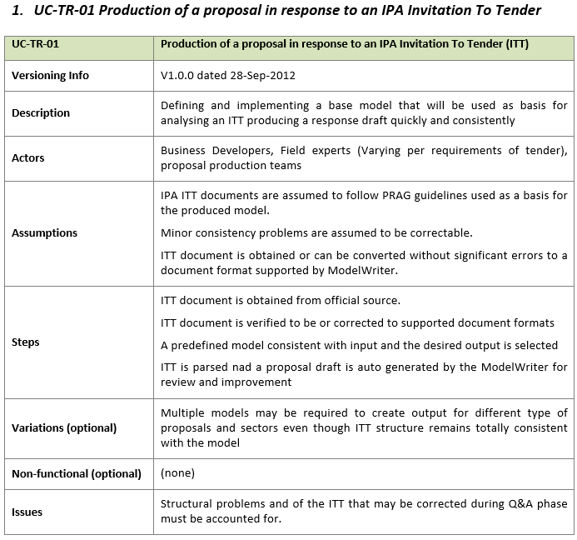
Leader: Hisbim
BNB’s main field of activity is developing proposals and implementation of the proposals of IPA, WB and local development agency projects in a multitude of fields. Preparing a first response to an ITT is requires both a methodical and thorough analysis of an ITT document and extensive knowledge on the previously generated information and methodologies of the company preparing the response.

Slide 22
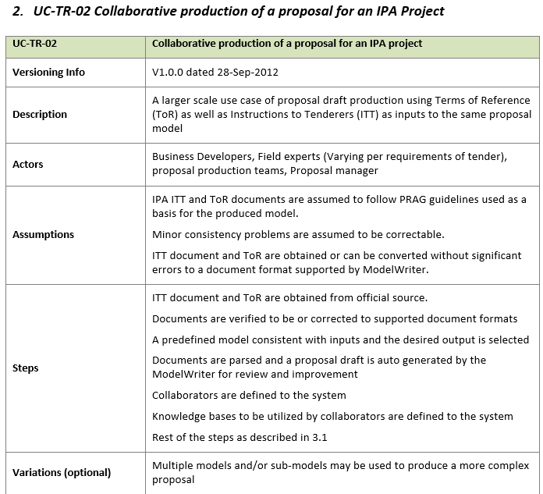
Leader: Hisbim
Development and use of a well-defined model to streamline the production of the response will increase efficiency of preparation of the document as well as improving its quality. This use case will also perform as a smaller scale introduction to the UC-TR-02

Slide 23
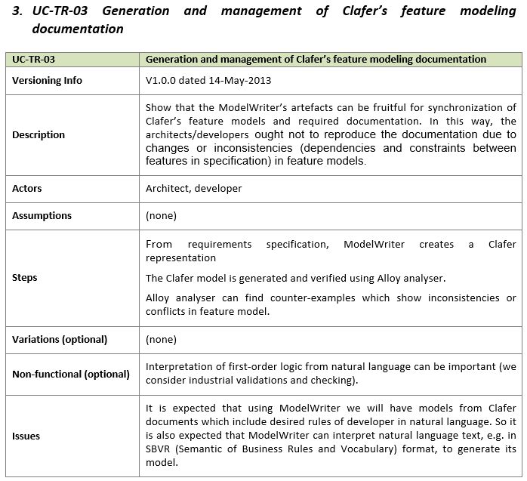
Leader: KoçSistem
Partner: UNIT
This Use Case aims at applying ModelWriter on Clafer’s feature models to generate documentation for domain models, architectural templates and product variants.

Slide 24
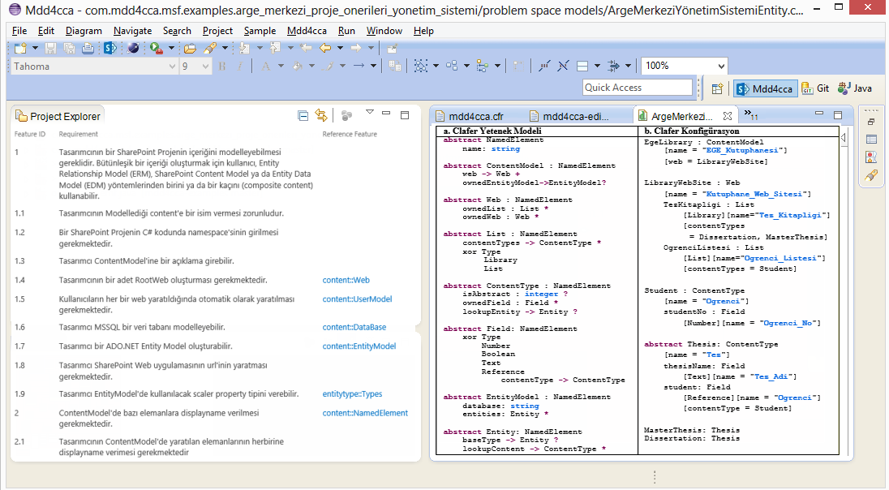
Industrial Use Cases (UNIT + KoçSistem) Generation of feature models from requirement documentation
Writer
Model

Slide 25
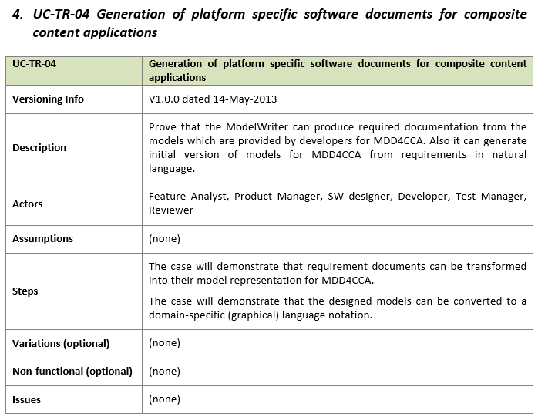
Leader: KoçSistem
Partner: UNIT
MDD4CCA is a set of domain specific languages to generate composite content applications on enterprise content management servers from high level models designed by developers. By using ModelWriter, it will be possible to generate documentations from MDD4CCA’s input models and to generate initial MDD4CCA input models from customer’s early requirement documents in natural language.

Slide 26
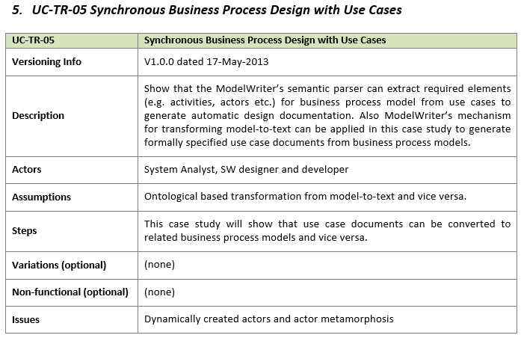
Leader: UNIT
Partner: KoçSistem
Business processes can be described with diagrams, e.g. BPMN diagrams, or as text. Use cases are a text-based notation. They are semiformal: a business process is expressed as a sequence of steps and each step is presented in a natural language. We aim to synchronize diagram-based and text-based notations and provide required tool.

Slide 27
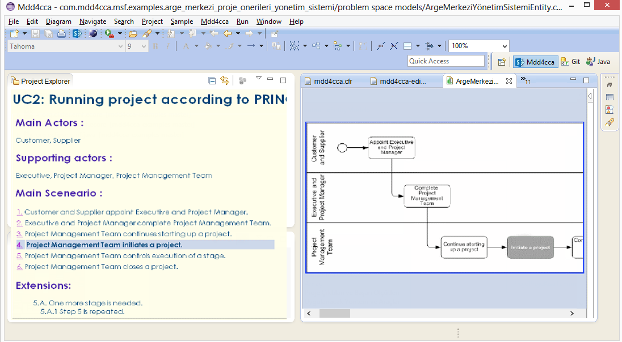
Industrial Use Cases (UNIT + KoçSistem) Synchronous Business Process Design with Use Cases
Writer
Model

Slide 28
WP3 - Model to/from Knowledge Base (UNIT)
T3.1 - Review of M2M transformation approaches (UNIT + KS)
T3.2 - Specification and design of the M2M Transformation Framework (UNIT + KS)
T3.3 – Development of the Transformation Manager component (UNIT)
T3.4 – Development of the Configuration Manager component (UNIT)
T3.5 – Development of the Traceability Manager component (UNIT)
T3.6 – Development of the Synchronization Manager component (UNIT)
T3.7 – Design of the model-to-model transformations (UNIT + Mantis + VUB)
T3.8 – Implementation of the model-to-model transformations (UNIT + VUB)
T3.9 – Validation of the M2M Transformation Framework (UNIT + Mantis + VUB + KS)

Slide 29
An Eclipse-based M2M Transformation Framework (UNIT)
Transformation Manager
Configuration Manager (Meta-model level)
Traceability Manager (Model Level)
Synchronization Manager
provides the infrastructure to register and launch transformations.
for personalizing the behaviour of the framework to meet the needs of a specific standard / organization / project / individual.
keeps links between elements of user-visible models and elements of the KB.
triggering transformations when synchronization is needed
A DSL for model transformation specifications
keeps traces between transformed models and its source models.
obtains one or several output models from one or several input models.
configures the transformations to be able to produce different outputs using the same inputs.

Slide 30
ModelWriter Open Source Campaign Open Call for Industrial User Stories
Shape the future ModelWriter
Early adaptation of the technology

Slide 31
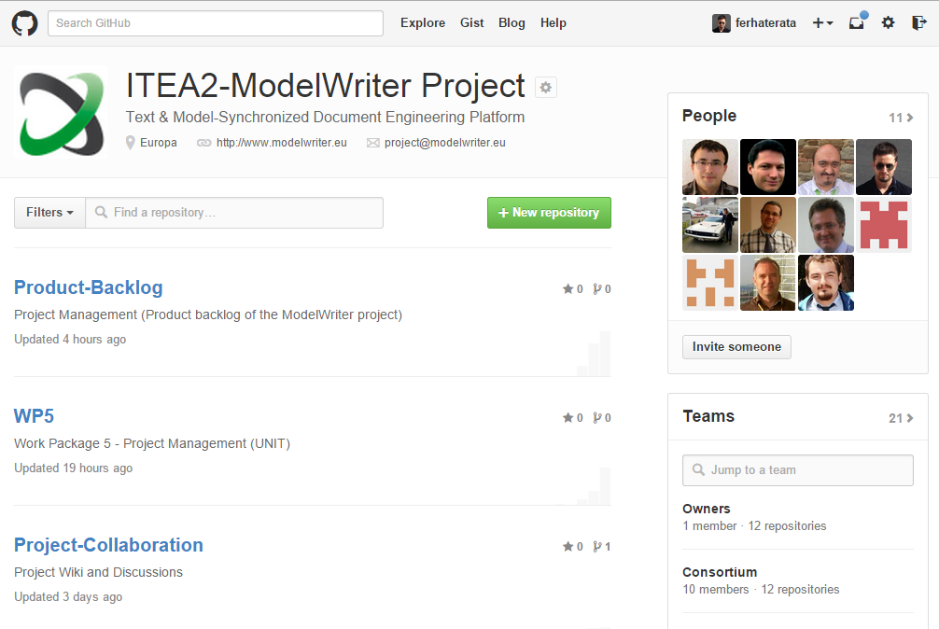
ModelWriter Open Source Campaign https://github.com/modelwriter

Slide 32
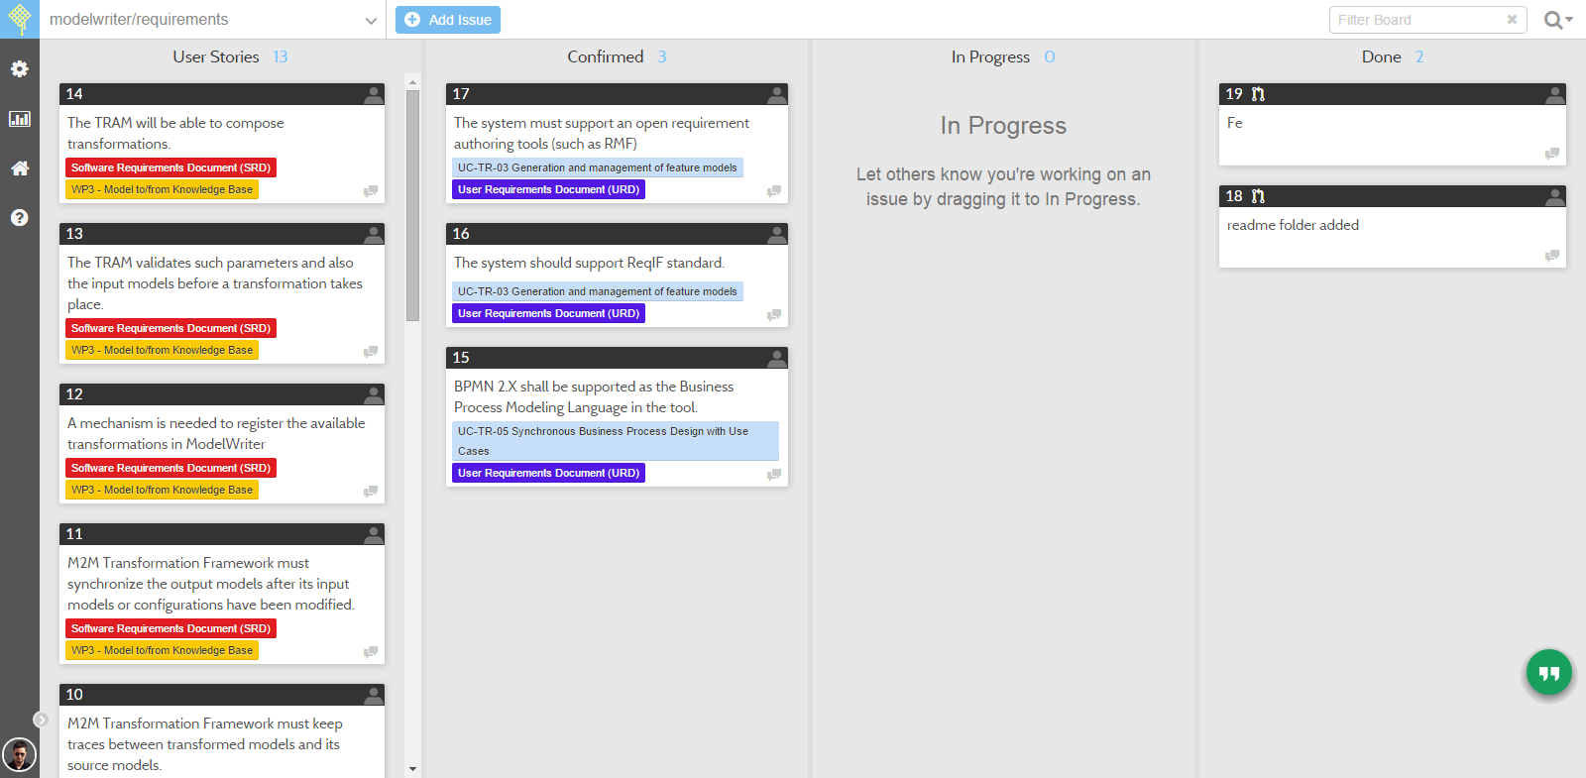
ModelWriter Requirments & User Stories https://waffle.io/modelwriter/requirements

Slide 33
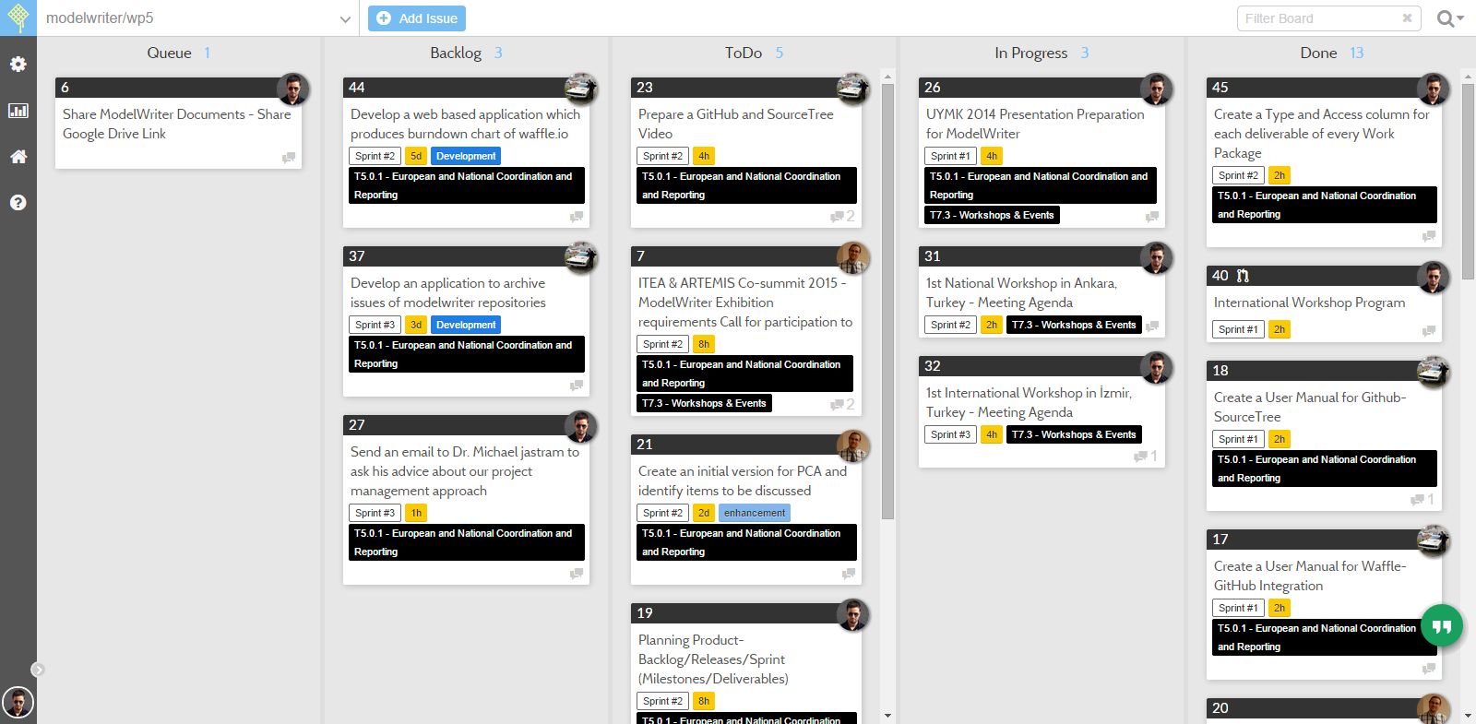
ModelWriter Requirments & User Stories https://waffle.io/modelwriter/wp5

Slide 34
1st International ModelWriter Workshop Call for Participation İzmir, Turkey, Jan 15-17, 2015

Slide 35
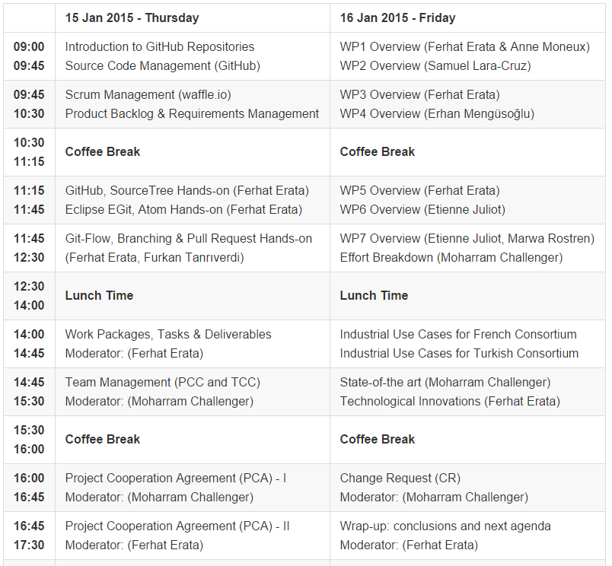
ModelWriter 2014 Workshop Program https://github.com/modelwrite/workshops

Slide 36
ModelWriter Project Consortium Contact details
Ferhat ERATA Project Leader ferhat@computer.org +90-539-5661271
Etienne Juliot French Consortium Coordinator etienne.juliot@obeo.fr +336 86 78 14 82
Dr. Güven Köse Turkish Consortium Coordinator guvenkose@mantis.com.tr
+90-312-2992505
Prof. Monique Snoeck Belgian Consortium Coordinator monique.snoeck@kuleuven.be +321 63 26 879
Project Management Office: project@modelwriter.eu
Project Site: www.modelwriter.eu
GitHub Site: https://github.com/modelwriter

Slide 37
Thanks You! Questions/Comments? Presentation: https://slideshare.net/ferhaterata

