Slide 1
ModelWriter WP1 - Industrial Use Cases Project meeting 15-17/01/2015, Izmir
Prepared by Anne MONCEAUX
15 01 2015

Slide 2
Outline
Objectives
Open question wrt WP1 organization
WP1 planning and interfaces with other WPs
Tasks & responsibilities
Collaboration & Tools
Use cases overview
French UCs
Turkish UCs

Slide 3
Objectives
To gather Industrial Use Cases from all the industrial partners and illustrate them by sample representative corpus data (e.g. pieces of software or system lifecycle documents and/or models)
To formalize and prioritize User Requirements (incl. commercial requirements) on ModelWriter platform.
To specify the Software Requirements, including the technology to be researched & developed (in WP2, WP3, WP4) and integrated (in WP6) within the ModelWriter platform.
To define evaluation methods, incl. metrics to quantify performance of technical authors with and without ModelWriter to enable evaluation.

Slide 4
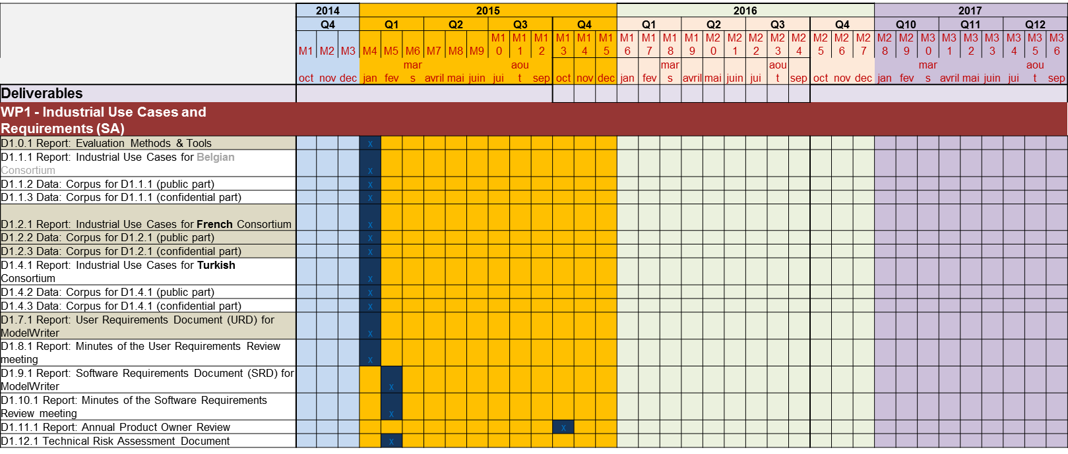
WP1 planning
WP1 Use Cases
(AIRBUS GROUP)
Almost all WP1 deliverables are due very early in the project
No explicit iterations
Already 1month slippage decision : M3 –> M4
Risk of no mature descriptions or delays for delivering proper data sets
WP6.0 Architecture
(OBEO)
? iterations
WP3 Knowledge base
(UNIT)
WP2 NLP - parsing/generation
(LORIA)
WP4 KB design and implementation
(Mantis)
WP6.4 Integration
(OBEO)
WP6.5 Evaluation
(OBEO)
interfaces with other WPs (from FPP figure 3 - simplified)

Slide 5
Task contributors, deliverable owners /1
Airbus Group accepts WP1 leadership but cannot fulfil all SA planned activities (cf. no additional time / budget ) –
➔ Demanded action: to reallocate tasks’ responsibilities
T1.0 - Evaluation Methods & Tools | UNIT + KS + Industrial UCs partners | D1.0.1 method document | M4
T1.1 – Industrial UCs for Belgian Consortium | (TBD)
T1.2 – Industrial UCs for French Consortium | Obeo + Airbus Group | D1.2.1 Report: Industrial Use Cases for French Consortium D1.2.2 Data: Corpus for D1.2.1 (public part) D1.2.3 Data: Corpus for D1.2.1 (confidential part) | M4
T1.3 – (DELETED)
T1.4 – Industrial UCs for Turkish Consortium | Mantis + UNIT + KS + HISBIM | D1.4.1 Report: Industrial Use Cases for Turkish Consortium D1.4.2 Data: Corpus for D1.4.1 (public part) D1.4.3 Data: Corpus for D1.4.1 (confidential part) | M4
T1.5 – (DELETED)
T1.6 – (DELETED)
T1.7 – Consolidated User Requirements | SA + Country Coordinators (Obeo, Mantis) | D1.7.1 User Requirements Document (URD) (= a common list of formal Req + initial prioritization compiled from all Industrial UCs) | M4

Slide 6
Task contributors, deliverable owners /2
T1.8 – User Requirements Review | SA + UNIT+ KS + KUL + ALL | D1.8.1 minutes of a Progress Meeting for the Industrial UCs partners to present Use Cases, corpora material and common User Requirements Document (URD) to all the other participating project partners. | M4
T1.9 – Software Requirements | SA + WP2 to WP7 leaders (Loria, UNIT, OBEO) | D1.9.1 common Software Requirements Document (SRD) derived from the previous URD will identify and prioritize the functional and non-functional requirements for the ModelWriter IDE + traceability | M5
T1.10 – Software Requirements Review | SA + UNIT + KS + KUL+ ALL | D.1.10.1 minutes of a Progress Meeting for the technology developers (WP2 to WP4 leaders) to present proposed ModelWriter platform features and non-functional requirements | M5
T1.11 – Annual Product Review | SA + Country Coordinators (OBEO, UNIT) | Before each new (±1-year long) a Product Review committee made of Country Coordinators and WP7 leader revises the features of the SRD + technical risk + URD changes | M13
T1.12 – Technical Risk Assessment and Management | Obeo + UNIT + KS+ ALL | D1.12.1 Technical Risk Assessment Document | M5
•

Slide 7

Tools & collaboration
Way of working - tools
Airbus Group doesn’t access GitHub
Way how to share private data to be defined: not shared on GitHub, only public corpora can be shared
Identify commonalities between UCs
Because WP2 cannot handle many different needs in terms of NLP approach, we need to agree on UCs with sufficient commonalities
Use common templates and data structures
UC template
Requirement capture
User req document - URD
System req documents - Refined SRD
- Req will be managed online on GitHub. - - Every task leader to contribute.
- UNIT will take charge of generatinf a req documents from the GitHHub

Slide 8
Use cases overview: FR industrial UCs
ID | TITLE | Owner | Country | Status | Comments
UC-FR-01 | Synchronization between Models and Documentation | OBEO | FR | Confirmed | Sirius software synchronization with its documentation – user guide part
UC-FR-02 | Enterprise Architecture | OBEO | FR | Confirmed | SmartEA based on Sirius tool and doesn’t have a mean to edit documentation => add a synchronized editor. Based on existing project where the documentation of the EA is explains the rationale for the EA changes - - so this will be a model documentation edition (current case and document come from COREGI)
UC-FR-03 | Requirements Engineering with SysML Designer | OBEO | FR | DELETED | Replaced by FR-03 NEW
UC-FR-03 (NEW) | Operational requirement document to model synchronization | AIRBUS | FR | Proposed | Still being defined- seeking for a technical contact point at Airbus + corpora
UC-FR-04 | Synchronization of regulation documentation with a design rule repository | AIRBUS | FR | Confirmed
UC-FR-05 | Production of a context specific design document | AIRBUS | FR | Confirmed

Slide 9
Use cases overview: TK industrial UCs
TK use case definition is still on going since the partners joined the consortium later they need a bit more time to fing technical contacts points and relevant available corpora. The table must be updated with names, and descriptions
ID | TITLE | Owner | Country | Status | Comments
UC-TR-01 | Production of a proposal in response to an IPA Invitation To Tender | HISBIM | TK | Confirmed | Quality Assurance documentation management. Product Quality Forms are in a database. They are trying to find a customer who accept that they use the Product Quality form.
UC-TR-02 | Collaborative production of a proposal for an IPA project | HISBIM | TK | Confirmed | Modeling NDA document – From a DB that contains elements of information that describe NDA, have the capability to generate the NDA documents
UC-TR-03 | Generation and management of Clafer’s feature modeling documentation | UNIT + Koçsistem | TK | Confirmed | Still seeking ind end user to provide corpus – on going negotiation. Tries to synchronize requirement with feature model (for product line management context)
UC-TR-04 | Generation of platform specific software documents for composite content applications | UNIT + Koçsistem | TK | Confirmed
UC-TR-05 | Synchronous Business Process Design with Use Cases | UNIT + Koçsistem | TK | Confirmed | Still seeking ind end user to provide corpus – on going negotiation. The customer uses BPMN (but may want to change to IDEF) (Turkish language) Another customer use UML state diagrams (English language)

