Slide 1
ModelWriter WP1 – Airbus Industrial Use Cases Project meeting 15-17/01/2015, Izmir
Prepared by Anne MONCEAUX
15 01 2015

Slide 2
Outline
ID | TITLE | Owner | Status
UC-FR-01 | Synchronization between Models and Documentation | OBEO | Confirmed
UC-FR-02 | Enterprise Architecture | OBEO
UC-FR-03 | Requirements Engineering with SysML Designer | OBEO | Replaced
UC-FR-03 (NEW) | Synchronization between operational Requirements and architecture Model | AIRBUS | On going definition
UC-FR-04 | Synchronization of regulation documentation with a design rule repository | AIRBUS | Confirmed
UC-FR-05 | Production of a context specific design document | AIRBUS | Confirmed

Slide 3
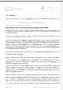
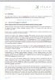






UC-FR-04 + UC-FR-05 common context
Initial doc
Overall objectives: to set up synchronized links between source documentation, applicable rules (installation rules) and design.
UC-FR-04
Extract rules
Rule repository
New structured doc
Generate synchronized doc
Product Structure
Elec. routing (A350 - S15 - Z102, Rte M)
Request. Operation
A/C
UC FR 05
Product breakdown
Environment + original Sol.
Section
Section
Zone1
Zone2
Adapted Rules list
Compo- nent
New Cpt
Design Solution
Parametric Comp.

Slide 4
UC-FR-04 + UC-FR-05 – Main functions
Well formed Rules
Rules structure & combination
Doc template
F2: Manage Rules
SIDP
AP/AM
Rule Model
Existing documents
Rules
Data base
F1: Extract / Create Rules
F3: Generate new document
Request operation
F4: List of Rules to apply
DMU environment original solution
New documents / rule sets
Parametric Component
DB
CATIA
OTHER ENG TOOLS?

Slide 5
UC-FR-04 + UC-FR-05 – Main functions
UC-FR-04: retrieve rules from document and synchronize a rule DB with the documents
Well formed Rules
Rules structure & combination
Doc template
F2: Manage Rules
SIDP
AP/AM
Rule Model
Existing documents
Rules
Data base
F1: Extract / Create Rules
F3: Generate new document
Request operation
F4: List of Rules to apply
DMU environment original solution
New documents / rule sets
UC FR 05: enable queries and reasoning on rules for synchronizing them with other engineering models
Parametric Component
DB
CATIA
OTHER ENG TOOLs

Slide 6
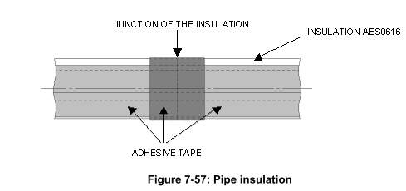
UC-FR-04 + UC-FR-05 Corpora status
Source documents
SIDP – available for NDA (.doc)
AP/AM – (To be Confirmed)
Models
SIDP documents are “composite” documents that contains text referring to visual models: mainly tables, diagrams and 2D drawings…
➔ These models can be treated as document-external models: they are (considered) authored and managed apart the textual parts of the documents
A SQL DB is built and contains part of the installation req written in a semi-structured format
➔ ER model available (to be confirmed)
“A space provision will be provided in order to insert a heater strip, if required.
To ensure the fixation of foam ABS0616, it is recommended to use self adhesive tape ABS5662B02 along the longitudinal foam slot.
In the same way, this adhesive tape shall surround the insulation at junction positions as shown in Figure 7-57 below. If insulation parts are twisted or bent on assembly, the ends are required to be cut straight. During assembly, cut the insulation to the correct length as required.”

Slide 7

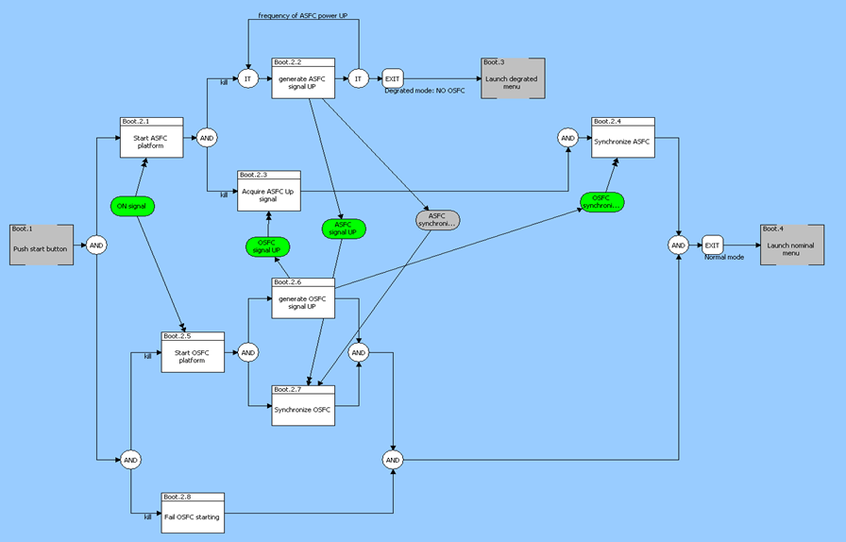
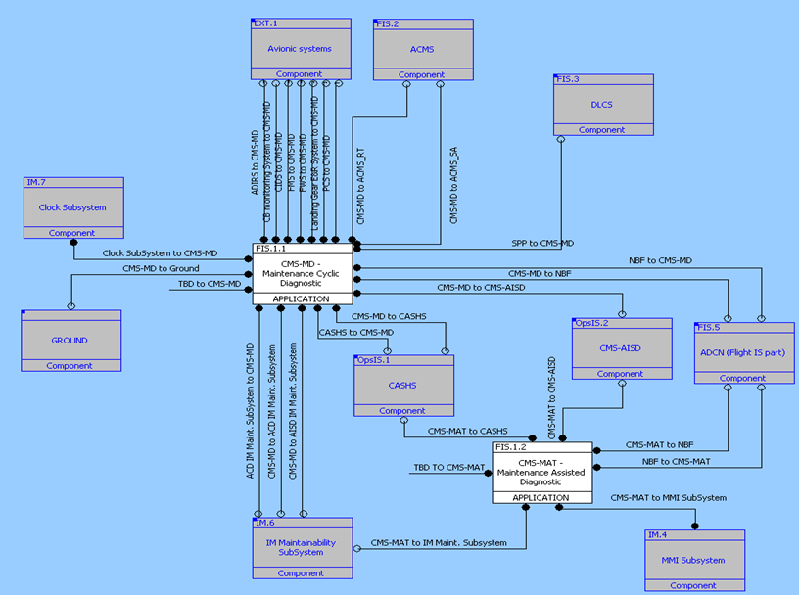
UC FR 03 (NEW) context
This UC is still under discussion. It will replace the foreseen OBEO UC03. The intent is to refine it and address an Airbus UC instead. We are currently considering the providing of a synchronized mechanism between text and operational requirements FFBD models.
Overall objective: Synchronization between Operational Requirements and Design
Initial doc
Sub-objective in ModelWriter: focus on Operational cases and Conditions and estimation and measurement expressions
Extract requirements
A/C operation & function reference + Op requirements
Structured doc
Generate synchronized doc
Aircraft Engineering result Database
Synchronized models
?

Slide 8
UC FR 06 (NEW) main functions
Overall objective: Synchronization between Operational Requirements and design
Certification documents
A/C Functions / Operations reference
A/C performances handbook
…
Operational conditions
Measurement
Source documents
Model
F1: support model definition
Operation & funfion reference Data base
Eng
Data base
F2: Synchronize target req
F3: Delta wrt design
Other MBSE models

Slide 9
UC-FR-06 (NEW) Corpora status
Source documents – on going collection - Most probably some ad-hoc public sources will have to be built
A/C Operation requirements
Safety recommendations
Performances book
Certification CS-25 document (format TBC)
Models
eFFBD models for Aircraft operation (CORE Vitech tool)
ProGreSQL DB and existing architecture ER model (to be extended)
Preliminary QUDT based tables for description of Quantities, Units, etc.

