Slide 1
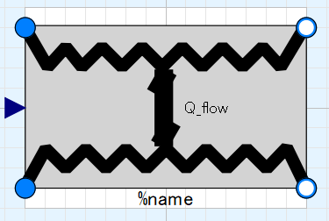
Ports (inlet & outlet) of fluid flow of Media 1, input&output (use “connect” operator)
Heat exchange effectiveness; input (use “connect” operator)
Ports (inlet & outlet) of fluid flow of Media 2, input&output (use “connect” operator)

Slide 2
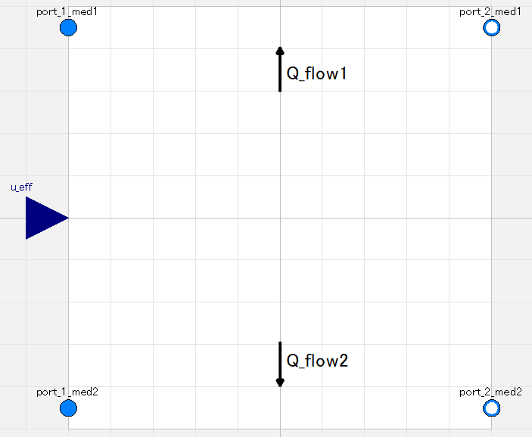
Amount of heat exchanged is calculated from fluid heat capacity of inlets and heat exchanger effectiveness which is given as real signal.
Which is hot or cold side is NOT pre-defined. It is automatically determined depending on states of inlet ports.
Add/Remove heat to/from fluid flow.
|Q_flow1| = |Q_flow2|
Which is inlet or outlet is NOT pre-defined. It is automatically determined depending on states of ports.

Slide 3
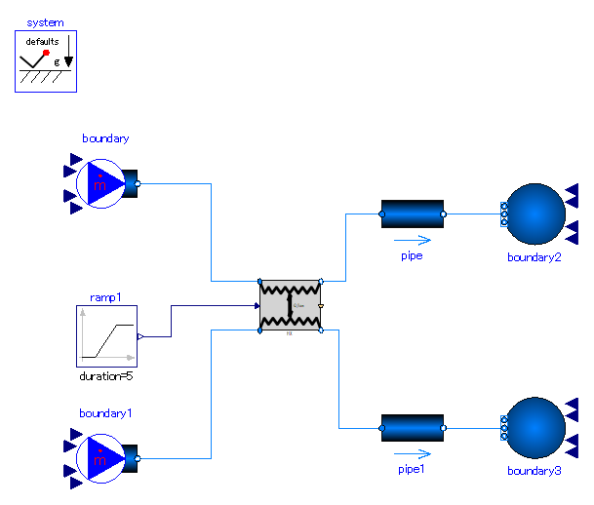

Slide 4
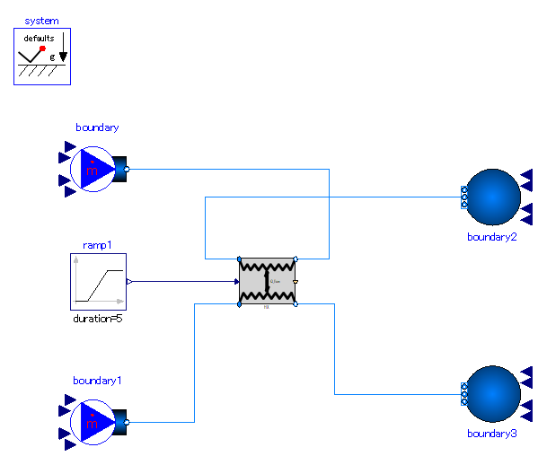

Slide 5
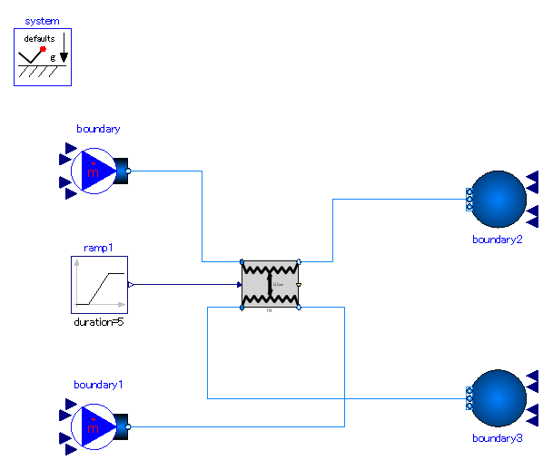

Slide 6


Slide 7
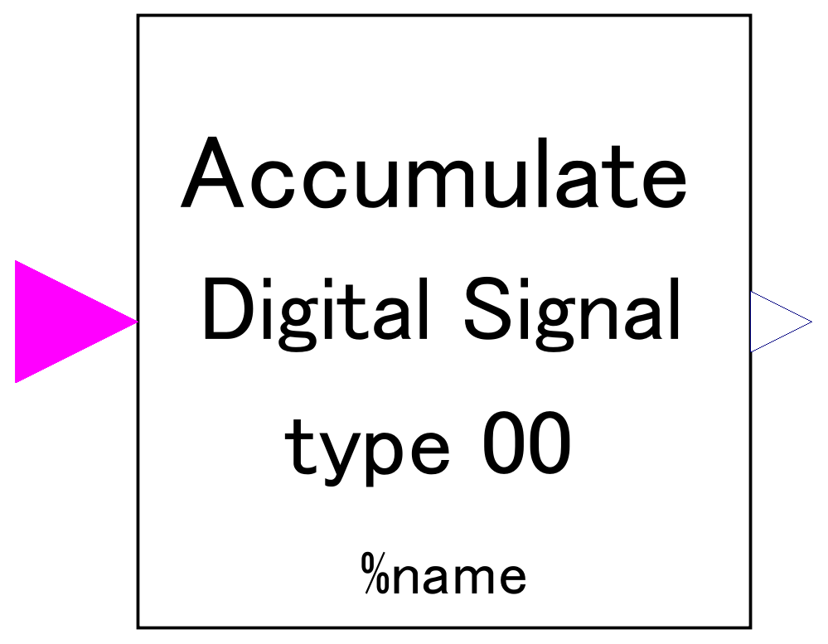
-. accumulate digital signal received and output.
-. Increase of output signal is determined by how many times true signal is received, NOT by how long true signal is maintained.
-. Output signal can be scaled by parameter setting for control of large values.
Receive Boolean signal of digital input.

Slide 8
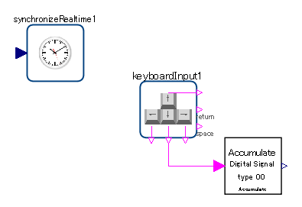
It is assumed to be deployed together with keybordInput component of Modelica_DeviceDrivers library.

Slide 9
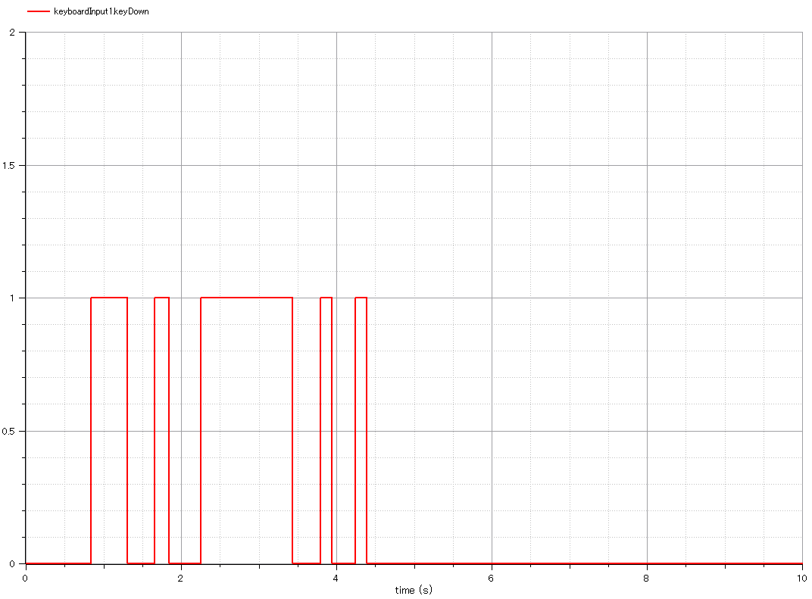
Input:
-. Beelean signal which represent keybord inout.
-.”1” represenets “pressed”.

Slide 10
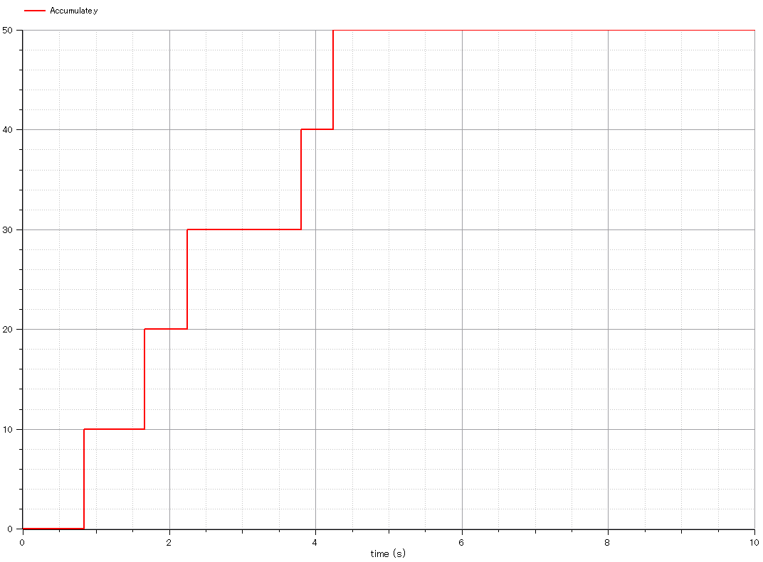
Output:
-. accumulated signal.
-. Output signal increases as keyboard is pressed.
-. How long the key is pressed does NOT affect on output signal.
-. Increments of output signal is 10 because scale factor is set 10.

Slide 11
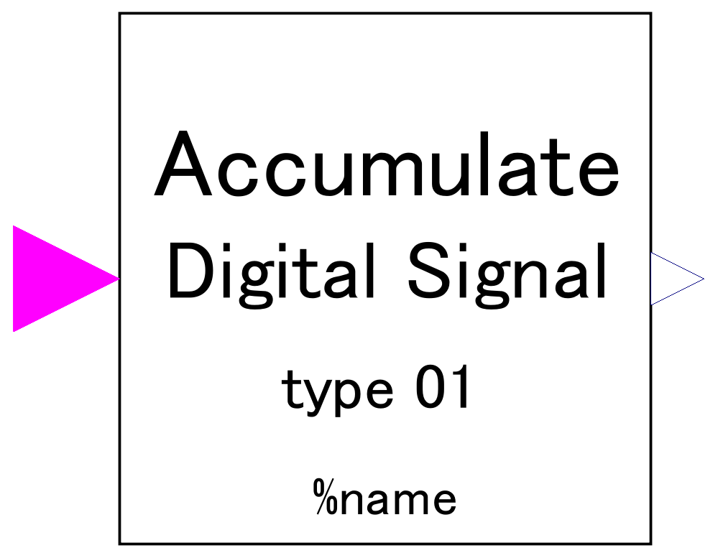
-. accumulate digital signal received and output.
-. Increase of output signal is determined by how many times true signal is received, NOT by how long true signal is maintained.
-. Output signal can be scaled by parameter setting for control of large values.
Receive Boolean signal of digital input.

Slide 12
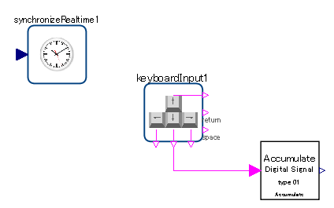
It is assumed to be deployed together with keybordInput component of Modelica_DeviceDrivers library.

Slide 13
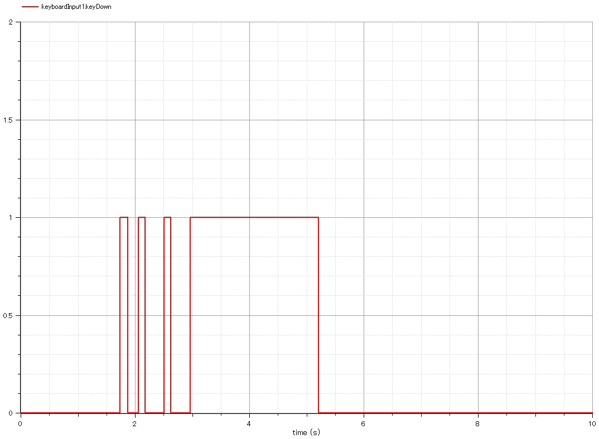
Input:
-. Beelean signal which represent keybord inout.
-.”1” represenets “pressed”.

Slide 14
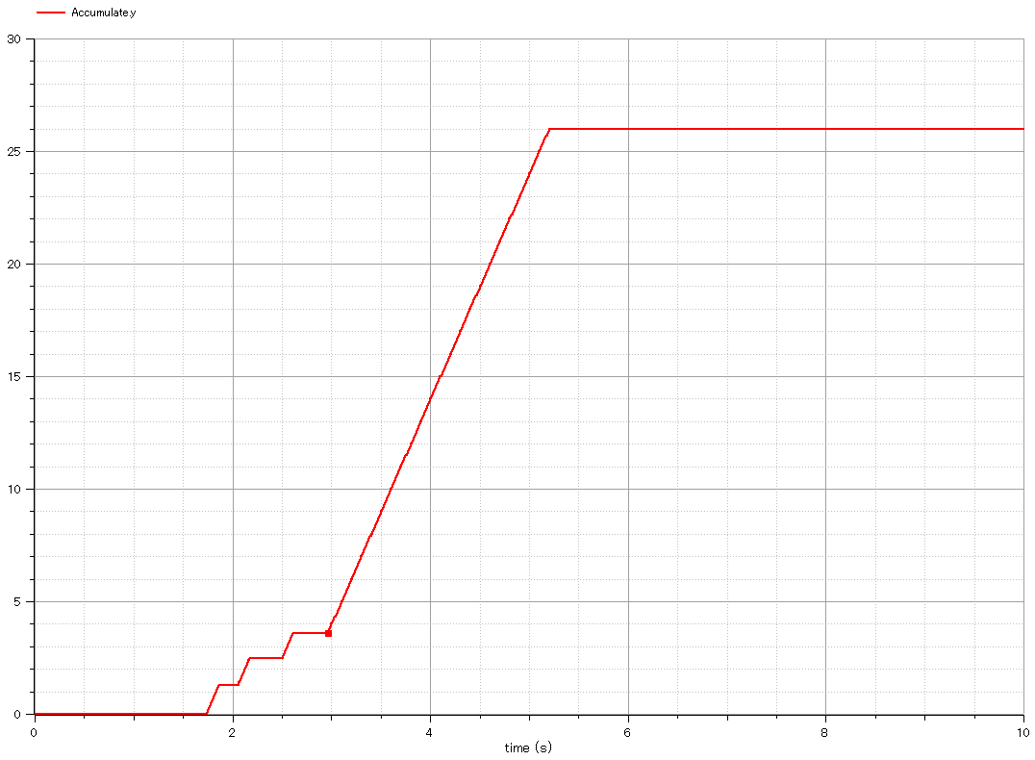
Output:
-. accumulated signal.
-. Output signal increases as keyboard is pressed.
-. How long the key is pressed does NOT affect on output signal.
-. Increments of output signal is 10 because scale factor is set 10.

