Slide 1
h
Const. Pressure Curve
W
Isentropic Compression
Const. Pressure Curve
s

Slide 2
h
Const. Pressure Curve
W
Isentropic Expansion
Const. Pressure Curve
s

Slide 3
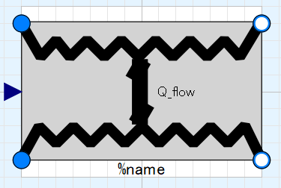
Ports (inlet & outlet) of fluid flow of Media 1, input&output (use “connect” operator)
Heat exchange effectiveness; input (use “connect” operator)
Ports (inlet & outlet) of fluid flow of Media 2, input&output (use “connect” operator)

Slide 4
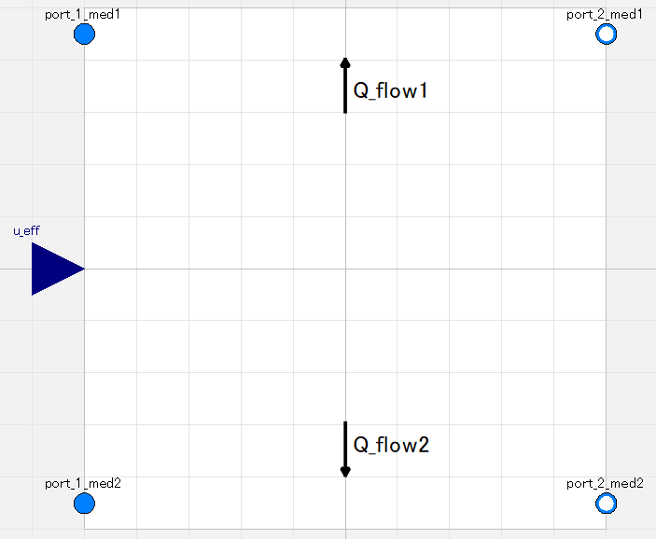
Amount of heat exchanged is calculated from fluid heat capacity of inlets and heat exchanger effectiveness which is given as real signal.
Which is hot or cold side is NOT pre-defined. It is automatically determined depending on states of inlet ports.
Add/Remove heat to/from fluid flow.
|Q_flow1| = |Q_flow2|
Which is inlet or outlet is NOT pre-defined. It is automatically determined depending on states of ports.

Slide 5
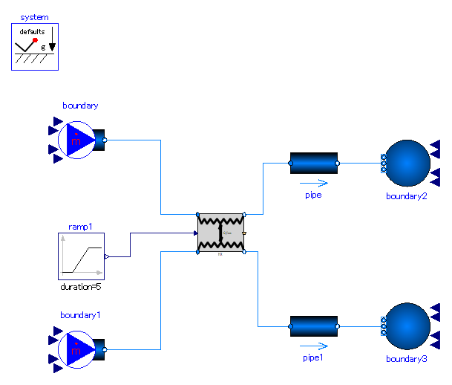

Slide 6
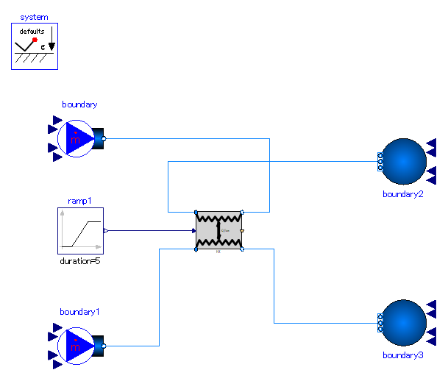

Slide 7
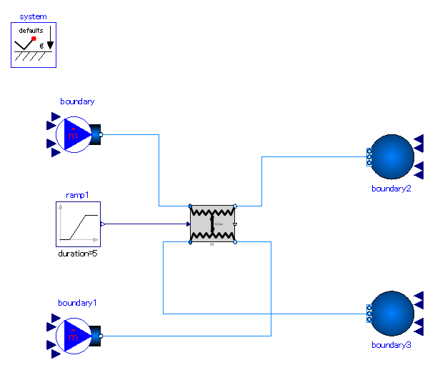

Slide 8


