Slide 1
p
Q
Adiabatic Expansion
W
Const. Vol.
Heat Addition
Q
Const. Press.
Heat Rejection
Vol

Slide 2
h
Q
Adiabatic Expansion
Const. Vol.
Heat Addition
W
W
Adiabatic Compression
Q
Const. Vol.
Heat Rejection
s

Slide 3
h
Const. Pressure Curve
W
Isentropic Compression
Const. Pressure Curve
s

Slide 4
h
Const. Pressure Curve
W
Isentropic Expansion
Const. Pressure Curve
s

Slide 5
h
Const. Pressure Curve
Q
Constant Volume Heat Addition
Const. Pressure Curve
s

Slide 6
h
Const. Pressure Curve
Q
Constant Pressure Heat Addition
s

Slide 7
h
Const. Pressure Curve
Constant Volume Heat Rejection
Q
Const. Pressure Curve
s

Slide 8
h
Const. Pressure Curve
Constant Pressure Heat Rejection
Q
s

Slide 9
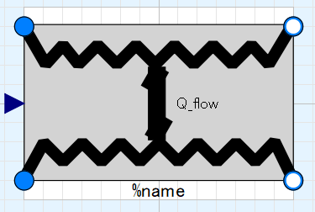
Ports (inlet & outlet) of fluid flow of Media 1, input&output (use “connect” operator)
Heat exchange effectiveness; input (use “connect” operator)
Ports (inlet & outlet) of fluid flow of Media 2, input&output (use “connect” operator)

Slide 10
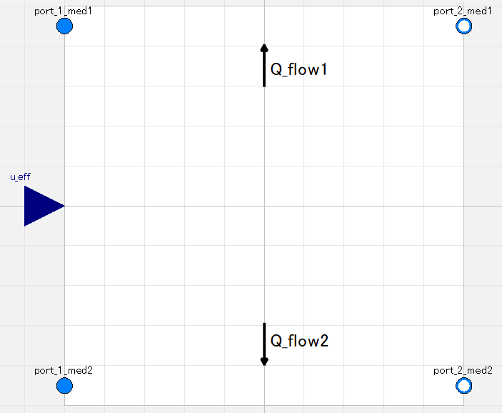
Amount of heat exchanged is calculated from fluid heat capacity of inlets and heat exchanger effectiveness which is given as real signal.
Which is hot or cold side is NOT pre-defined. It is automatically determined depending on states of inlet ports.
Add/Remove heat to/from fluid flow.
|Q_flow1| = |Q_flow2|
Which is inlet or outlet is NOT pre-defined. It is automatically determined depending on states of ports.

Slide 11
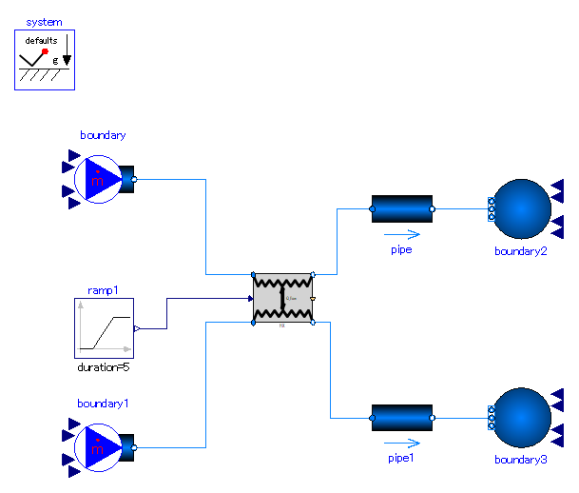

Slide 12
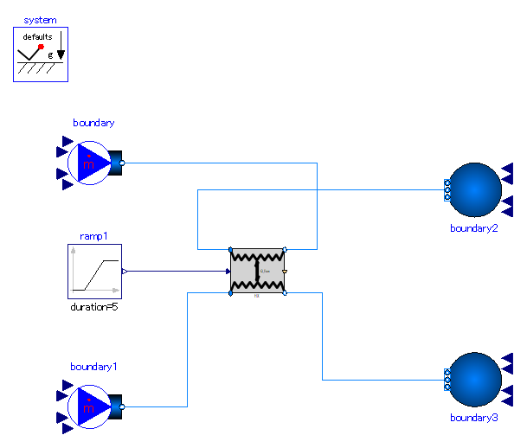

Slide 13
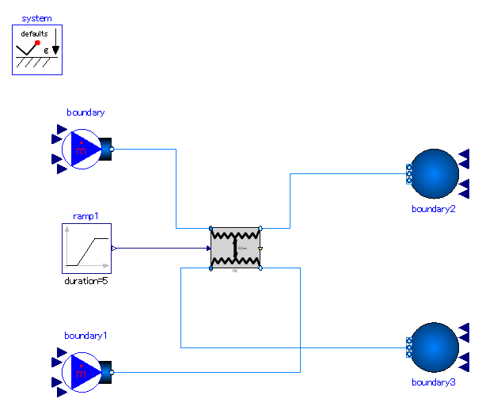

Slide 14


