Slide 1
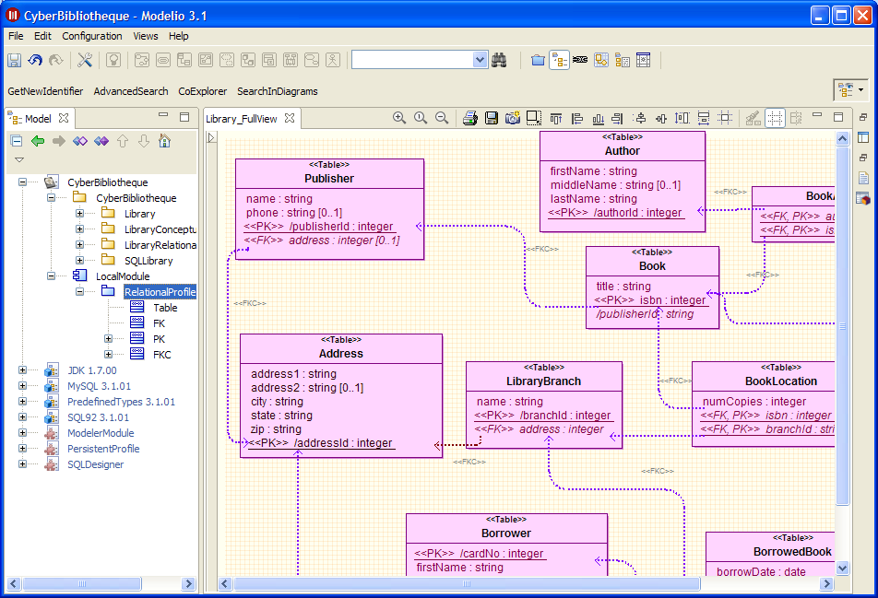
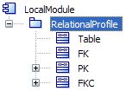
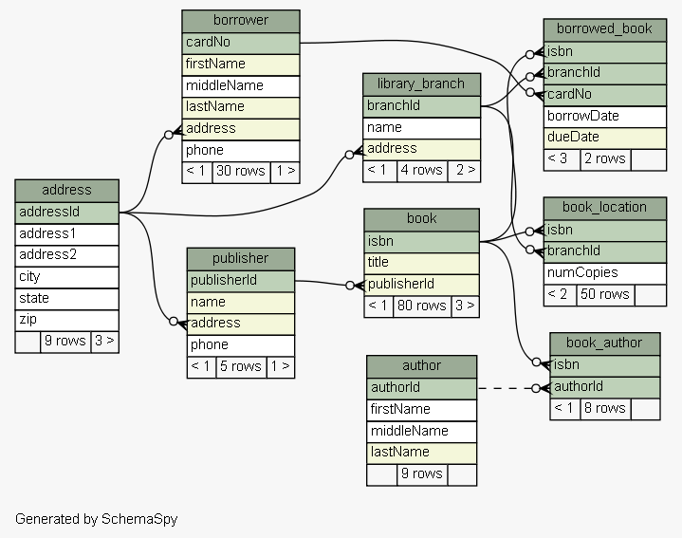


SQLScribe in a Nutshell
SQLScribe
SQL
CREATE TABLE BookLocation(
numCopies INT(10),
isbn BIGINT(19),
branchId INT(10),
)
CREATE TABLE BorrowedBook(
borrowDate DATE(10),
dueDate DATE(10),
branchId INT(10),
cardNo INT(10),
isbn BIGINT(19),
)
...

Slide 2
Library Example – Relational Model
Schema
SPY
example available at schemaspy.sourceforge.net/sample/

Slide 3
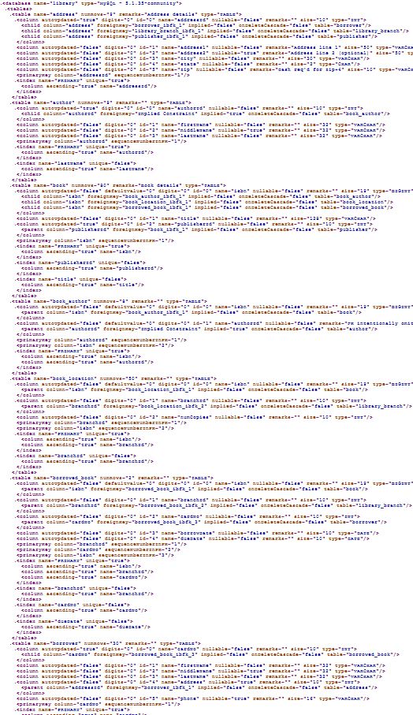
XML Representation
Schema
SPY

Slide 4
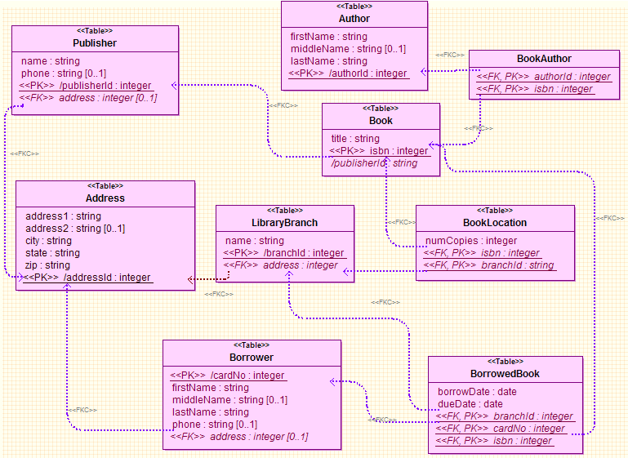
Using a the "Relational Profile"

Slide 5
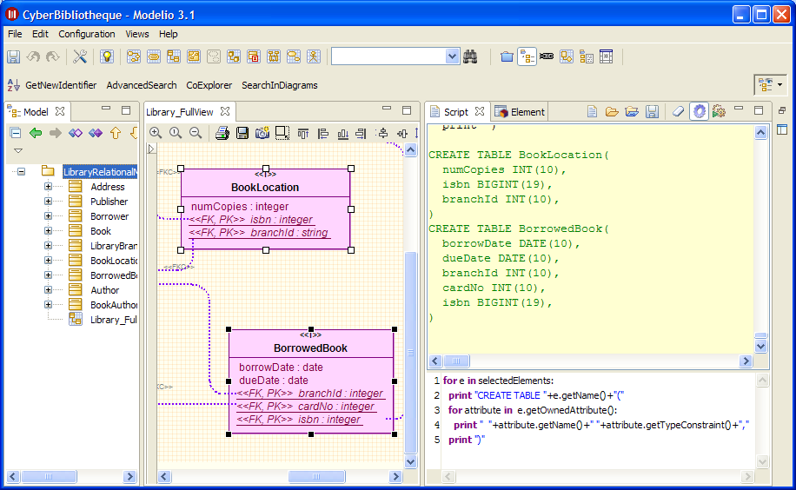

Slide 6
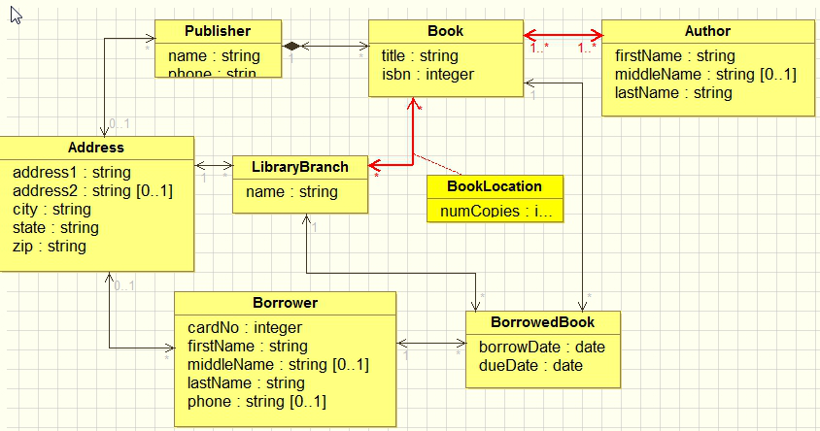
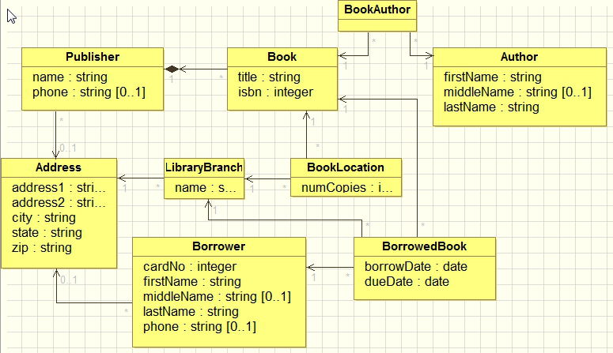
CREATE TABLE BookLocation(
numCopies INT(10),
isbn BIGINT(19),
branchId INT(10),
)
CREATE TABLE BorrowedBook(
borrowDate DATE(10),
dueDate DATE(10),
branchId INT(10),
cardNo INT(10),
isbn BIGINT(19),
)
...

Slide 7
Conceptual Level

Slide 8
UML Subset

Slide 9
SQL Model

