Slide 1
cribe
S
PROJECT

Slide 2


cribe
S
PROJECT
Integrating Project Management and Modelio <add your name here>
jean-marie favre
part of
on open source project on

Slide 3

References
github.com/megaplan/ModelioScribes
modelio.org
ganttproject.biz

Slide 4
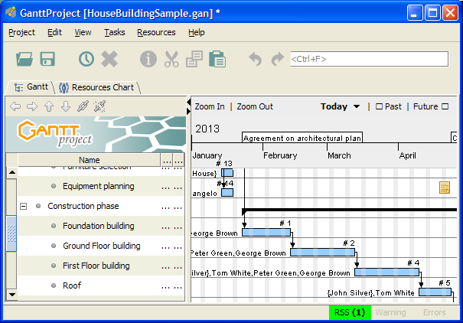
OCLScribe In a Nutshell

Slide 5
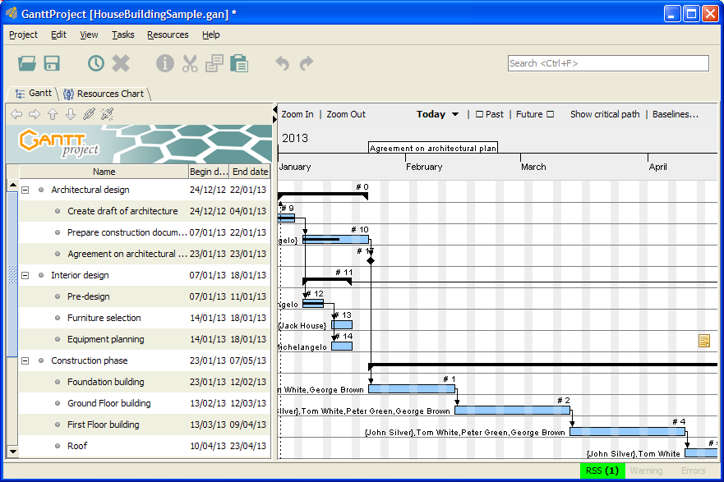
HouseBuilding Example
example available in the distribution as HouseBuildingSample.gan

Slide 6
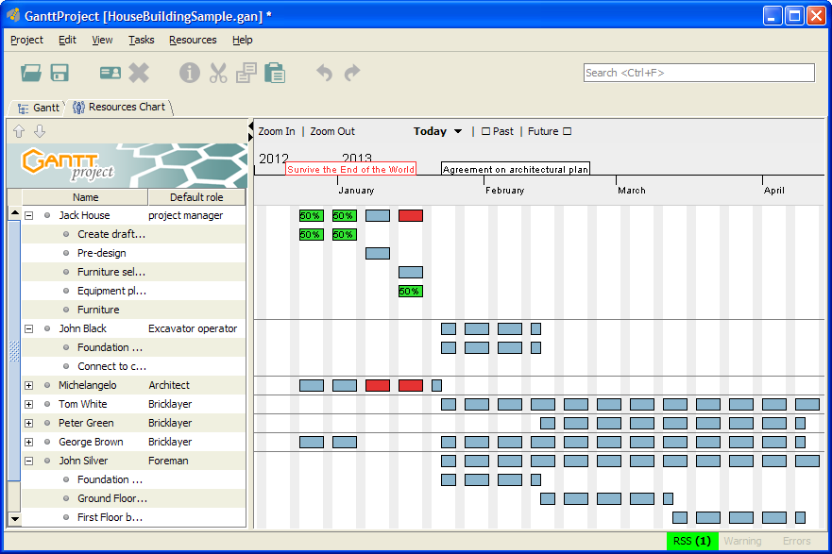
HouseBuilding Example
example available in the distribution as HouseBuildingSample.gan

Slide 7
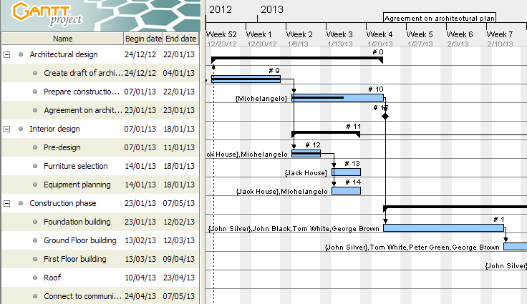
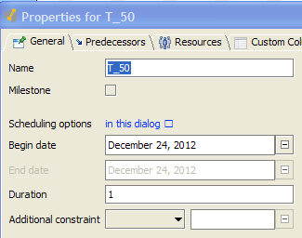
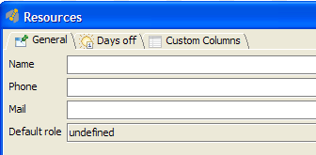

Slide 8
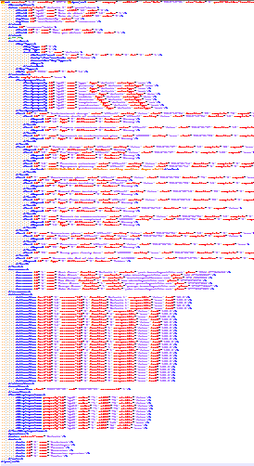
XML Representation
<project>
<tasks>
<resources>
<allocations>
<roles>

Slide 9
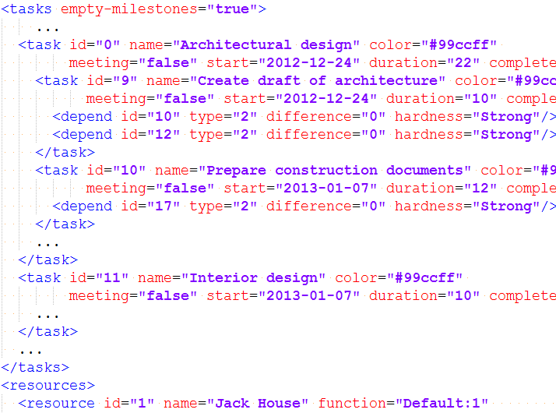

Slide 10
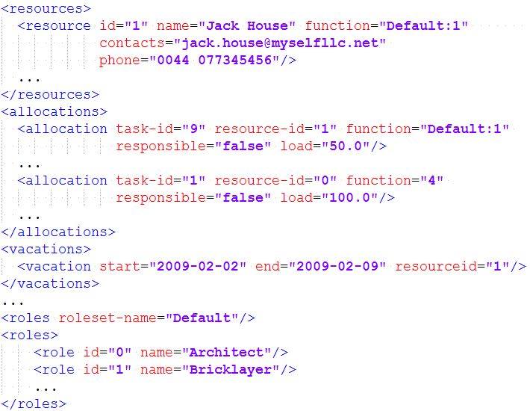

Slide 11
"Project" Profile
<<PTask>>
<<PResource>>
<<PResource>>

Slide 12
cribes
S
MODELIO
For downloads and contributions
visit github.com/megaplan/ModelioScribes

