Slide 1
cribe
S
SQL

Slide 2


cribe
S
SQL
SQL Support for Modelio
<add your name here>
jean-marie favre
part of
on open source project on

Slide 3

References
github.com/megaplan/ModelioScribes
modelio.org
Schema
SPY
schemaspy.sourceforge.net

Slide 4
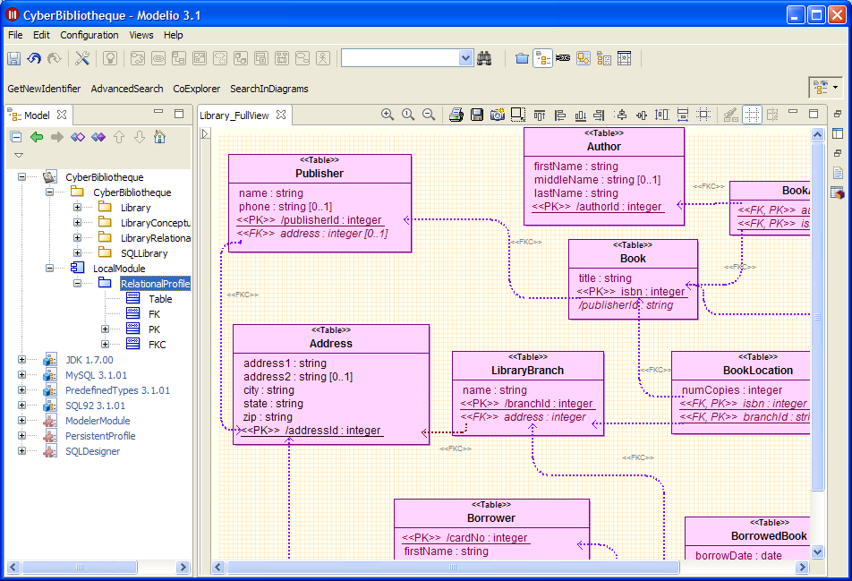
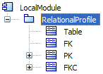

SQLScribe in a Nutshell
SQL
CREATE TABLE BookLocation(
numCopies INT(10),
isbn BIGINT(19),
branchId INT(10),
)
CREATE TABLE BorrowedBook(
borrowDate DATE(10),
dueDate DATE(10),
branchId INT(10),
cardNo INT(10),
isbn BIGINT(19),
)
...

Slide 5
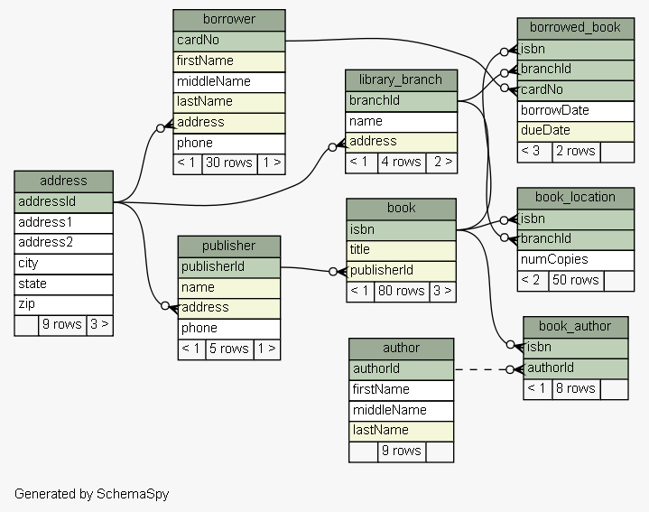
Library Example – Relational Model
Schema
SPY
example available at schemaspy.sourceforge.net/sample/

Slide 6
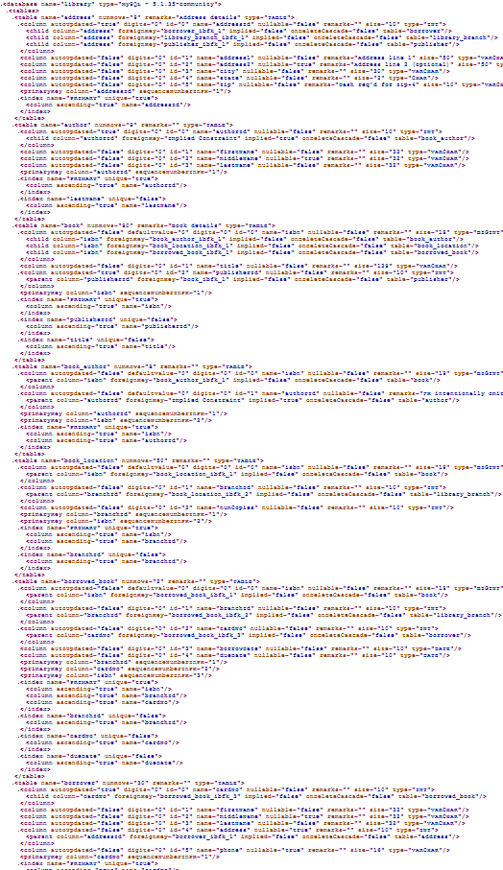
XML Representation
Schema
SPY

Slide 7
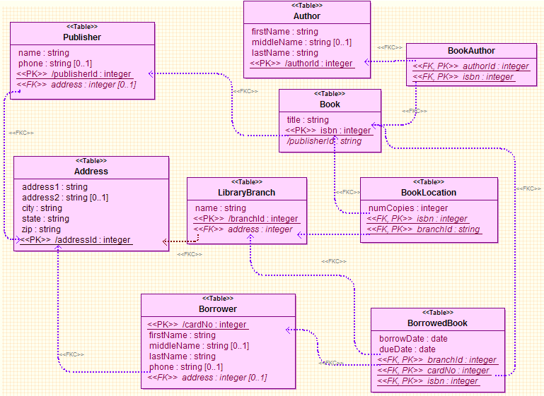
Using a the "Relational Profile"

Slide 8
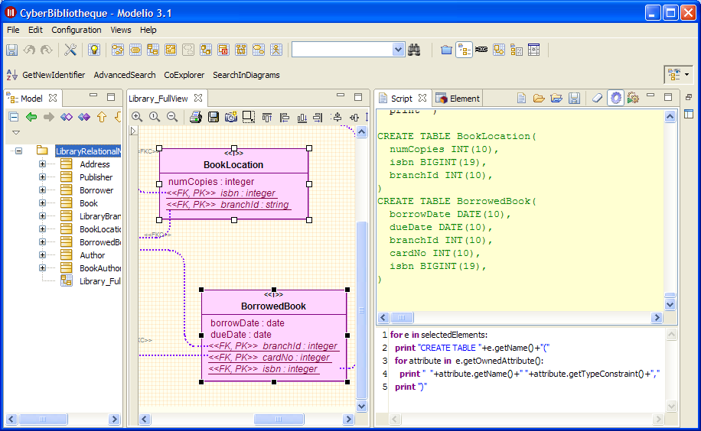

Slide 9
cribes
S
MODELIO
For downloads and contributions
visit github.com/megaplan/ModelioScribes

