Slide 1


ModelioScriptor Scripting with Jython
jean-marie favre, university of grenoble

Slide 2
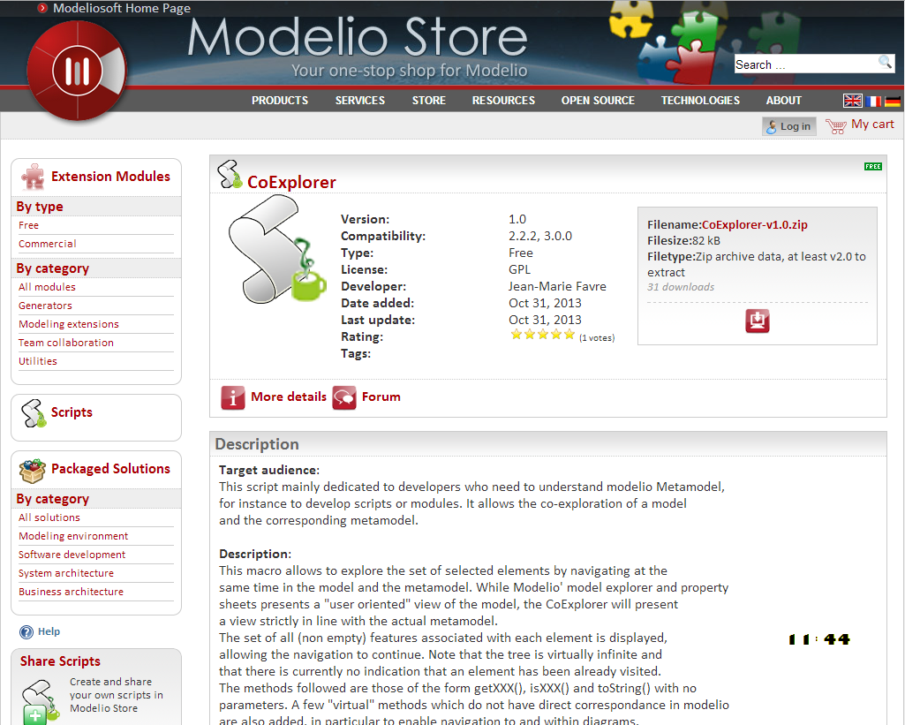
rank it ;-)
use this forum
last "builds"
are in the
"downloads"
directory

Slide 3
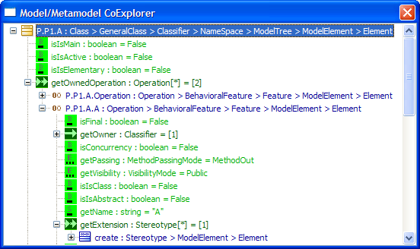
CoExplorer
http://www.modeliosoft.com/en/modelio-store/scripts/coexplorer.html

Slide 4
module modelioscriptor
small python module
<workspace>/macros/lib/modelioscriptor.py
complements the modelio official API
for interactive use & simplified scripting
mostly entry points & shortcuts
simplify recurrent code snippets
totally compatible with modelio API
automatically loaded with the CoExplorer

Slide 5
Modelio API "Services"
Model services
model navigation
CRUD operations for models
listen to model changes
Metamodel services
Diagram services
CRUD operations for diagrams
Image services
Get a model element’s icons
Edition services
Open an editor for a model element
Navigation services
fire and listen to "selection" events
Picking services
use or be a picking provider
Model components services
package & deploy model components
Module services
manage the project modules
call a module’s peer services
Transaction api
Script services
get a Python interpreter to execute a Python script
Log services
log a message
Audit services
check a model element
Context services
get the workspace
get I18n and versionning data

Slide 6
Model Starting Points (M1)
selectedElements
theRootPackage()
allInstances(UseCase) aka findByClass
allInstances(Element)
instancesNamed(DataType,"string")
instanceNamed(DataType,"string")

Slide 7
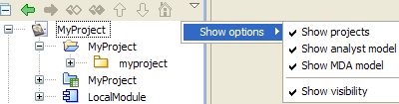
Top Level Elements – Current Project
theUMLProject() : Project
theRootPackage() : Package
theAnalystProject() : AnalystProject
theLocalModule() : ModuleComponent
1
2
3
4
1
2
3
4

Slide 8
Diagram Graphics
allDiagrams() : [ AbstractDiagram ]
allDiagrams(ClassDiagram) : [ ClassDiagram ]
getDisplayingDiagrams(myUseCase)
: [ AbstractDiagram ]
getDiagramGraphics(myUseCase)
getDiagramGraphics(myUseCase,diag)
getDiagramGraphics(myUseCase,[diag1,diag2])
: [AbstractDiagram ]

Slide 9
Factories
theUMLFactory() : UMLModel
theBPMNFactory () : UMLModel
theAnalystFactory() : IAnalystModel

Slide 10
Navigating within Elements
for e in selectedElements:
print e.getName()+" : "+e.getMClass().getName()
if isinstance(e,Class):
for a in e.getOwnedAttribute()
print " ",a

Slide 11
Creating/Modifying Model Elements
trans = theSession().createTransaction("C")
try: fact= theUMLFactory() myp = instanceNamed(Package,"MyPackage")
c1 = fact.createClass()
c1.setOwner(myp)
c1.setName("Class1")
c2 = fact.createClass("Class2",myp) trans.commit()
except: trans.rollback() raise

Slide 12
Metamodel Starting Points (M2)
allMClasses() : [ MClass ]
allMInterfaces() : UMLModel
getMClass(UseCase) : MClass
getMClass("UseCase") : MClass
getMInterface("UseCase") : Class (java interface)
getMInterface(mclass1) : Class (java interface)

Slide 13
M1 <--> M2
Java Interfaces
MClasses
M2
getMInterface
UseCase
mc1
getMClass
allInstances
getMClass
allInstances
getMInterface
isKindOf(uc1,UseCase)
isKindOf(uc1,UseCase)
isTypeOf(uc1,UseCase)
isTypeOf(uc1,UseCase)
M1
...
...
uc1

