Slide 1
cribe
S
OCL

Slide 2


cribe
S
OCL
Integrating Modelio and USEOCL
oussama housni
<add your name here>
jean-marie favre
part of
on open source project on

Slide 3


References
github.com/megaplan/ModelioScribes
modelio.org
sourceforge.net/projects/useocl

Slide 4
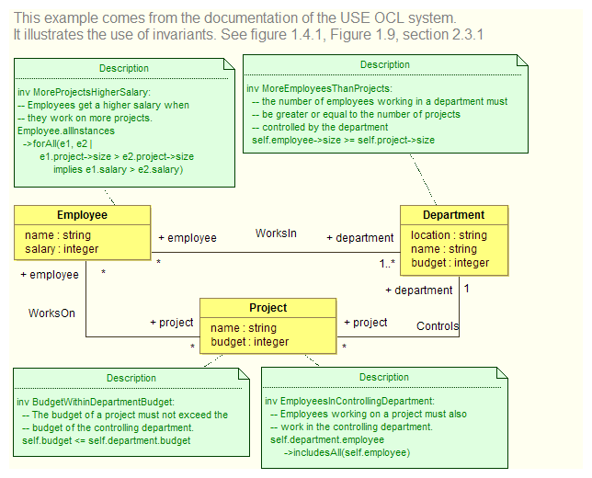
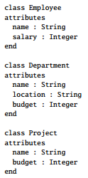
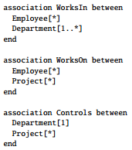
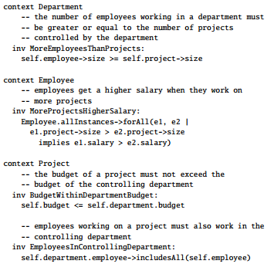
OCLScribe In a Nutshell

Slide 5
Objectives
Integration of OCL contraints into Modelio
use of a simple "Contraint" profile defined on Notes
<<Invariant>>,<<Precondition>>,<<Postcondition>>
Generation of the "Structural" model
Copy of the OCL constraints

Slide 6
Possible Extensions
Launching OCLUSE environment & error reporting
Reverse engineering of OCL models
Instances (.soil)
generation from object models
reverse engineering

Slide 7
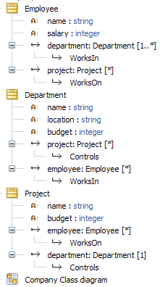
"Company" Example
Structure
Constraints
Structure

Slide 8
"Company" Example
Structure
Constraints
See section 2.3.1 of USEOCL manual for comments and reference to the full version

Slide 9
Structure

Slide 10
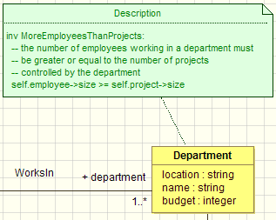

Constraints

Slide 11
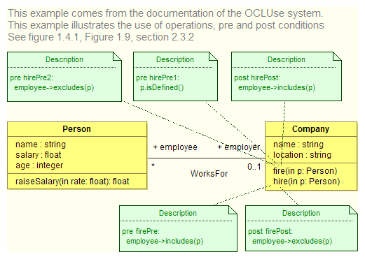
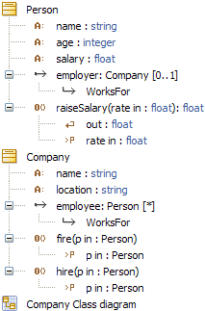
"Employee" Example

Slide 12
cribes
S
MODELIO
For downloads and contributions
visit github.com/megaplan/ModelioScribes

