Slide 1
HackMontfort
Track-1
Environment and Energy
Team Modern
Public School

Slide 2
CO₂
O₂ Reducer
Problem Tackled:- Climate Change
Solution :- Using Direct Air Capture of CO₂ and transferring the CO₂ to a greenhouse where photosynthesis converts CO₂ to O_{2.}

Slide 3
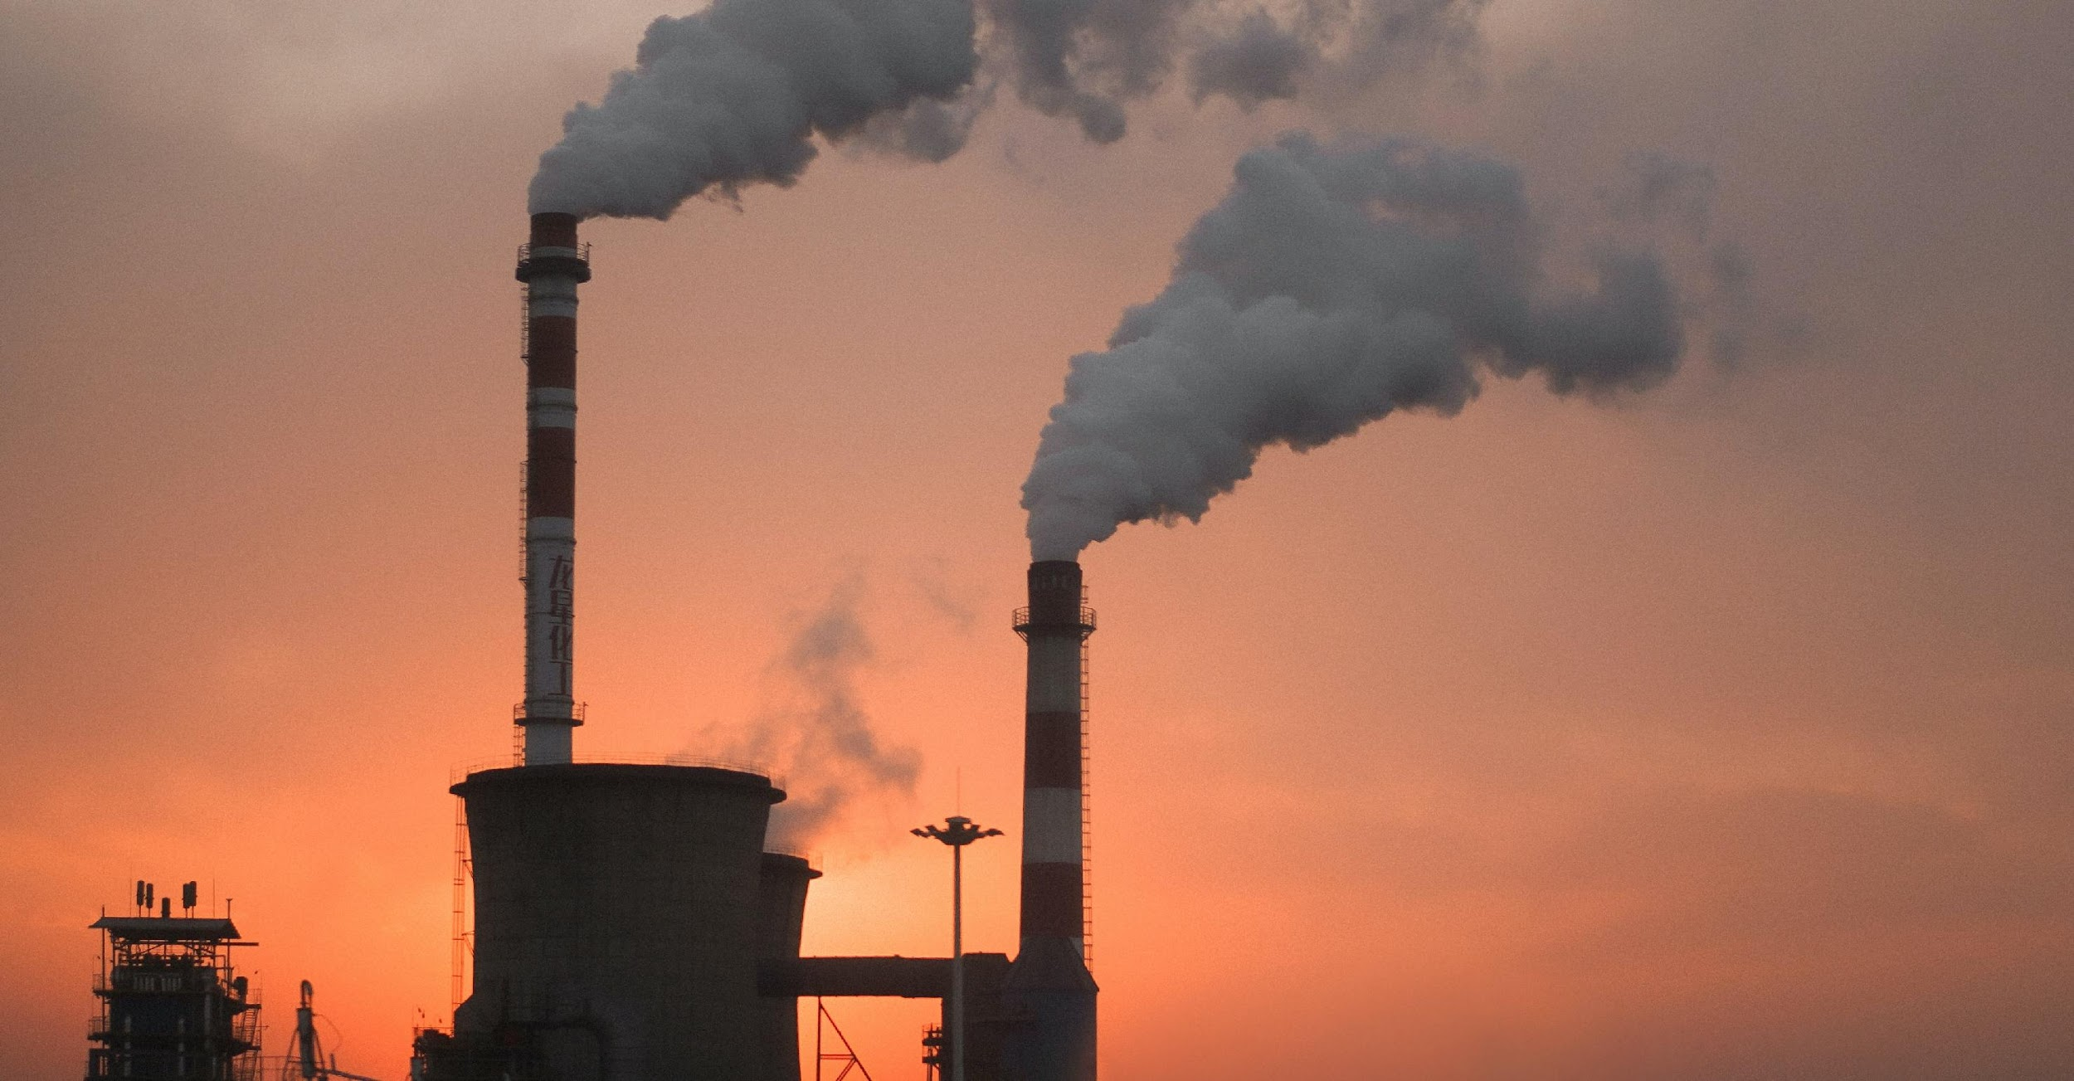
Some facts about Carbon Footprint
Demands for fossil fuels is at an all-time high with ongoing rise in energy consumption.
Total depletion of non-renewable resources is expected by the next 25 years
Burning fossil fuels disturbs the carbon budget with a rise in CO₂ concentrations

Slide 4
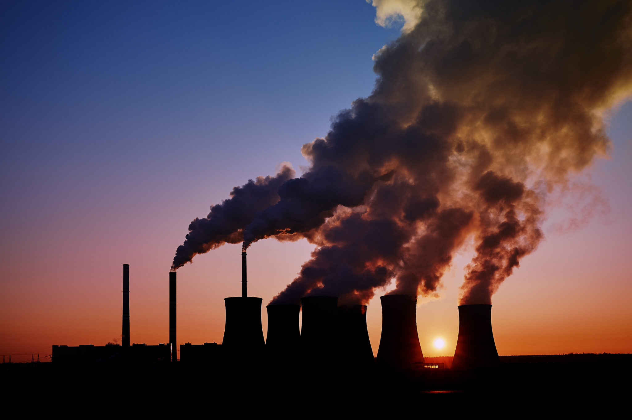
Carbon imbalance is raising temperatures at a rate above what living organisms can adapt to survive.
When burned fossil fuels give off atmospheric pollutants, toxins and greenhouse gases impacting the entire planet.
Sourcing and transporting fossil fuels is harmful to wildlife, in particular oil spills and destruction of natural habitat.

Slide 5
The SOLUTION

Slide 6
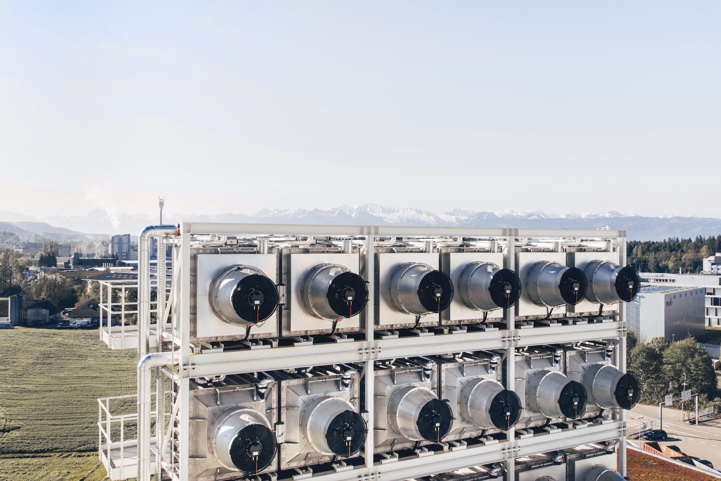
CO₂
O₂ Reducer
This solution uses a Direct Air Capture setup.
A Direct Air Capture setup
has a air contactor and a regeneration facility, in which a lot of reactions take place, ultimately resulting in CO2 which can be compressed and stored.

Slide 7
Working of the Setup
The Direct Air Capture Setup running on solar energy has a high pressure storage chamber for the CO₂ which is positioned right next to a greenhouse farm.
Greenhouse Farms
The Direct Air Capture Facility
Carbon Dioxide Storage chambers
Solar panels powering the setup

Slide 8
The Working
The Greenhouse Farm
Uses up the carbon dioxide and produces oxygen effectively reducing the carbon ‘footprint’
03
The Direct Air Capture Facility
uses solar energy to compress and store carbon-dioxide.
01
02
The Storage Chamber
slowly pumps carbon dioxide into the greenhouse farm

