Slide 1
Department of Computer Science, COCIS Makerere University Supervisor: Ggaliwango Marvin
Exploratory Data Analysis for Pipeline Inspection and Leakage Detection
A Study Using Annotated Image Data and Sensor Time-Series
Group CODE: SW-ML-7
Keywords: EDA, Fault Detection, Gas Leak Detection, Machine Learning, Sensor Data, Object Detection
Team Members: Name, Student Number, Registration Number, Student Email, University Affiliation
Modest Nakiroya, modest.nakiroya@students.mak.ac.ug, 23/U/13810/PS, Student
Carlton Ayebare T., ayebare.carltont@students.mak.ac.ug, 23/U/07137/EVE, Student

Slide 2
Contents of Presentation
Introduction & Background
Related Work
Problem Statement
Research Questions and Objectives
Research Contributions
Methodology / System Architecture
Dataset Description
EDA Results: Sensor Data
EDA Results: Image Data
Key Findings & Discussion
Conclusions & Future Work
References & Acknowledgements

Slide 3
INTRODUCTION & BACKGROUND
Industrial systems such as chemical plants and pipeline networks operate continuously under complex physical conditions.
Pipeline faults and gas leaks can develop gradually and may not be immediately visible to human operators.
This project focuses on performing structured Exploratory Data Analysis (EDA) on:
The Tennessee Eastman Process (TEP) sensor dataset
An annotated gas leak image dataset
The goal is to extract insights that inform future model development.

Slide 4
RELATED WORK
Tennessee Eastman Process (TEP)
Introduced by Downs & Vogel (1993), it simulates an industrial chemical plant with 41 sensor measurements and 21 fault scenarios. It is a key benchmark for fault detection. CNNs, LSTMs, and autoencoders have all been tested on it.
Gas Leak Image Detection
Infrared cameras and annotated datasets are used to train models like YOLO and Faster R-CNN to detect gas leaks visually. Pascal VOC XML format is the standard for storing bounding box annotations used in this dataset.

Slide 5
PROBLEM STATEMENT
Pipeline faults and gas leakages are hard to detect early using traditional manual methods. Delayed detection leads to equipment damage, safety risks, and financial losses.
Without a thorough understanding of feature distributions, temporal behaviour, and annotation characteristics, machine learning models may produce unreliable or biased results.
This project addresses the need to systematically examine and validate these datasets to establish a data-driven foundation for accurate and robust detection models.

Slide 6
RESEARCH OBJECTIVES
To examine the quality and structure of both datasets (sensor data and image data)
To explore the distribution of sensor measurements and identify trends over time
To analyse bounding box properties and image resolution in the gas leak dataset
To identify data characteristics that will inform future model selection and preprocessing

Slide 7
RESEARCH CONTRIBUTIONS
Characterised gas leak dataset (8,881 images, 9,384 boxes) including scale and aspect ratio variability
Conducted comprehensive data quality validation for both sensor and image datasets
Characterised bounding box size distribution, revealing multi-scale leak variation
Analysed aspect ratio variability to inform anchor box design

Slide 8
METHODOLOGY
Tools: Python 3, pandas, matplotlib, Pillow (PIL), xml.etree.ElementTree Sensor Data (data.ipynb):
Load sample (1,000 rows) → Check quality (missing values, duplicates) → Histograms & Boxplots → Label distribution → Time-series plots → Rolling Mean & Rolling Std Dev Image Data (image_eda.ipynb):
Locate images & XML files → Parse VOC annotations into DataFrame → Class distribution → Bounding box area & aspect ratio → Image resolution scatter plot → Visualise annotated images

Slide 9
DATASET 1: TENNESSEE EASTMAN PROCESS (TEP) SENSOR DATA
Source: TEP simulation CSV file Sample size: 1,000 rows (chunked random sampling) Columns: 57 total
1 timestamp (time) 41 sensor measurements (xmeas_1 to xmeas_41): faultNumber, simulationRun, sample, label Missing values: NONE Duplicate rows: NONE Data types: mostly float64 (continuous measurements) Label: All 1,000 sampled rows = normal (label 0.0)
Sensor distributions: broadly bell-shaped, different spreads per sensor Boxplots: small number of outlier readings: likely genuine transient events Time-series: sensors stay within consistent ranges under normal conditions Rolling Mean (window=30): reveals slow underlying trends in some sensors Rolling Std Dev (window=30): highlights periods of instability: potential early fault signals

Slide 10
DATASET 2: GAS LEAK IMAGE DATASET
Source: gas_leak.v7i.voc (Pascal VOC) Total images: 8,881 | XML files: 8,881 Bounding boxes: 9,384 (avg 1.06/image) Class: single: “leak” Resolution: mostly 600 x 600 px Format: Pascal VOC XML (xmin, ymin, xmax, ymax)
Class distribution: all boxes = “leak” (single-class detector) Box area: wide range: compact and large leaks present; multi-scale detection needed Aspect ratio: mostly square (~1.0) but elongated shapes also present Resolution: width ~600px consistent; height varies in subset: padding needed Visual samples: annotations correctly placed on gas plume regions

Slide 11
KEY FINDINGS & DISCUSSION
SENSOR DATA FINDINGS Both datasets: clean: no missing values, no duplicates Sampled records are ALL normal (label=0). Fault samples must be added when preparing training data. Rolling Std Dev spikes = potential early warning signal which is useful engineered feature Some sensors drift slowly, rolling mean reveals underlying trends
IMAGE DATA FINDINGS 9,384 boxes across 8,881 images: most images have one leak Wide range of box sizes: multi-scale detector (YOLOv5) recommended Aspect ratios vary: anchor boxes should reflect range of leak shapes Height variation in some images: resizing/padding required before training

Slide 12
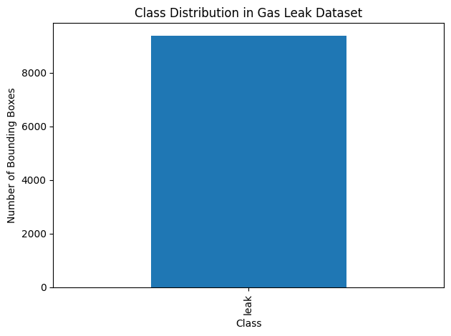
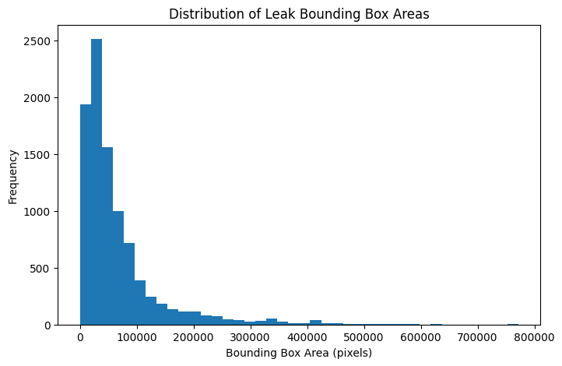
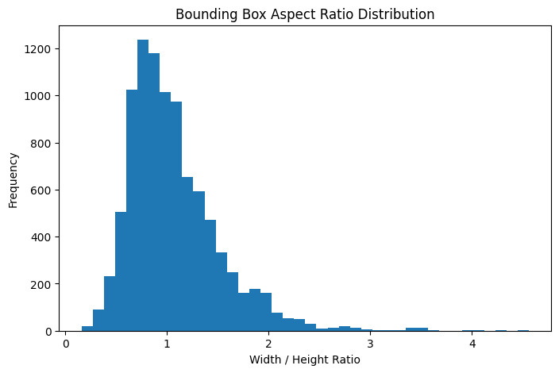
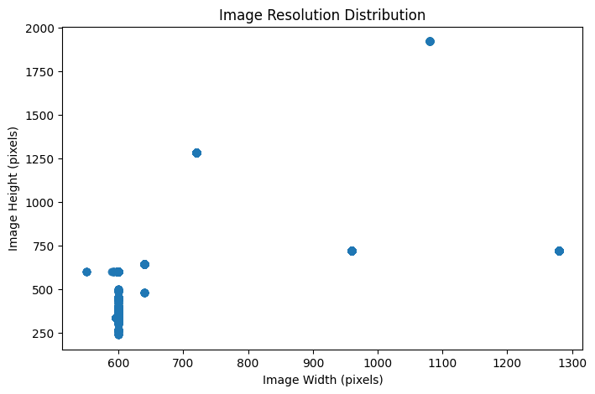
OUTPUT RESULTS

Slide 13
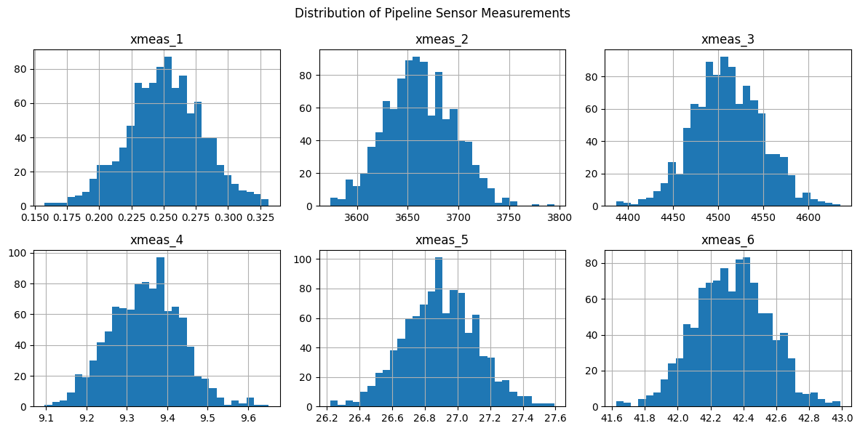
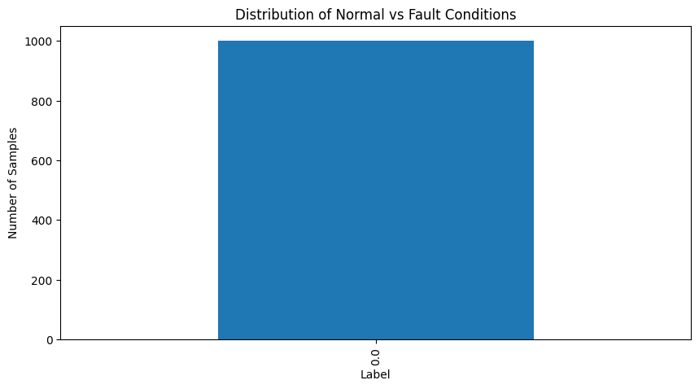
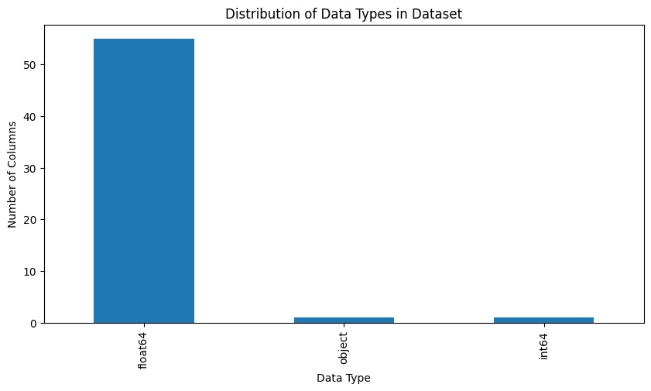
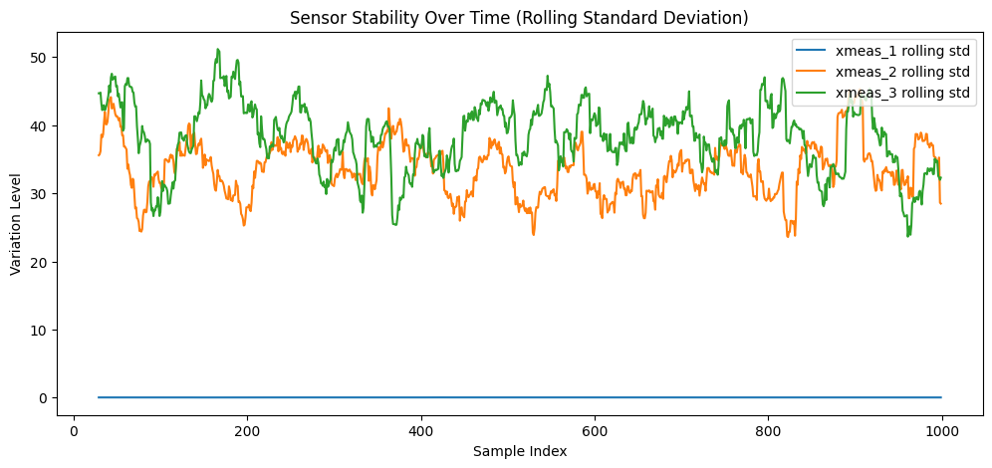
OUTPUT RESULTS

Slide 14
CONCLUSIONS & LIMITATIONS
Conclusions
Both datasets are clean, well-structured, and ready for model training
EDA revealed important properties: class imbalance in sensor labels, multi-scale variation in image annotations
Rolling statistics are a promising feature engineering approach for fault detection
Limitations
Only 1,000 rows sampled from TEP; no fault records captured; full dataset needed
No models trained yet; this study is EDA only; results cannot be validated without a model
Image dataset may include augmented/duplicate frames; deduplication may improve model generalisation

