Slide 1

Deep Learning for HF Radio Signal Type Classification
Project members:
G Kavya Sudha CB.EN.U4ELC20020
H Kesava Sravan CB.EN.U4ELC20023
L Moditha Chowdary CB.EN.U4ELC20036
P Laxmi Ganesh CB.EN.U4ELC20048
Guided by
Name: Amit Agarwal, PhD
Designation: Professor
Dept: Electrical & Electronics
Engineering | Cybersecurity

Slide 2
Introduction
High-frequency radio signals are vital for communication systems such as satellite, radar, and wireless networks. Efficient classification ensures reliable communication and signal integrity.
Optimizes Communication: Enhances system performance by accurately identifying signals.
Detects Interference: Helps in identifying and mitigating signal interference.
Defense Applications: Crucial for military monitoring and reconnaissance.
Technological Advancement: Utilizing deep learning for better signal processing solutions.

Slide 3
Objective
Investigate the effectiveness of Deep CNN and ResNet to classify HF radio signals into signal types.
To develop a neural architecture search (NAS) algorithm to significantly reduce the classifier size, i.e., develop a tiny version.
To assess the Nash equilibrium of accuracy vs network size (measured as number of MACs and FLOPS) of tiny classifiers.

Slide 4
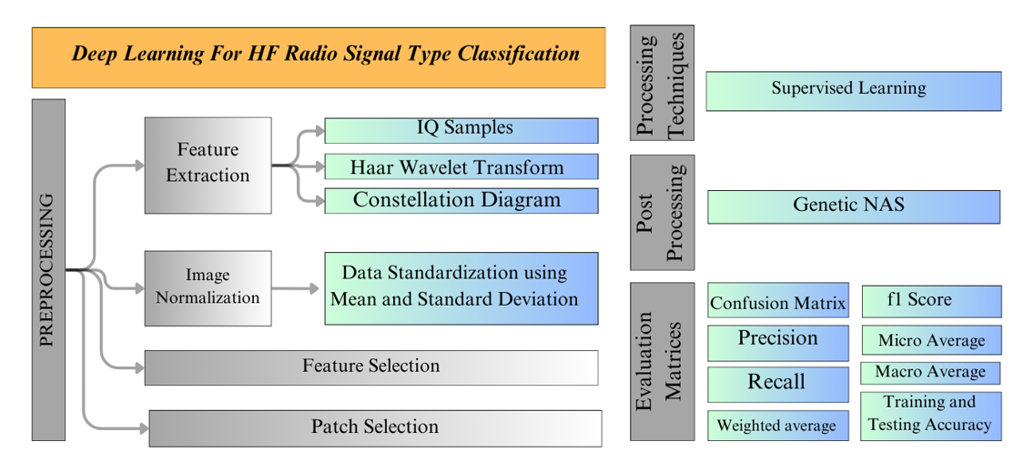
Graphical Layout

Slide 5
Dataset Details
Data shape: (172800, 2048, 2) # Total 172800 signals
# 2048 IQ samples in each signal # 2 Channels I and Q
X_train shape: (144000, 2048, 2) # 144000 signals for Training
X_test shape: (28800, 2048, 2) # 28800 signals for Testing
Y_train shape: (144000, 18) # 8000 * 18 = 144000
Y_test shape: (28800, 18) # 1600 * 18 = 28800

Slide 6
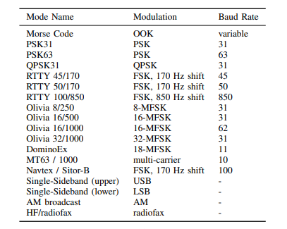
Transmission Modes

Slide 7
Table of Contents
1. Models used of HF radio Signal Classification
2. Classification using IQ samples
3. Classification using Haar Wavelets features
4. G-NAS based Classification using IQ samples and Haar Wavelets features

Slide 8
Models used for HF radio Signal Classification

Slide 9
Deep CNN
(2048, 2)
CONV 1D, 32
CONV 1D, 32
Block 1
MAX 1D /2
CONV 1D, 32
Block 2
CONV 1D, 32
MAX 1D /2
CONV 1D, 64
CONV 1D, 64
Block 3
MAX 1D /2
CONV 1D, 64
Block 4
CONV 1D, 64
MAX 1D /2
CONV 1D, 128
CONV 1D, 128
Block 5
MAX 1D /2
DROP OUT, 0.5
Batch Normalization
DENSE, 18

Slide 10
ResNet
(2048, 2)
Res Stack
96
ReLU
Res Stack
96
CONV 1D, x
ReLU
CONV 1D, x
Res Stack
96
ReLU
+
Res Stack
128
ReLU
Res Stack
128
Batch Normalization
DROP OUT, 0.5
DENSE, 18

Slide 11
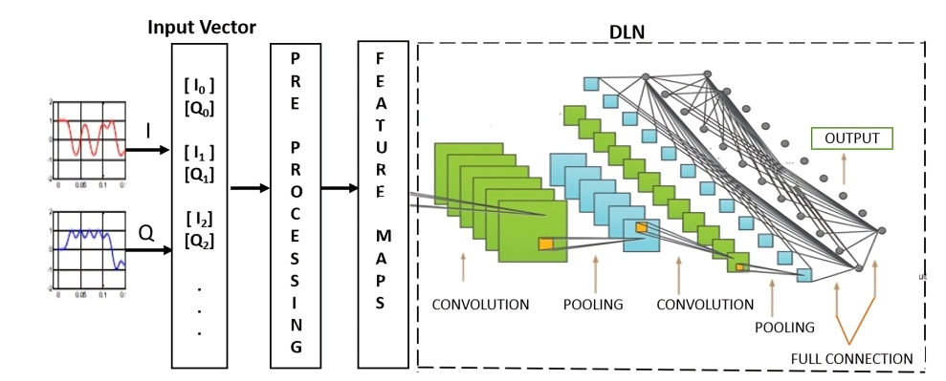
Flow diagram for the Classification using IQ samples

Slide 12
Classification Report Based on DeepCNN using IQ samples
precision recall f1-score support
1. am 0.81 0.93 0.86 1600
2. dominoex11 0.88 0.93 0.91 1600
3. fax 0.92 0.90 0.91 1600
4. lsb 1.00 0.96 0.98 1600
5. morse 0.99 0.91 0.95 1600
6. mt63_1000 0.96 0.99 0.97 1600
7. navtex 0.98 0.95 0.96 1600
8. olivia16_1000 0.99 0.96 0.97 1600
9. olivia16_500 0.81 0.87 0.84 1600
10. olivia32_1000 0.94 0.88 0.90 1600
11. olivia8_250 0.83 0.88 0.86 1600
12. psk31 0.81 0.92 0.86 1600
13. psk63 0.97 0.91 0.94 1600
14. qpsk31 0.90 0.77 0.83 1600
15. rtty100_850 0.99 0.98 0.99 1600
16. rtty45_170 0.90 0.90 0.90 1600
17. rtty50_170 0.93 0.90 0.91 1600
18. usb 0.98 0.97 0.91 1600
overall 0.92 0.92 0.92 28800
Training accuracy: 93.22
Testing accuracy: 92.64
Trainable Parameters: 4,333,394
Network Size: 49.7 MB

Slide 13
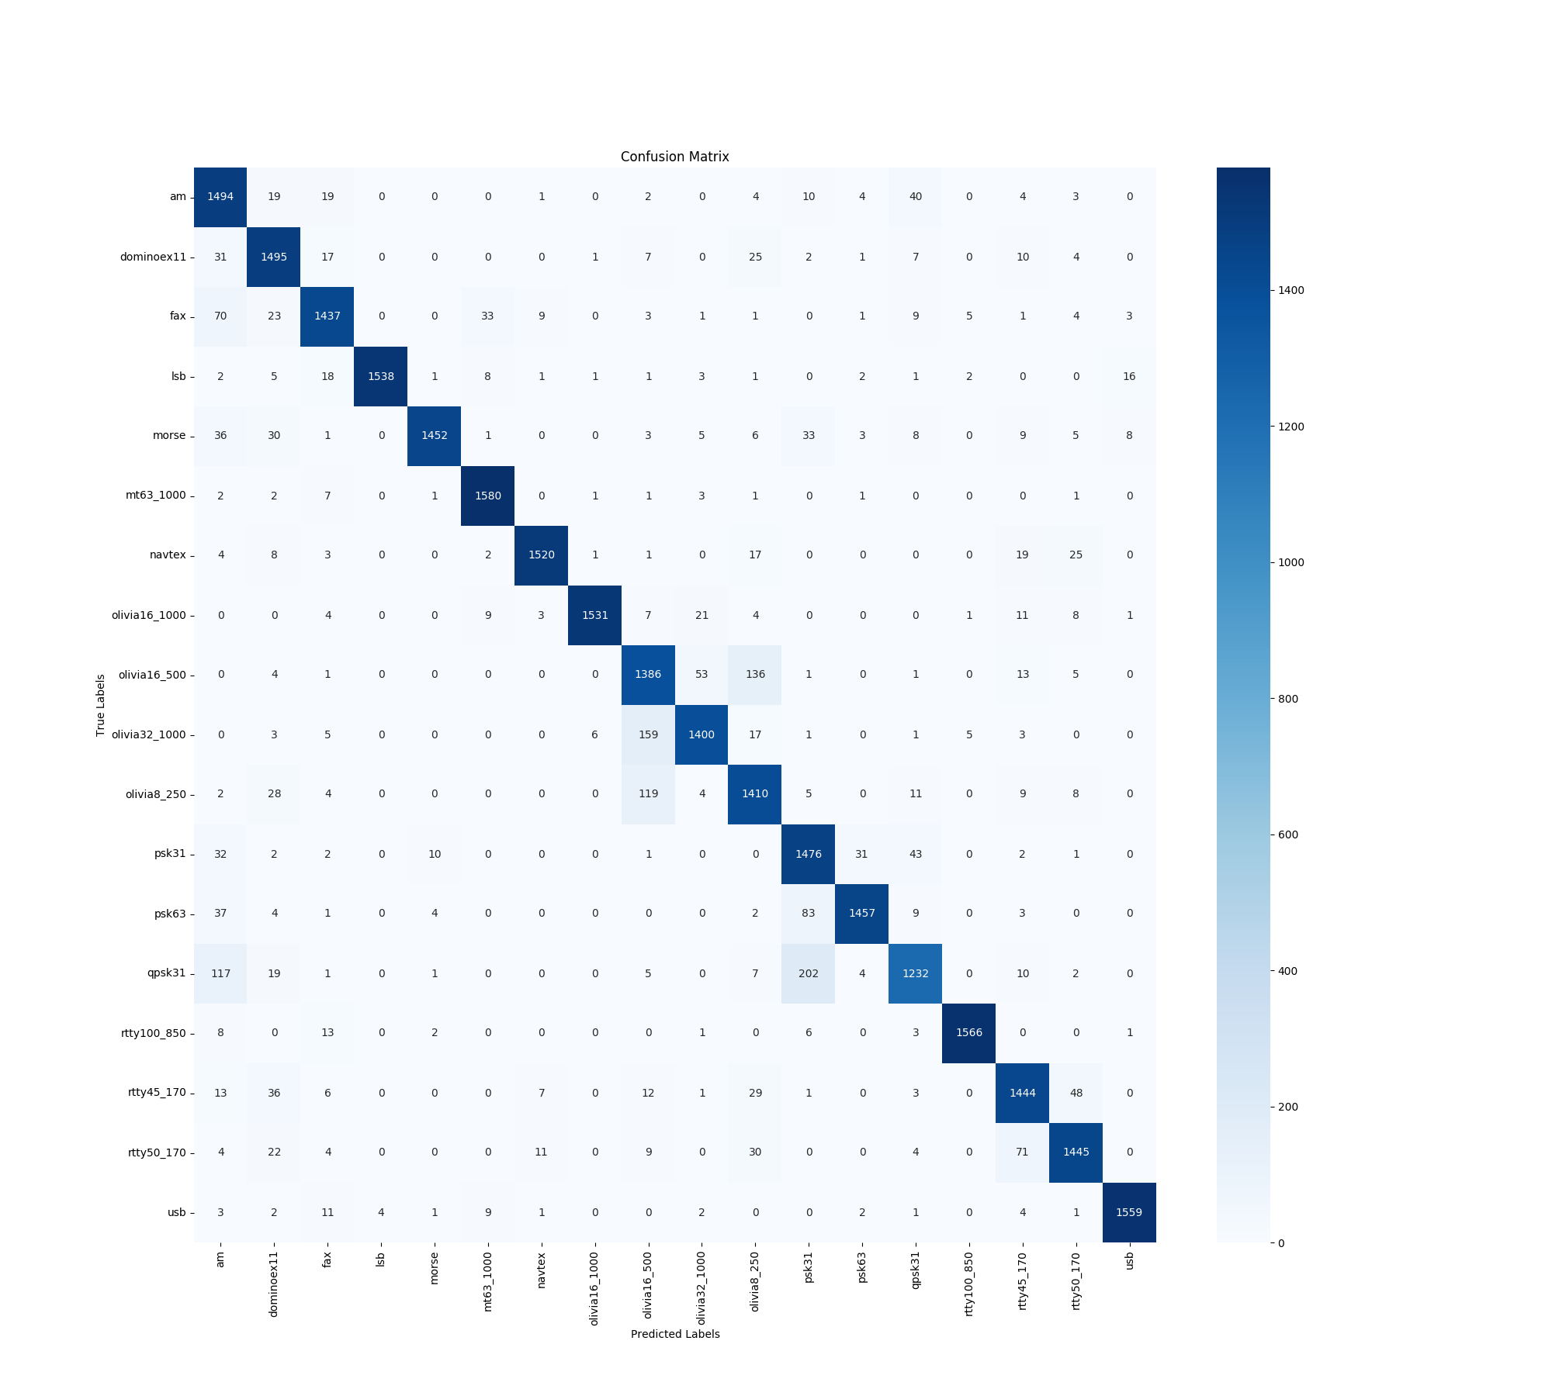
Confusion Matrix of Deep CNN using IQ Samples

Slide 14
Classification Report Based on ResNet using IQ samples
precision recall f1-score support
1. am 0.91 0.53 0.67 1600
2. dominoex11 0.68 0.68 0.68 1600
3. fax 0.89 0.84 0.86 1600
4. lsb 0.99 0.97 0.98 1600
5. morse 0.92 0.90 0.91 1600
6. mt63_1000 0.91 0.98 0.94 1600
7. navtex 0.74 0.75 0.75 1600
8. olivia16_1000 0.92 0.69 0.79 1600
9. olivia16_500 0.58 0.76 0.66 1600
10. olivia32_1000 0.79 0.76 0.78 1600
11. olivia8_250 0.59 0.60 0.60 1600
12. psk31 0.74 0.73 0.74 1600
13. psk63 0.60 0.93 0.73 1600
14. qpsk31 0.85 0.52 0.64 1600
15. rtty100_850 0.96 0.94 0.95 1600
16. rtty45_170 0.45 0.21 0.28 1600
17. rtty50_170 0.38 0.72 0.50 1600
18. usb 1.00 0.96 0.98 1600
overall 0.77 0.75 0.75 28800
Training accuracy: 72.21
Testing accuracy: 74.66
Trainable Parameters: 284,082
Network Size: 3.45 MB

Slide 15
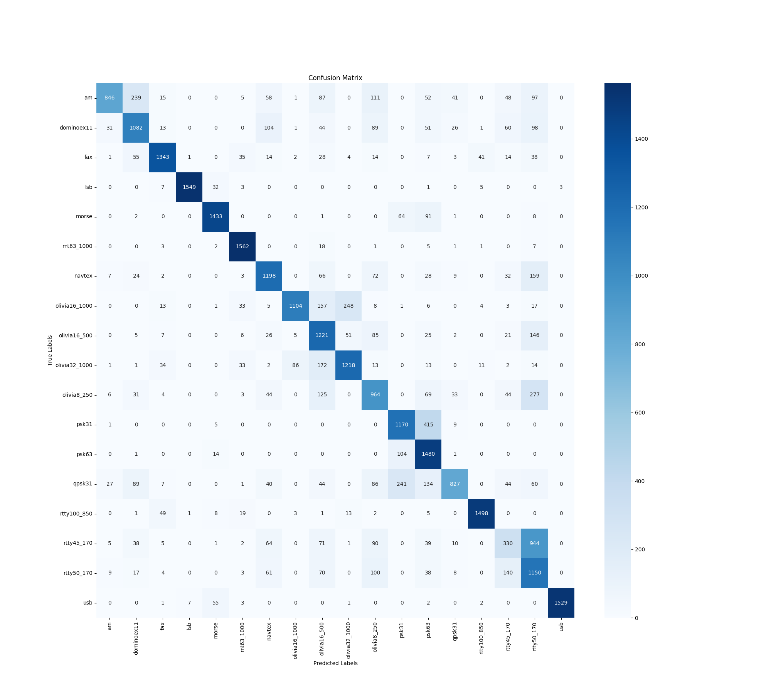
Confusion Matrix of Resnet using IQ Samples

Slide 16
Performance Comparison table
Aspect | IQ DeepCNN | IQ ResNet
Training Accuracy | 93.22 | 72.21
Testing Accuracy | 92.64 | 74.66
Precision | 92.00 | 77.00
F1 Score | 92.00 | 75.00
Recall | 92.00 | 75.00
Trainable Parameters | 4,332,114 | 284,082
Network Size | 49.7 MB | 3.46 MB

Slide 17
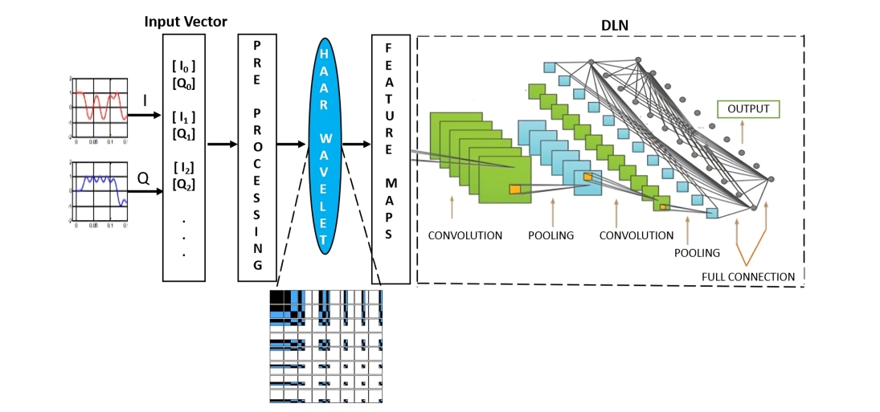
Flow diagram for the Classification using Haar Wavelets features

Slide 18
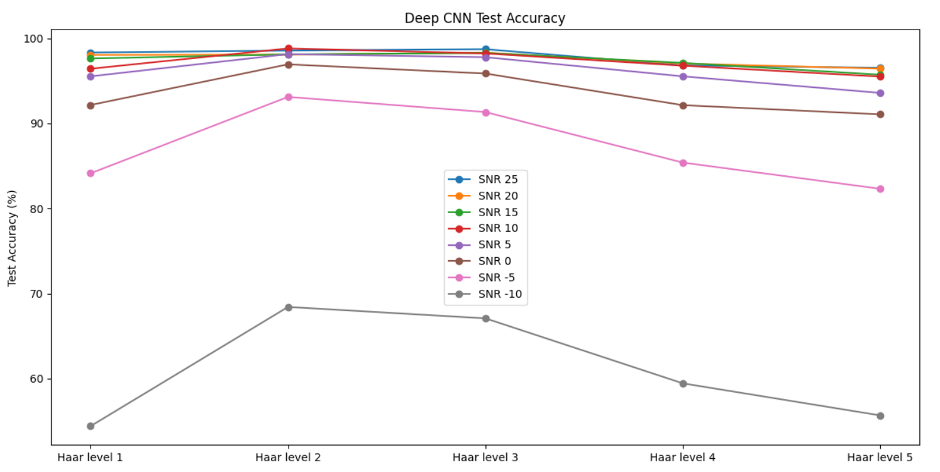
Selection of Haar Wavelet Level for Deep CNN

Slide 19
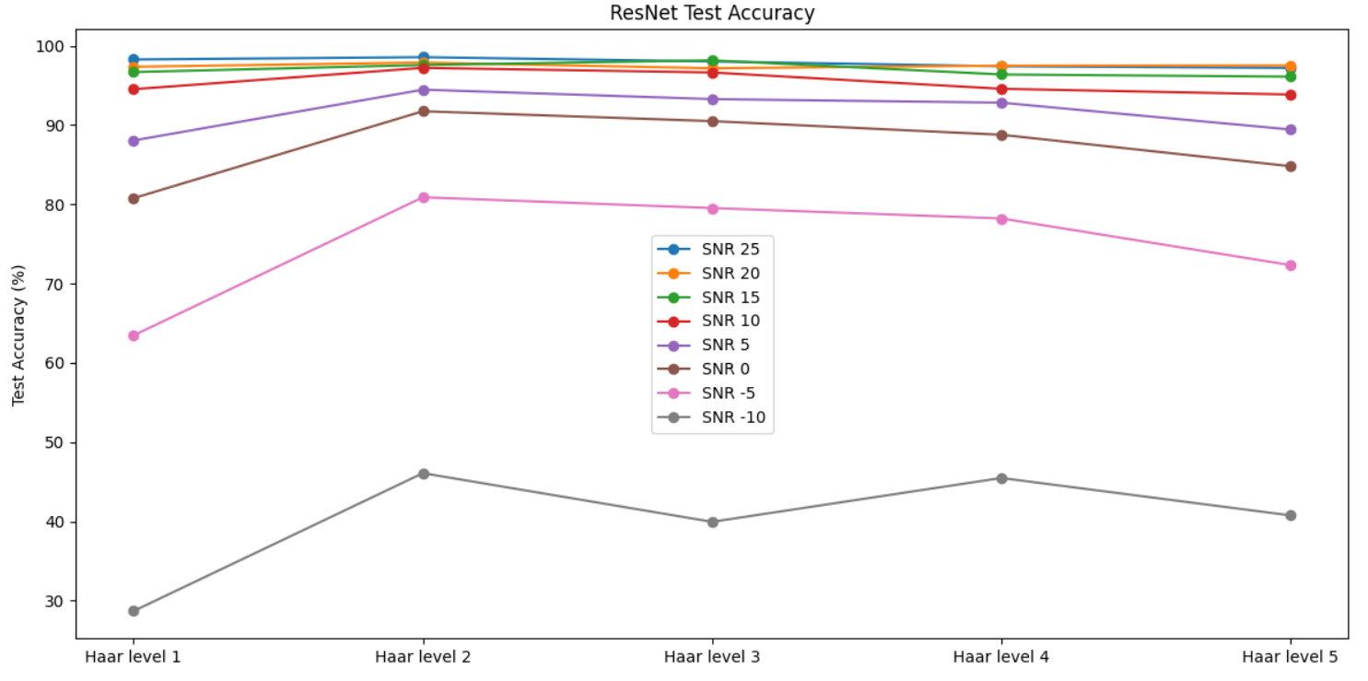
Selection of Haar Wavelet Level for ResNet

Slide 20
Classification Report Based on Deep CNN Using Haar Wavelet Features
precision recall f1-score support
1. am 0.87 0.92 0.89 1600
2. dominoex11 0.95 0.95 0.95 1600
3. fax 0.92 0.91 0.92 1600
4. lsb 0.97 0.94 0.96 1600
5. morse 0.98 0.96 0.97 1600
6. mt63_1000 0.97 0.98 0.98 1600
7. navtex 0.99 0.99 0.99 1600
8. olivia16_1000 0.98 0.97 0.97 1600
9. olivia16_500 0.93 0.85 0.89 1600
10. olivia32_1000 0.96 0.92 0.94 1600
11. olivia8_250 0.87 0.97 0.92 1600
12. psk31 0.82 0.94 0.87 1600
13. psk63 0.93 0.92 0.93 1600
14. qpsk31 0.89 0.81 0.85 1600
15. rtty100_850 0.98 0.98 0.98 1600
16. rtty45_170 0.96 0.95 0.96 1600
17. rtty50_170 0.96 0.96 0.96 1600
18. usb 0.98 0.95 0.96 1600
overall 0.94 0.94 0.94 28800
Training accuracy: 94.18
Testing accuracy: 93.77
Trainable Parameters: 4,332,114
Network Size: 49.7 MB

Slide 21

Confusion Matrix of Deep CNN using Haar Wavelet

Slide 22
Classification Report Based on ResNet Using Haar Wavelet Features
precision recall f1-score support
1. am 0.70 0.85 0.77 1600
2. dominoex11 0.81 0.76 0.78 1600
3. fax 0.97 0.82 0.89 1600
4. lsb 0.98 0.87 0.92 1600
5. morse 0.92 0.87 0.90 1600
6. mt63_1000 0.82 0.99 0.90 1600
7. navtex 0.99 0.90 0.94 1600
8. olivia16_1000 0.96 0.88 0.92 1600
9. olivia16_500 0.86 0.75 0.80 1600
10. olivia32_1000 0.87 0.88 0.88 1600
11. olivia8_250 0.92 0.75 0.83 1600
12. psk31 0.72 0.87 0.79 1600
13. psk63 0.80 0.92 0.85 1600
14. qpsk31 0.77 0.78 0.78 1600
15. rtty100_850 0.95 0.94 0.94 1600
16. rtty45_170 0.73 0.71 0.72 1600
17. rtty50_170 0.62 0.71 0.67 1600
18. usb 0.94 0.92 0.93 1600
overall 0.85 0.84 0.84 28800
Training accuracy: 81.71
Testing accuracy: 84.25
Trainable Parameters: 284,082
Network Size: 3.46 MB

Slide 23

Confusion Matrix of Resnet using Haar Wavelet

Slide 24
Performance Comparison table
Aspect | HAAR Wavelet DeepCNN | HAAR Wavelet ResNet
Training Accuracy | 94.18 | 81.71
Testing Accuracy | 93.77 | 84.25
Precision | 92.00 | 85.00
F1 Score | 92.00 | 84.00
Recall | 92.00 | 84.00
Trainable Parameters | 4,332,114 | 284,082
Network Size | 49.7 MB | 3.46 MB

Slide 25
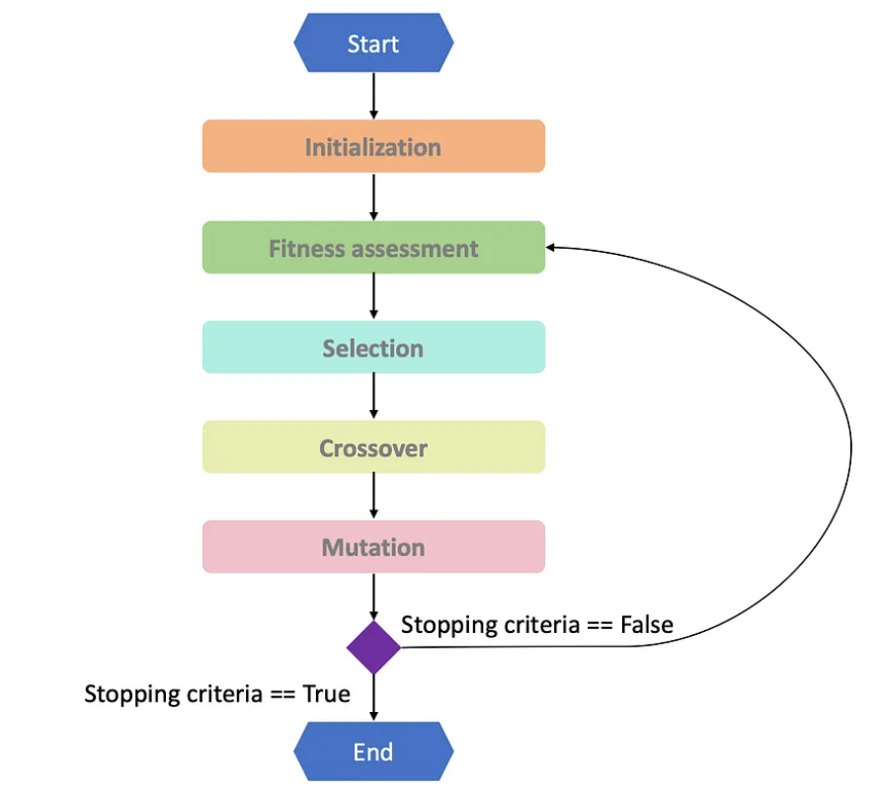
Genetic – Neural Architecture Search (GNAS) based Classification using IQ samples and Haar Wavelets features

Slide 26
IQ DeepCNN Model
GNAS IQ Deep CNN Model
Filters: 32, Kernel: 2, Act: ReLU
CONV 1D
Filters: 256, Kernel: 6, Act: ReLU
Filters: 32, Kernel: 2, Act: ReLU
CONV 1D
Filters: 256, Kernel: 6, Act: ReLU
MAX 1D
Filters: 32, Kernel: 2, Act: ReLU
CONV 1D
Filters: 32, Kernel: 4, Act: ReLU
Filters: 32, Kernel: 2, Act: ReLU
CONV 1D
Filters: 32, Kernel: 4, Act: ReLU
MAX 1D
Filters: 64, Kernel: 2, Act: ReLU
CONV 1D
Filters: 64, Kernel: 1, Act: ReLU
Filters: 64, Kernel: 2, Act: ReLU
CONV 1D
Filters: 64, Kernel: 1, Act: ReLU
MAX 1D
Filters: 64, Kernel: 2, Act: ReLU
CONV 1D
Filters: 16, Kernel: 5, Act: Sigmoid
Filters: 64, Kernel: 2, Act: ReLU
CONV 1D
Filters: 16, Kernel: 5, Act: Sigmoid
MAX 1D
Filters: 128, Kernel: 2, Act: ReLU
CONV 1D
Filters: 256, Kernel: 6, Act: GeLU
Filters: 128, Kernel: 2, Act: ReLU
CONV 1D
Filters: 256, Kernel: 6, Act: GeLU
MAX 1D
Rate: 0.5
DROP OUT
Rate: 0.1
Act: SoftMax
DENSE
Act: SoftMax

Slide 27
NAS Classification Report Based on Deep CNN using IQ samples
precision recall f1-score support
1. am 0.80 0.91 0.85 1600
2. dominoex11 0.86 0.90 0.88 1600
3. fax 0.96 0.86 0.90 1600
4. lsb 0.98 0.95 0.96 1600
5. morse 0.96 0.94 0.95 1600
6. mt63_1000 0.96 0.95 0.95 1600
7. navtex 0.93 0.98 0.95 1600
8. olivia16_1000 0.97 0.95 0.96 1600
9. olivia16_500 0.92 0.91 0.91 1600
10. olivia32_1000 0.97 0.95 0.95 1600
11. olivia8_250 0.80 0.92 0.86 1600
12. psk31 0.82 0.86 0.84 1600
13. psk63 0.95 0.94 0.95 1600
14. qpsk31 0.87 0.81 0.79 1600
15. rtty100_850 0.99 0.95 0.97 1600
16. rtty45_170 0.92 0.90 0.91 1600
17. rtty50_170 0.89 0.92 0.91 1600
18. usb 0.99 0.95 0.97 1600
Overall 0.94 0.93 0.93 28800
Training accuracy: 96.36
Testing accuracy: 93.14
Trainable Parameters: 1,788,466
Network Size: 17.6 MB

Slide 28

Confusion Matrix of NAS based Deep CNN using IQ samples

Slide 29
Haar Wavelet DeepCNN Model
GNAS Haar Wavelet Deep CNN Model
Filters: 32, Kernel: 2, Act: ReLU
CONV 1D
Filters: 128, Kernel: 2, Act: GeLU
Filters: 32, Kernel: 2, Act: ReLU
CONV 1D
Filters: 128, Kernel: 2, Act: GeLU
MAX 1D
Filters: 32, Kernel: 2, Act: ReLU
CONV 1D
Filters: 64, Kernel: 6, Act: Tanh
Filters: 32, Kernel: 2, Act: ReLU
CONV 1D
Filters: 64, Kernel: 6, Act: Tanh
MAX 1D
Filters: 64, Kernel: 2, Act: ReLU
CONV 1D
Filters: 256, Kernel: 4, Act: ReLU
Filters: 64, Kernel: 2, Act: ReLU
CONV 1D
Filters: 256, Kernel: 4, Act: ReLU
MAX 1D
Filters: 64, Kernel: 2, Act: ReLU
CONV 1D
Filters: 128, Kernel: 5, Act: ReLU
Filters: 64, Kernel: 2, Act: ReLU
CONV 1D
Filters: 128, Kernel: 5, Act: ReLU
MAX 1D
Filters: 128, Kernel: 2, Act: ReLU
CONV 1D
Filters: 64, Kernel: 3, Act: Sigmoid
Filters: 128, Kernel: 2, Act: ReLU
CONV 1D
Filters: 64, Kernel: 3, Act: Sigmoid
MAX 1D
Rate: 0.5
DROP OUT
Rate: 0.1
Act: SoftMax
DENSE
Act: SoftMax

Slide 30
NAS Classification Report Based on Deep CNN using Haar Wavelet Features
precision recall f1-score support
1. am 0.90 0.95 0.92 1600
2. dominoex11 0.95 0.97 0.96 1600
3. fax 0.96 0.92 0.94 1600
4. lsb 0.98 0.95 0.96 1600
5. morse 0.98 0.96 0.97 1600
6. mt63_1000 0.99 0.97 0.98 1600
7. navtex 0.99 0.98 0.99 1600
8. olivia16_1000 0.97 0.98 0.98 1600
9. olivia16_500 0.92 0.91 0.91 1600
10. olivia32_1000 0.96 0.94 0.95 1600
11. olivia8_250 0.93 0.96 0.94 1600
12. psk31 0.86 0.94 0.90 1600
13. psk63 0.95 0.94 0.95 1600
14. qpsk31 0.92 0.85 0.88 1600
15. rtty100_850 0.98 0.98 0.98 1600
16. rtty45_170 0.89 0.93 0.91 1600
17. rtty50_170 0.93 0.89 0.91 1600
18. usb 0.95 0.96 0.96 1600
Overall 0.94 0.94 0.94 28800
Training accuracy: 94.30
Testing accuracy: 94.33
Trainable Parameters: 962,514
Network Size: 11.1 MB

Slide 31

Confusion Matrix of NAS based Deep CNN Using Haar Wavelet Features

Slide 32
Architecture Performance Comparison for CNN
Aspect | IQ DeepCNN | GNAS IQ DeepCNN | HAAR Wavelet DeepCNN | GNAS HAAR Wavelet DeepCNN
Training Accuracy | 93.22 | 94.30 | 94.18 | 94.30
Testing Accuracy | 92.64 | 93.14 | 93.77 | 94.33
Trainable Parameters | 4,332,114 | 1,788,466 | 4,332,114 | 962,514
Network Size | 49.7 MB | 17.6 MB | 49.7 MB | 11.1 MB

Slide 33
Architecture Performance Comparison for Resnet
Aspect | IQ ResNet | GNAS IQ ResNet | HAAR Wavelet ResNet | GNAS HAAR Wavelet ResNet
Training Accuracy | 72.21 | 58.85 | 81.71 | 79.19
Testing Accuracy | 74.66 | 63.01 | 84.25 | 83.64
Trainable Parameters | 284,082 | 373,842 | 284,082 | 238,130
Network Size | 3.46 MB | 4.49 MB | 3.46 MB | 2.97 MB
Note: The ResNet model already has a relatively small number of trainable parameters and a compact model size of just 3.45 MB. However, applying GNAS to the ResNet model did not result in any reduction in model size, nor did it lead to any improvement in accuracy.

Slide 34
Overall Comparison table
Aspect | IQ Deep CNN | IQ ResNet | HAAR Wavelet Deep CNN | HAAR Wavelet ResNet | GNAS IQ Deep CNN | GNAS Haar Deep CNN
Training Accuracy | 93.22 | 72.21 | 94.18 | 81.71 | 96.36 | 94.30
Testing Accuracy | 92.64 | 74.66 | 93.77 | 84.25 | 93.14 | 94.33
Precision | 92.00 | 77.00 | 92.00 | 85.00 | 94.00 | 94.00
F1 Score | 92.00 | 75.00 | 92.00 | 84.00 | 93.00 | 94.00
Recall | 92.00 | 75.00 | 92.00 | 84.00 | 93.00 | 94.00
Trainable Parameters | 4,332,114 | 284,082 | 4,332,114 | 284,082 | 1,788,466 | 962,514
Network Size | 49.7 MB | 3.46 MB | 49.7 MB | 3.46 MB | 17.6 MB | 11.1 MB

Slide 35
Time Frame
The actual timeline could deviate due to challenges in estimating time:
needed to perform tasks of secondary priority
university’s HPC environment needs on a realistic dataset (c13 GB in csv format)
Mth & Yr | Task to be Completed
Aug 2023 | Get Dataset
Sep 2023 | Code classifiers
Oct 2023 | Investigate FPs & FNs
Nov 2023 | Develop NAS algorithm | Extract Image Features
Dec 2023 | Estimate MACs & Flops | Redevelop Classifier
Jan 2023 | Graph Accuracy vs Classifier
Feb 2023 | Analyze Nash Equilibrium Surface
FY report in LaTex – as per the department’s deadline | Organize materials for paper submission in LaTex

Slide 36
References
[1] Hang Qian, “Counting the Floating Point Operations (FLOPS),” MATLAB Central File Exchange, 2023. [Online]. Available: https://www.mathworks.com/matlabcentral/fileexchange/50608-counting-the-floating-point-operations-flops. [Accessed: 19-Aug-2023].
[2] Hailong Ge, Bingyin Ren, Teng Niu, and Zhifei Yang, “Signal Analysis and Processing Method of HF Digital Communication Waveform,” in Proc. IEEE 5th Advanced Information Management, Communicates, Electronic and Automation Control Conf., Chongqing, China, Dec. 2022.
[3] Mathuranathan, “Spectrogram Analysis using Python,” 2022. [Online]. Available: https://www.gaussianwaves.com/2022/03/spectrogram-analysis-using-python/. [Accessed: 2022].
[4] Dirk Kolb, Ulla Uebler, and Elmar Nöth, “A Novel Transmission Scanner Framework for Real-Time Applications,” in Proc. IST-092 Symp. Military Commun. and Networks, Wroclaw, Poland, Sep. 2010.
[5] Xin Wang, "Moving Window-Based Double Haar Wavelet Transform for Image Processing," IEEE Trans. Image Process., vol. 15, no. 9, pp. 2771-2779, Sep. 2006, doi: 10.1109/TIP.2006.877316.

Slide 37
[6] T. J. O’Shea, T. Roy, and T. C. Clancy, "Over-the-Air Deep Learning Based Radio Signal Classification," IEEE J. Sel. Topics Signal Process., vol. 12, no. 1, pp. 168-179, Feb. 2018, doi: 10.1109/JSTSP.2018.2797022.
[7] X. Zhang, F. Reveriano, J. Lu, X. Fu, and T. Zhang, "The Effect of High Performance Computer on Deep Learning: A Face Expression Recognition Case," in Proc. IEEE Int. Conf. Comput. Sci. and Eng. (CSE) and IEEE Int. Conf. Embedded and Ubiquitous Comput. (EUC), New York, NY, USA, 2019, pp. 40-42, doi: 10.1109/CSE/EUC.2019.00017.
[8] Jing Wang, “Neural Architecture Search with NNI,” Towards Data Science, 2019. [Online]. Available: https://towardsdatascience.com/neural-network-intelligence-to-learnfunction-approximation-44046de9cccb. [Accessed: 2019].
[9] A. Krizhevsky, I. Sutskever, and G. E. Hinton, "ImageNet Classification with Deep Convolutional Neural Networks," in Proc. Advances in Neural Information Processing Systems, Lake Tahoe, NV, USA, 2012, pp. 1097-1105.
[10] C. Szegedy, W. Liu, Y. Jia, P. Sermanet, S. Reed, D. Anguelov, D. Erhan, V. Vanhoucke, and A. Rabinovich, "Going Deeper with Convolutions," in Proc. IEEE Conf. Computer Vision and Pattern Recognition (CVPR), Boston, MA, USA, 2015, pp. 1-9, doi: 10.1109/CVPR.2015.7298594.

Slide 38
[11] S. Han, H. Mao, and W. J. Dally, "Deep Compression: Compressing Deep Neural Networks with Pruning, Trained Quantization and Huffman Coding," in Proc. Int. Conf. Learning Representations (ICLR), San Juan, Puerto Rico, 2016.
[12] M. Abadi, P. Barham, J. Chen, Z. Chen, A. Davis, J. Dean, M. Devin, S. Ghemawat, G. Irving, M. Isard, et al., "TensorFlow: A System for Large-Scale Machine Learning," in Proc. 12th USENIX Conf. Operating Systems Design and Implementation (OSDI 16), Savannah, GA, USA, 2016, pp. 265-283.
[13] K. Simonyan and A. Zisserman, "Very Deep Convolutional Networks for Large-Scale Image Recognition," in Proc. Int. Conf. Learning Representations (ICLR), San Diego, CA, USA, 2015.
[14] F. Chollet, "Xception: Deep Learning with Depthwise Separable Convolutions," in Proc. IEEE Conf. Computer Vision and Pattern Recognition (CVPR), Honolulu, HI, USA, 2017, pp. 1251-1258, doi: 10.1109/CVPR.2017.195.
[15] G. Huang, Z. Liu, L. Van Der Maaten, and K. Q. Weinberger, "Densely Connected Convolutional Networks," in Proc. IEEE Conf. Computer Vision and Pattern Recognition (CVPR), Honolulu, HI, USA, 2017, pp. 2261-2269, doi: 10.1109/CVPR.2017.243.

Slide 39
THANK YOU

