Slide 1
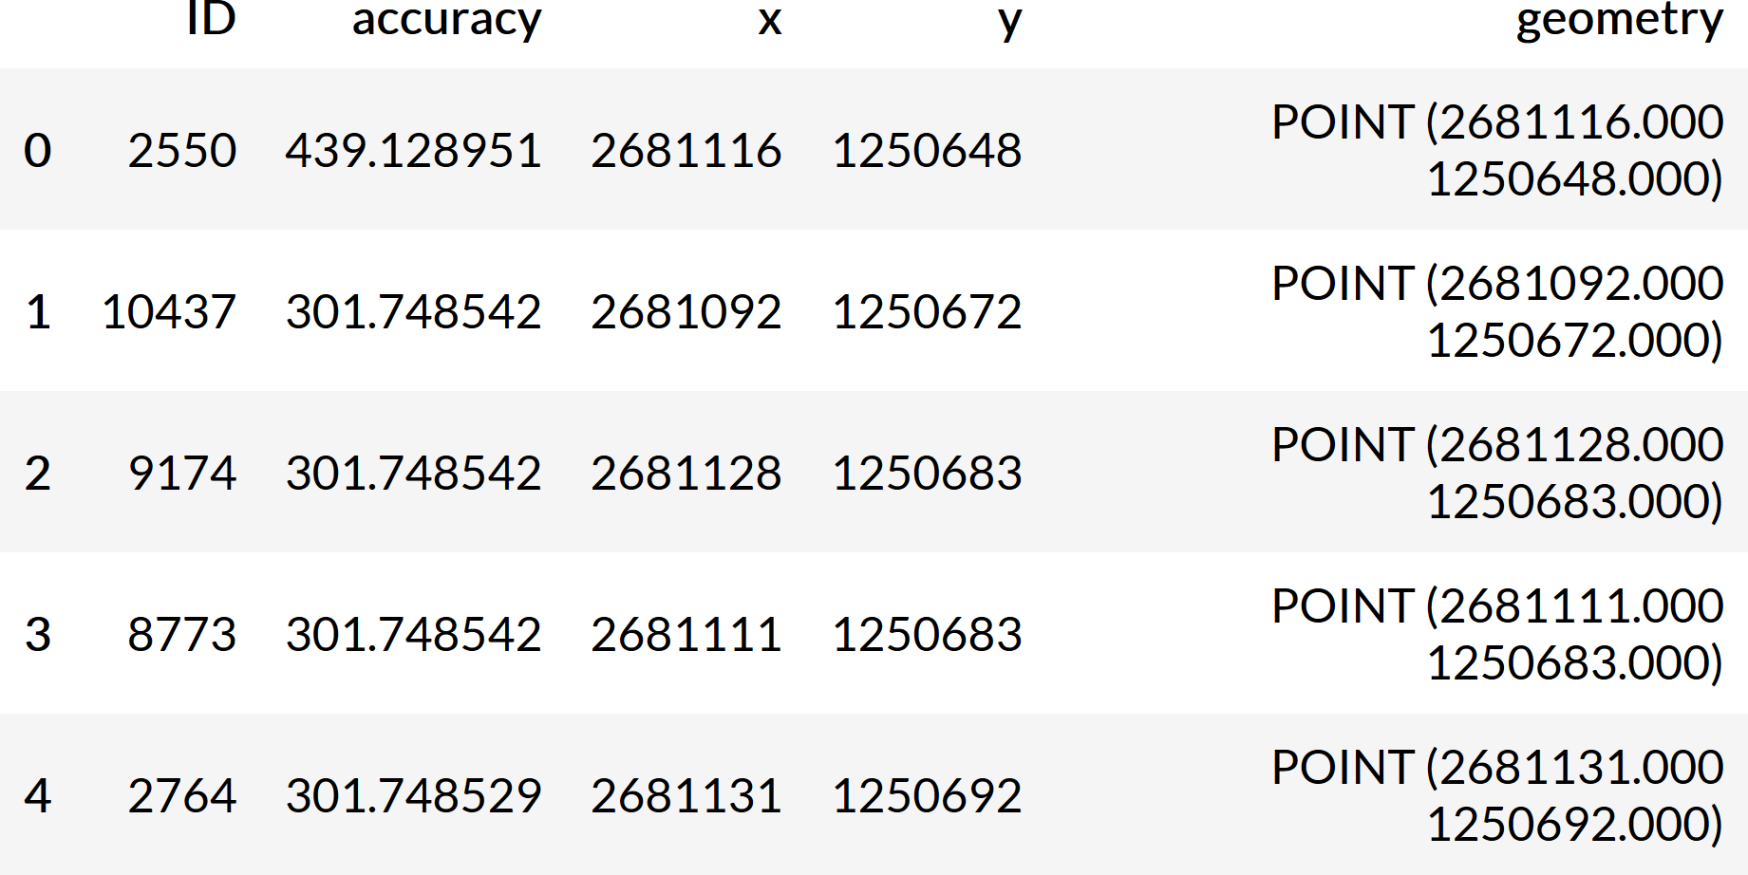
GeoDataFrame
Geometry
GeoSeries

