Slide 1

ATM Interface
Abdulelah Khalid Alwadani
ID:221421185
Mohammed Hany badry
ID:221445241

Slide 2

Welcome to the ATM Program
This program is developed using Java and incorporates a Graphical User Interface (GUI).
The purpose of this program is to simulate an ATM system for a bank, providing users with a virtual banking experience.

Slide 3
Program Overview
Developed in Java, this ATM program offers a user-friendly interface for banking operations.
It enables users to perform essential transactions, such as withdrawing cash, checking account balances, and transferring funds.
The program is designed to provide a realistic and secure virtual ATM experience.

Slide 4
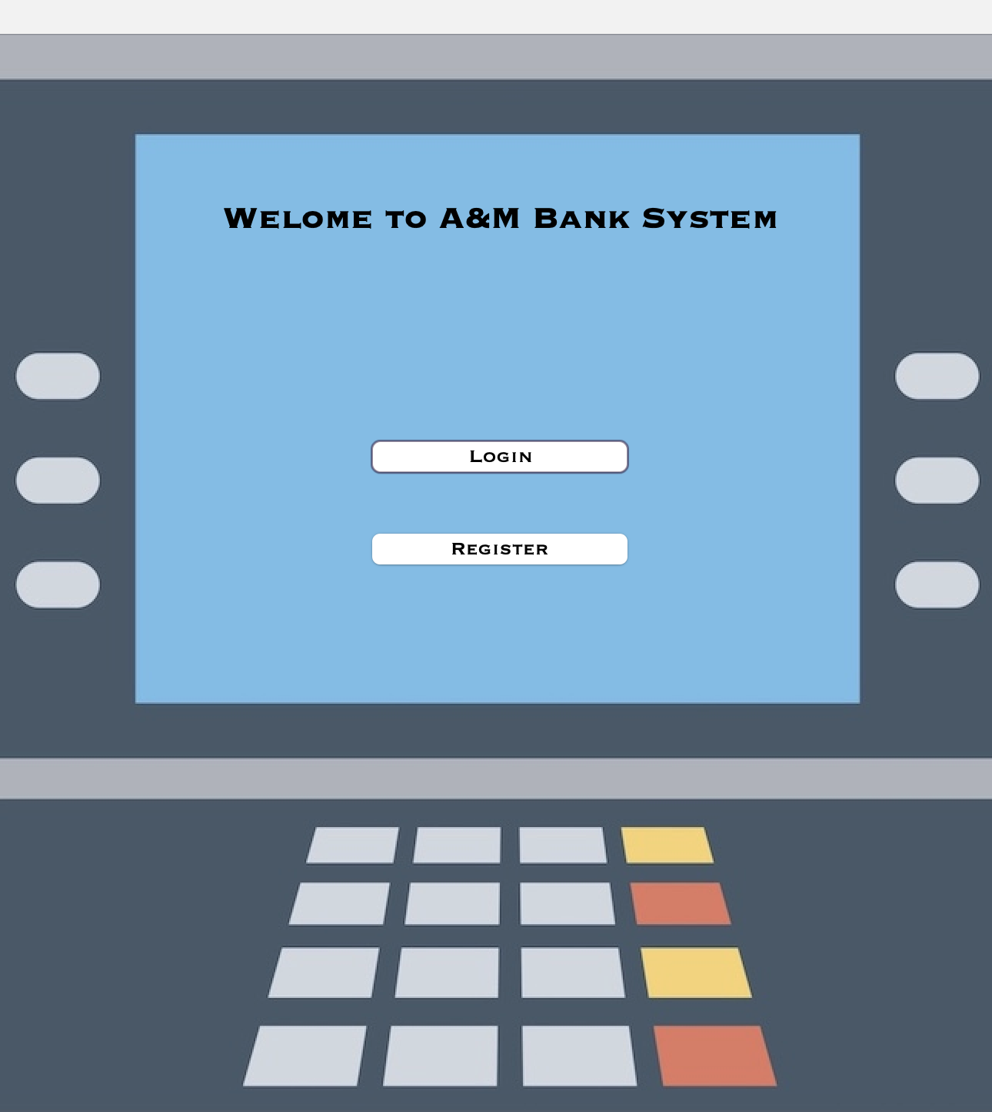
Main Class Overview
The Main class in the ATM program serves as the main window and entry point for the application, The Main class is responsible for managing the overall functionality of the program.
Key Components:
WelcomeL: Displays the welcome message.
RegisterB: Button for user registration.
Login: Button for user login.
Background: Displays the background image.
Key Methods:
getConnection(): Establishes a connection to a MySQL database.
RegisterBActionPerformed(): Handles registration button clicks.
LoginActionPerformed(): Handles login button clicks.

Slide 5

Registration Class Overview
The Registration class handles the user registration process in the ATM program. It collects user information and stores it in a MySQL database.
The key aspects are :
WelcomeL: Displays the welcome message.
LoginL: Displays the registration form title.
FnameF: Text field for entering the first name.
LnameF: Text field for entering the last name.
MaleRB: Radio button for selecting male gender.
FemaleRB: Radio button for selecting female gender.
IdF: Text field for entering the ID number.
birthdateComponent: Birthdate selection component.
NextB: Button for proceeding to the next registration step.
BackB: Button for going back to the main menu.

Slide 6
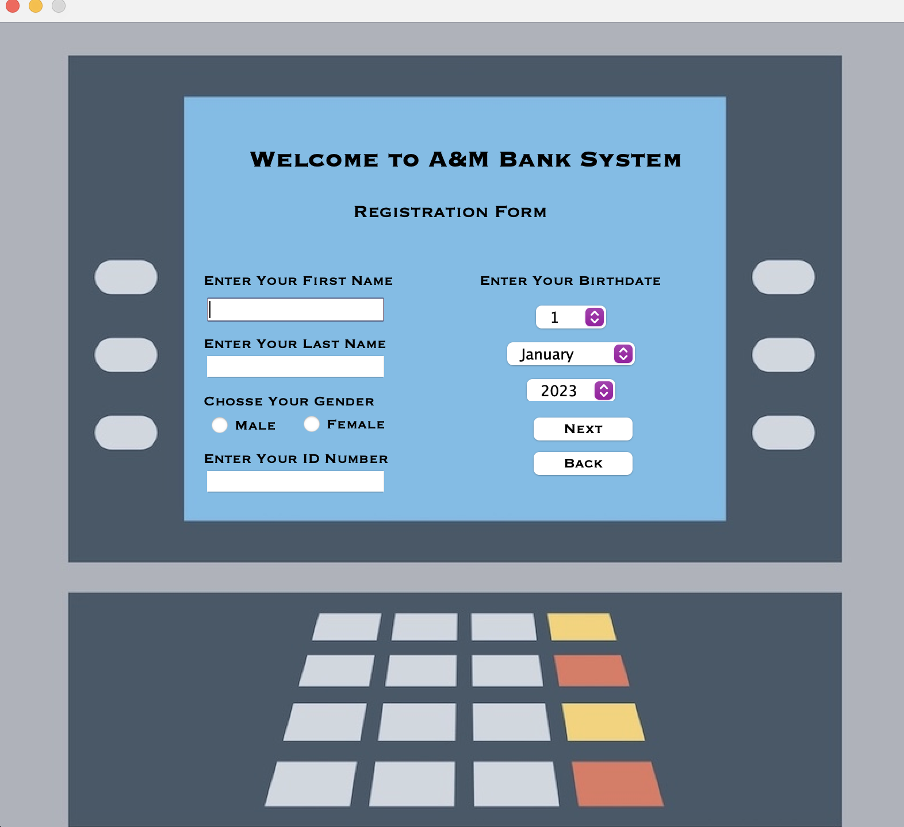
Key Methods:
getConnection(): Establishes a connection to the MySQL database.
insertRegistrationData(): Inserts the registration data into the database.
NextBActionPerformed(): Handles the next button click event.
BackBActionPerformed(): Handles the back button click event.
The Registration class allows users to enter their personal information, such as their name, gender, ID number, and birthdate. The entered data is stored in the database for further processing.

Slide 7
DateCo Class Overview
The DateCo class is a JPanel component that provides a user-friendly interface for selecting a date. It consists of three combo boxes: dayComboBox, monthComboBox, and yearComboBox.
The key aspects are :
dayComboBox: ComboBox for selecting the day of the month.
monthComboBox: ComboBox for selecting the month.
yearComboBox: ComboBox for selecting the year.
DateCo(): Constructor that sets up the layout and initializes the combo boxes with appropriate values.
getSelectedDate(): Retrieves the selected date from the combo boxes and returns it as a Date object.

Slide 8
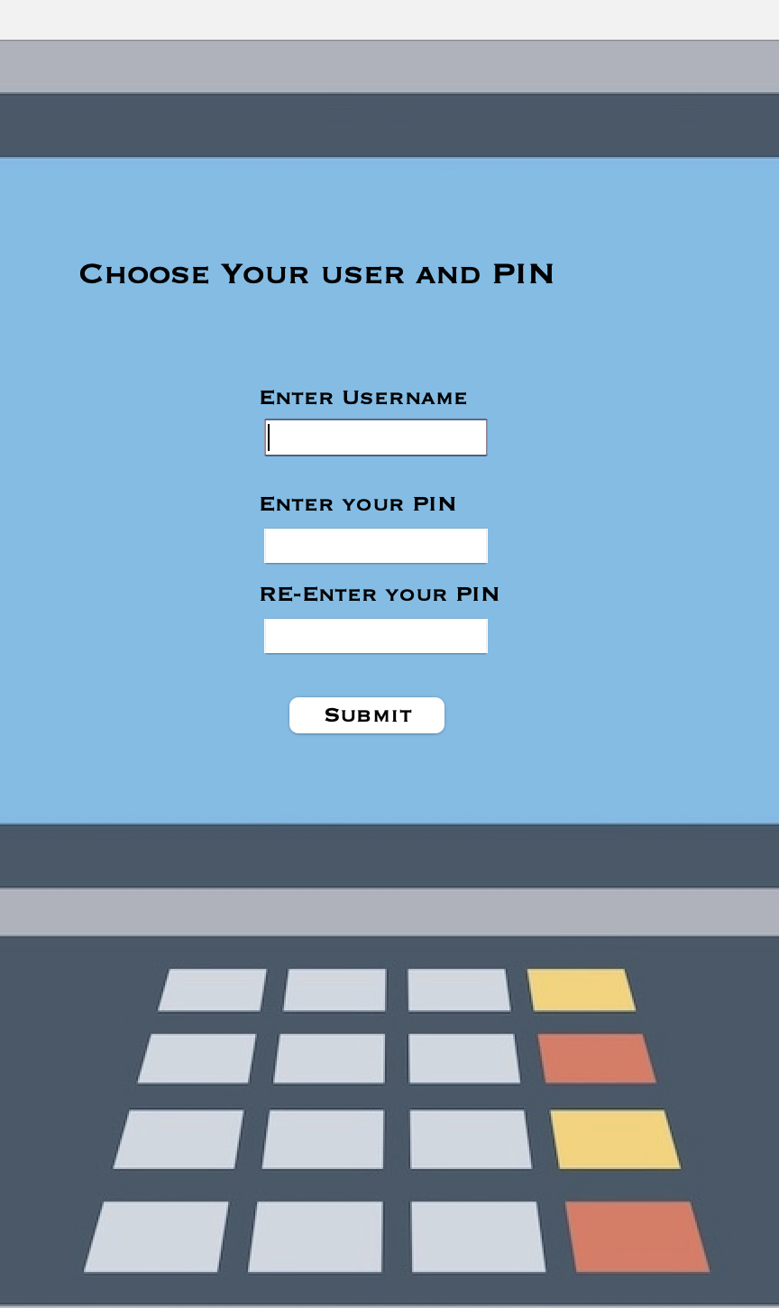
RegistrationPart2 Class Overview
The RegistrationPart2 class enables users to register for the ATM system by entering a username, PIN, and re-entering the PIN for verification. It validates input, checks username existence, and inserts user data into the database. After successful registration, the Login window is displayed for users to log in.
The key aspects are :
Components: UserF (username field), PassF (PIN field), RePassF (re-enter PIN field), SubmitB (submit button).
getConnection() establishes a database connection.
initComponents() initializes GUI components.
isUsernameExist(String username) checks if username already exists in the database.
insertUserData(String username, String password) inserts user data into the database.
SubmitBActionPerformed(ActionEvent evt) validates input, inserts data, and opens the Login window.

Slide 9
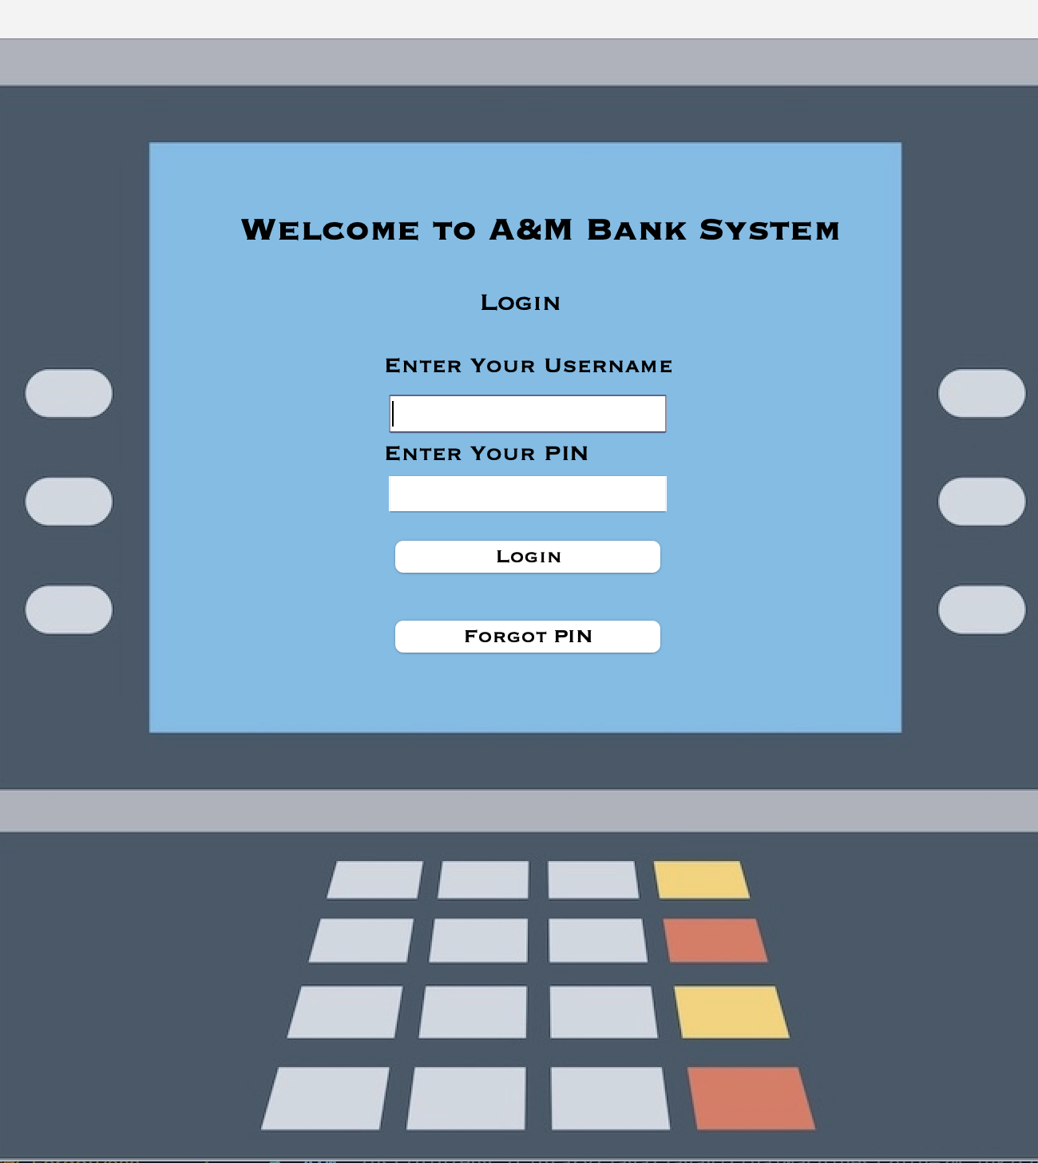
Login Class Overview
The Login class is responsible for user authentication in an ATM system. It extends the JFrame class and includes components such as username and PIN fields, login button, and a "Forgot PIN" button.
The key aspects are :
getConnection(): Establishes a connection to the database.
validateUser(String username, String password): Validates the entered username and password against the database.
LoginBActionPerformed(ActionEvent evt): Validates user credentials, displays a success message, and opens the Menu window upon successful login.
FpassBActionPerformed(ActionEvent evt): Opens the Check window for PIN recovery.
Overall, the Login class provides a user-friendly interface for users to log in to the ATM system, perform authentication, and access the main functionality of the system.

Slide 10
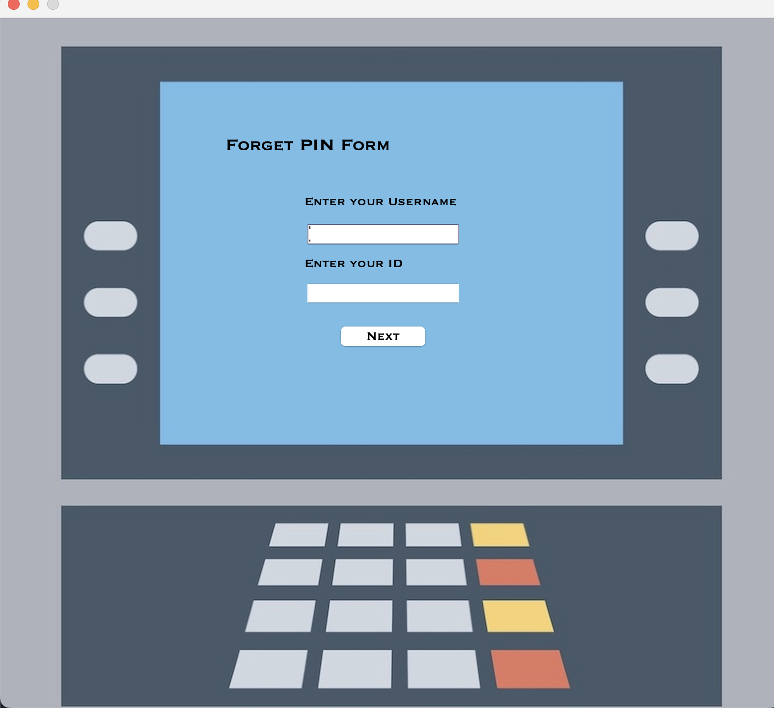
Check class Overview
The Check class is responsible for the PIN recovery form in the ATM system. It allows users to enter their username and ID for PIN recovery.
The key aspects are:
getConnection(): Establishes a connection to the database.
NextBActionPerformed(): Retrieves the entered username and ID, checks if the user exists in the database, and opens the ForgotPass window for PIN recovery if the user is found.
checkUserExists(): Checks if the given username and ID number exist in the database.
getUserId(): Retrieves the user ID from the database based on the given username and ID number.
The Check class provides a simple user interface and performs necessary database interactions to facilitate PIN recovery for users.

Slide 11

ForgotPass Class Overview
The ForgotPass class represents the PIN recovery form in the ATM system. It allows users to enter a new PIN and confirm it for verification purposes.
The key aspects are :
getConnection(): Establishes a connection to the database.
SubmitBActionPerformed(): Retrieves the entered passwords, checks if they match, and updates the password in the database if they do.
updatePassword(): Updates the password in the database based on the given ID number.
The ForgotPass class provides a simple user interface and performs necessary database interactions to facilitate PIN recovery and update the password for the user.

Slide 12
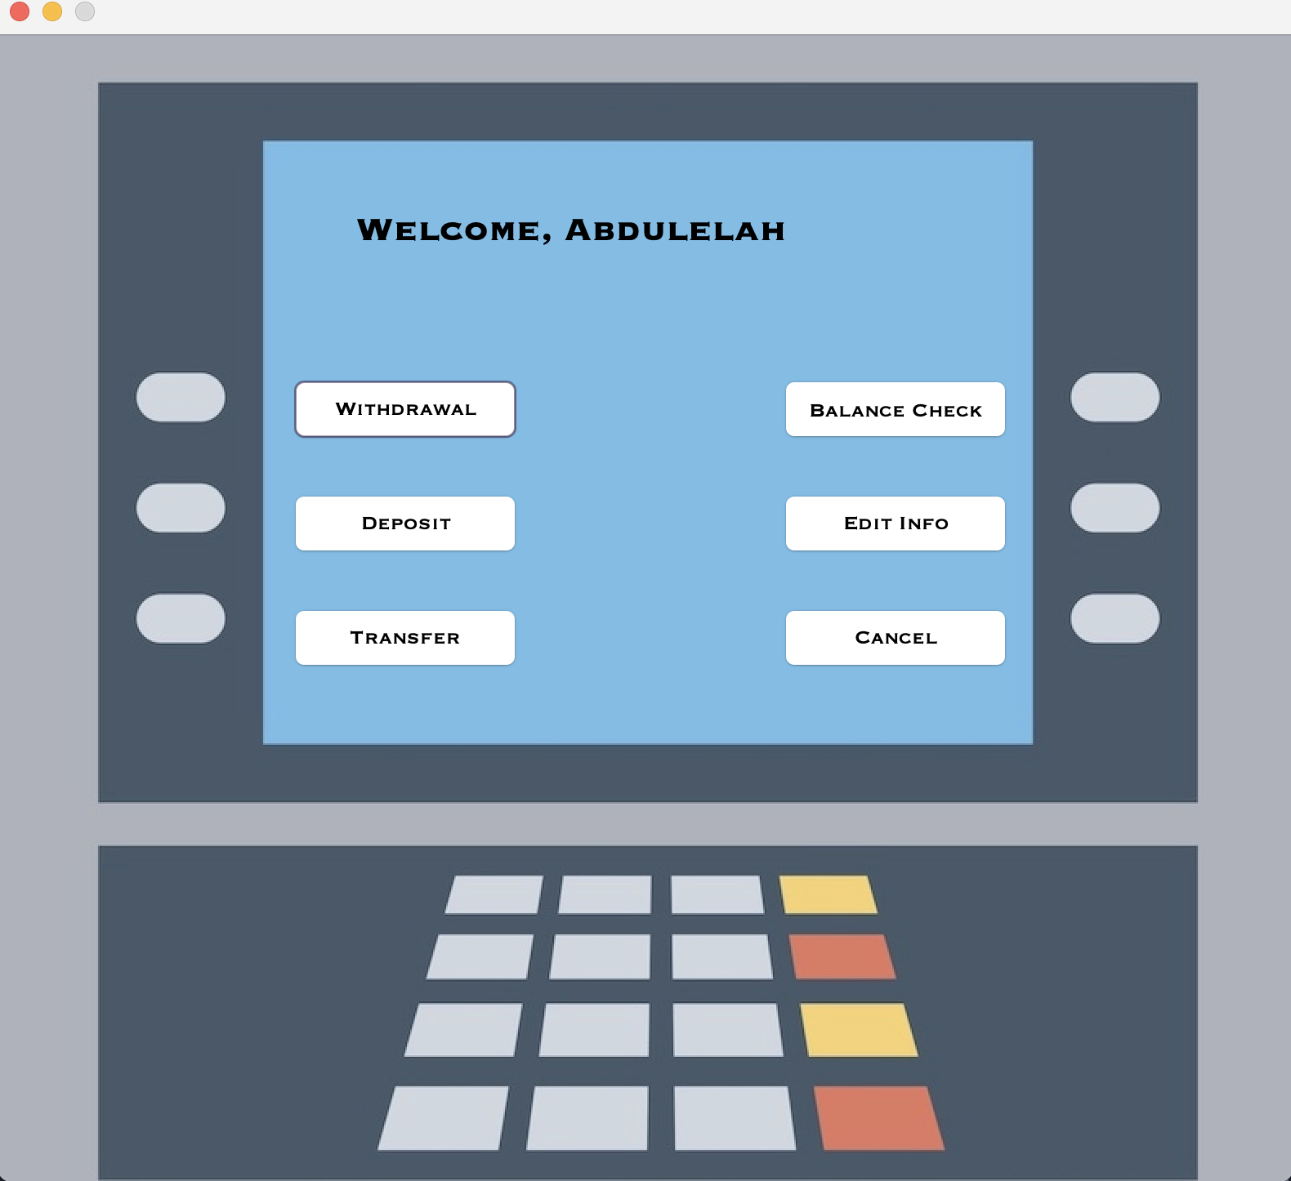
Menu Class Overview
The Menu class represents the main menu of the ATM system. It provides options for withdrawal, balance check, deposit, editing user information, transfer, and cancellation of transactions.
The key aspects are :
getConnection(): Establishes a connection to the database.
getFirstName(): Retrieves the first name of the user based on the username.
WithdrawalBActionPerformed(): Opens the withdrawal form.
BalanceBActionPerformed(): Retrieves and displays the balance of the user.
DepositBActionPerformed(): Opens the deposit form.
EditBActionPerformed(): Opens the edit information form.
TransferBActionPerformed(): Opens the transfer form.
CancelBActionPerformed(): Returns to the main menu.
The Menu class creates a user interface with buttons for different operations and handles the corresponding actions based on user interaction. It retrieves and displays user information from the database and provides options to perform various ATM transactions.

Slide 13
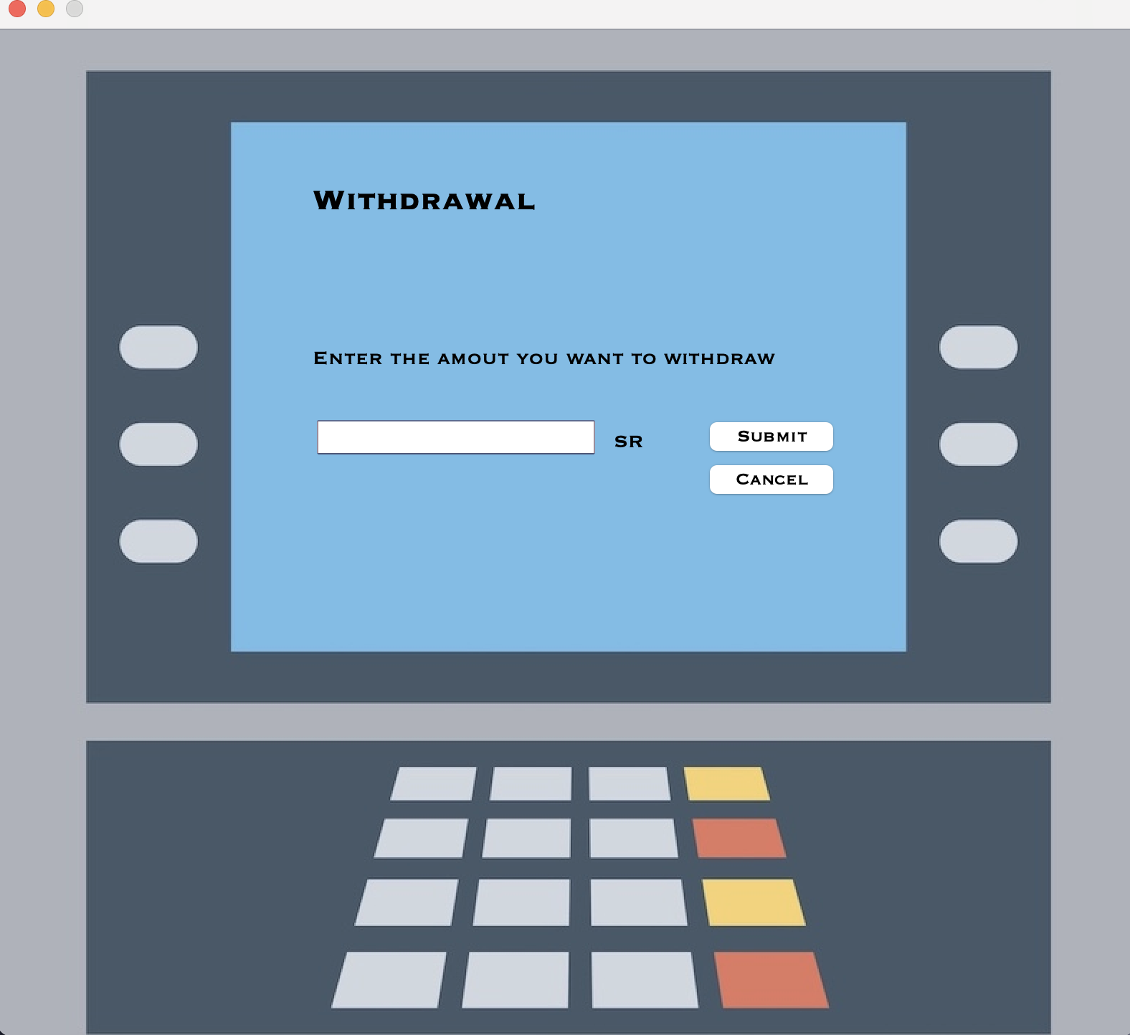
Withdraw Class Overview
The Withdrawal class represents the withdrawal form in the ATM system. It allows the user to enter the amount they want to withdraw from their account.
The key aspects are :
The getConnection() method establishes a connection to the database.
The Withdrawal() constructor initializes the withdrawal form and sets the username.
The SubmitBActionPerformed() method handles the event when the user submits the withdrawal amount. It validates the withdrawal amount, updates the balance in the database if valid, and displays appropriate messages.
The CancelBActionPerformed() method handles the event when the user cancels the withdrawal and returns to the menu.
The initComponents() method initializes and sets up the graphical user interface elements of the withdrawal form.
The Withdrawal form includes labels, input fields, and buttons for the withdrawal amount, submission, and cancellation. It utilizes the Java Swing library for creating the graphical user interface.

Slide 14
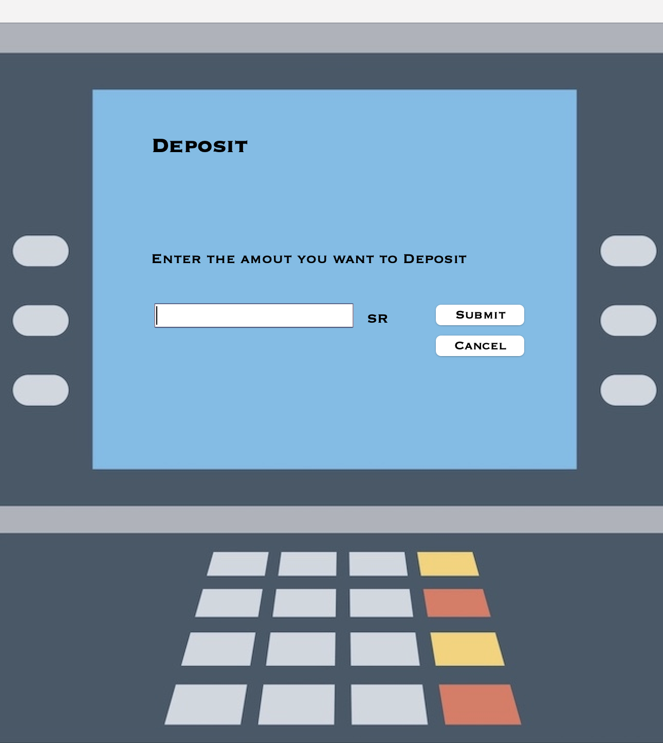
Deposit Class Overview
The Deposit class represents the deposit form in an ATM system. It allows the user to enter the amount they want to deposit into their account.
The key aspects are
Establishing a database connection using the getConnection() method.
Initializing the deposit form and setting the username in the constructor.
Handling the event when the user submits the deposit amount in the SubmitBActionPerformed() method. It retrieves the current balance from the database, updates the balance by adding the deposit amount, and displays a success message.
Handling the event when the user cancels the deposit and returns to the menu in the CancelBActionPerformed() method.
Creating the graphical user interface elements for the deposit form in the initComponents() method.
The form includes labels, input fields, and buttons for the deposit amount, submission, and cancellation. It utilizes the Java Swing library for creating the graphical user interface.

Slide 15
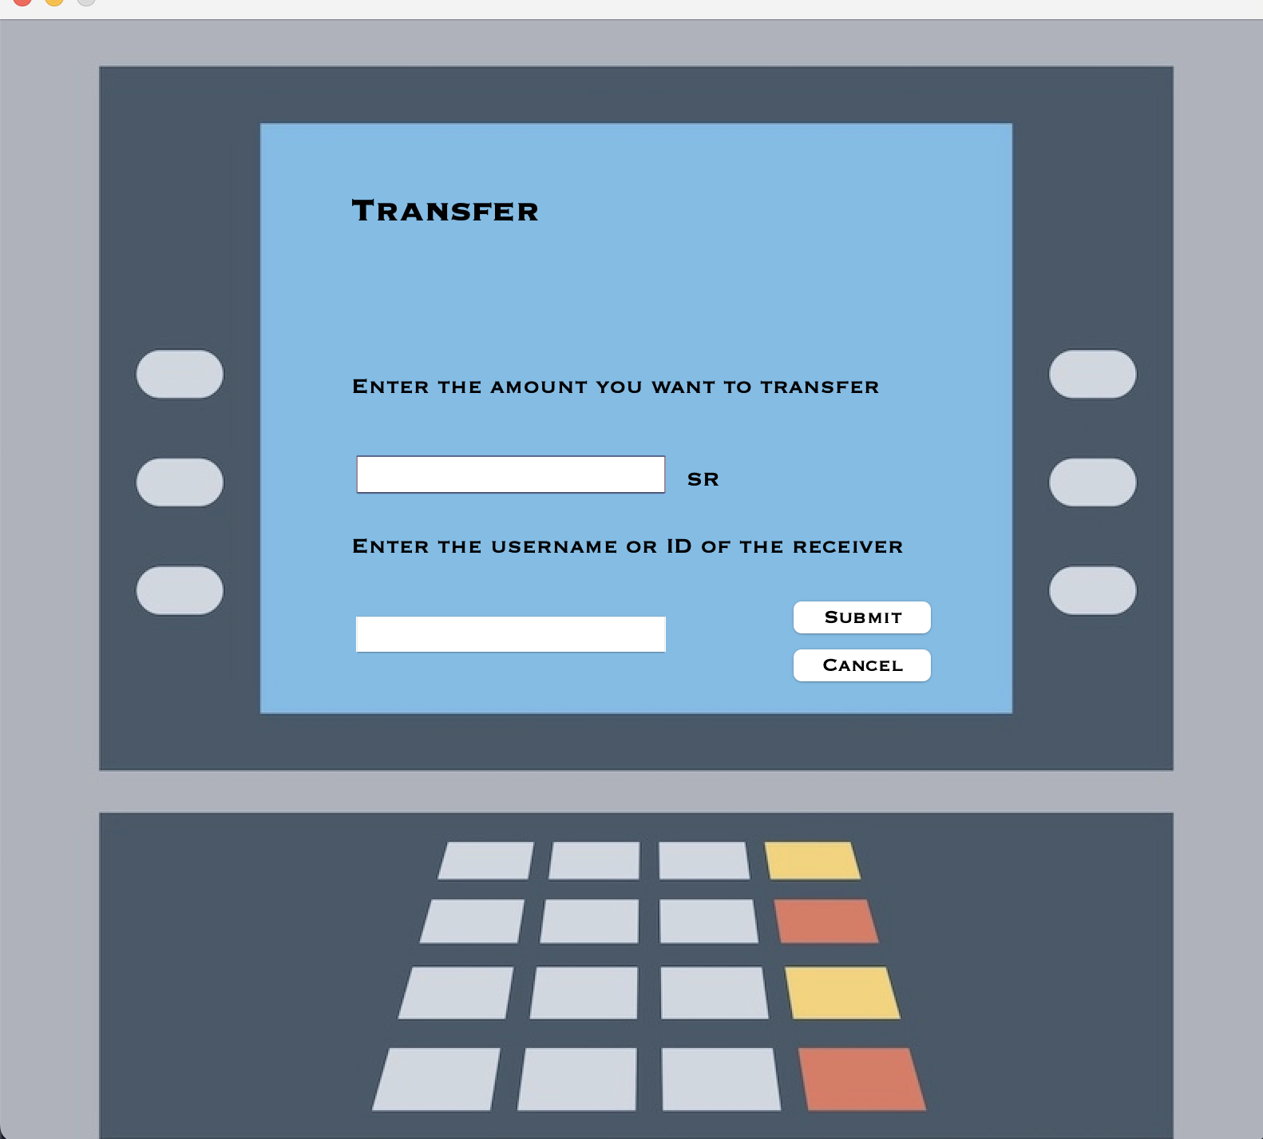
Transfer Class Overview
The Edit class represents an edit information form in an ATM system. It allows users to change their username or PIN.
The key aspects are:
The getConnection() method establishes a database connection.
The constructor initializes the form and sets the user's username.
The CancelBActionPerformed() method handles canceling and returns to the menu.
The ChangeUserBActionPerformed() method handles changing the username. It prompts for a new username, checks availability, updates it in the database, and displays a success message.
The ChangePassBActionPerformed() method handles changing the PIN by opening a new form.
The initComponents() method creates the user interface elements.

Slide 16
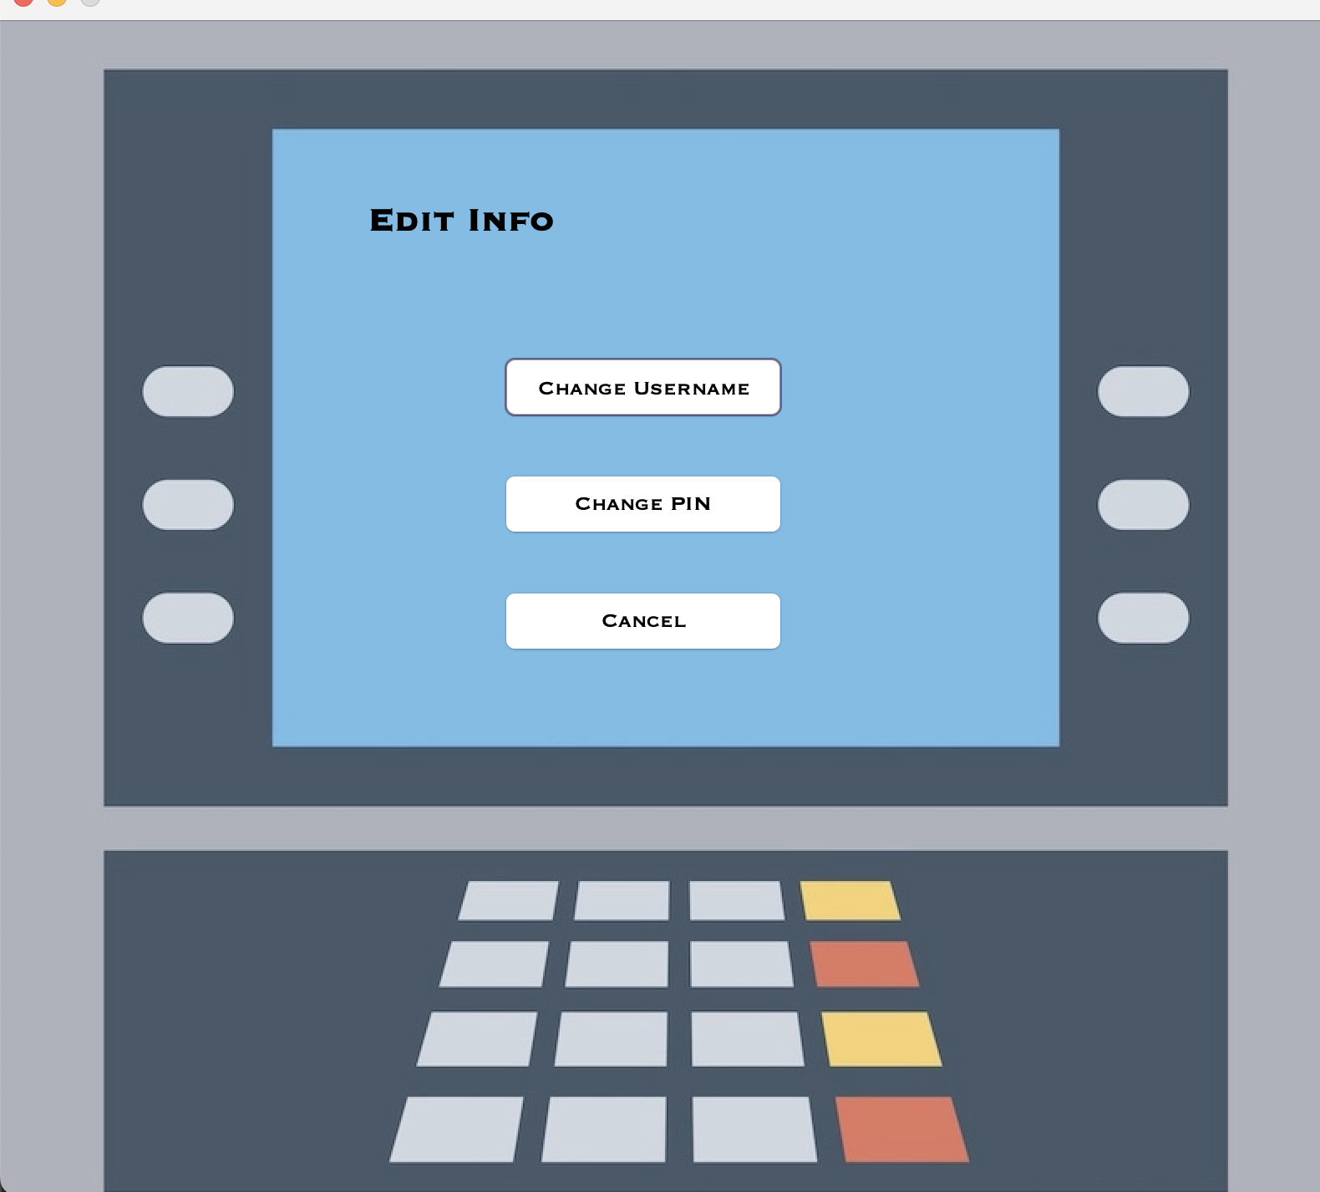
Edit Class Overview
The Edit class represents an edit information form in an ATM system. It allows users to change their username or PIN.
The key aspects are:
The getConnection() method establishes a database connection.
The constructor initializes the form and sets the user's username.
The CancelBActionPerformed() method handles canceling and returns to the menu.
The ChangeUserBActionPerformed() method handles changing the username. It prompts for a new username, checks availability, updates it in the database, and displays a success message.
The ChangePassBActionPerformed() method handles changing the PIN by opening a new form.
The initComponents() method creates the user interface elements.

Slide 17
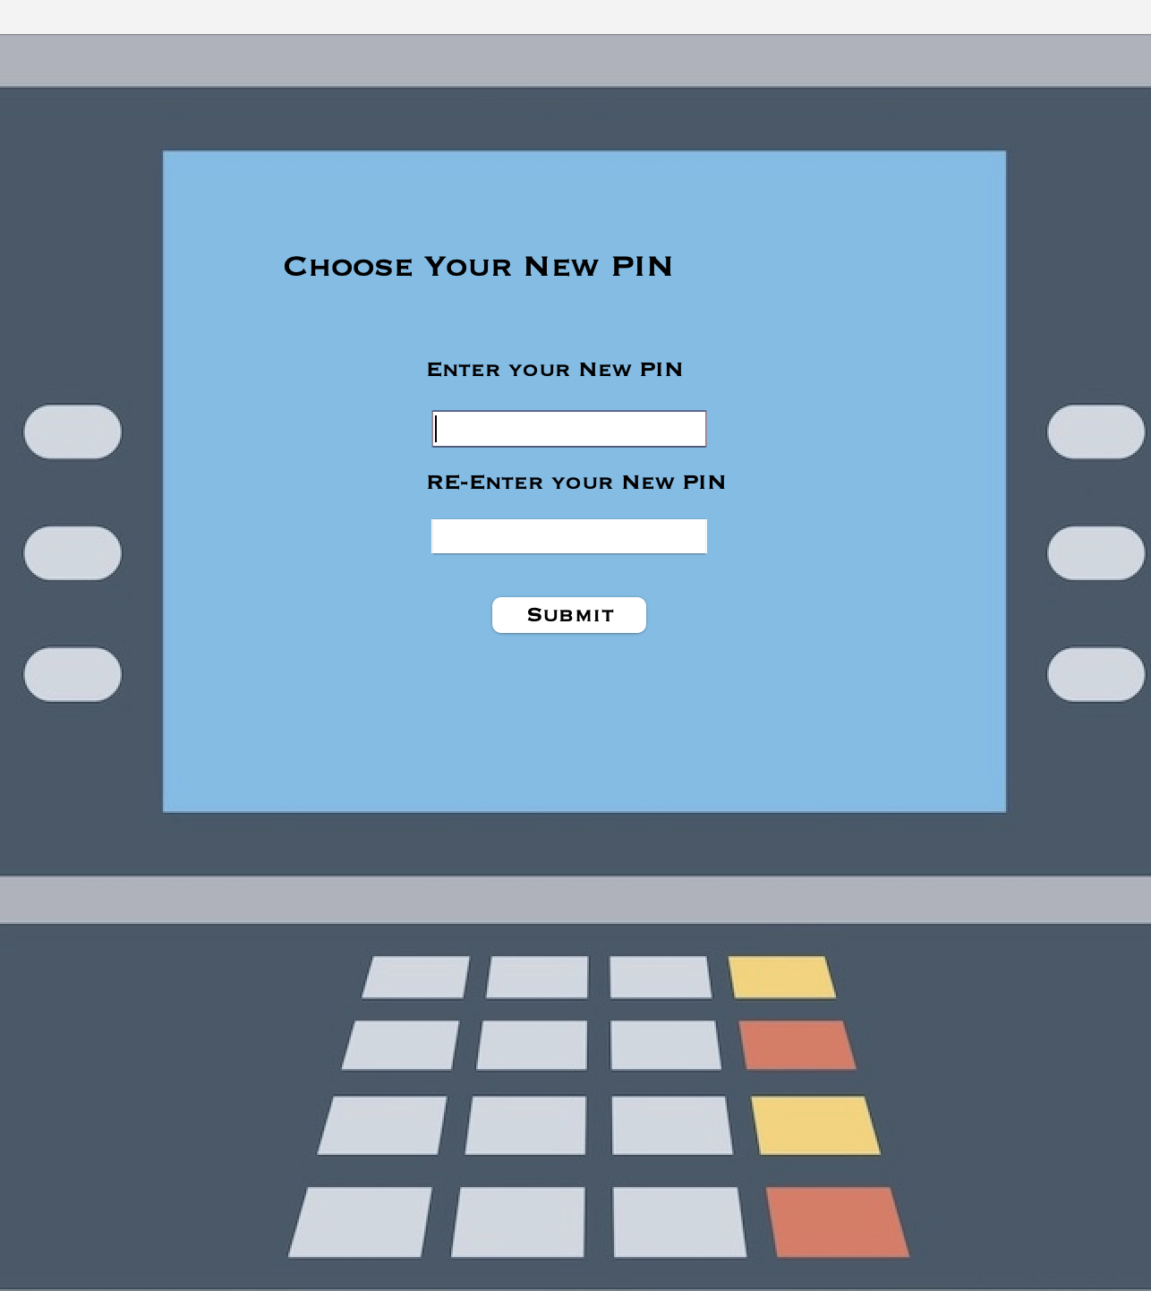
UpdatePass Class Overview
The UpdatePass class represents a form for updating the PIN in an ATM system.
The key aspects are :
The getConnection() method establishes a database connection.
The constructor initializes the form and sets the user's username.
The initComponents() method creates the user interface elements.
The SubmitBActionPerformed() method handles the submit button action. It validates the entered PIN, checks if it matches the confirmation, updates the PIN in the database, and displays a success message. If the update is successful, it closes the current form and opens the menu form.

Slide 18
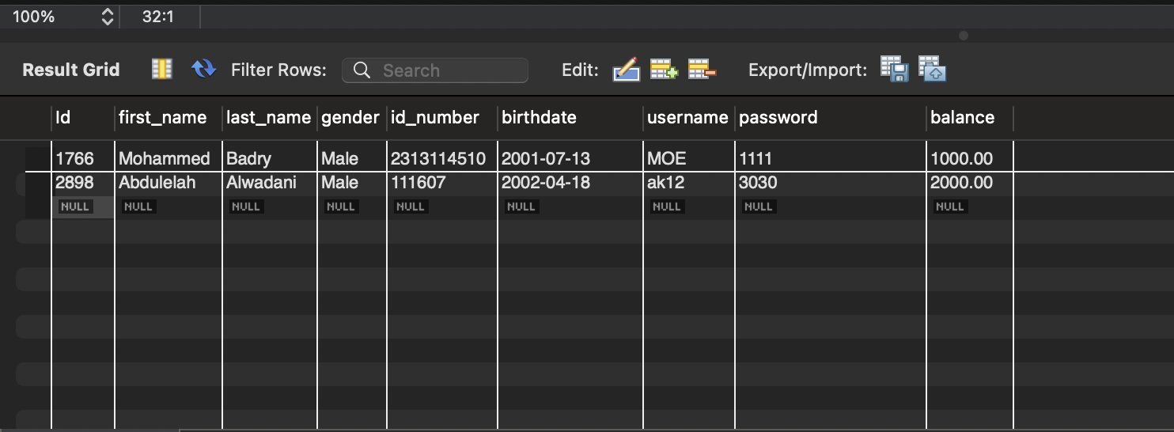
Our MySQL Database

Slide 19

Thank you !

