Slide 1
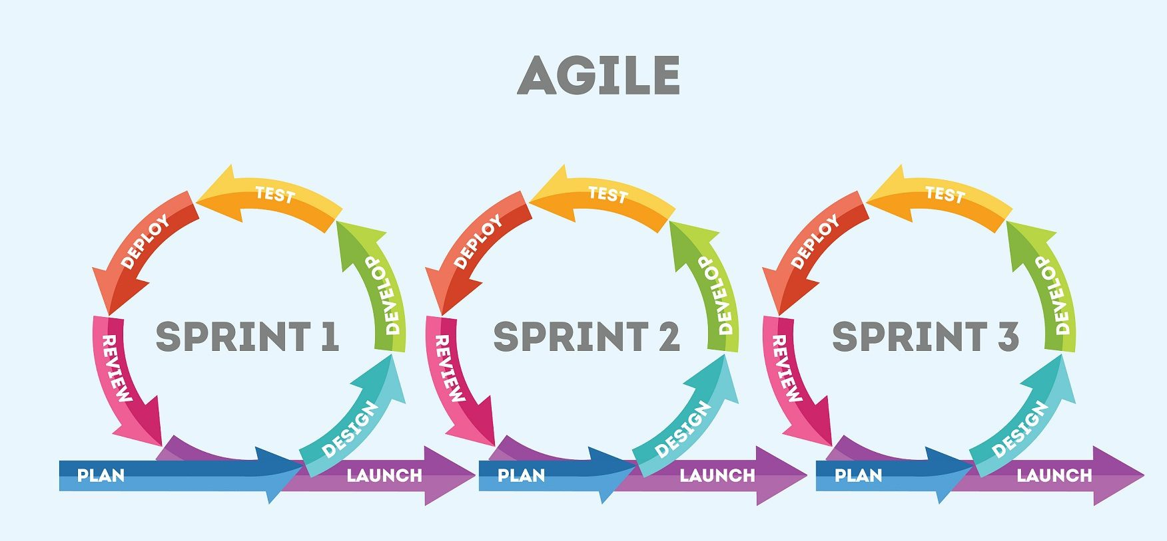
Introductory Meeting
21/6

Slide 2
Idea
What we solve :
We make their online presence Powerful
We automate their customer service
We will make it easy to track market trends
Will make a powerful recommender for customers

Slide 3

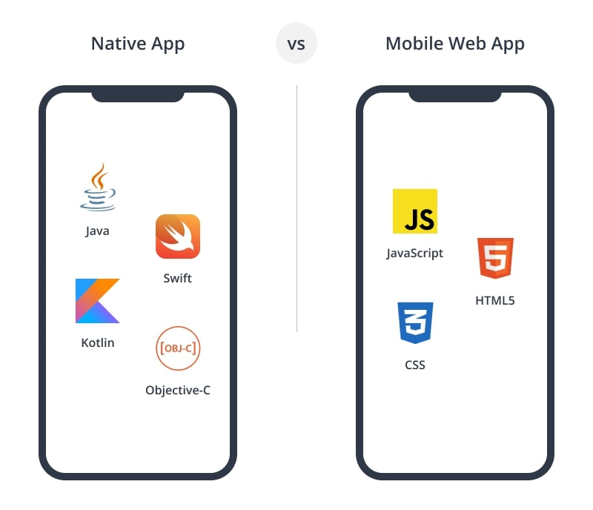
Web or App
Flutter
Flask, Html, CSS, JS

Slide 4
Teams
Design | PM | Market Study | Software | Modeling | LLM tuning or adaptation
Lama and Saja | Lama | Zbeeb Saja Rawad Salman | Zbeeb rawad cobra | Cobra Salman

Slide 5
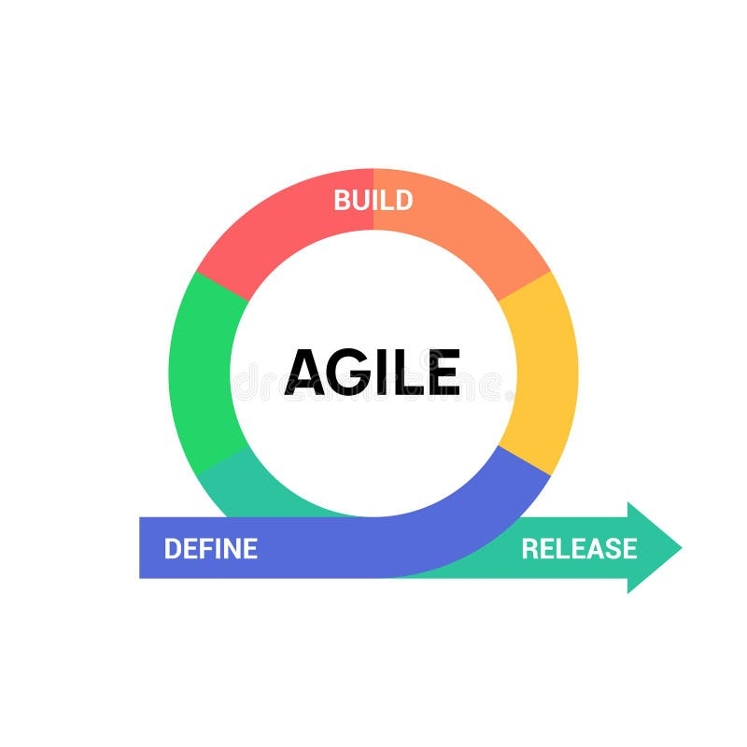
The Sprint System

Slide 6
Features
Easy-to-use interface for posting and managing products
Automated Customer Service
Data Science Tools : Stay Ahead of the Trends
Recommender System: Personalized Shopping Experience

Slide 7
Sprint - 1 - 5 days

Slide 8
Market study
Market Research and Initial Setup
Define the target audience and market segments
Revenue Model
Conduct SWOT

Slide 9

Github
4 sub-branches and 1 main-branch
Don’t commit, pull, review, then merge

Slide 10
Design - Monday
Desig done by Monday main pages, subpages and chatbot design
Use an iPad

Slide 11

Basic Data for Modeling
Done by Monday
Data and its API
We have 50,000 datasets on kaggle
Colab notebooks and then deploy in python

Slide 12


LLM Decision
Meet Ali
Cobra Find a good LLM and design the Pipeline for LLM tuning or choose between using an API
Consider researching Langchain and for sure hugging face

