Slide 1
EECE 350
MANUAL
Name: Mohamad Abou Salem

Slide 2
Instructions
Run WAMP or XAMP to launch mysql and apache.
When opening the code, run jdbc.java to create the database on WAMPS’s server.

Slide 3
Instructions
Change the IP address on “client.java” depending on the user. (IP address can be found in "Network and sharing center" -> "press on network name connected to" -> "details" -> "IP address is written on the row of IPv4 address). Alternatively open cmd and type "ipconfig", IP is written under IPv4 address of your wireless or ethernet connection. (we implemented an Inetaddress function in case and put the other socket ip which can be manually done as a comment)
Import mySQLconnector (provided in the zip file) library (MyConnection.java)

Slide 4
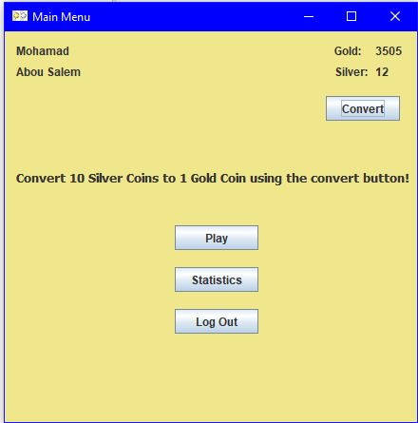
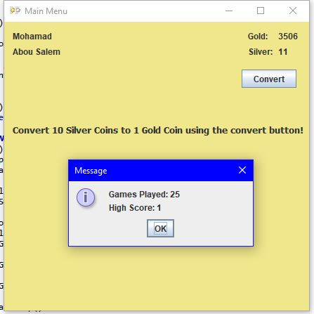
MainMenu

Slide 5
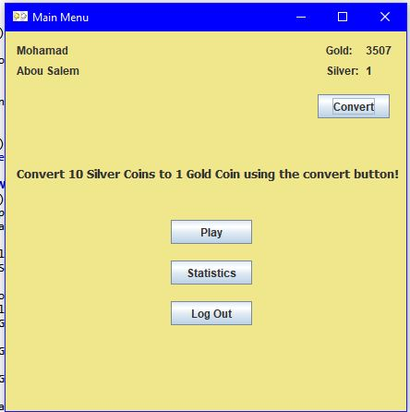
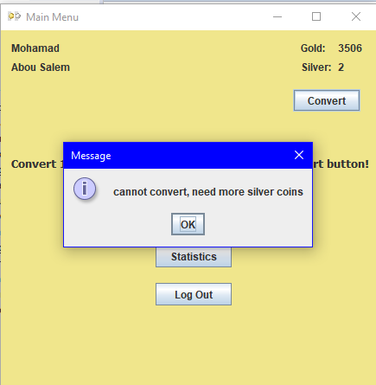
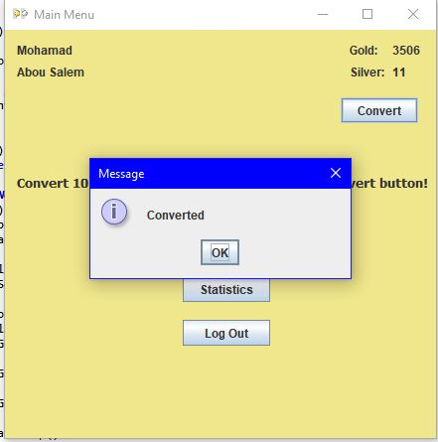

Slide 6
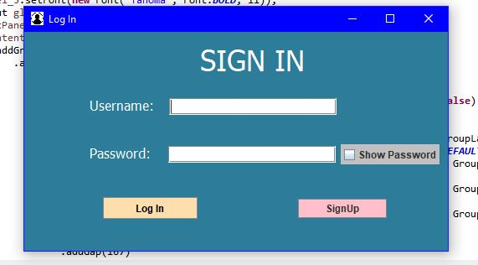
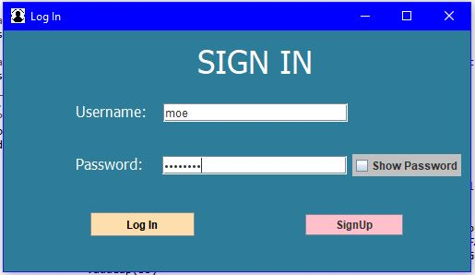
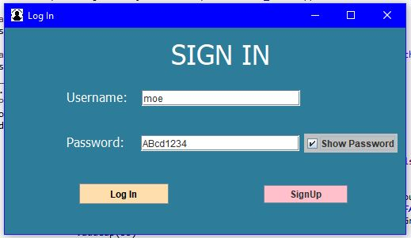
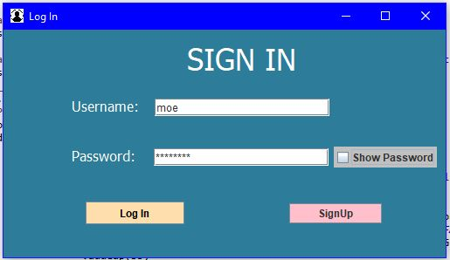
LogIn

Slide 7
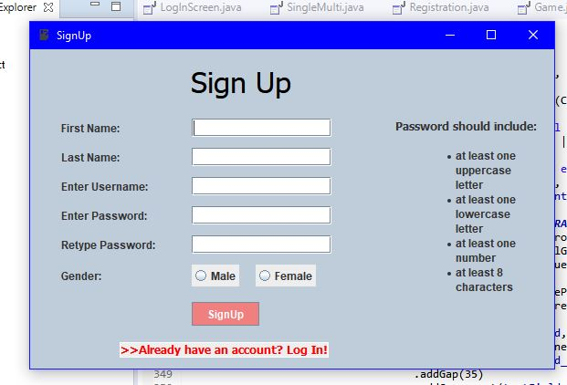
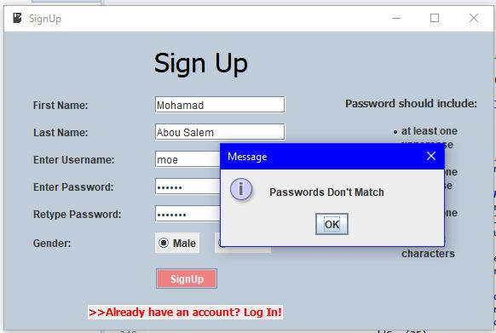
Registration

Slide 8
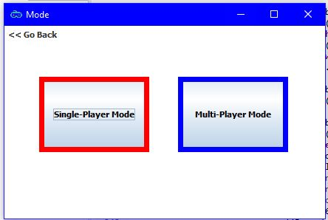
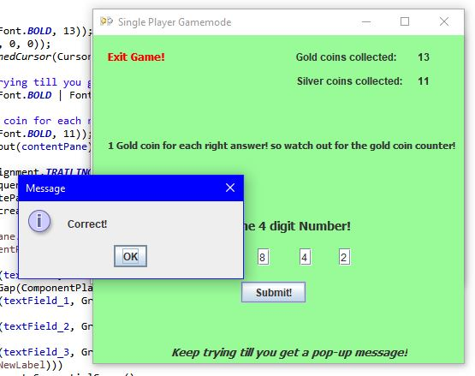
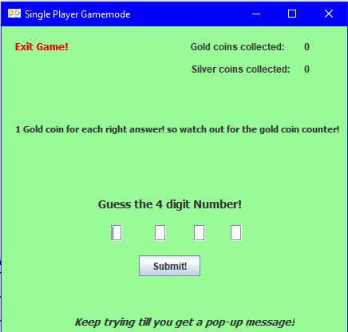
Game Mode

