Slide 1

Amusement Park optimal ratio of fastpass buyers
CSE561: Modeling & Simulation Theory and Application
Nov 1, 2023
Jisoo Lee, Ying Yu Wu

Slide 2


Introduction
Does a Fast Pass at an amusement park really reduce wait time?
In this project, our goal is to determine the ideal ratio of FastPass ticket users to achieve a specific waiting time gap between two lines: Fast line and normal line. These results will assist amusement parks in setting appropriate FastPass ticket prices.

Slide 3
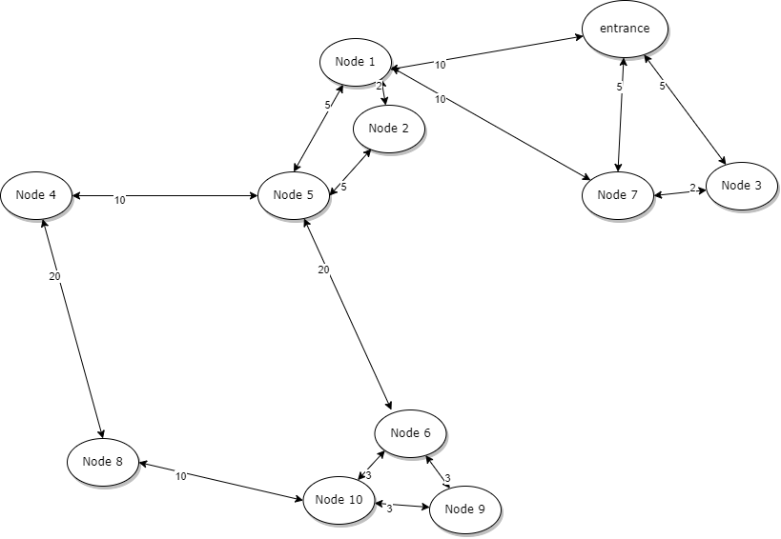
Amusement park map and visitor flaw
entrance: visitors enter at regular interval
nodes: attractions
distance: travel time between places

Slide 4
Configurations and Variables
Variables | definition
Number of amusement park attractions | 10
Number of visitors | 2000-3000 (50-70 per group)
Park opening time | 8:00 am
Park last entrance time | 2:59 pm
Entrance time for each tourist | People group will enter the park at 10-minute intervals.
Distance (time) between attractions (mins) | We assume that people walk at a certain rate and it takes a specific time between two attractions. The time between attractions will be set to different constant numbers mentioned in Figure 1.

Slide 5
Variables | definition
Priority order list | Each tourist will have a priority order list for attractions. Here is an example. The range of the number of attractions in the queue is between 0 and 10. The value of -1 in the queue is used to represent the scenario where a visitor will ride fewer than 10 attractions. When a node is assigned the value -1, the visitor proceeds to the next ride in the queue.This priority list will be set randomly. Visitors can revisit attractions.
Duration for each attraction (mins) | Each amusement ride operates for a specific duration. The machines operate with a high degree of precision, and with each attempt, they run for the exact same duration of time.
Capacity of each attraction | Each attraction has their own capacity.
Ratio of FastPast Buyer (Input) | [10,20,30] (%)
Waiting time for each attraction (mins) (Output) | Waiting time for each attraction will be different depending on the ratio of FastPass ticket buyers

Slide 6
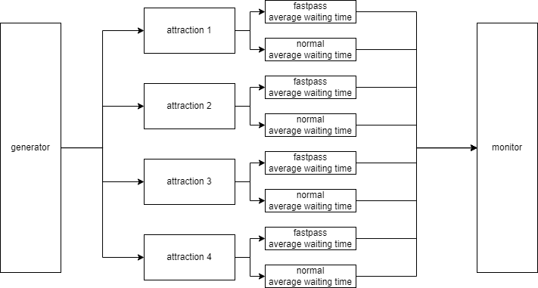
Amusement park system abstraction
Transducer

Slide 7
Experiments
Transducer
Ratio of Fastpass buyer
: 10, 20, 30 (%)
Wait time difference

Slide 8
Generator
the components of every visitor’s entity
status: {fastpass,normal}
priority queue

Slide 9
Generator
public class Visitor{
boolean isFastpass;
Queue<Integer> priority_queue= new LinkedList<>();
double ratio = 0.25;
public Visitor(){
for(int i=0;i<10;i++){
priority_queue.offer((int) (Math.random() * 11) - 1)
}
isFastpass = Math.random() < ratio? true : false;
}
}
public class generator extends siso{
protected int period;
public generator(String name,int Period){
super(name);
period = Period;
}

Slide 10
public void initialize(){
phase = "active";
sigma = period;
super.initialize();
}
public void deltint( ){ holdIn("active",period); }
public double Out( ){
List<Visitors> visitorGroup = new ArrayList<>();
int groupSize = (int) (Math.random() * 20) + 50
for (int i = 0; i < groupSize; i++) {
Visitors visitor = new Visitors();
visitorGroup.add(visitor);
}
return visitorGroup;
}
}

Slide 11

Attraction model
Visitor Example
isFastPass: 1
priority queue: [4, 5, 2, 1, 3, -1, 7, 8, 6, 3]
attraction
input
output
A list of waiting time

Slide 12
External function
public void Deltext(Visitor input){
Continue(e);
if (input.isFastpass == 1){ // fastpass
FastPassQ.add(java.time.LocalDateTime.now(),input);
}
if(input.isFastpass == 0 ){ // normal
NormalQ.add(java.time.LocalDateTime.now(),input);
}
}
fastpass visitors queue
normal visitors queue
Will be replaced by Transducer

Slide 13
Internal function
parameter:
duration
capacity
public void Deltint(){
if (phase == “load”){
count = 0;
for(int i=0;i<FastPassQ.size();i++){
Queue<Pair<LocalDateTime, Visitor>> Fq = FastPassQ.remove();
FinishFastPassQ.add(Duration.between(java.time.LocalDateTime.now(),Fq.getKey())+duration,
Fq.getValue().isFastpass);
count++;
if(count>capacity){phase = “run”;Break;}
}
if(count<capacity){
for(int i=0;i<NormalQ.size();i++){
Queue<Pair<LocalDateTime, Visitor>> Nq = NormalQ.remove();
FinishNormalQ.add(Duration.between(java.time.LocalDateTime.now(),Nq.getKey())+duration,
Nq.getValue().isFastpass);
count++;
if(count>capacity){phase = “run”;Break;}
}
}
}
holdIn(“run”,duration);
phase = load;
}

Slide 14
Internal function
waiting time = current time - arrive time + duration
finish fastpass queue
finish normal queue
Will be replaced by Transducer

Slide 15
Output function
public void Output(){
List<Pair<Integer, Boolean>> combinedList = new ArrayList<>();
if(phase == “run” && FinishFastPassQ.isEmpty()!=0){
for(int i=0;i<FinishFastPassQ.size();i++){
combinedList.add(FinishFastPassQ.getKey(),1);
}
if(phase == “run” && FinishNormalQ.isEmpty()!=0){
for(int i=0;i<FinishNormalQ.size();i++){
combinedList.add(FinishNormalQ.getKey(),0);
}
}
return combinedList;
Notes:
(34, 1), (56, 0 ), (34, 1), (34, 1), (34, 1),

Slide 16
Thank You
Q&A

