Slide 1
MY CAL
Moeed Ahmed
21380870

Slide 2
Introduction
Bronze age on a stone tablet, 11,000 years ago.
Egyptians made every month 30 days following solar calendar.
Romans decided to have some months with 28,29,30 etc - year started in march ended in February.
1582 the Gregorian calendar was made which is most similar to what we use today.
www.Portalstothepast.co.uk

Slide 3
Why make a calendar?
76% of people said they would be prepared to spend between 15-30 minutes a day if better time management saved them 90 minutes, reduced stress and improved their reputation at work
1 in 8 people (12%) use a dedicated time management system
44% of people feel they have things under control at work 5 days a week
38% of people say they spend up to an hour a day on tasks or meetings that aren’t important to their role, 32% say they waste 1-2 hours and a further 17% waste 2-3 hours
Survey carried out by pollfish
Everyone over age 18, 83% were between 25-44
www.timewatch.com

Slide 4
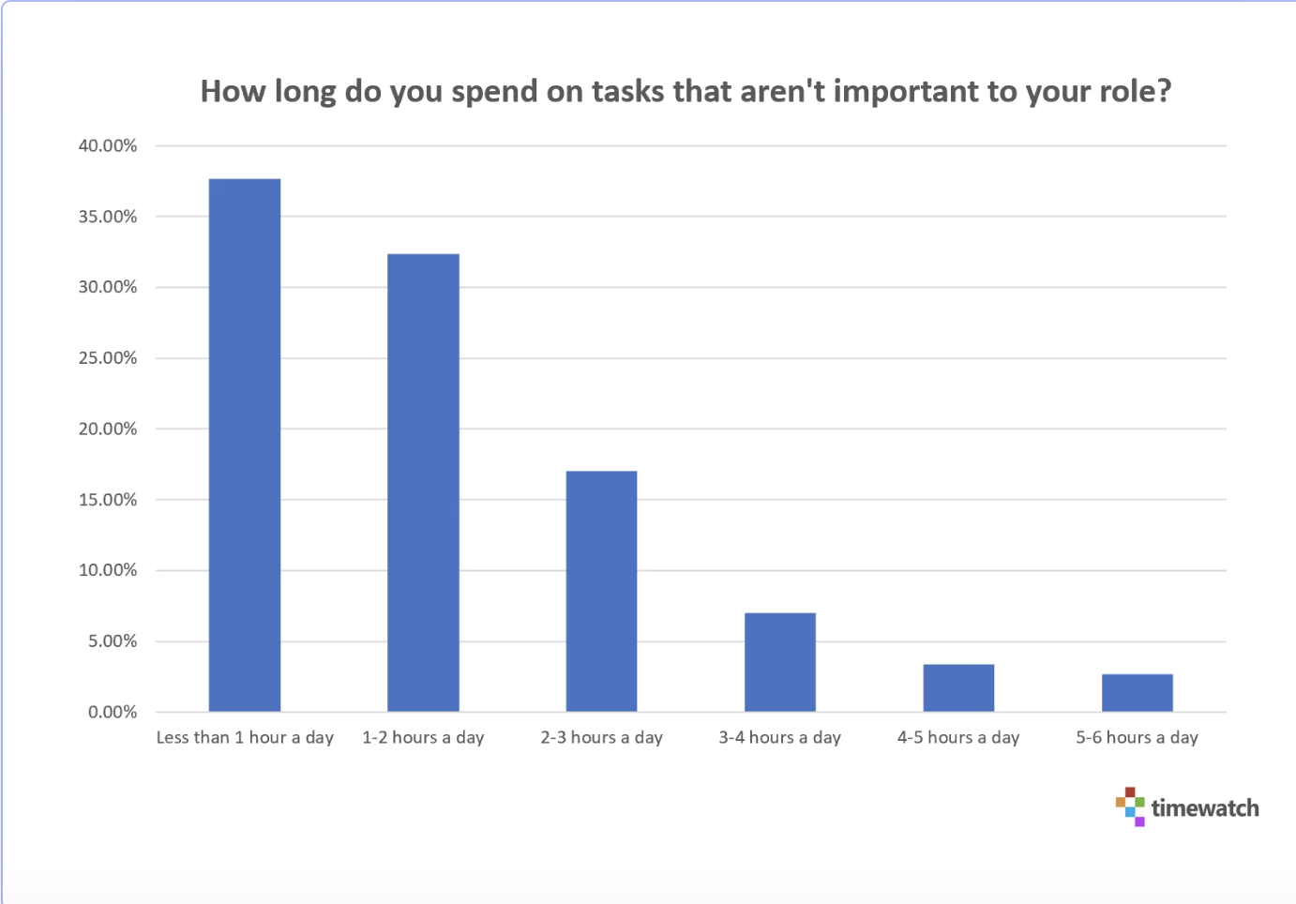

Slide 5
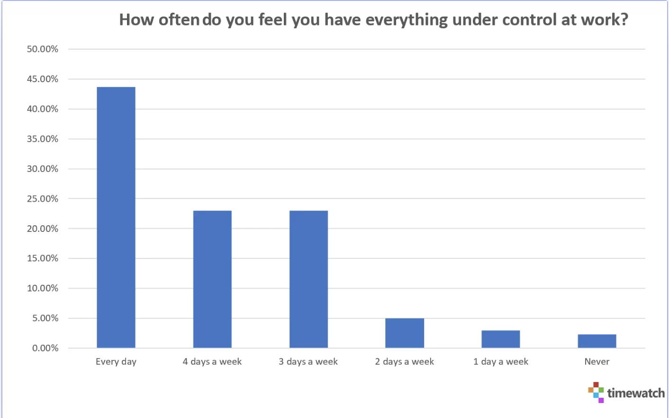

Slide 6
My approach
Lots of additions that could be made to the traditional calendars
Wanted to make this calendar basic so more people would feel inclined to use it
User can use as a regular calendar or use the AI features to ease the process/ make them more likely to use it
Some things I would like added in the future; A system which will show users things in their area and possibly even book reservations for them, Voice commands and a mobile application version as well as the full implementation of AI

Slide 7
Thank you for listening

