Slide 1

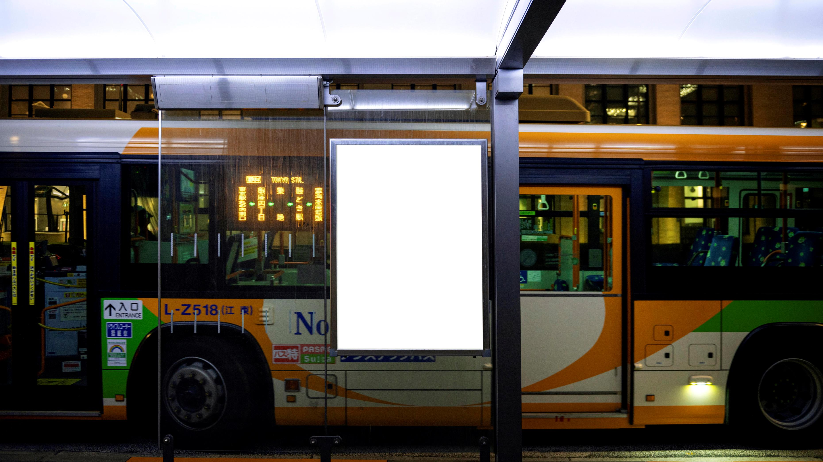
Mustafa Faysal 25231
Moeen haider 24505
Bus
Stop
Service

Slide 2
Introduction
The project consists of a search engine that utilizes three Data Structures, namely: Binary Trees, Linked List & Array.
The user can access the Bus Stop lists sorted according to the distance from KU in ascending order.
Another feature would be the option to view all the routes of a particular Bus stop by entering it’s name via user input at run-time.
The name, location, distance, &it’s routes are all stored accordingly.
Arrays are used in order to ensure that the user can access the routes of each bus stop via user input.

Slide 3
Why a Bus Stop Service
Daily office commute has become a worldwide problem. While technology has brought the world closer, people still find it a challenge to travel to and from work on an everyday basis.
Providing shuttle services have some very practical benefits. Typically, they start from easy to access landmarks like bus stops where students are likely to gather for pickup. they are picked up from the specified landmark and dropped back after work at the same place.
This project helps students identify what bus stops are nearest to them and the routes they offer throughout the day, ensuring productivity as well as the efficiency.

Slide 4
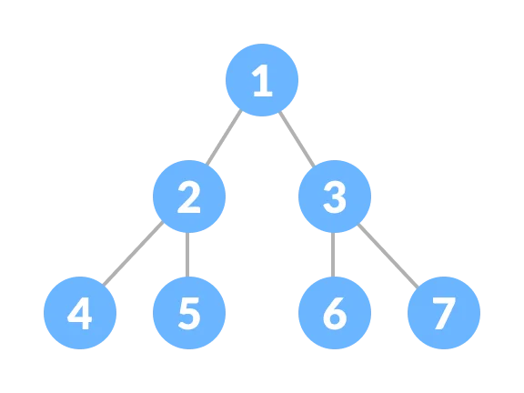
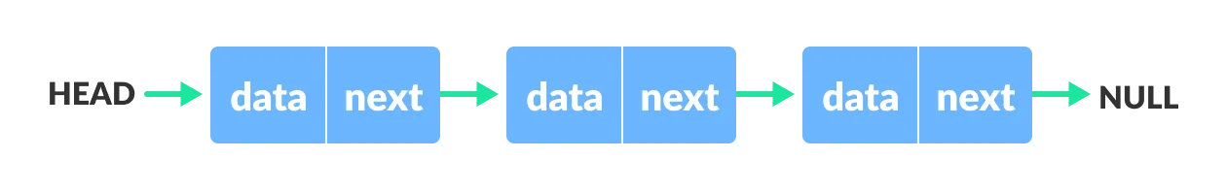


Methods Used
Bus stop #1
Bus Stop #2 Bus Stop #3
To display the routes inside each bus stop

Slide 5
BusNode – What it contains ?
LEFT
RIGHT
NAME
LOCATION
DISTANCE
Link List of Routes

Slide 6
Array
After the InOrder traversal that prints out every single Bus Stop’s information, we have the option to access one of these to view it’s routes.
In order to ensure that the information is available even after the traversal is done, we place these Bus nodes within an array. We then take user input of any one number, and whatever number is entered, the bus stop corresponding to that number has it’s information displayed.

Slide 7
Reasoning
The insertion & search of the binary tree yields more than satisfactory time complexity.
A Binary Tree would’ve worked for the route as well, but for the ease of implementation & because we knew the number of routes wouldn’t be particularly high, we used a LinkedList.
We use a Binary Tree in order to store the Bus Nodes. A hashing table would’ve made it impossible to implement any sorting algorithms. A LinkedList’s time complexity would’ve been a major drawback.
We utilize a LinkedList to store the routes. An array would’ve wasted memory since the number of routes is not pre-defined.

Slide 8
Complexity Analysis
The number of lines within the text file are always a fixed amount, and as such, the time complexity of the file being read will always be O(1) [Constant].
The first table corresponds to the Binary Search Tree. The second to the LinkedList within the nodes of the tree.
All array operations are of time complexity O(1)
Function | Time Complexity
InsertByDistance | O(Log(N))
ArrayCreation | O(1)
InOrder Traversal | O(N)
Insert | O(N)
ToString | O(N)
Find | O(N)

Slide 9
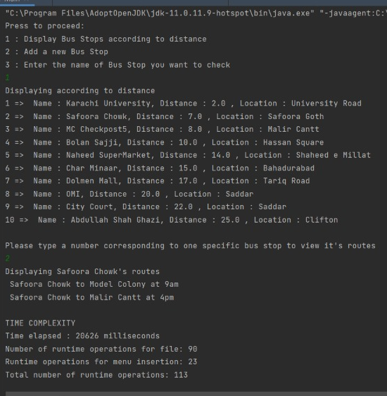
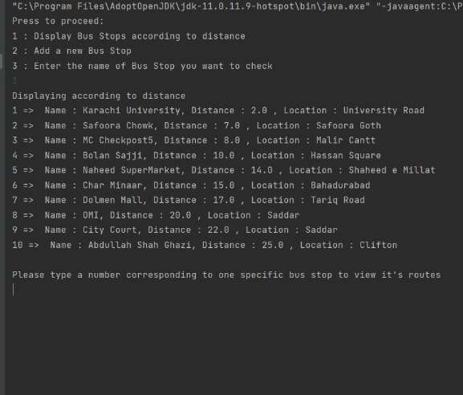
Outputs

Slide 10
