Slide 1

CryptoNote
Track Any Where Do you want
M.MOEEZ.KHAN
BSCS-4B

Slide 2

Content
Introduction
Problem Statement
Application Interface
Features
Detail Review
Future Work

Slide 3

Introduction
As we see and hear that Cryptocurrencies demand implementation are increasing day by day .There prices are going up and down like stock market or trading so Cryptonote app brings you the feature to track cryptocurrencies live and additional feature to note down private note in app like your calculations

Slide 4

Problem Statement
Tracking Issues we don’t have direct resource from where we can track the cryptocurrencies live in detail and note that immediately
Let’s dive in

Slide 5

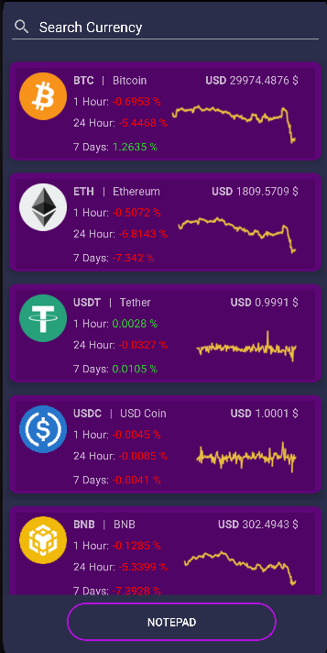
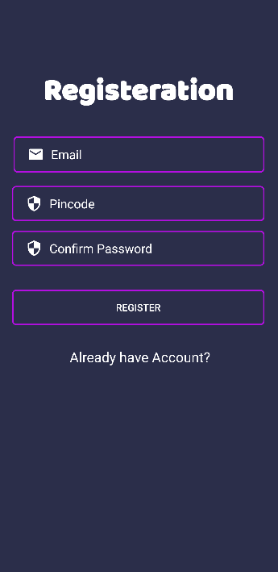
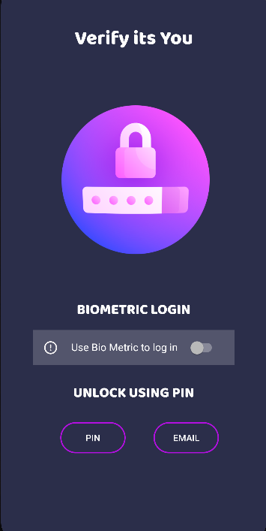
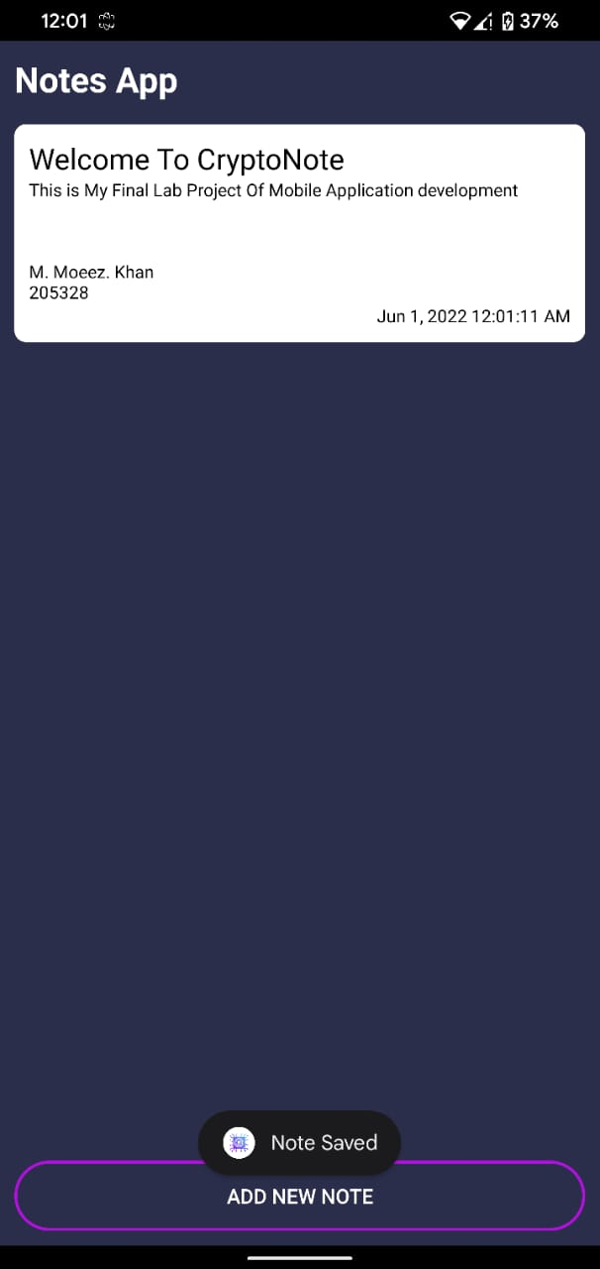
Main Interface

Slide 6






Features
Searching available
Can search single currency from many of them using search
Trading Will be Good
Profits are up in the last quarter by 3%
Live Tracking
Can track every Currency live anytime
We’re getting our work done
We finished the consolidation project
Private Notepad
To store private keys notes with three types of login available.
Upadation
There will be more update available for improving the app

Slide 7
Detail Review
In This app I have integrated Coin market cap API to fetch the live data about cryptocurrencies in the main activity you can see currencies there prices in USD the up and down of 7days,24hours and 1 day too and can also see coin picture with 7 day graph of each coin I have fetched all the coin data that were freely available using API .You can even search for coin in app . App also have a private Notepad with login of email, pin and biometric to save your private notes in that app the note will stay in app until you delete app data or uninstall app

Slide 8

More data can still be fetch of single coin there is quite more detail avaible using that api so can work more in detail to display that info to for better experience.
Future Work
More Details Makes more Satisfaction

Slide 9


Thank You
Any Questions
.
M.Moeez.khan
205328@aack.au.edu.pk

