Slide 1
Time complexity of Simplex Algorithm

Slide 2
Outline
The Problem
Simplex Algorithm
Time complexity and exponential behavior
Demonstration
Generalization

Slide 3
The Problem

Slide 4
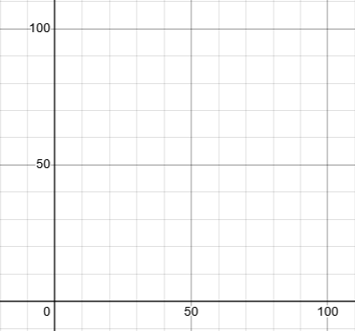
The problem
Maximize: z = 3x₁ + 2x₂
s.t.:
x₁ + x₂ < 80
2x₁ + x₂ < 100
x₁ < 40
x₁ > 0, x₂ > 0

Slide 5
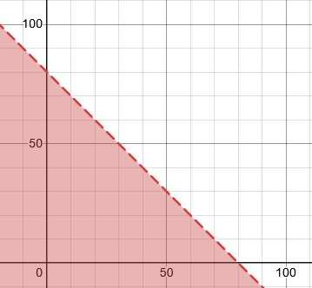
The problem
Maximize: z = 3x₁ + 2x₂
s.t.:
x₁ + x₂ < 80
2x₁ + x₂ < 100
x₁ < 40
x₁ > 0, x₂ > 0

Slide 6
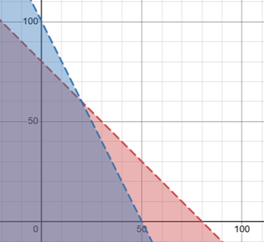
The problem
Maximize: z = 3x₁ + 2x₂
s.t.:
x₁ + x₂ < 80
2x₁ + x₂ < 100
x₁ < 40
x₁ > 0, x₂ > 0

Slide 7
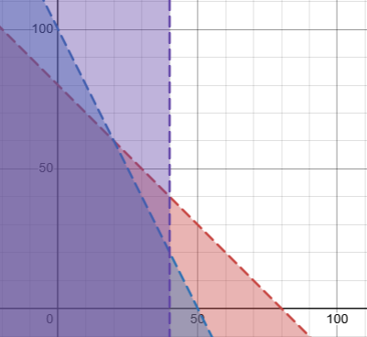
The problem
Maximize: z = 3x₁ + 2x₂
s.t.:
x₁ + x₂ < 80
2x₁ + x₂ < 100
x₁ < 40
x₁ > 0, x₂ > 0

Slide 8
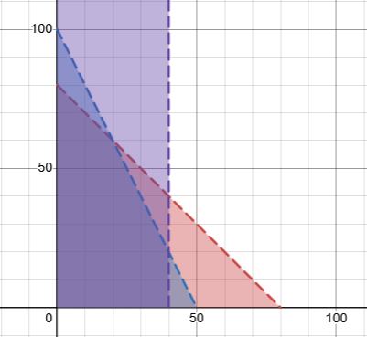
The problem
Maximize: z = 3x₁ + 2x₂
s.t.:
x₁ + x₂ < 80
2x₁ + x₂ < 100
x₁ < 40
x₁ > 0, x₂ > 0

Slide 9
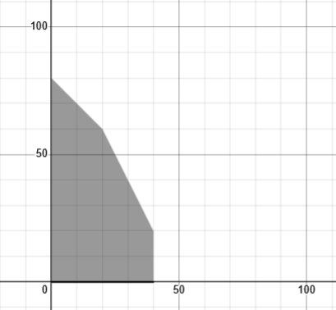
The problem
Maximize: z = 3x₁ + 2x₂
s.t.:
x₁ + x₂ < 80
2x₁ + x₂ < 100
x₁ < 40
x₁ > 0, x₂ > 0

Slide 10
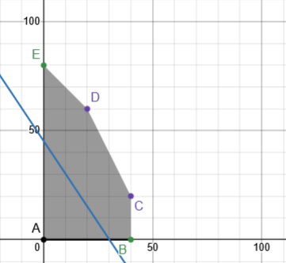
The problem
Maximize: z = 3x₁ + 2x₂
s.t.:
x₁ + x₂ < 80
2x₁ + x₂ < 100
x₁ < 40
x₁ > 0, x₂ > 0

Slide 11
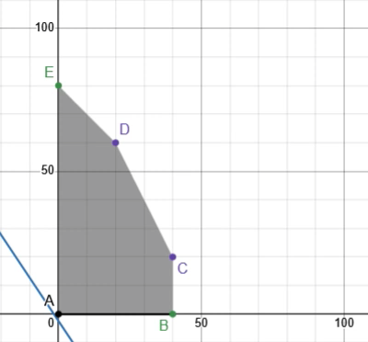
The problem
Maximize: z = 3x₁ + 2x₂
s.t.:
x₁ + x₂ < 80
2x₁ + x₂ < 100
x₁ < 40
x₁ > 0, x₂ > 0

Slide 12
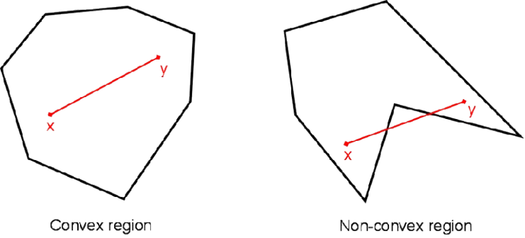
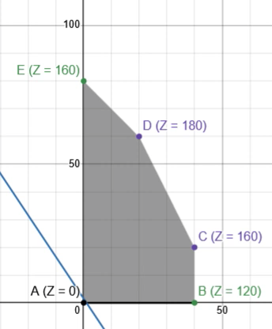
two foundational theories
Convexity of the Feasible Region
Optimality at a Vertex
The feasible region of any linear programming problem is a convex set.
The optimal solution of a linear programming problem (if it exists) lies at one of the vertices (extreme points) of the feasible region.

Slide 13
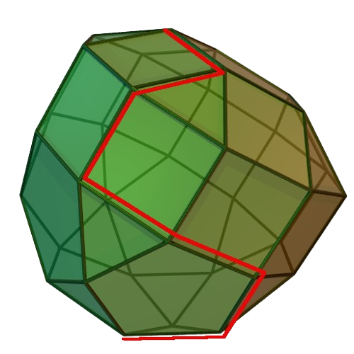
Simplex Algorithm

Slide 14
Standardization, Initialization, and Progression
Standard Form for Maximization Problems: Linear programs in standard form maximize a linear objective function C^{T}x subject to Ax ≤ b constraints, and require all variables x ≥ 0.
Initial Basis: A feasible starting solution is determined by selecting a set of basic variables, ensuring they satisfy the constraints and provide a valid corner (vertex) of the feasible region.
Exploring Adjacent Solutions: The Simplex algorithm moves from one vertex to a neighboring vertex (adjacent solution) by pivoting, improving the objective function while maintaining feasibility.

Slide 15
Step By Step Example

Slide 16
The problem
Maximize: z = 3x₁ + 2x₂
s.t.:
x₁ + x₂ < 80
2x₁ + x₂ < 100
x₁ < 40
x₁ > 0, x₂ > 0

Slide 17
Standardization
Maximize: z = 3x₁ + 2x₂
s.t.:
x₁ + x₂ + s₁ = 80
2x₁ + x₂ + s₂ = 100
x₁ + s₃ = 40
x₁ > 0, x₂ > 0
s₁, s₂, s₃ > 0

Slide 18
Standardization
Maximize: z - 3x₁ - 2x₂ = 0
s.t.:
x₁ + x₂ + s₁ = 80
2x₁ + x₂ + s₂ = 100
x₁ + s₃ = 40
x₁ > 0, x₂ > 0
s₁, s₂, s₃ > 0

Slide 19
Basic and Non-Basic Variables
Basic Variables (BV)
Non-Basic Variables (NBV)
Variables included in the current basis that determine the solution at a vertex of the feasible region. These variables are typically non-zero in a basic feasible solution.
Variables not included in the basis, set to zero in the current solution. Adjusting these variables allows movement to adjacent vertices in the feasible region.

Slide 20

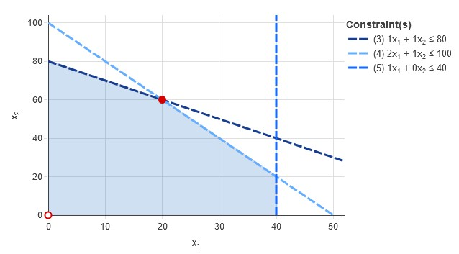

Maximize: z - 3x₁ - 2x₂ = 0
s.t.:
x₁ + x₂ + s₁ = 80
2x₁ + x₂ + s₂ = 100
x₁ + s₃ = 40
x₁ > 0, x₂ > 0
s₁, s₂, s₃ > 0
z | x₁ | x₂ | s₁ | s₂ | s₃
1 | -3 | -2 | 0 | 0 | 0 | 0
s₁ | 1 | 1 | 1 | 0 | 0 | 80
s₂ | 2 | 1 | 0 | 1 | 0 | 100
s₃ | 1 | 0 | 0 | 0 | 1 | 40

Slide 21
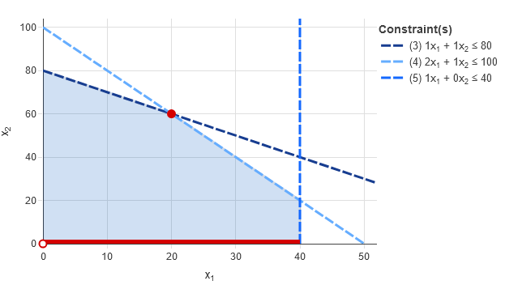
Maximize: z - 3x₁ - 2x₂ = 0
s.t.:
x₁ + x₂ + s₁ = 80
2x₁ + x₂ + s₂ = 100
x₁ + s₃ = 40
x₁ > 0, x₂ > 0
s₁, s₂, s₃ > 0
z | x₁ | x₂ | s₁ | s₂ | s₃
1 | 0 | -2 | 0 | 0 | 3 | 120
s₁ | 0 | 1 | 1 | 0 | -1 | 40
s₂ | 0 | 1 | 0 | 1 | -2 | 20
x₁ | 1 | 0 | 0 | 0 | 1 | 40

Slide 22
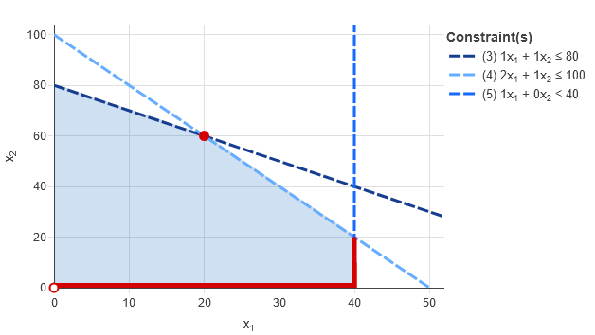
Maximize: z - 3x₁ - 2x₂ = 0
s.t.:
x₁ + x₂ + s₁ = 80
2x₁ + x₂ + s₂ = 100
x₁ + s₃ = 40
x₁ > 0, x₂ > 0
s₁, s₂, s₃ > 0
z | x₁ | x₂ | s₁ | s₂ | s₃
1 | 0 | 0 | 0 | 2 | -1 | 160
s₁ | 0 | 0 | 1 | -1 | 1 | 20
x₂ | 0 | 1 | 0 | 1 | -2 | 20
x₁ | 1 | 0 | 0 | 0 | 1 | 40

Slide 23
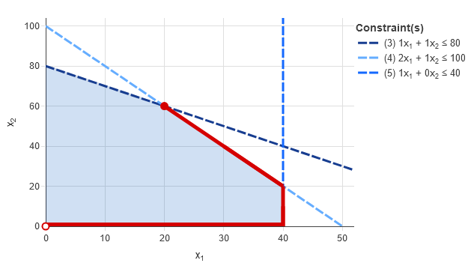
Maximize: z - 3x₁ - 2x₂ = 0
s.t.:
x₁ + x₂ + s₁ = 80
2x₁ + x₂ + s₂ = 100
x₁ + s₃ = 40
x₁ > 0, x₂ > 0
s₁, s₂, s₃ > 0
z | x₁ | x₂ | s₁ | s₂ | s₃
1 | 0 | 0 | 1 | 1 | 0 | 180
s₃ | 0 | 0 | 1 | -1 | 1 | 20
x₂ | 0 | 1 | 2 | -1 | 0 | 60
x₁ | 1 | 0 | -1 | 1 | 0 | 20

Slide 24

Time Complexity

Slide 25
Time Complexity
Worst Case:
The Simplex algorithm can visit up to 2^{n} vertices in degenerate cases, leading to an exponential time complexity overall.
Average Case:
In practice, Simplex performs efficiently on most real-world problems.
The observed time complexity is approximately O((m+n)n) on average, making it highly practical despite its theoretical limitations.
n: Number of variables (decision variables).
m: Number of constraints.

Slide 26
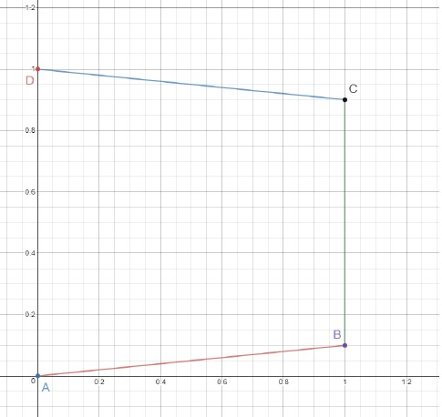
Two dimensional example

Slide 27
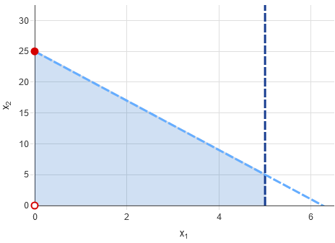
Maximize: z - 2x₁ - x₂ = 0
s.t.:
x₁ + s₁ = 5
4x₁ + x₂ + s₂ = 25
x₁ > 0, x₂ > 0
s₁, s₂ > 0
z | x₁ | x₂ | s₁ | s₂
1 | -2 | -1 | 0 | 0 | 0
s₁ | 1 | 0 | 1 | 0 | 5
s₂ | 4 | 1 | 0 | 1 | 25

Slide 28
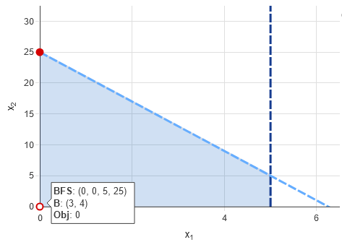
Maximize: z - 2x₁ - x₂ = 0
s.t.:
x₁ + s₁ = 5
4x₁ + x₂ + s₂ = 25
x₁ > 0, x₂ > 0
s₁, s₂ > 0
z | x₁ | x₂ | s₁ | s₂
1 | -2 | -1 | 0 | 0 | 0
s₁ | 1 | 0 | 1 | 0 | 5
s₂ | 4 | 1 | 0 | 1 | 25
Table 1

Slide 29
Maximize: z - 2x₁ - x₂ = 0
s.t.:
x₁ + s₁ = 5
4x₁ + x₂ + s₂ = 25
x₁ > 0, x₂ > 0
s₁, s₂ > 0
z | x₁ | x₂ | s₁ | s₂
1 | -2 | -1 | 0 | 0 | 0
s₁ | 1 | 0 | 1 | 0 | 5
s₂ | 4 | 1 | 0 | 1 | 25
Table 1

Slide 30
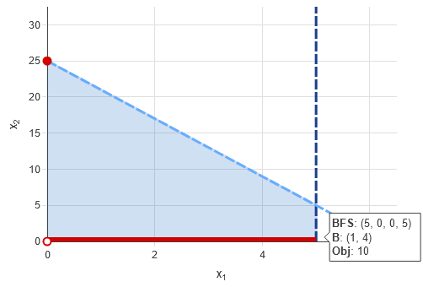
Maximize: z - 2x₁ - x₂ = 0
s.t.:
x₁ + s₁ = 5
4x₁ + x₂ + s₂ = 25
x₁ > 0, x₂ > 0
s₁, s₂ > 0
z | x₁ | x₂ | s₁ | s₂
1 | 0 | -1 | 2 | 0 | 10
x₁ | 1 | 0 | 1 | 0 | 5
s₂ | 0 | 1 | -4 | 1 | 5
Table 2

Slide 31
Maximize: z - 2x₁ - x₂ = 0
s.t.:
x₁ + s₁ = 5
4x₁ + x₂ + s₂ = 25
x₁ > 0, x₂ > 0
s₁, s₂ > 0
z | x₁ | x₂ | s₁ | s₂
1 | 0 | -1 | 2 | 0 | 10
x₁ | 1 | 0 | 1 | 0 | 5
s₂ | 0 | 1 | -4 | 1 | 5
Table 2

Slide 32
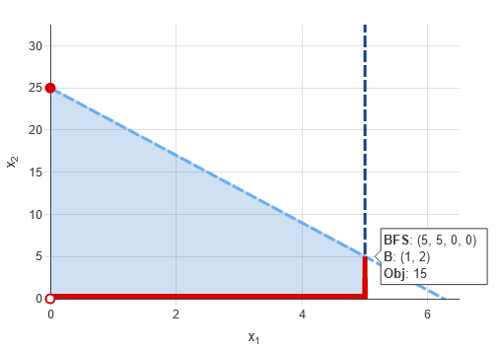
Maximize: z - 2x₁ - x₂ = 0
s.t.:
x₁ + s₁ = 5
4x₁ + x₂ + s₂ = 25
x₁ > 0, x₂ > 0
s₁, s₂ > 0
z | x₁ | x₂ | s₁ | s₂
1 | 0 | 0 | -2 | 1 | 15
x₁ | 1 | 0 | 1 | 0 | 5
x₂ | 0 | 1 | -4 | 1 | 5
Table 3

Slide 33
Maximize: z - 2x₁ - x₂ = 0
s.t.:
x₁ + s₁ = 5
4x₁ + x₂ + s₂ = 25
x₁ > 0, x₂ > 0
s₁, s₂ > 0
z | x₁ | x₂ | s₁ | s₂
1 | 0 | 0 | -2 | 1 | 15
x₁ | 1 | 0 | 1 | 0 | 5
x₂ | 0 | 1 | -4 | 1 | 5
Table 3

Slide 34
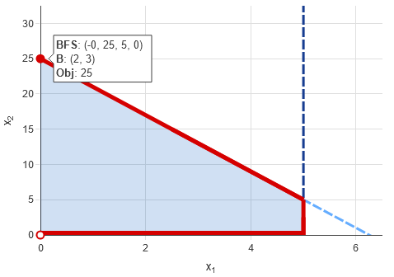
Maximize: z - 2x₁ - x₂ = 0
s.t.:
x₁ + s₁ = 5
4x₁ + x₂ + s₂ = 25
x₁ > 0, x₂ > 0
s₁, s₂ > 0
z | x₁ | x₂ | s₁ | s₂
1 | 2 | 0 | 0 | 1 | 25
s₁ | 1 | 0 | 1 | 0 | 5
x₂ | 4 | 1 | 0 | 1 | 25
Table 4

Slide 35
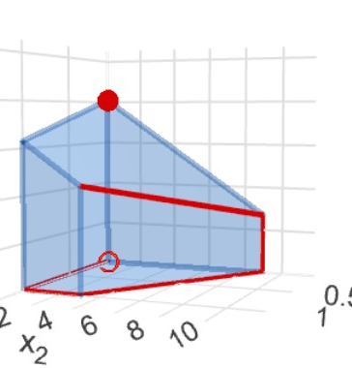
Three dimensional Example And Demonstration

Slide 36

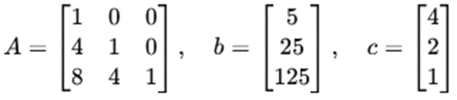
The problem
Maximize:
z = 4x₁ + 2x₂ + x₃
s.t.:
x₁ ≤ 5
4x₁ + x₂ ≤ 25
8x₁ + 4x₂ + x₃ ≤ 125
x₁, x₂, x₃ ≥ 0

Slide 37
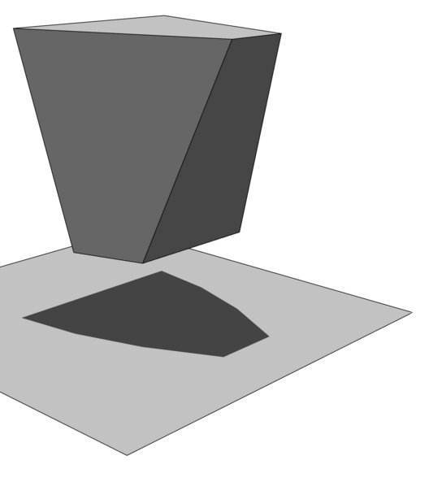
Klee–Minty Problem (Generalization)

Slide 38
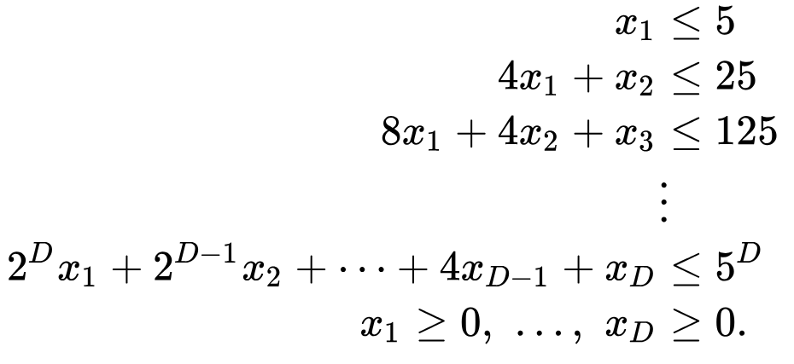
Maximize: Z =

Slide 39

Thanks For Watching
References:
https://en.wikipedia.org/wiki/Klee-Minty_cube
Bazaraa, M. S. Linear Programming and Network Flows. New York: Wiley, 1977.
https://www.researchgate.net/publication/332109102_Simplex_method_is_NOT_a_polynomial_time_algorithm

