Slide 1
Bayesian Learning and Montecarlo Simulation Energy Efficiency

Slide 2
Content
Problem description
Data Analysis
Data Preprocessing
Conjugate model
Model Selection in BAS
Results from prediction

Slide 3
Problem description
The Problem: With extreme temperatures becoming more common, improving the energy efficiency of buildings is a critical goal for reducing both environmental impact and energy costs.
Project Objective: To model and predict the Heating Load for residential buildings using a dataset of simulated building designs.
Our Approach: We will use a Bayesian statistical framework. This is ideal for this problem because it allows us to formally manage the high degree of uncertainty among many potential predictive models.

Slide 4
Data analysis
An initial data analysis was performed. We will now highlight our key findings related to;
The correlation matrix
The distribution of the response variable
Scatter plots

Slide 5
Data analysis Data overview
First a quick data overview
The dataset comprises 768 samples with 8 features, and two real valued responses
It is simulated

Slide 6
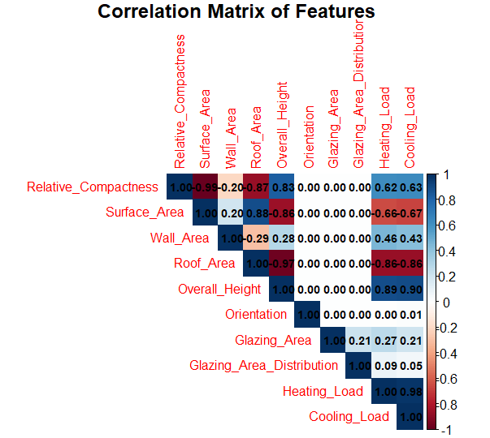
Data Analysis Correlation Matrix
The correlation matrix reveals significant multicollinearity among the geometric features.
Key Example: Relative Compactness and Surface Area have a near-perfect negative correlation of r = -0.99.
Implication: This tells us that some features are redundant. We cannot simply include all of them in a model and trust the results for each one. This finding confirms that a formal model selection procedure is essential for our analysis.

Slide 7
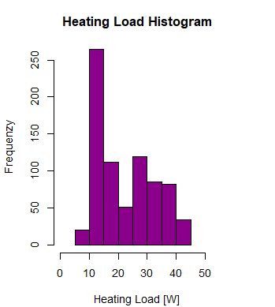
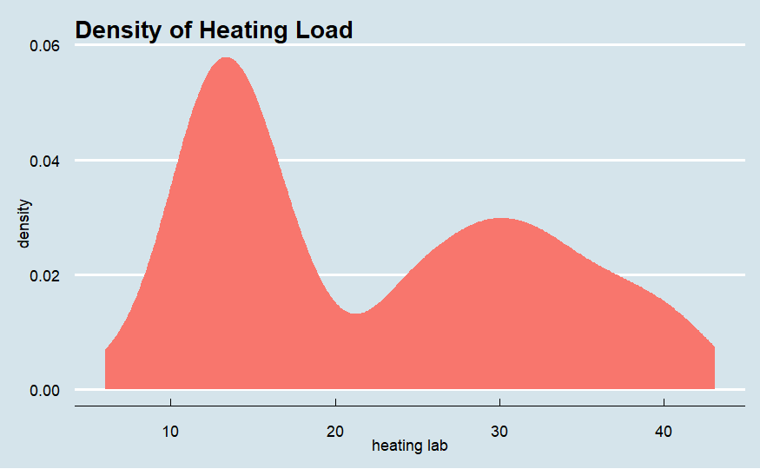
Data Analysis distribution of the response variable
Looking at the Heating Load response variable, its histogram is non-normal
The histogram is bimodal, meaning it has two distinct peaks.
One peak is around 11 kWh/m².
The second peak is around 30 kWh/m².
Implication: This strongly suggests our dataset contains two different groups of buildings: a high-efficiency group with low heating needs, and a low-efficiency group with high heating needs. This could cause problems for a normal linear model.

Slide 8
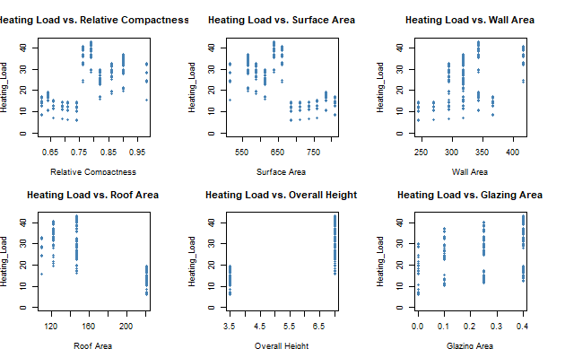
Data Analysis scatterplots
Scatterplots show clear and physically intuitive trends
As Relative Compactness increases, so does Heating Load
As Surface Area and Roof Area increase, Heating Load tends to decrease
Key Observation: The relationships are not perfectly linear. The plots clearly show the same two distinct data clusters we saw in the histograms, separating buildings into high- and low-efficiency groups.
Implication: These trends validate using a linear regression framework as a starting point.

Slide 9
Data Preprocessing
A preprocessing pipeline was made based on finding in the data analysis, its key stages are;
Logarithmic transformation
Categorical Variable Encoding
Feature Scaling
Data Partitioning

Slide 10
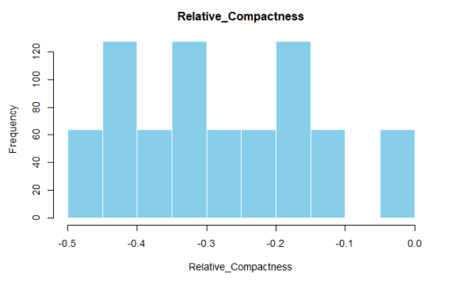
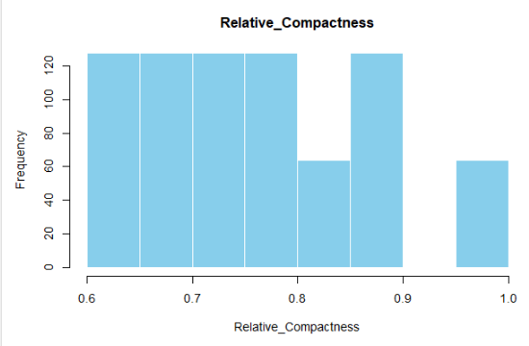

Data Preprocessing Logarithmic transformation
Problem: Our analysis showed that some features, specifically Relative_Compactness and Wall_Area, had a positive skew. This non-normal distribution can be problematic for linear regression models.
Action: We applied a logarithmic transformation to these two features.

Slide 11
Data Preprocessing Categorical Variable Encoding
Problem: Linear regression requires all input variables to be numeric. Our dataset contained two categorical features, Orientation and Glazing_Area_Distribution.
Action: We converted these features into a set of binary "dummy variables" using one-hot encoding. For a feature with 'k' categories, this creates 'k-1' new binary columns

Slide 12
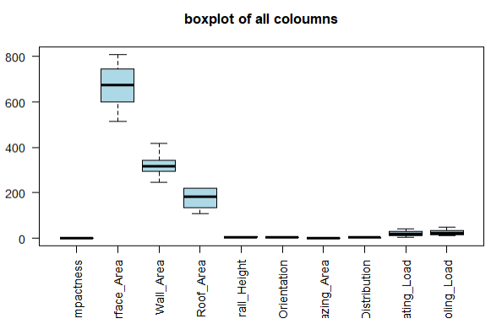
Data Preprocessing Feature Scaling
Problem: The features operates on vastly different scales. For example, Surface_Area values are in the hundreds, while Relative_Compactness is less than 1. This can cause features with larger values to dominate the model unfairly
Action: We standardized all numeric features by transforming them to have a mean of zero and a standard deviation of one.

Slide 13
Data Preprocessing Data Partitioning
Problem: To truly know how well our model performs, we must evaluate it on data it has not seen during training.
Action: We partitioned the dataset into a training set, comprising 80% of the observations, and a test set for the remaining 20%.

Slide 14
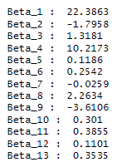
Conjugate Model
Main motivation: Conjugate posteriors can easily be calculated analytically very fast, not much more..
The priors are given as such;
Conns: A lot of hyperparametertuning is required
How we selected the hyperparameters
Identity matrix * c -> low to give large prior variance
a, b -> low to get a flat distribution to account for uncertainty in prior
beta -> multiple values used, resulted in surprisingly little change in result, opted for a low value due to scaling
Result: Bad model, model selection is necessary, and less hyperparameters.
(Beta_1 = Intercept, Beta_4 = Overall_Height , Beta_8 = Glazing_Area and Beta_9 = Glazing_Area_Distribution_0)

Slide 15
Model Selection
After preprocessing, our dataset has 14 potential predictor variables. This creates a massive model space of 2 to the power of 14, which equals 16,384 competing models.
The key challenge is to identify a good model that explains the variability in Heating Load without overfitting, especially given the multicollinearity we identified earlier.

Slide 16
Model Selection Initial analysis
Using BAS, an experiment was conducted, using prior=“g-prior” as with a=n (We learn from data). And modelprior = uniform().
The top model based on highest posterior probability (HPM) was selected.
Based on it, the best feature combination is; "Intercept", "Relative_Compactness", "Wall_Area", "Roof_Area", "Overall_Height", "Glazing_Area", "Glazing_Area_Distribution_0“, with 0.36 posterior probability
The model was tested against a weighted average model using (BMA), and a model including all features. The results are the following;
Model | MSE | N outside pred. interval | % outside pred. interval
HPM | 9.08 | 16 | 10.46%
BMA | 9.10 | 16 | 10.46%
Full Model | 9.15 | 17 | 11.11%

Slide 17
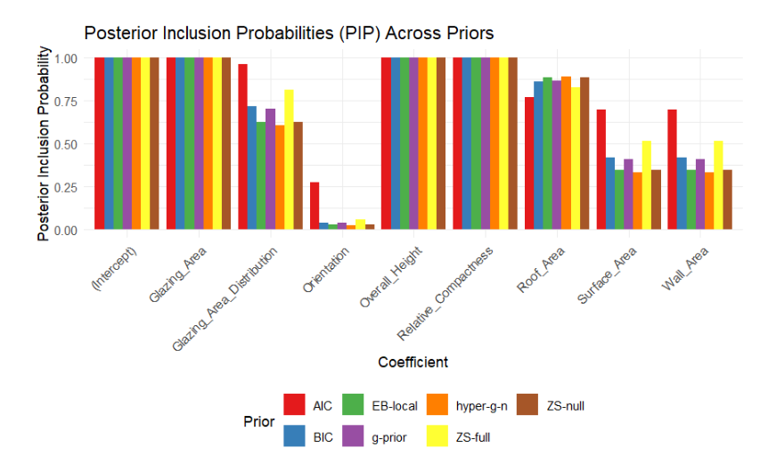
Further model selection
To perform a more more thorough model selection, we test out multiple priors, and look at the Posterior Inclusion Probabilities for the different features. some priors where;
Zellner’s g-prior, g=n
Zellner–Siow Cauchy Prior, hyperparam. not required
The result is summarised in the figure.
From the results, we observe that the features Glazing Area, Overall Height, and Relative Compactness exhibit PIPs close to 1 across all priors
From all our model selection analysises Glazing Area, Overall Height Consitently are the most important features.

Slide 18
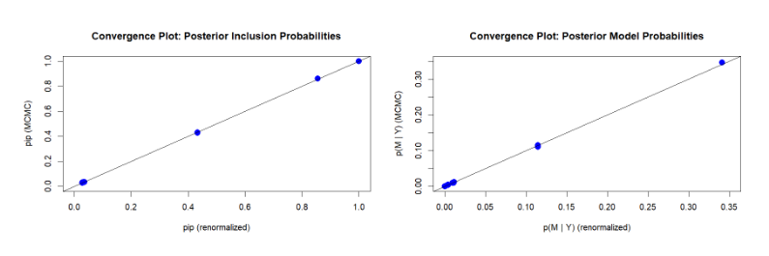
Bayesian model with markov chain monte carlo (MCMC) sampler
Framework exploring the model space.
Best way to determine exploration is to compare posterior inclusion probability. As seen in the plot, this was quite successful.
My thoughts on the results

Slide 19
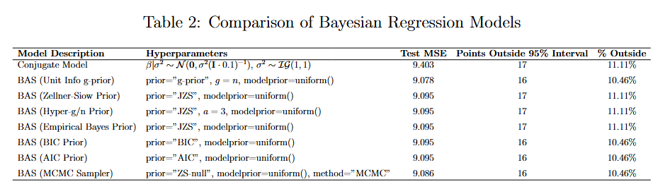
Regression results on test set
This effectively works as a sensitivity analysis. The stability of the performance metrics demonstrates that the model’s conclusions are robust and not overly sensitive to the choice of prior variance for the coefficients.
My thoughts on the percentage outside the 95% prediction interval.

Slide 20
Future work

