Slide 1

Investigating Air Quality and Mortality in U.S. Counties
Michael Moen
12/02/2024

Slide 2
Introduction
Poor air quality has been shown to have negative impacts on public health.
Mortality rates due to chronic respiratory disease and cardiovascular disease (CVD) vary across U.S. counties.
Understanding the relationship between air quality and mortality is critical for public health.

Slide 3
Background – Data
The data in this analysis comes from 3 sources:
Institute for Health Metrics and Evaluation (IHME): Mortality data for 21 different causes by U.S. county as recent as 2014
Environmental Protection Agency (EPA): Pollution data by U.S. county as of 2023
United States County Level Health Data (Kaggle dataset): Various demographic and public health factors by U.S. county, as of 2019

Slide 4
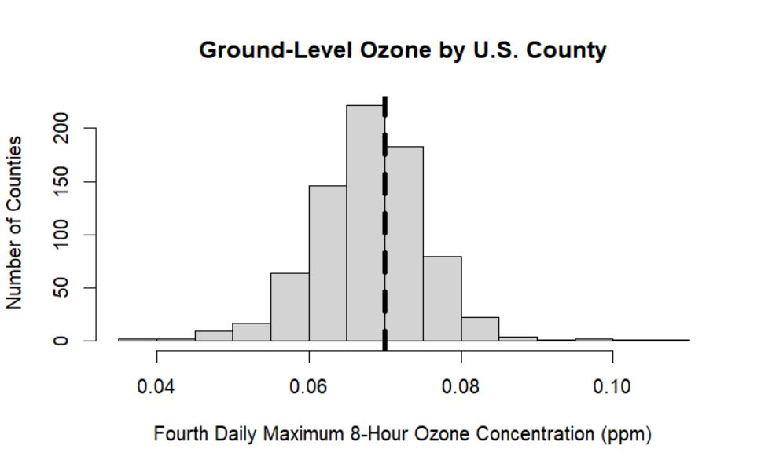
Background – Ground-Level Ozone
Ground-level ozone is one of the most widely measured pollutants and has been shown to negatively impact health
The EPA sets the maximum threshold of acceptable ground-level ozone at 0.07 ppm

Slide 5
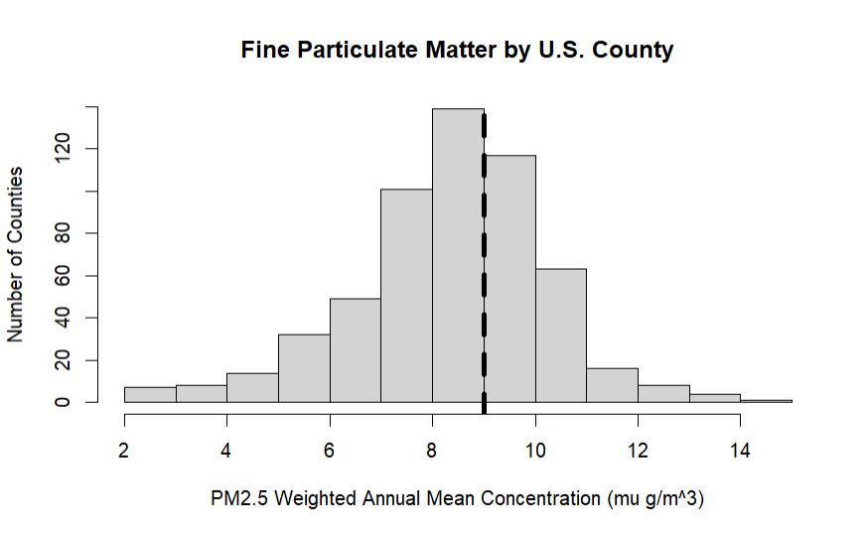
Background – Fine Particulate Matter
Fine particulate matter (PM2.5) is another widely recorded pollutant shown to negatively impact public health
The EPA sets the maximum threshold of acceptable PM2.5 at 9.0 μg/m³

Slide 6
Predicting Mortality Outcomes from Air Quality Data
Examine impact of ground-level ozone and PM2.5 on mortality outcomes via multiple linear regression models
Measurement of other pollutants are too sparse to be useful
Two mortality categories are considered: chronic respiratory disease and cardiovascular disease (CVD)
Most other mortality categories have little logical and statistical correlation with air quality
All data is given at the U.S. county level

Slide 7
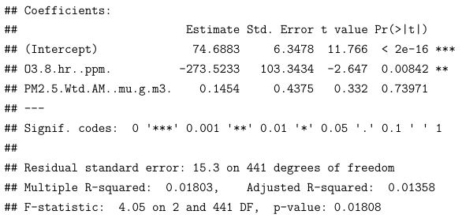
Chronic Respiratory Mortality Predicted from Air Quality

Slide 8
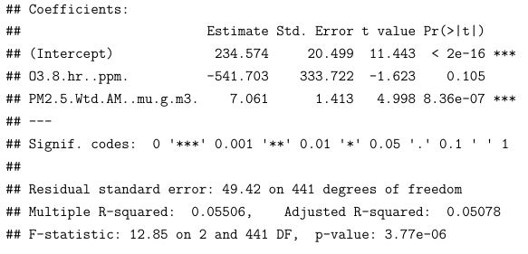
CVD Mortality Predicted from Air Quality

Slide 9
Takeaways from Previous Models
Suspicious signs of coefficients
Mortality decreases as pollution increases
Low adjusted R² values
Air quality metrics explain little of the variation in the data
Low p-values indicate statistically significant predictors

Slide 10
Predicting Mortality Outcomes with More Predictors
Include demographic factors in the multiple linear regression models to better understand the drivers behind mortality, and how they compare to air quality predictors
Factors considered in initial models:
Ground-level ozone
PM2.5
Percentage of adults who smoke
Percentage of developed area
Median household income
Poverty rate
Unemployment rate
Uninsured rate

Slide 11
Predicting Mortality Outcomes with More Predictors
Since many of our predictors are correlated (e.g. median household income and poverty rate), we perform variable selection using backward elimination with BIC
Resulting models should be much better at predicting mortality rates

Slide 12
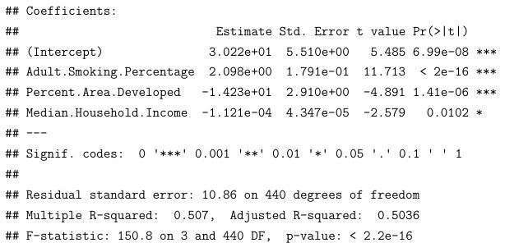
Chronic Respiratory Mortality Final Model

Slide 13
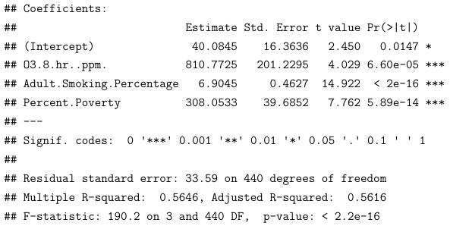
CVD Mortality Final Model

Slide 14
Takeaways from the Updated Models
New predictors explain much more of the variance in outcomes (high adjusted R²)
Suggests county-level air quality metrics have little effect on county-level mortality figures
Neither air quality metric selected in final model for chronic respiratory model
Suggests county-level air quality metrics have little effect on county-level mortality figure
Smoking is an extremely significant predictor for both categories

Slide 15
Conclusions
County-level air quality metrics have a statistically significant, but weak impact on county-level mortality outcomes
Variation in mortality outcomes is much better explained by other factors
Mortality due to CVD is more heavily affected by air quality than mortality due to chronic respiratory disease
Smoking is really bad for your health

