Slide 1

Chapter 9
Internet Control Message Protocol Version 4 (ICMPv4)
TCP/IP Protocol Suite
Copyright © The McGraw-Hill Companies, Inc. Permission required for reproduction or display.

Slide 2
9-1 INTRODUCTION
The IP protocol has no error-reporting or error correcting mechanism. What happens if something goes wrong? What happens if a router must discard a datagram because it cannot find a router to the final destination, or because the time-to-live field has a zero value? These are examples of situations where an error has occurred and the IP protocol has no built-in mechanism to notify the original host.
TCP/IP Protocol Suite

Slide 3
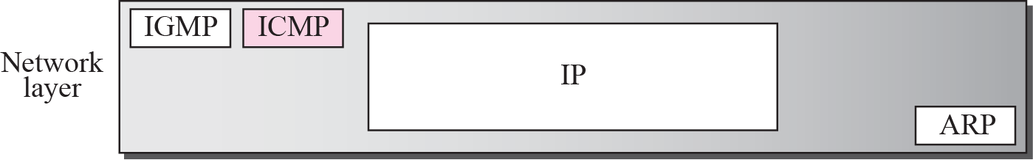
Figure 9.1 Position of ICMP in the network layer
TCP/IP Protocol Suite

Slide 4
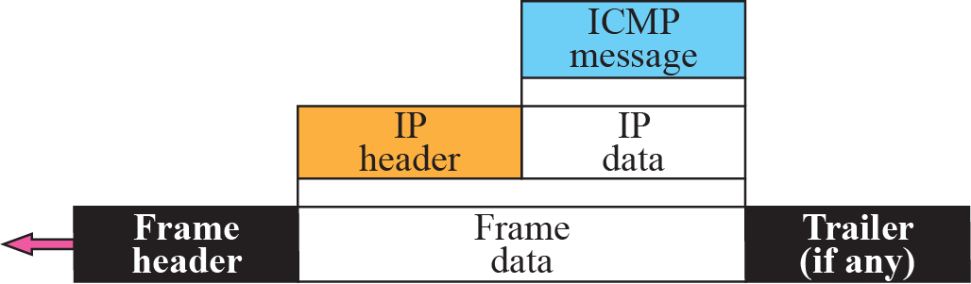
Figure 9.2 ICMP encapsulation
TCP/IP Protocol Suite

Slide 5
9-2 MESSAGES
ICMP messages are divided into two broad categories: error-reporting messages and query messages. The error-reporting messages report problems that a router or a host (destination) may encounter when it processes an IP packet. The query messages, which occur in pairs, help a host or a network manager get specific information from a router or another host. Also, hosts can discover and learn about routers on their network and routers can help a node redirect its messages.
TCP/IP Protocol Suite

Slide 6
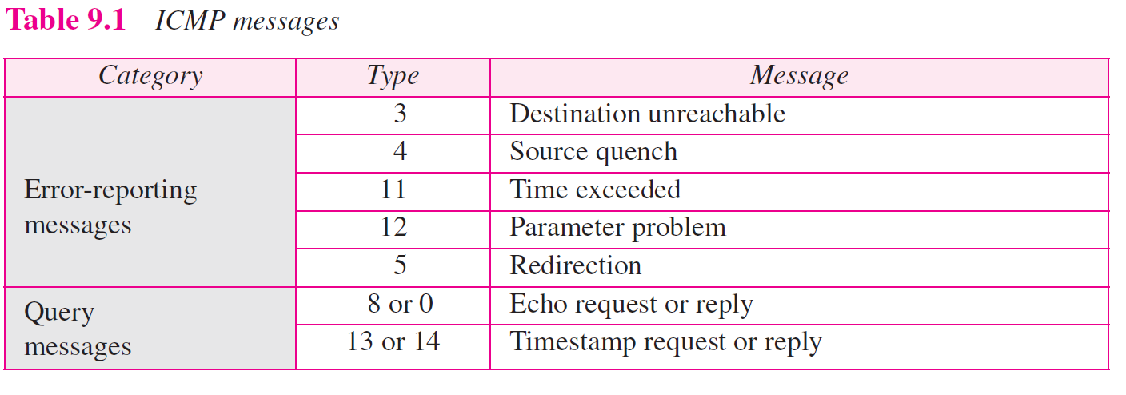
TCP/IP Protocol Suite

Slide 7
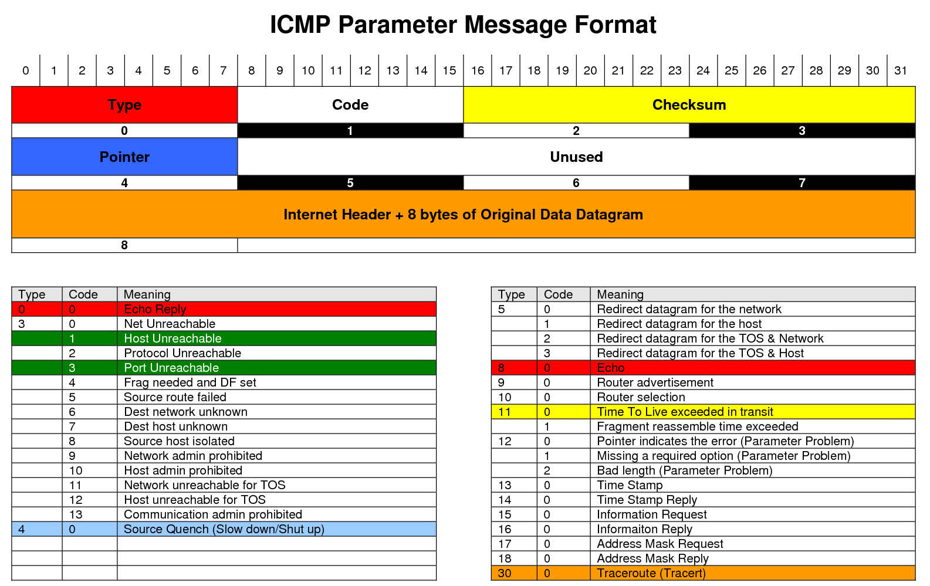
TCP/IP Protocol Suite

Slide 8
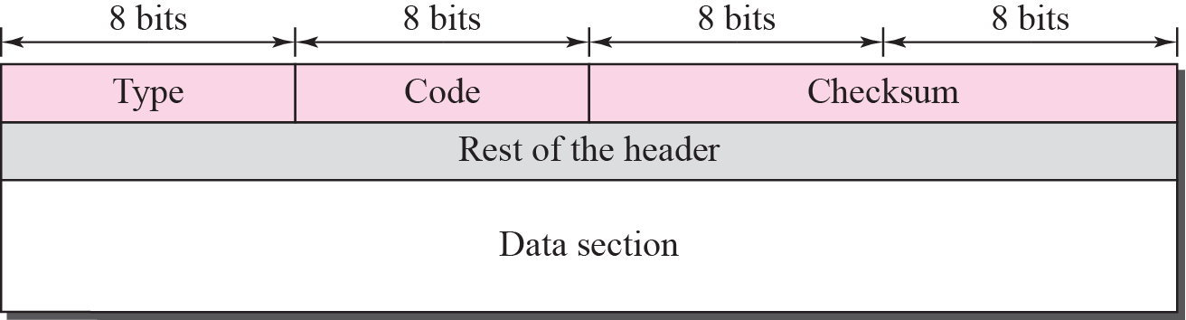
Figure 9.3 General format of ICMP messages
TCP/IP Protocol Suite

Slide 9

Note
ICMP always reports error messages to the original source.
TCP/IP Protocol Suite

Slide 10
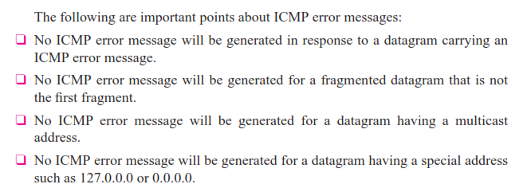
Note that all error messages contain a data section that includes the IP header of the original datagram plus the ﬁrst 8 bytes of data in that datagram. The original data- gram header is added to give the original source, which receives the error message, information about the datagram itself.
TCP/IP Protocol Suite

Slide 11
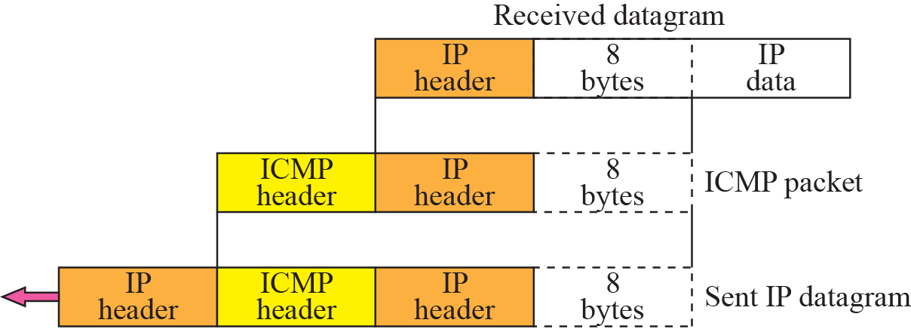
Figure 9.5 Contents of data field for the error message
TCP/IP Protocol Suite

Slide 12
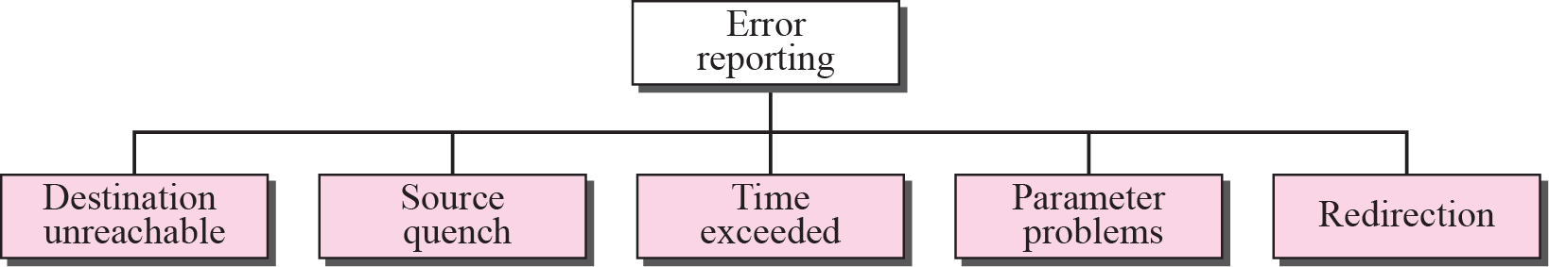
Figure 9.4 Error-reporting messages
TCP/IP Protocol Suite

Slide 13
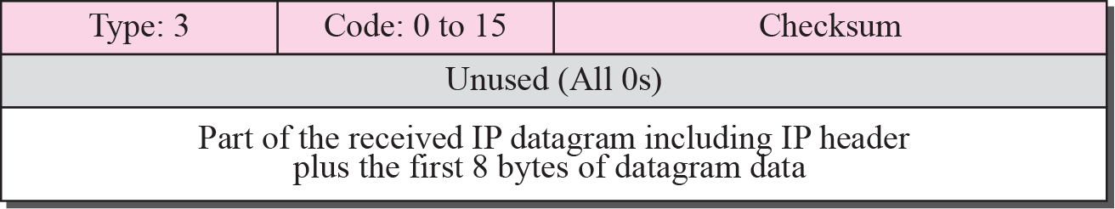
Figure 9.6 Destination-unreachable format
TCP/IP Protocol Suite

Slide 14
Note
Destination-unreachable messages with codes 2 or 3 can be created only by the
destination host.
Other destination-unreachable messages can be created only by routers.
TCP/IP Protocol Suite

Slide 15
Note
An echo-request message can be sent by a host or router.
An echo-reply message is sent
by the host or router that receives
an echo-request message.
TCP/IP Protocol Suite

Slide 16
Note
Echo-request and echo-reply messages can be used by network managers to check the operation of the IP protocol.
TCP/IP Protocol Suite

Slide 17
Note
Echo-request and echo-reply messages can test the reachability of a host.
This is usually
done by invoking the ping command.
TCP/IP Protocol Suite

Slide 18
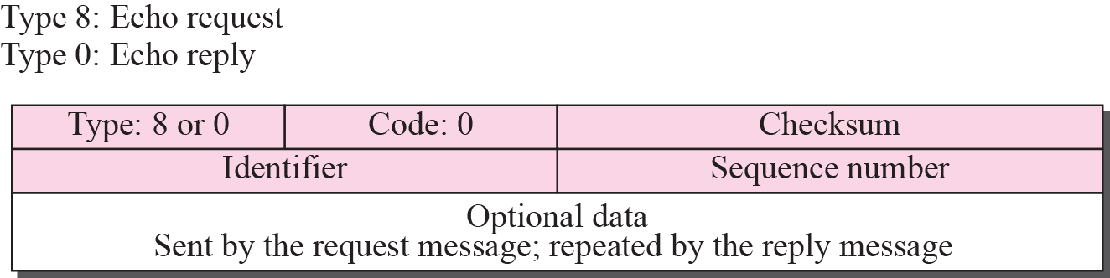
Figure 9.12 Echo-request and echo-reply message
TCP/IP Protocol Suite

Slide 19
9-3 DEBUGGING TOOLS
There are several tools that can be used in the Internet for debugging. We can find if a host or router is alive and running. We can trace the route of a packet. We introduce two tools that use ICMP for debugging: ping and traceroute. We will introduce more tools in future chapters after we have discussed the corresponding protocols.
TCP/IP Protocol Suite

Slide 20
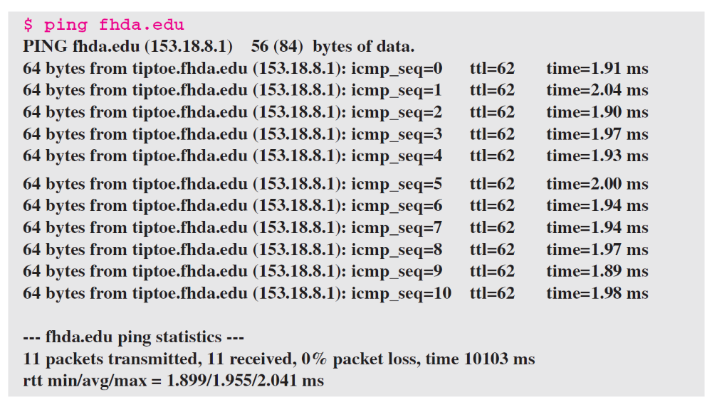
Example 9.2
We use the ping program to test the server fhda.edu. The result is shown below:
TCP/IP Protocol Suite

Slide 21
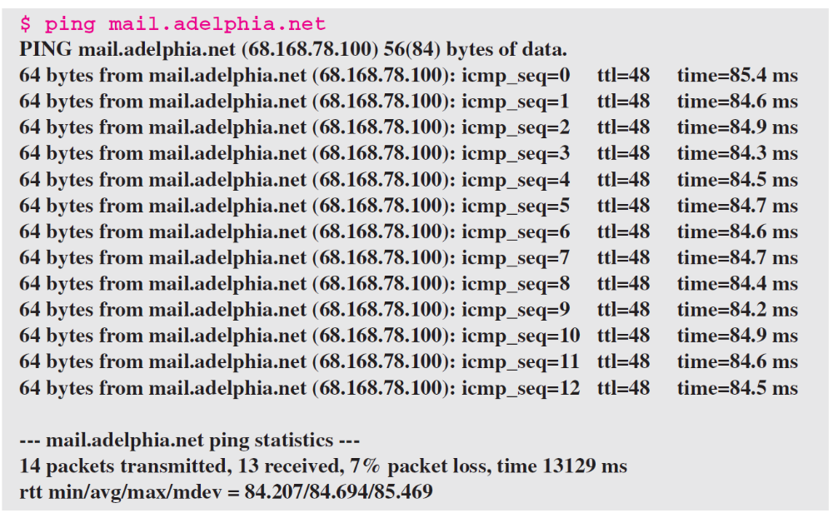
Example 9.3
For the second example, we want to know if the adelphia.net mail server is alive and running. The result is shown below: Note that in this case, we sent 14 packets, but only 13 have been returned. We may have interrupted the program before the last packet, with sequence number 13, was returned.
TCP/IP Protocol Suite

Slide 22
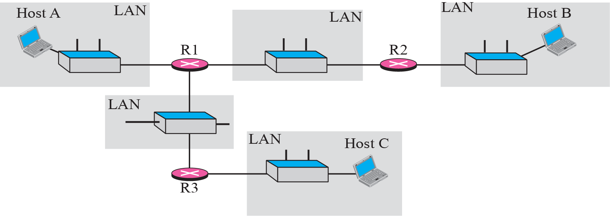
Figure 9.15 The traceroute program operation
TCP/IP Protocol Suite

Slide 23
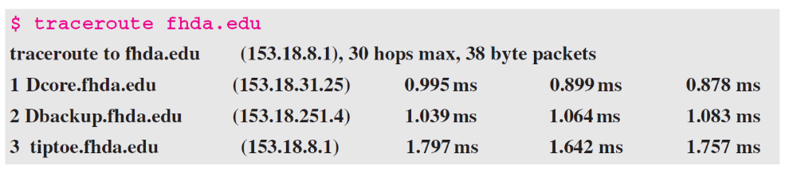
Example 9.4
We use the traceroute program to find the route from the computer voyager.deanza.edu to the server fhda.edu. The following shows the result.
TCP/IP Protocol Suite

