Slide 1



Management of a Training Platform
Developed by :
Moez Ben Jemiaa

Slide 2
1 / Project Overview
This project is a Java-based application for managing formations, students and trainers;
2 / Objectives
1. Simplify formation management.
2. Provide user-friendly GUI interfaces.
3. Ensure seamless database integration.

Slide 3
3 / Features
1. CRUD operations for students, trainers, and formations.
2. Intuitive GUI interfaces for interaction.
3. Robust database handling with MySQL.
4.Handling all the exceptions with tray/catch block
4 / Technologies Used
1. Programming: Java
2. GUI: Swing/AWT ( Swing and Awt libreries)
3. Database: MySQL (connected to java project using JDBC Module)
4. Tools: MySQL Workbench, VSCode

Slide 4
5 / Classes Diagram
User
Name
Email
Password
Etudiant
Formateur
0/N
1/1
Formation
Title
Description
Price
Registered
0/N
0/N
Creat

Slide 5
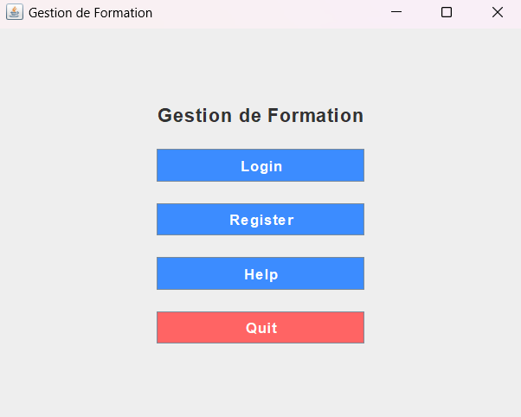
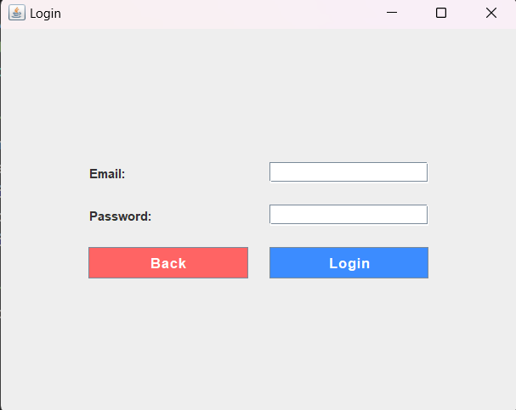
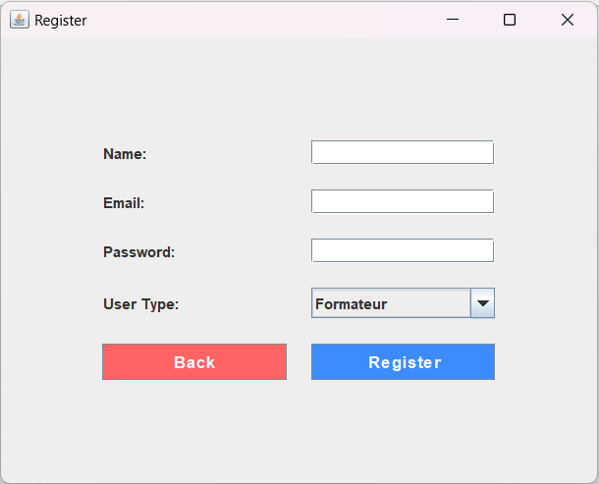
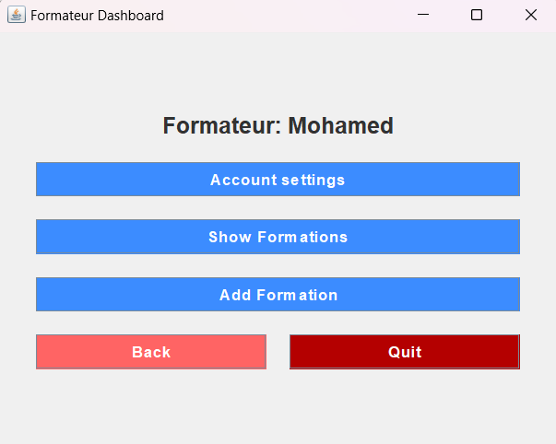
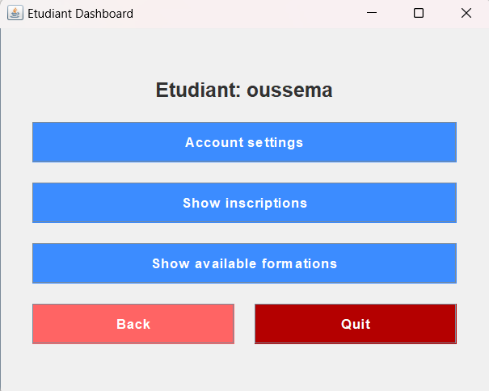
6 / GUI Design
Main menu
Login
Page
Registration
Page
Formateur Dashbord
Etudiant Dashbord

Slide 6


7 / Database graphical presentation
inscriptions
# id_Etu
# id_For
Utilisateurs
formations
id_for
titre
Description
Prix
# id_formateur
id
nom
Email
mot_de_pass
user_type
(SQL scripts and MySQL Workbench models are provided.)

Slide 7
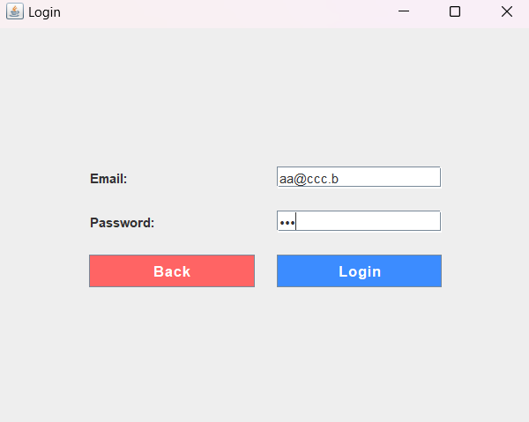
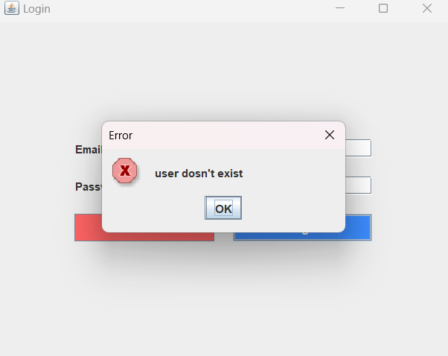
8 / Exceptions
This program can handle exceptions in various ways, for example, when trying to log in with a non-existent account.
Log in with non-existent account
Handling Exception

Slide 8
9 / Conclusion and Future Scope
Conclusion: A complete formation management system.
Future Scope:
1. Add more features.
2. Optimize performance.
3. Transition to a web-based platform or a mobile application.

