Slide 1
Supermarket Sales Performance Analysis
Executive Market Analysis & Strategic Recommendations

Slide 2
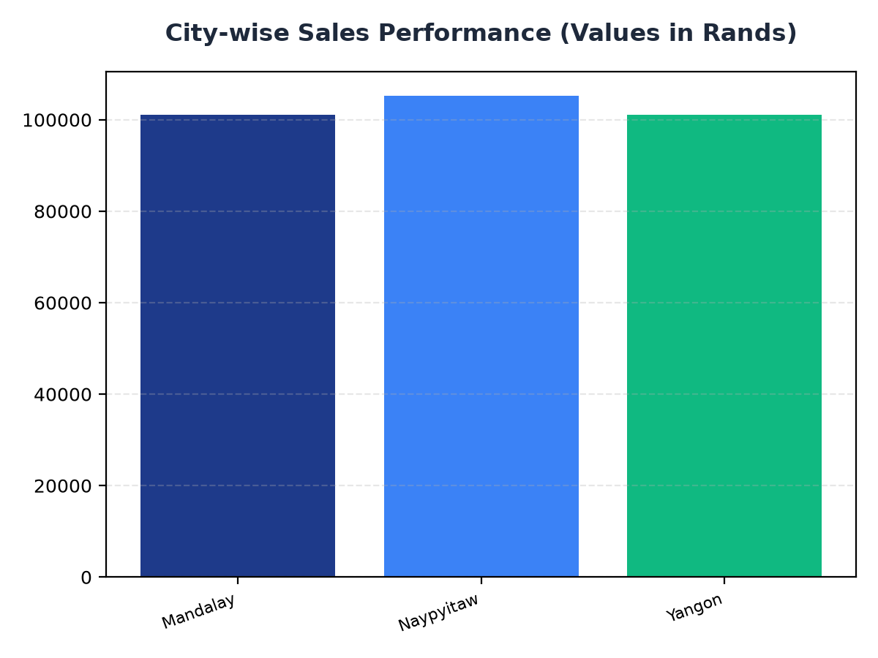
City-wise Sales Performance
Mandalay generated R101,140.64 in sales, indicating a strong market presence.
Naypyitaw has the highest sales with R105,303.53, suggesting opportunities for further growth.
Yangon's sales of R101,143.21 highlight the need for targeted marketing strategies.

Slide 3
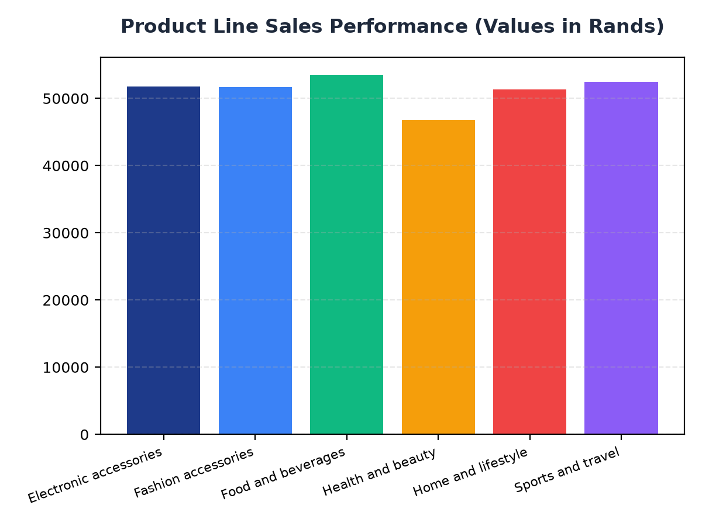
Product Line Sales Performance
Food and beverages is the top-selling product line with R53,471.28 in sales.
Electronic accessories and Fashion accessories have similar sales figures, with R51,750.03 and R51,719.90 respectively.
Health and beauty products have the lowest sales, with R46,851.18, indicating a need for product line optimization.

